Slide 1
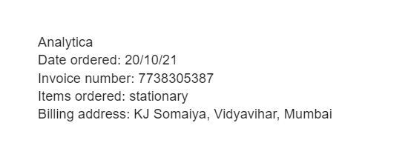
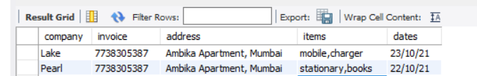
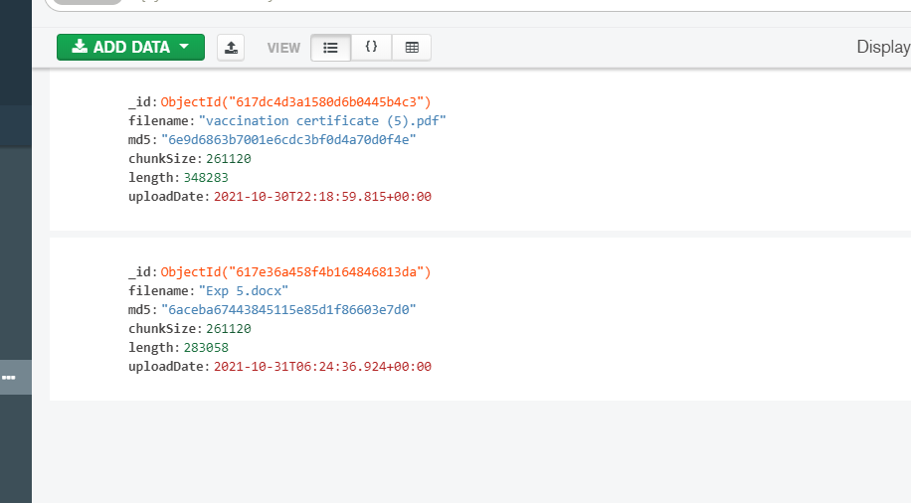
Email format
Data stored in MySQL
Attachments stored in MongoDB

Slide 2
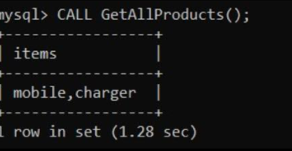

This is a procedure GetAllProducts(), whenever called it displays the contents of all the items ordered by the company ‘Lake’ . Many such useful procedures can be created
This is a trigger that is created after our data is inserted.
This program checks for the unread email from the specified id and stores the data accordingly. The email body should be in a specific format as shown in the first slide. Furthermore it uploads all the attachments included in the email in a separate database. This helps in organizing our data in a efficient way thus saving time going through every email.

