Slide 1
Natural Language Processing
Guided BY-
Dr. Pooja Jain
Presented By-
Apeksha Pandey (BT19ECE024)
Priya Gupta(BT19ECE011)

Slide 2
Contents:
1.Topic and Introduction
2.Methodology Used
3.Detailed explanation
5.Flow of the code
6.Scope of improvement
7.Applications
8.References

Slide 3
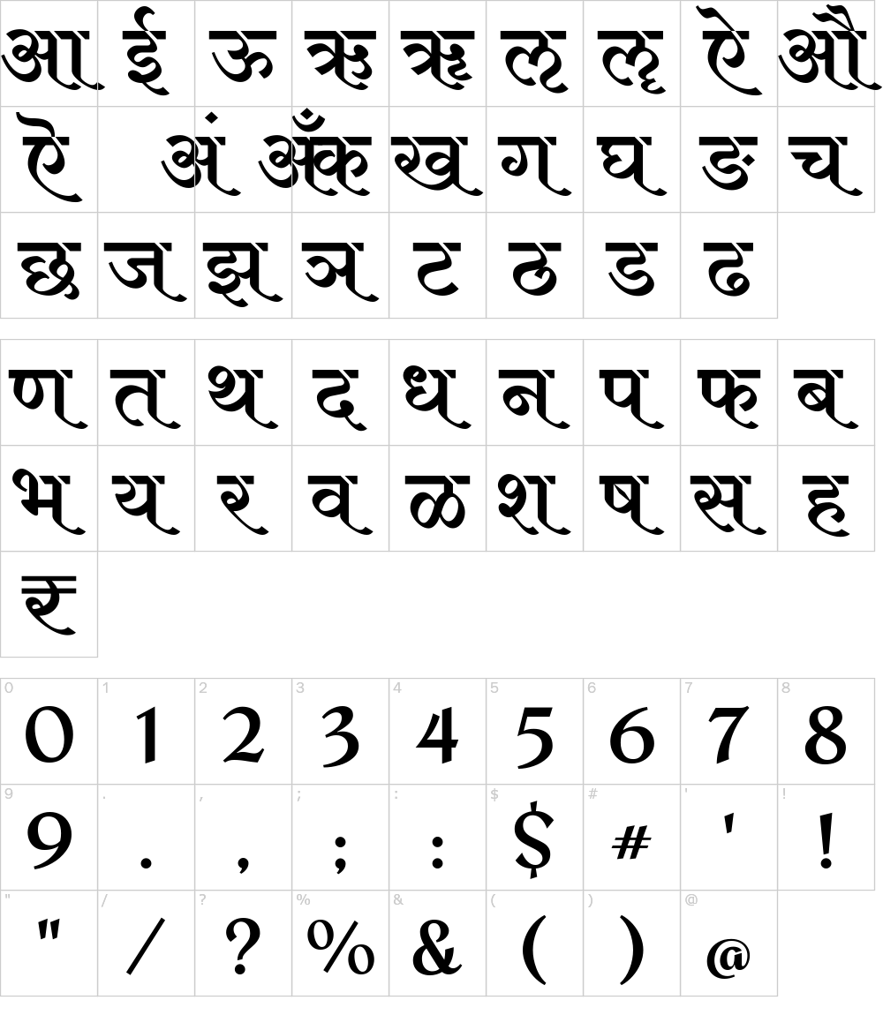
Topic and Introduction We will be working on Question Answering in Hindi Language. The user will be able to input the questions in Hindi(Devanagari) font and our project will answer queries in the same.

Slide 4
Methodology Used
Compare the user input to the information available
Match the closest information
Provide the best output

Slide 5
Example
कोरोना एक वायरस जनित रोग है जिसने महामारी का रूप ले लिया है और समस्त संसार में तबाही मचा रहा है. इस रोग की शुरुआत जुकाम एवं खासी मात्र से होती है. कोरोना से बचाव करने में ही समझदारी है, क्योंकी यह एक संक्रामक रोग है जो बहुत ही तेजी से एक दूसरे में फैलता है.
कोरोना एक वायरस जनित रोग है जिसने महामारी का रूप ले लिया है और समस्त संसार में तबाही मचा रहा है.
इस रोग की शुरुआत जुकाम एवं खासी मात्र से होती है.
कोरोना से बचाव करने में ही समझदारी है, क्योंकी यह एक संक्रामक रोग है जो बहुत ही तेजी से एक दूसरे में फैलता है.
[‘कोरोना’,’ एक’,’ वायरस’, ‘जनित’,’ रोग’, ‘है ‘,’जिसने’,’ महामारी’, ‘का’ ,‘रूप’, ‘ले’,’लिया’,’ है’,’और’,’ समस्त’,’ संसार’,’ में’,’ तबाही’,’ मचा’, ‘रहा’,’ है’]

Slide 6
Break information into sentences and then to words
Stemming- to get specific words to match
Cosine Similarity to match keywords in query and information data.
Libraries used-nltk,inltk,sklearnetc

Slide 7
Detailed explanation
Here in this project,there are a specific set of rules. If the user query matches any rule, the answer to the query is generated, otherwise the user is notified that the answer to user query doesn't exist.One of the advantages of this is that they give accurate results most of the time. However, on the downside, they do not scale well. To add more responses, you have to define new rules.
In this,as the user enters a query, the query will be converted into vectorized form. All the sentences in the corpus will also be converted into their corresponding vectorized forms. Next, the sentence with the highest cosine similarity with the user input vector will be selected as a response to the user input.
If the proper match is not found,this will be handled by a hardcoded response and will again ask for the next input till the user inputs the query to stop the process.

Slide 8
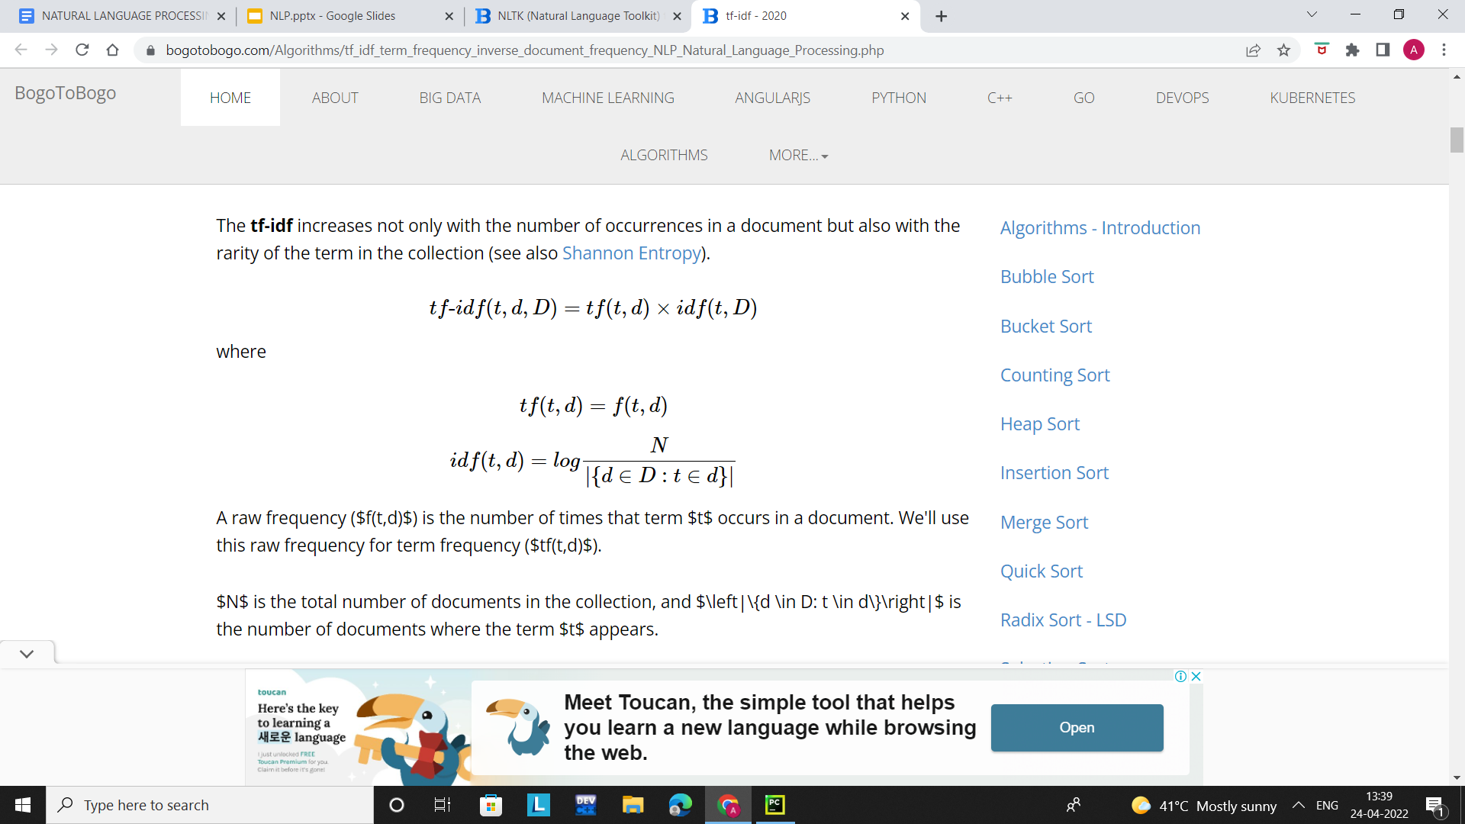
The tf-idf (term frequency-inverse document frequency) is used to weigh how important a word of a document in a document collection.
NLTK does not support tf-idf. So, we're going to use scikit-learn. The scikit-learn has a built in tf-Idf implementation while we still utilize NLTK's tokenizer to preprocess the text.
So, tf-idf weight for a term is the product of its tf weight and idf weight. It's the best known weighting scheme in information retrieval. Sometime people denote it as tf.idf.

Slide 9
Then, we call fit_transform() which does the following:
-it creates a dictionary of 'known' words based on the input text given to it.
- it calculates the tf-idf for each term found in an article.
We then use the cosine_similarity() function to find the cosine similarity between the last item in the all_word_vectors list (which is actually the word vector for the user input since it was appended at the end) and the word vectors for all the sentences in the corpus.
We sort the list containing the cosine similarities of the vectors, the second last item in the list will actually have the highest cosine (after sorting) with the user input. The last item is the user input itself, therefore we did not select that.
similar_sentence_number = similar_vector_values.argsort()[0][-2]

Slide 10
Finally, we flatten the retrieved cosine similarity and check if the similarity is equal to zero or not. If the cosine similarity of the matched vector is 0, that means our query did not have an answer.
In that case, we will simply print that we do not understand the user query.
so "मैं क्षमाप्रार्थी हूँ पर मैं आपके इस सवाल का उत्तर देने में असमर्थ हूँ ।" is returned.
Otherwise, if the cosine similarity is not equal to zero, that means we found a sentence similar to the input in our corpus.
In that case, we will just pass the index of the matched sentence to our "article_sentences" list that contains the collection of all sentences.

Slide 11
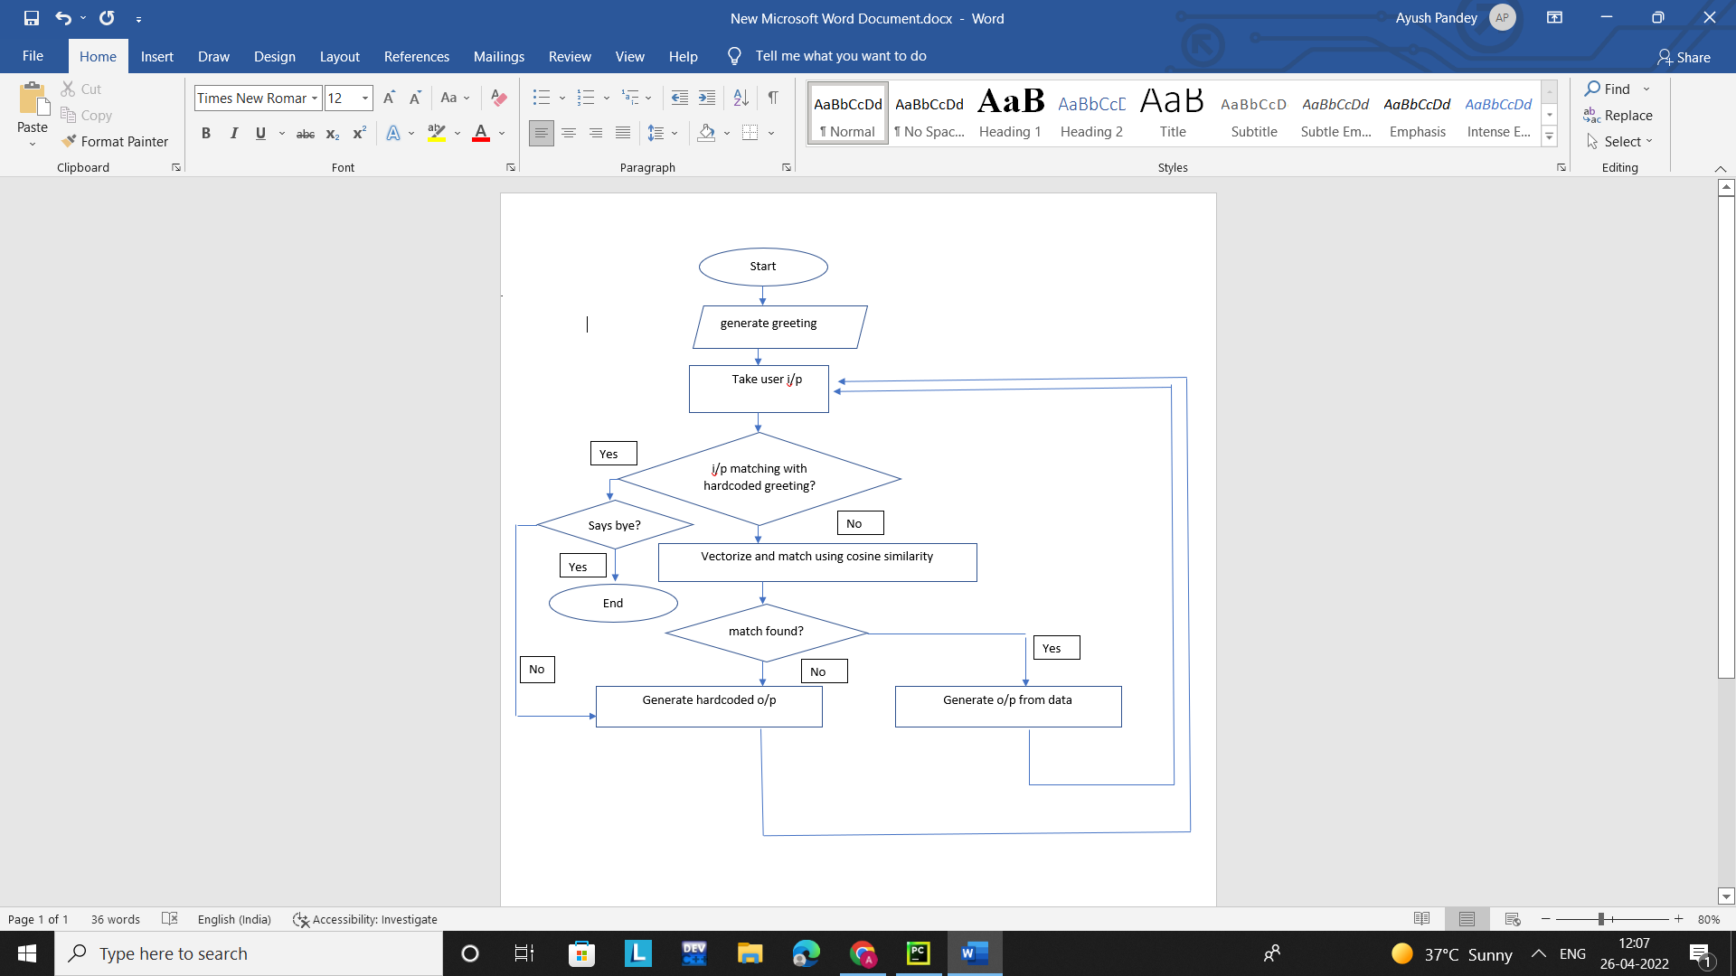

Slide 12
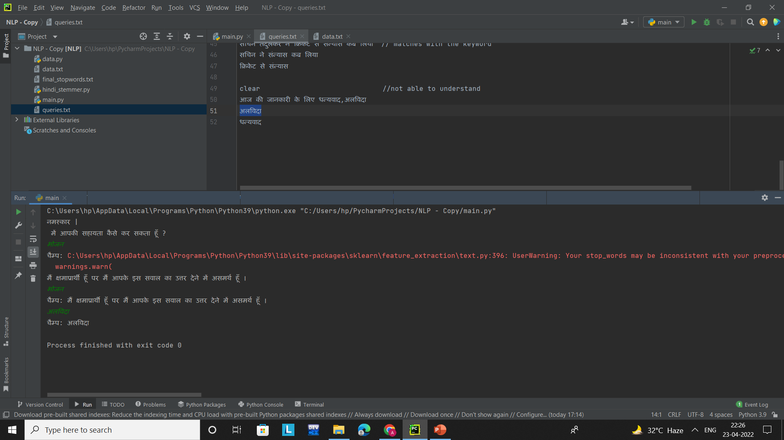
HARDCODED MESSAGES TO GREET AND GRACEFULLY HANDLE THE ERROR

Slide 13
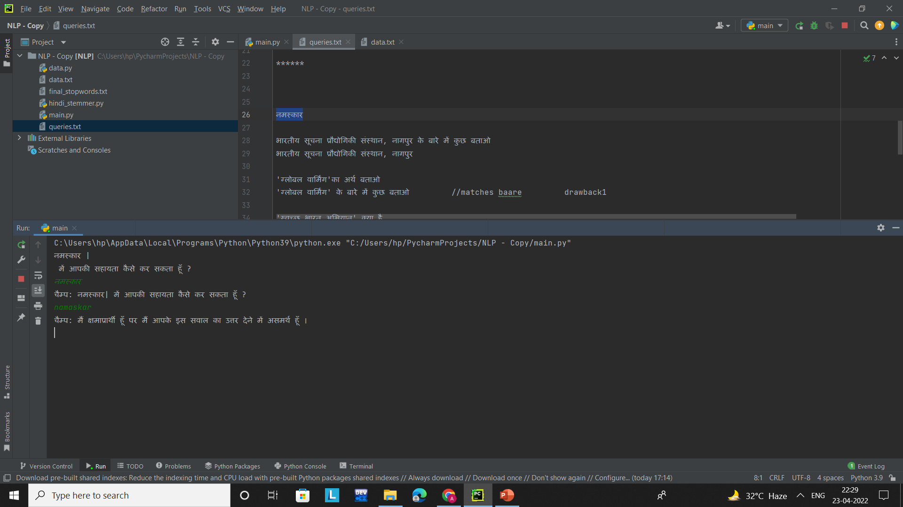
Response to different language script:

Slide 14
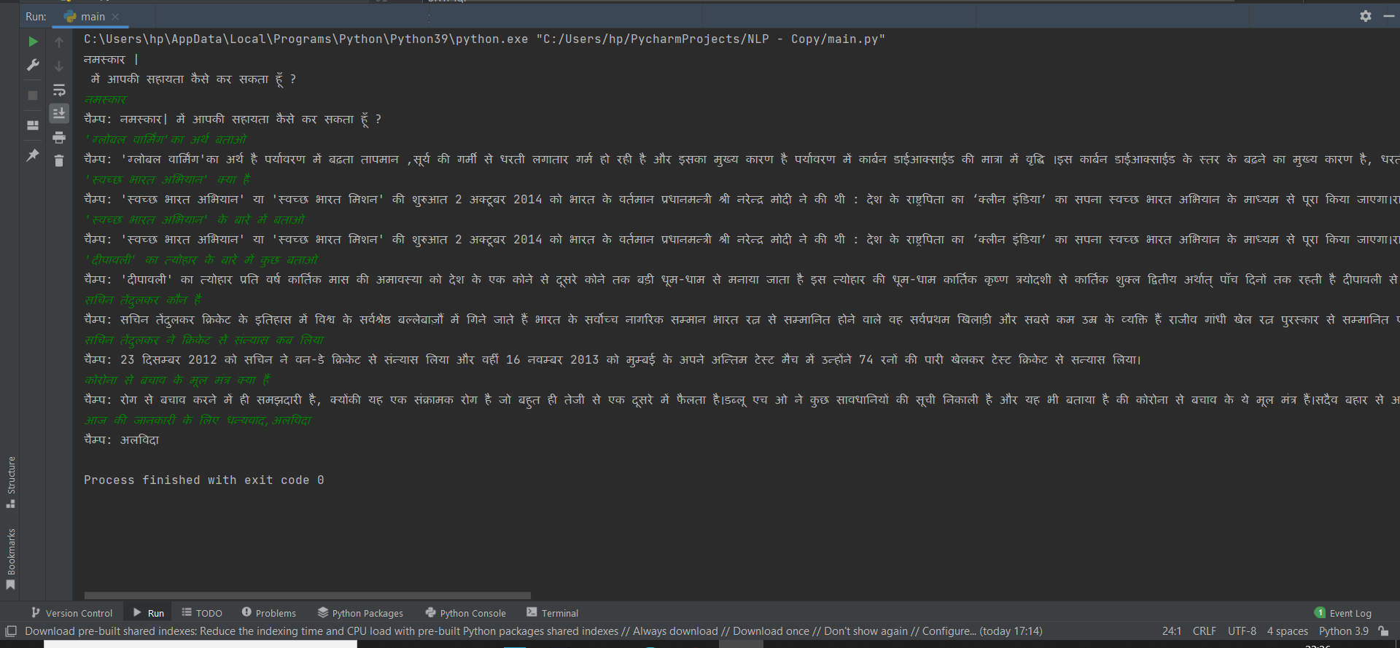
Some input and responses:

Slide 15
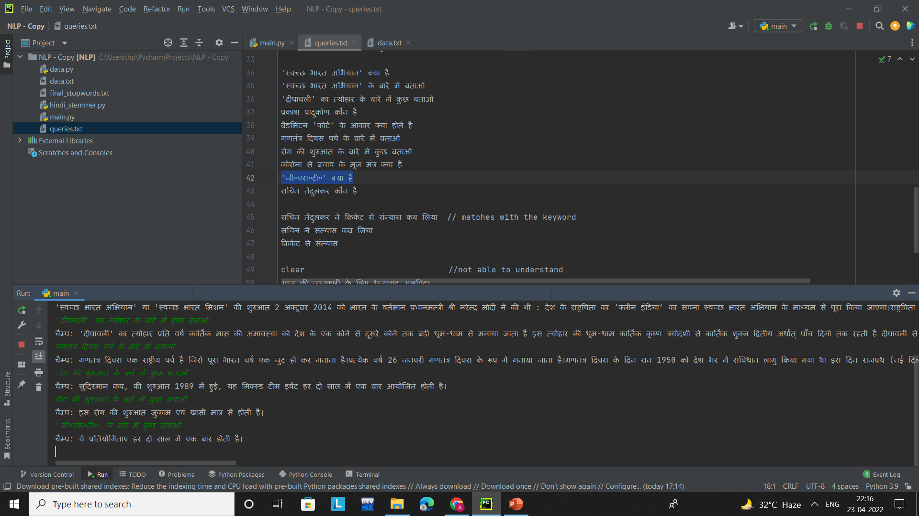
Scope of Improvement
Certain errors regarding absolute text matching can occur if more than one occurrence is there in different contexts.
A Lemmatizer in place of stemmer would better the results for example
Here in this, बारे मे Was searched as बार leading to wrong result.

Slide 16
Application:
Can help people to put questions and get answers written in Hindi Text.
Handy and Helpful for those to read and
understand Hindi better than English.

Slide 17
References
https://www.analyticsvidhya.com/blog/2020/01/3-important-nlp-libraries-indian-languages-python/
https://research.variancia.com/hindi_stemmer/
https://github.com/goru001/inltk
https://studymachinelearning.com/cosine-similarity-text-similarity-metric/
https://www.geeksforgeeks.org/python-measure-similarity-between-two-sentences-using-cosine-similarity/
https://www.analyticsvidhya.com/blog/2021/10/hands-on-hindi-text-analysis-using-natural-language-processing-nlp/

Slide 18
WE THANK YOU FOR YOUR TIME!!

