Slide 1
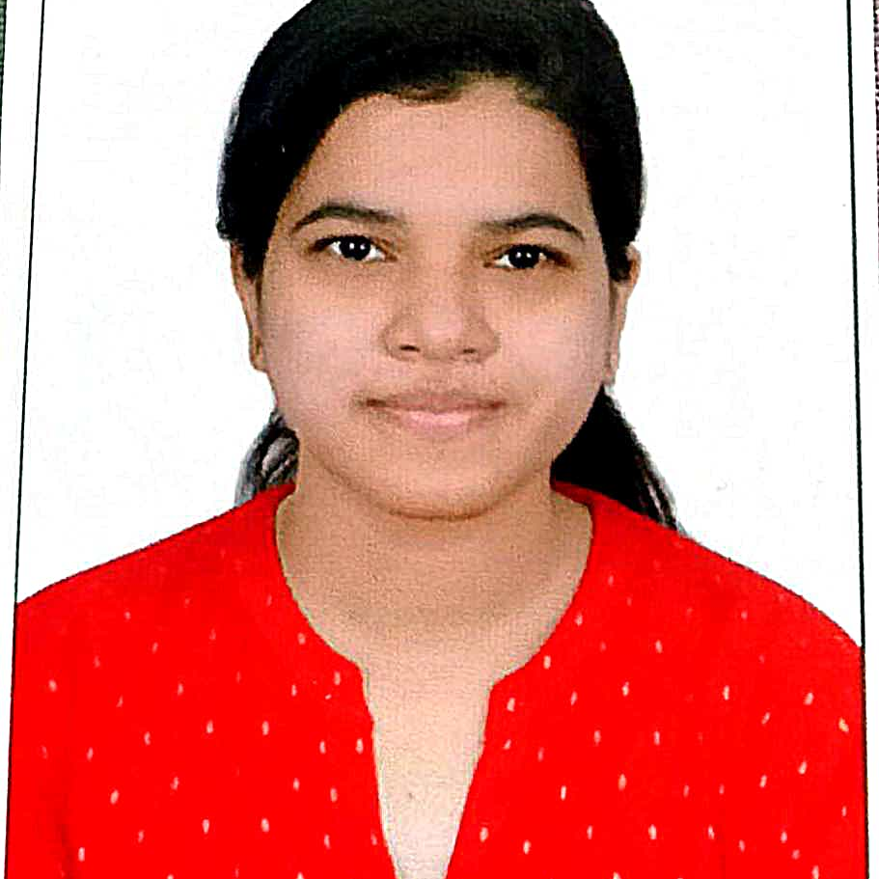


Apeksha Laad
Analyst/Software Engineer
Bachelor of Technlogy, Computer Science and Engineering : 2016-2021
Skills
C# | Basics, OOPS, Exception Handling ,Arrays ,Collection and Generics, Delegates and Events, File Io and Serialization.
.NET Framework | Architecture which includes CTS,CLS,FCL,BCL and CLR.
Ado.net | Basics Architecture
Database | Basic SQL
Tools | GIT
UI Technology | HTML and CSS
Mumbai
apeksha.balasaheb-laad@capgemini.com
A4
+919028511697
Full Stack Developer
Understanding of RDMS concepts using SQL Server.
Practical understanding of C# and SQL concepts using Visual Studio and SQL Server
Hands on experience in developing applications using .NET Framework, ADO.NET and SQL Server.
Understanding of HTML and CSS.
Currently completing the course Azure Fundamentals
Completed Case Study on Railway Management System using MySQL, .Net core Web API and Angular used Html, CSS, Bootstrap and Typescript for designing. Which is used to manage the details of Trains, Timetable, Stations, Fares, Searching and Booking the Trains.
https://github.com/apekshaalaad

