Slide 1
CSE 5324
Project Inception –Team 7
Auto TasX
Apeksha Bhat(1000981003)
Harikrishna Bokksum(1001096002)
Meghana Anoop(1000981002)
Kaustubh Mohgaonkar(1001101770)
Michael Ho (1001135968)

Slide 2
Auto tasX
This application allows the user to automate his android device based on the user’s location.
KEY FEATURES:
User friendly interface.
Location based automation.
Customizable features.
Multiple actions for locations.

Slide 3
Vision and Business Case
Minimizing user intervention in performing repeated tasks by helping him achieve these task automatically through the application.
Convenient
Material Design UI
Phone automation

Slide 4
Competitors
Competitors include:
Geofence Tracker tasker
Locotext
Smart Silence
How’s Auto tasX better: There are a few applications like locoText , Smart Silence each of which includes only one of the features included In our application. The Geofence Tracker Tasker although does most of the functionalities included in our application ,it does not have the “Location based Reminder” feature.

Slide 5
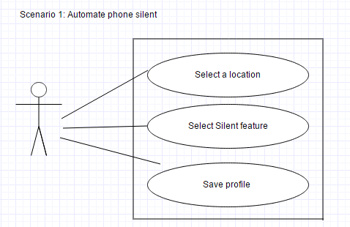
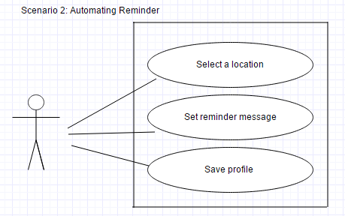
Use Cases

Slide 6
Risk and mitigations
Delay or inconsistency in getting most recent location data
- Fused location API from Google
Implementing multiple actions for each location
- performing more than one action for a location would be possible through iteration
Background activity getting killed because of memory leak
- this is a limitation in the android memory management due to which the background activity might get killed. The activity needs to be restarted in such a case.

Slide 7
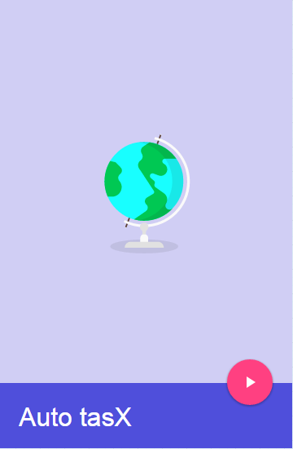
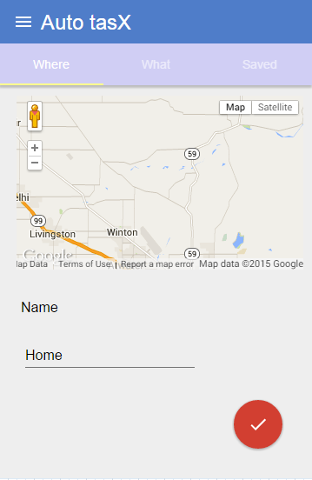
Mock up

Slide 8
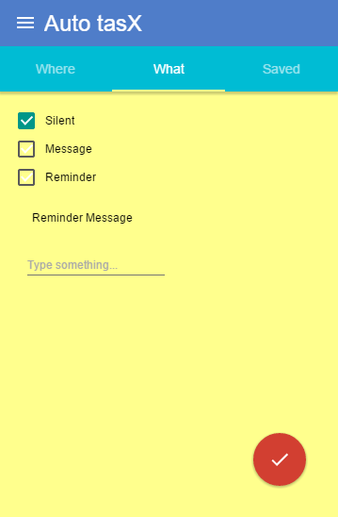
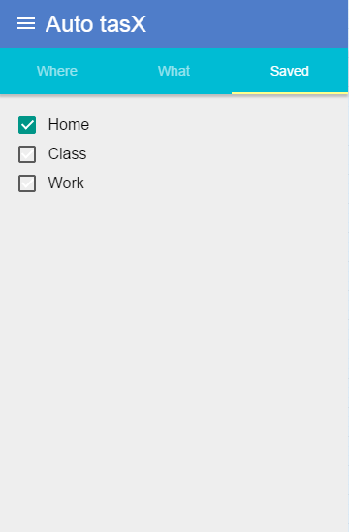
Mock up cont..

Slide 9
Iteration Plan
Iteration 1
Working on the UI.
Work on Geofence API.
Iteration 2
Implementing actions for geofences.
Implement use cases.
Iteration 3
Work on multiple actions for a geofence.
Performance enhancements.

Slide 10
THANK YOU ☺
Any Questions?

