Slide 1
DataStructure
We will be using the android’s inbuilt sqlite database.
A saved task in our application will create an entry in the sqlite as given below.
Android ships with sqlite version 3.4.0
Database table Structure:
Location | Silent | Reminder | TextMsg | Maps | RejectCall
(lat,long) | 1 | 0 | 1 | 0 | 0

Slide 2
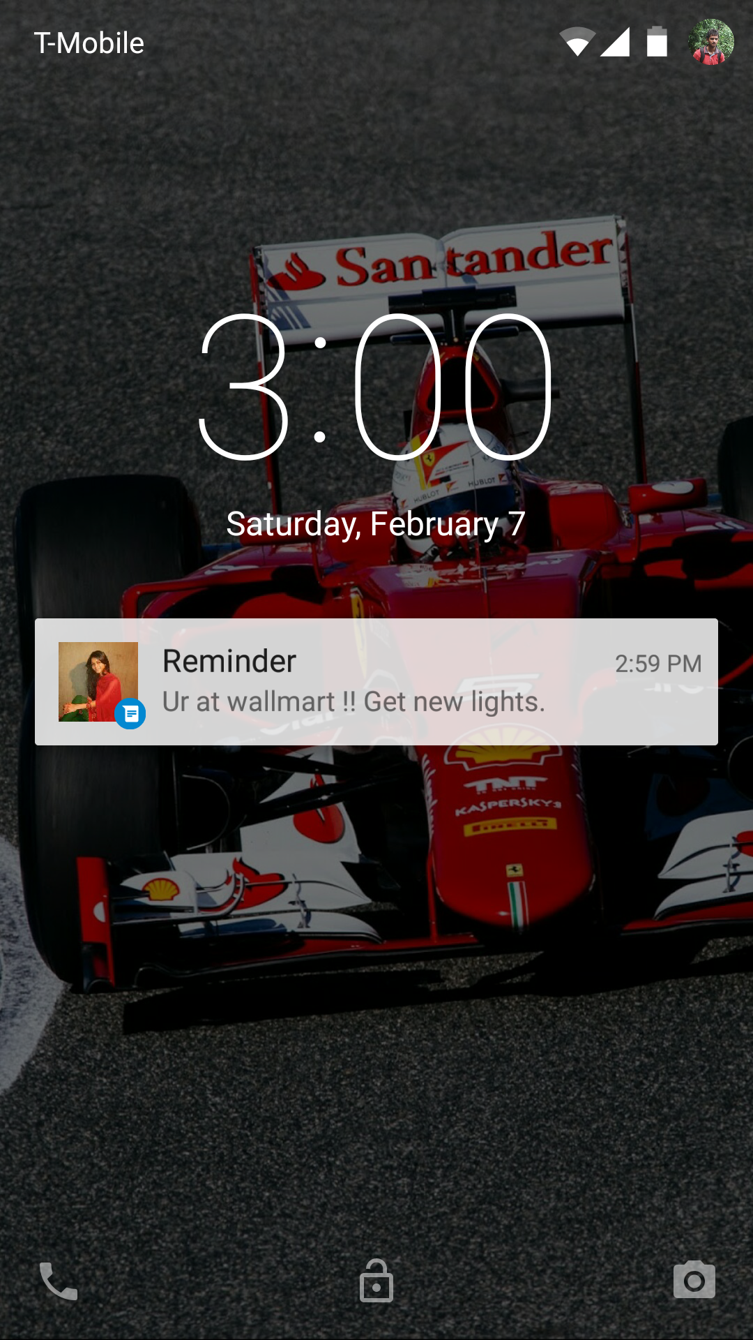


Slide 3
