Slide 1
Learning Java 8
Behavior Parameterization

Slide 2
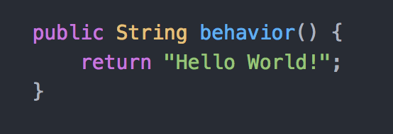
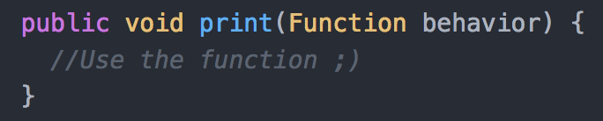
What is Behavior Parameterization
Given a function
Pass the function as parameter to another function

Slide 3







Slide 4
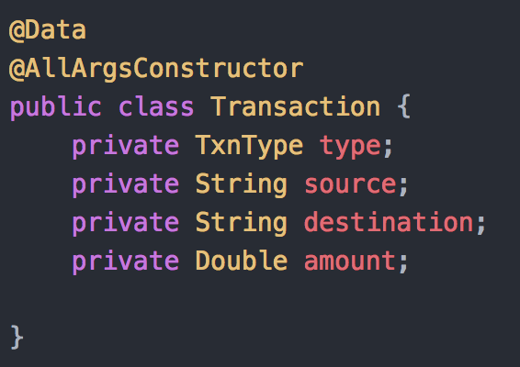
Java 7 Explains : Example Domain
Consider a Transaction Entity

Slide 5
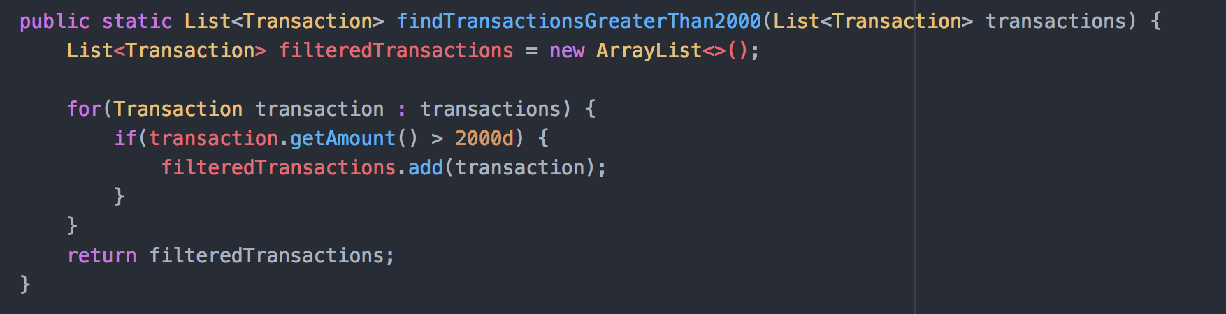
Java 7 Explains : Problem Statement
Given a list of transactions, get all the transactions with amount greater than 2000 units

Slide 6

Java 7 Explains : Bigger Problem
The one constant in Software Development

Slide 7
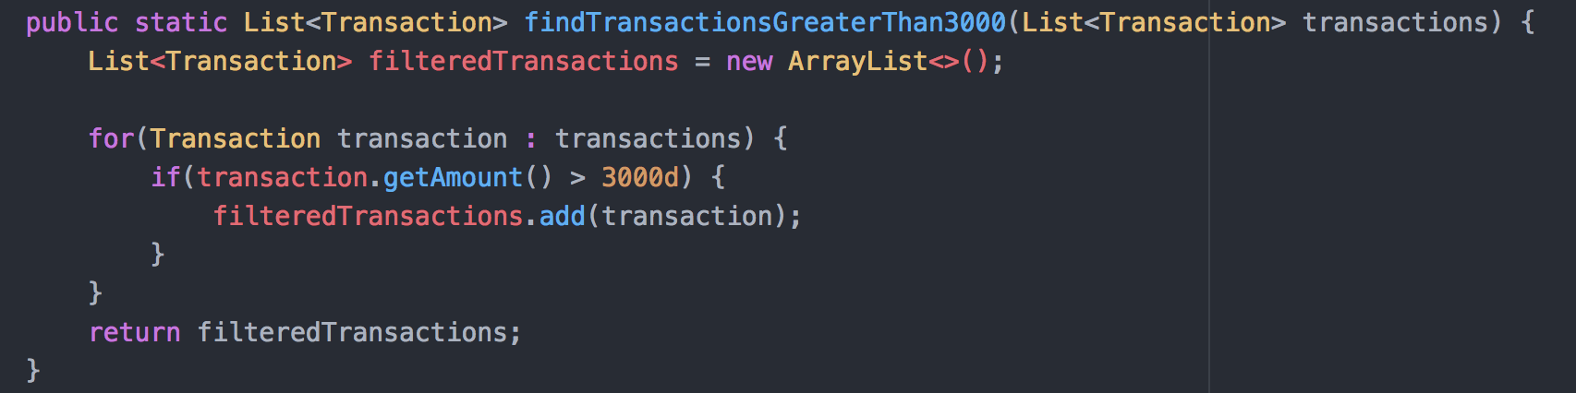
Java 7 Explains : And CHANGE it is!!
Given a list of transactions, get all the transactions with amount greater than 3000 units
Naive

Slide 8
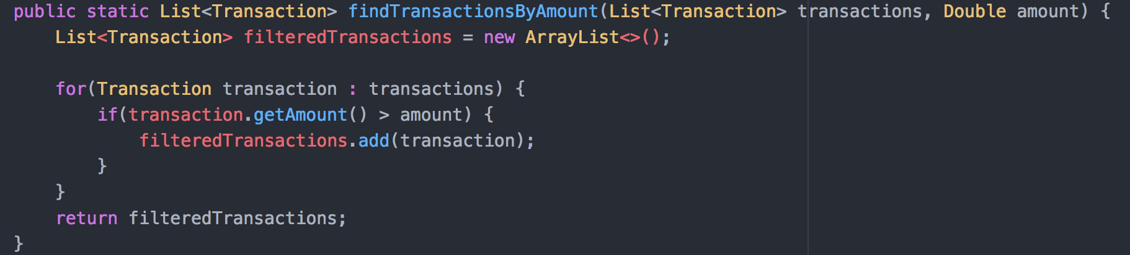
Java 7 Explains : More generic approach
Given a list of transactions, get all the transactions with amount greater than 3000 units

Slide 9
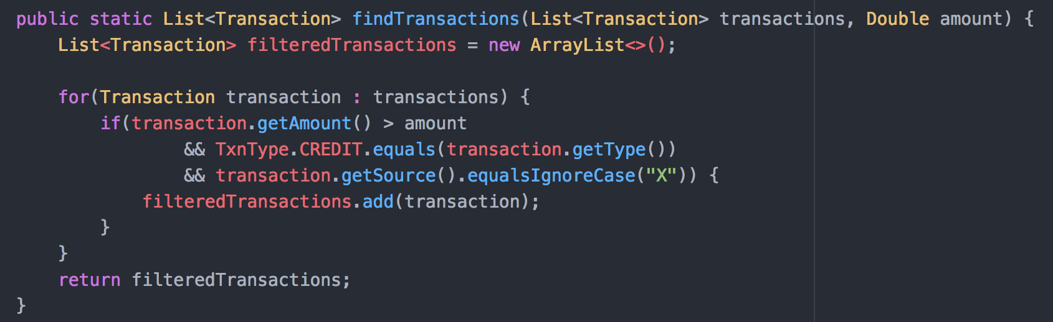
Java 7 Explains : More change in the making
Given a list of transactions, get all the CREDIT transactions with amount greater than a specified amount
and carried out by ‘X’

Slide 10
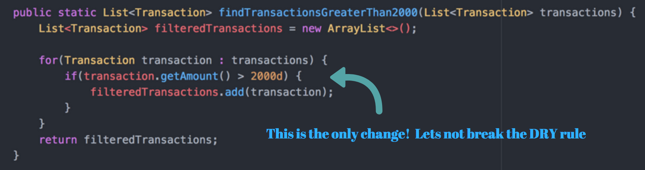
Java 7 Explains : If we observe closely

Slide 11
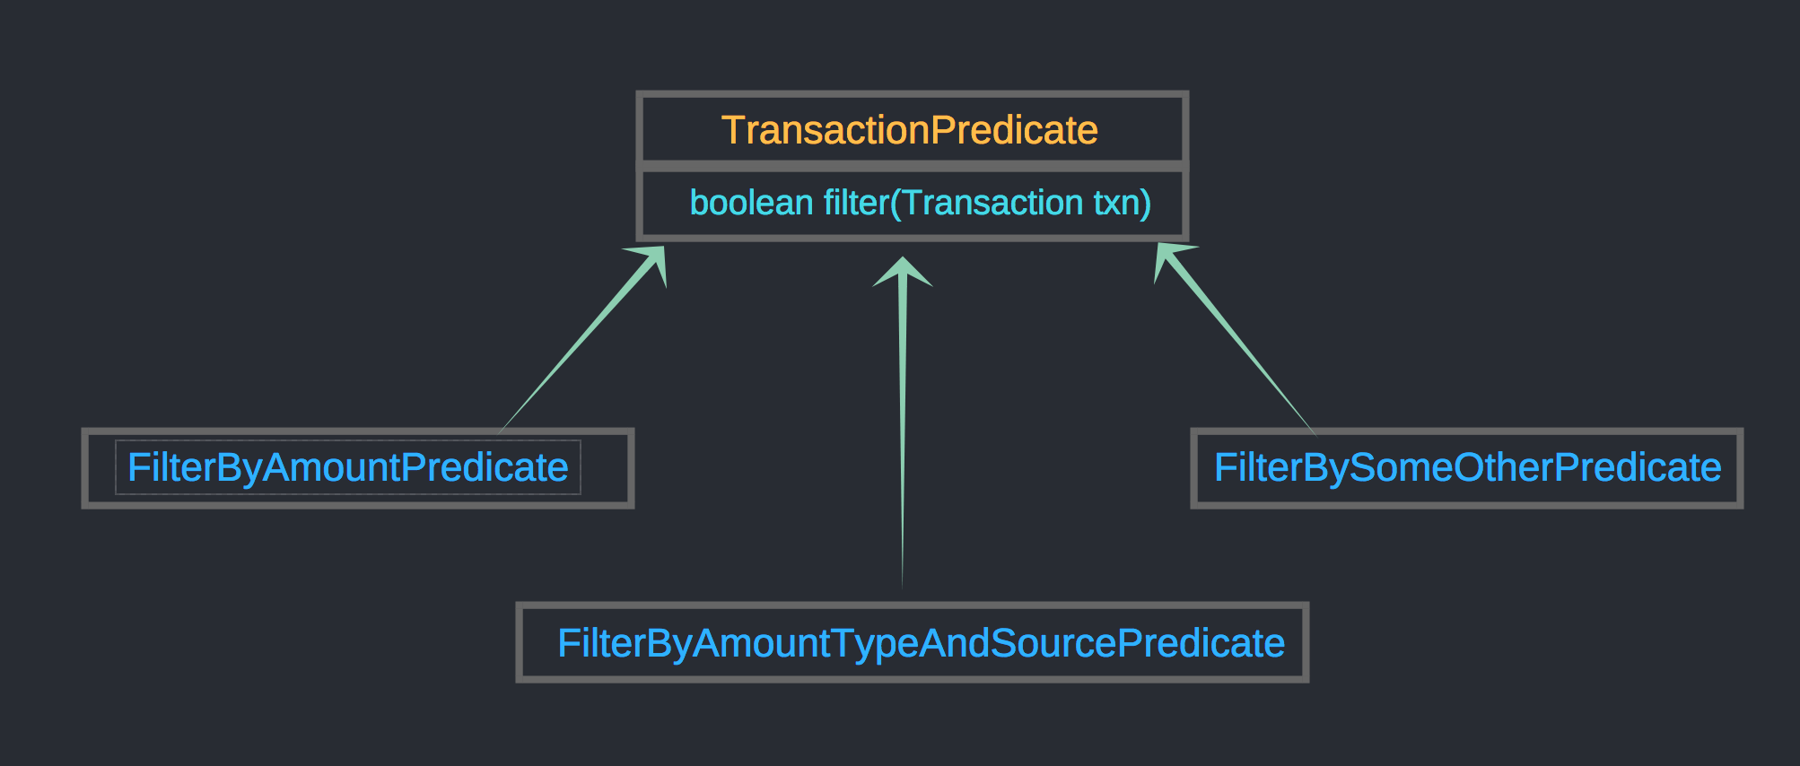
Java 7 Explains : Code Re-use

Slide 12
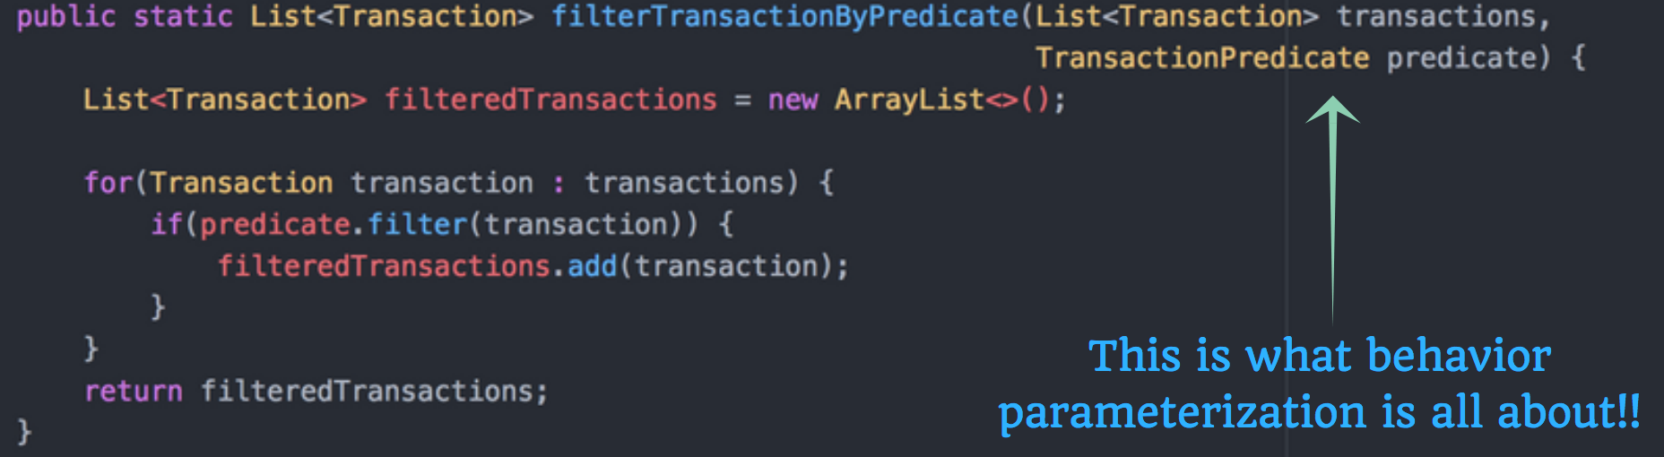
Java 7 Explains : Optimized Filter Function

Slide 13
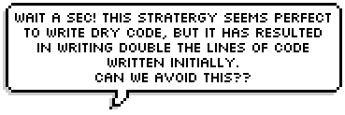


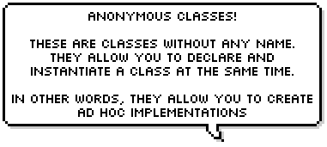

Slide 14
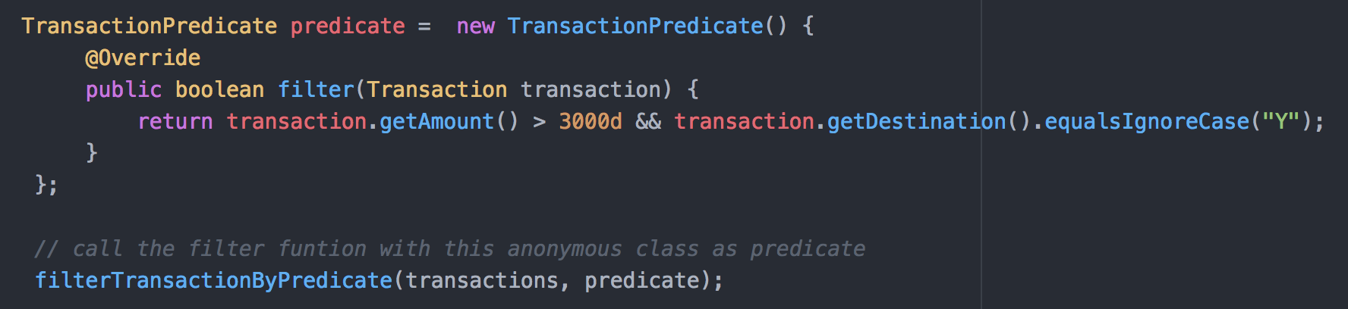
Java 7 Explains : Reduce verbosity

Slide 15






Slide 16

Time to Exercise

