Slide 1
PowerPoint Presentation Structure

Slide 2
Aviation Risk Analysis: Recommendations for Safer Aircraft Investment
Based on NTSB Data (1962–2023)
Presenter: Antonine Pelicier
Date: 15/06/2025

Slide 3
Executive Summary
Company wants to expand into aviation
Goal: Determine safest aircraft to buy and operate
Based on historical accident and fatality data

Slide 4
Methodology
Cleaned and analyzed 88,889 accident reports
Focused on model, engine type, flight purpose, and fatality risk
Developed risk scores and ranked aircraft

Slide 5
Aircraft Safety Insights
List of safest aircraft by model Bar chart: Top 10 models with lowest fatality rates (min 20 incidents) Callout: e.g., “Cessna 172 has 0.03 average fatality rate over 200+ incidents”

Slide 6
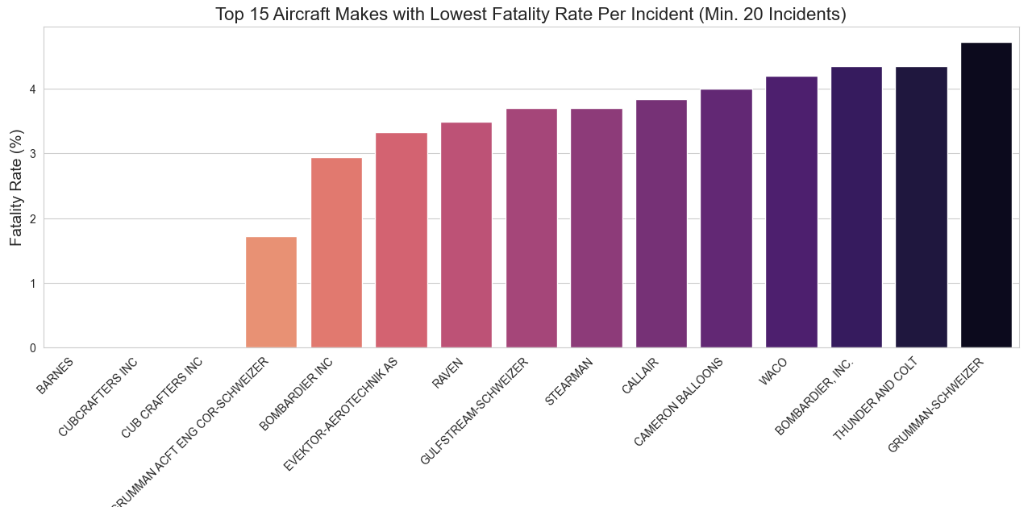
Top 15 aircraft makes with lowest fatality rate per incident

Slide 7
Engine Type Risk
Chart: Average fatality rate by engine type
Summary:
Turboprop/turbojet engines show fewer
fatalities
Reciprocating engines (piston-based) are
more common in risky incidents

Slide 8
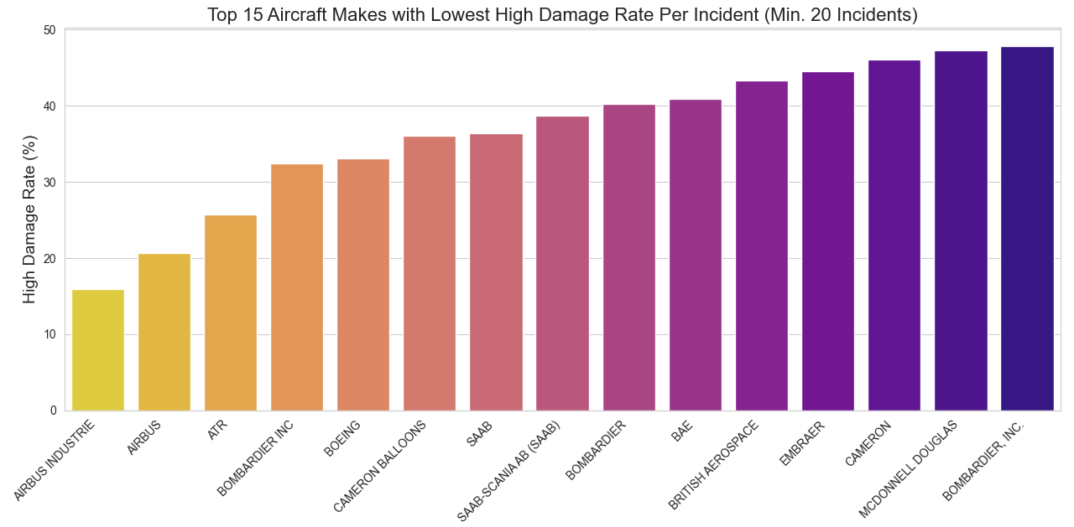
Top 15 Aircraft makes with lowest high damage rate per incident

Slide 9
Flight Purpose Risk
Chart: Fatality rates by purpose (e.g., personal, commercial, training)
Insight: Personal flights are 3× more fatal than commercial flights

Slide 10
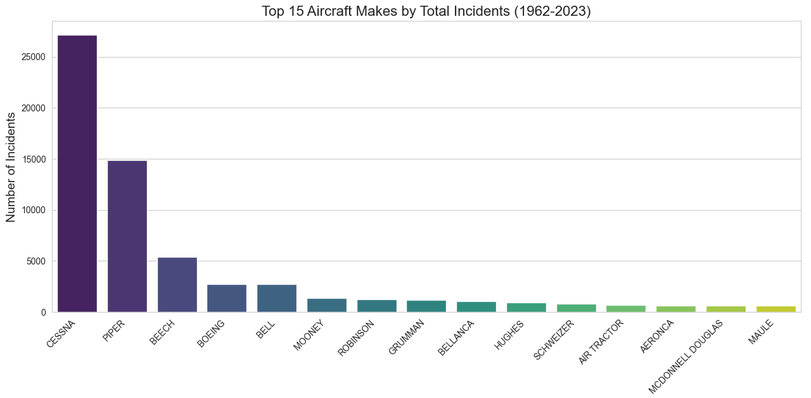
Top 15 aircraft makes by total incidents

Slide 11
Safety Over Time
Line graph: Accidents per year
Line graph: Average fatality rate per year
Insight: Aviation safety has improved steadily since the 1980s

Slide 12
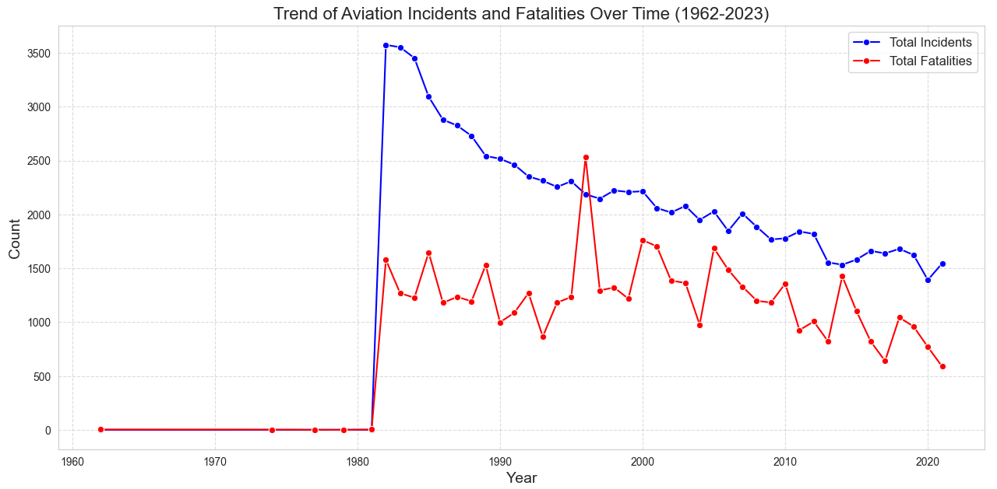
Safety Over Time graph

Slide 13
Key Recommendations
Purchase models with >20 events and fatality rate <5%
Prefer newer twin-engine or turboprop aircraft
Avoid older aircraft primarily used for recreational or personal use

Slide 14
Interactive Dashboard
Screenshot of Power BI dashboard
Mention filters: aircraft, engine, weather, flight phase
Encourage hands-on exploration

Slide 15
Next Steps
Conduct due diligence on top models
Integrate risk scoring into procurement process
Explore maintenance/parts availability for shortlisted aircraft

Slide 16
Thank you

