Slide 1
PowerPoint Presentation Structure

Slide 2
Movie Studio Data Analysis Actionable recommendations for the head to launch a new movie studio
Based on Box Office Mojo and IMDB movie datasets
Presenter: Antonine Pelicier
Email: antoninepelicier10@gmail.com
Date: 20/07/2025

Slide 3
Introduction & The Business Problem
The Big Picture: My company is venturing into the exciting world of original video content with a new movie studio.
The Challenge: I am new to this space and need to understand what drives success in the competitive film industry.
My Goal: To identify the types of films currently performing best at the box office and provide actionable recommendations to guide my studio's strategy.

Slide 4
My Data Sources
To uncover these insights, I've analyzed data from two key industry sources:
Box Office Mojo: Provides crucial financial performance metrics, including domestic and foreign gross revenue.
IMDB: Offers rich movie metadata, such as genres, release years, audience ratings, and the number of votes.

Slide 5
My Process
I meticulously merged these datasets, linking financial success to specific movie characteristics and audience reception.

Slide 6
Key Finding 1: Genre Dominance in Box Office
My analysis reveals that certain genres consistently outperform others in terms of average worldwide gross.
The Leaders: Adventure, Action, and Sci-Fi films stand out as the top-earning categories.

Slide 7
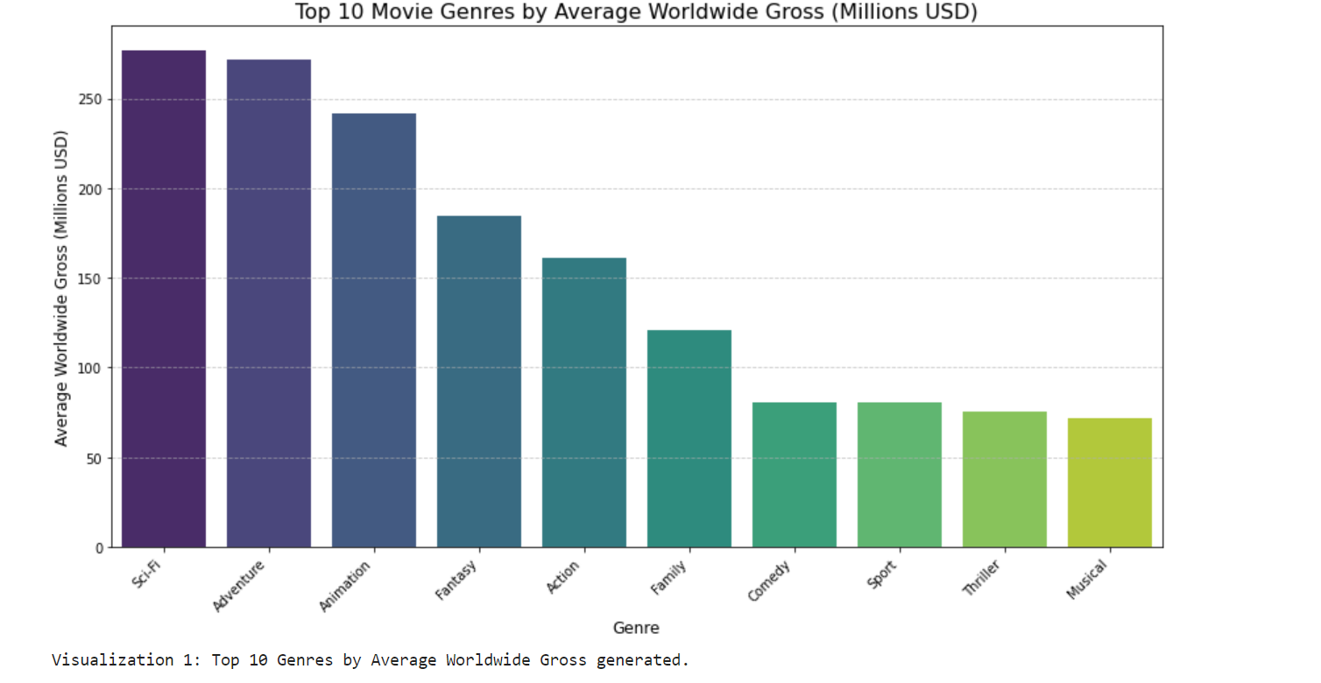
Top 10 Movie Genres by Average Worldwide Gross (Millions USD) Visually highlight Adventure, Action, Sci-Fi as leading.

Slide 8
Recommendation 1: Prioritize High-Performing Genres
Actionable Advice: For my initial film slate, focus development efforts on Adventure, Action, and Sci-Fi genres.
Why: These genres have a proven track record of generating the highest average box office returns, offering the strongest potential for financial success.

Slide 9
Key Finding 2: The Power of Audience Engagement
While a good average rating is valuable, my data indicates that the number of audience votes (a proxy for broad engagement and interest) is a stronger predictor of high worldwide gross.
Films that capture significant public attention and discussion tend to perform better financially.

Slide 10
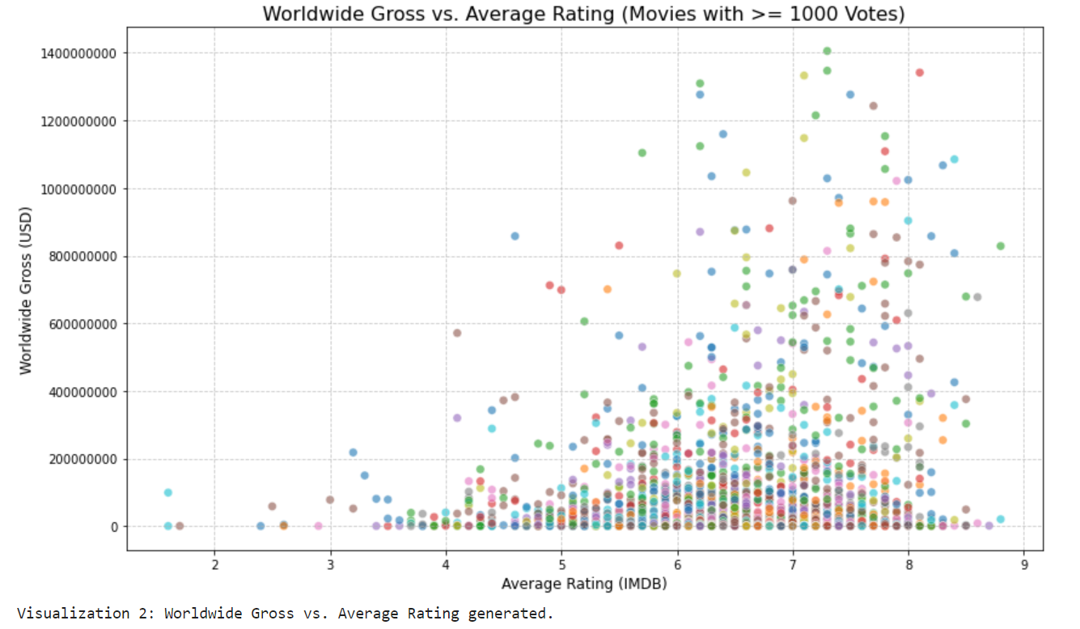
Worldwide Gross vs. Number of Votes (log scale for votes) Show a positive trend, emphasizing that higher vote counts often correspond to higher gross.

Slide 11
Recommendation 2: Invest in Films with Broad Appeal
Actionable Advice: Beyond just critical acclaim, aim to produce movies that can generate widespread interest and encourage broad audience participation and discussion.
Why: High audience engagement directly translates into higher ticket sales and overall box office revenue.

Slide 12
Key Finding 3: The Reach of Universal Themes
The highest-grossing films are often those that resonate with a very wide audience, as evidenced by their substantial number of votes.
This suggests that movies with universal themes or broad appeal are more likely to attract a large and diverse demographic.

Slide 13
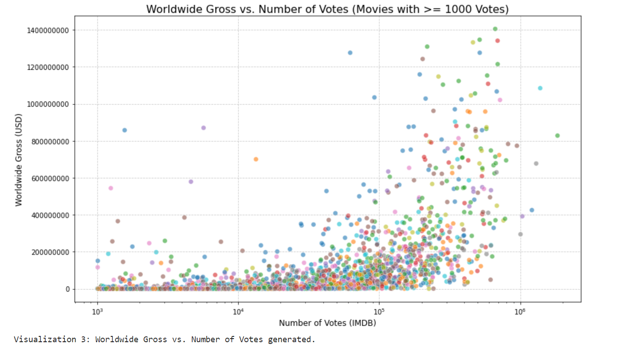
Reinforcing the idea of reaching a large audience base

Slide 14
Recommendation 3: Focus on Broad Audience Resonance
Actionable Advice: Prioritize stories, themes, and intellectual properties that have the potential to appeal to a diverse and large demographic, rather than overly niche markets.
Why: Maximizing reach to a wide audience is key to unlocking the highest box office revenue potential.

Slide 15
Conclusion
Key Takeaways:
Genre Matters: Adventure, Action, and Sci-Fi are top performers.
Engagement is Gold: Films that generate high audience interest and votes drive greater revenue.
Broad Appeal Wins: Universal themes and widespread resonance lead to blockbuster success.

Slide 16
My Path Forward
By strategically focusing on these areas, my new movie studio is well-positioned to create compelling content that captures audiences and achieves significant box office success.

Slide 17
Next Steps for the Studio
Conduct deeper market research within identified top genres.
Develop concepts that prioritize broad audience appeal and potential for high engagement.
Strategize talent acquisition and marketing efforts to align with these findings.

Slide 18
Thank you

