Slide 1
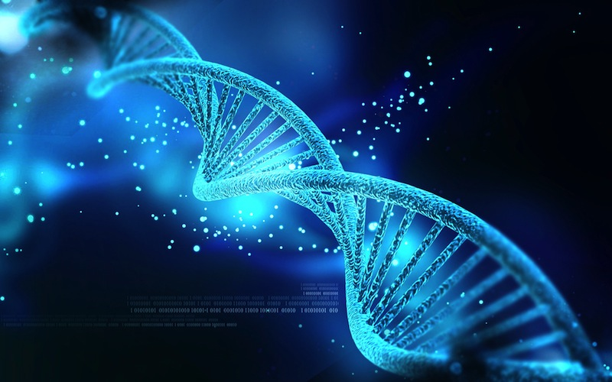
BIOINFORMATICS FINAL PROJECT
MUGLA UNIVERSITY (ING) COMPUTER ENGINEERING
AHMET PELIT
GULIZAR VURAL
YAVUZ SELIM ABAZAOGLU

Slide 2
Project Question
Given two lists that contain mappings between protein identifiers and target (Gene Ontology or protein domain) identifiers
Visualize all relations between protein sets and target identifiers with a bipartite graph using Cytoscape.js library
The goal is to visualize/identify Gene Ontology terms or protein domains of degree one
To see go terms/protein domains that exist only in one set of proteins

Slide 3
Project Steps
Getting two lists from uniprot
Entry ids of proteins which are given with cross-reference(InterPro) from two different organisms
Entry ids of proteins which are given specific GO(Molecular function) from two different organisms
Used cross-reference(InterPro) or GO(Molecular Function) in the command line thats JavaScript(document library)
Visualize cross-reference(InterPro) or GO terms as a node with source and target identifiers
Used cytoscape.js library with bipartite
Linked the all nodes with attribute that have own databases
Report the all associate nodes between Protein set of organisms in the HTML

Slide 4
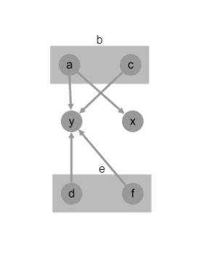
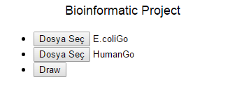
Example View
Two different organisms like e and b
a,c,d and f are Protein Ids of organisms
y and x are GO(Molecular Function) or cross-reference(InterPro)

Slide 5
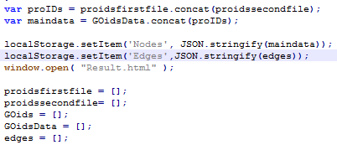
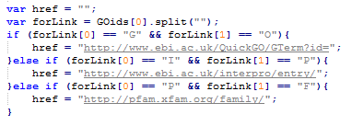
Command Line
In this part,we didn’t need to use server
Local storage of Google crome that provide up to10 MB
In this part,we gave to link the all nodes their own database
As a given which one of GO(Molecular Function) , cross-reference (InterPro) or protein family is executable

Slide 6
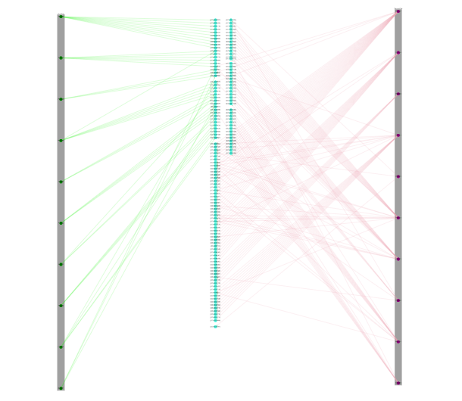
Result
As a result, two lists were compared GO(molecular function) or cross-reference (InterPro) as nodes(blue) that are circle
In the rectangle,Showed up Protein Ids as nodes(green)
Each edge of organisms are different

Slide 7

Thanks For
Listening…
https://github.com/apelit10/VisualizeOrganismIDs

