Slide 1
Automated testing of models of cyber-physical systems
Faculty of Information Technology, Department of Digital design
Ing. Tomáš Apeltauer
1.5.2018

Slide 2

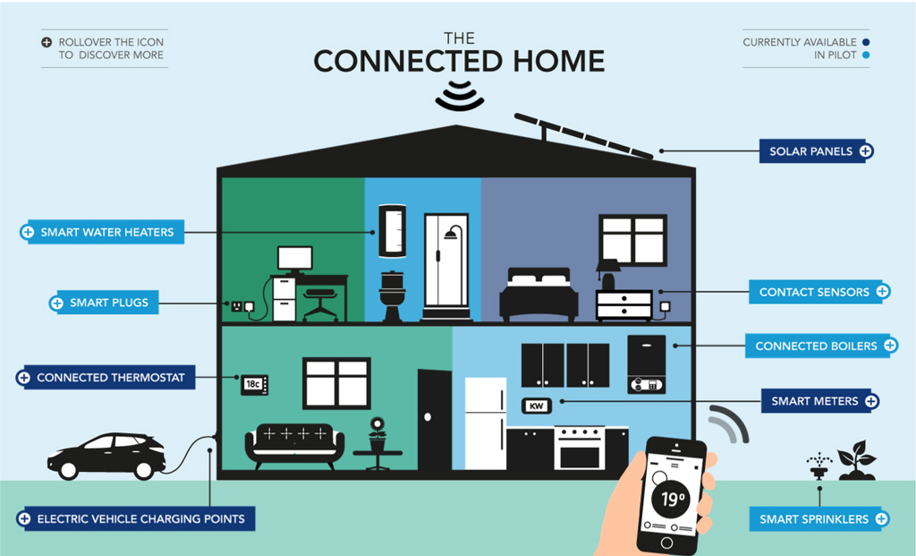
What is the Czech guy doing?

Slide 3
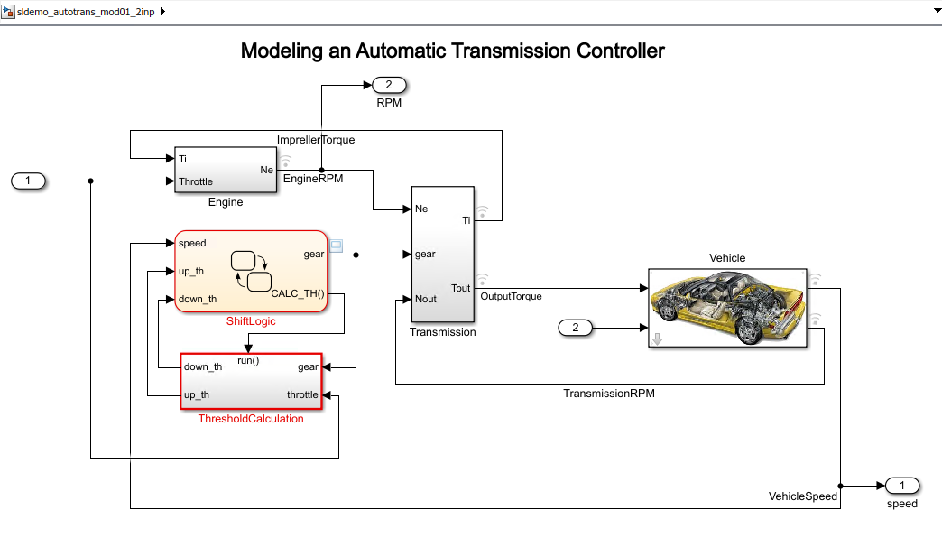
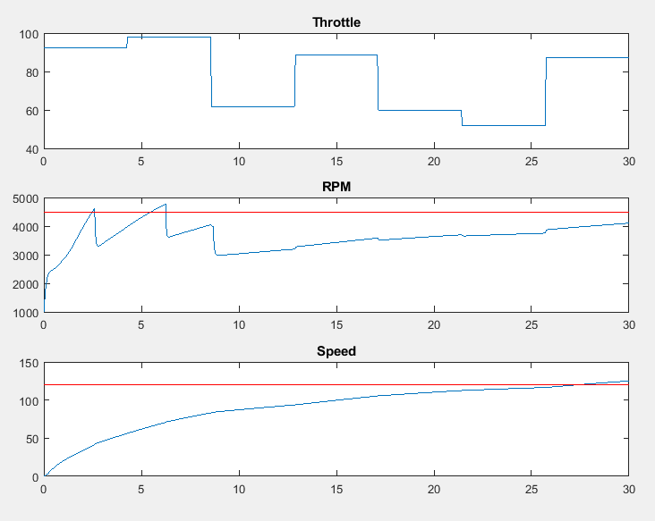
CPS Example:
Automatic transmission
Finding an input throttle schedule
Does engine speed reach 4500 rpm?
Does vehicle speed exceed 120 km/h?

Slide 4
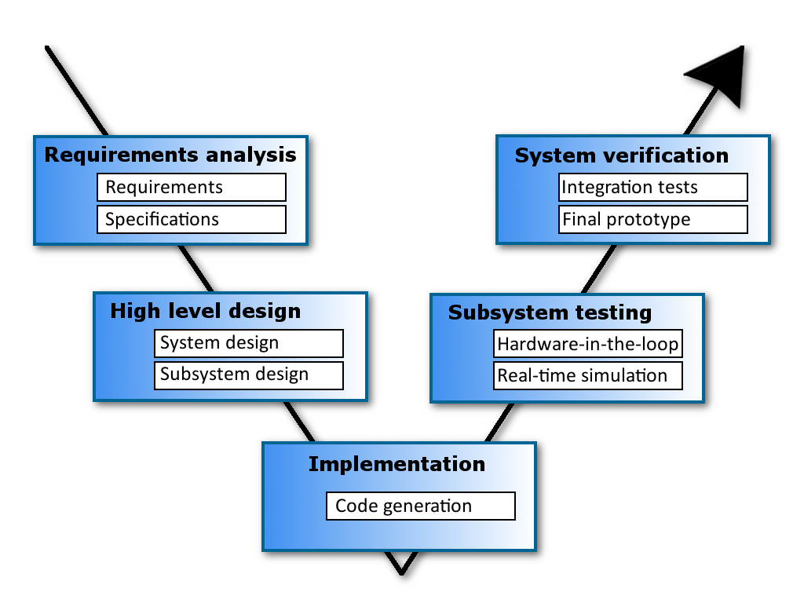
V-design cycle

Slide 5
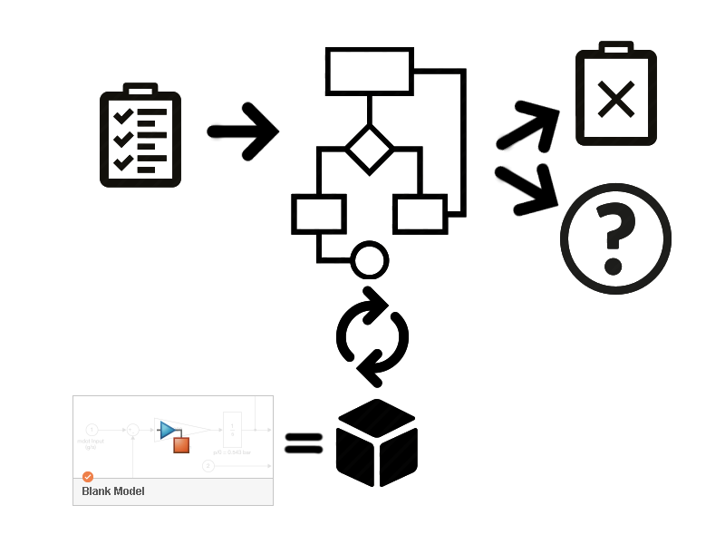
General approach
Proof
SA, GA, CE, UR solver algorithms
MTL specification
Structure of the model
Black box

Slide 6
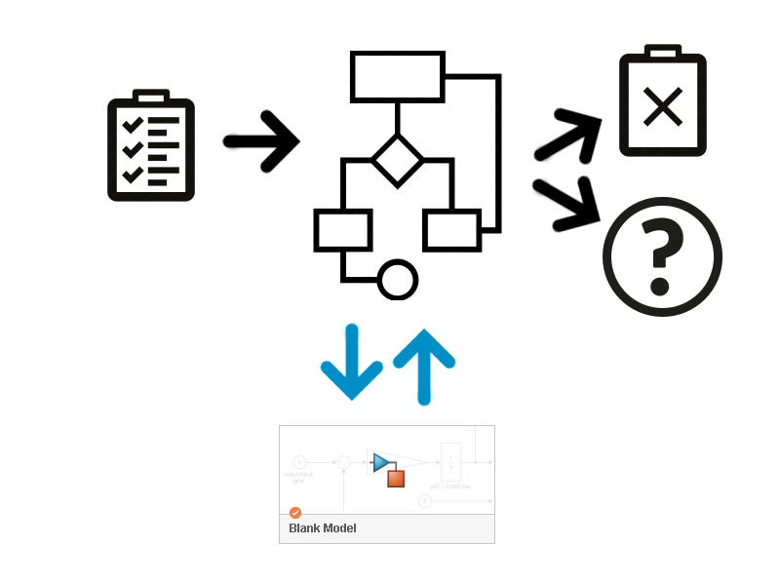
Innovative approach
Proof
SA, GA, CE, UR solver algorithms
MTL specification
Structure of the model

Slide 7

ROADMAP for 1st half of 2018
Conference article
Collecting results
06/2018
Experiments
05/2018
Benchmarks
04/2018
MTL spec.
03/2018

Slide 8

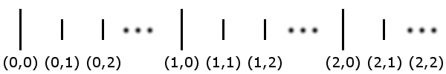
Defined by Ron Koymans in 1990. It provides a formal specification method for real-time systems.
Metric Temporal Logic (MTL) specification
Classical temporal logic only involves qualitative operators, but real-time systems are characterized by quantitative timing properties
Koymans extends temporal logic by including a distance function d
The range of d is defined as nonarchimedean (we DO have infinitely large or small elements)
Addition and zero element are defined over d
Koymans creates
a metric point structure
+ metric versions of operators: G, F, H, P, until and since

Slide 9
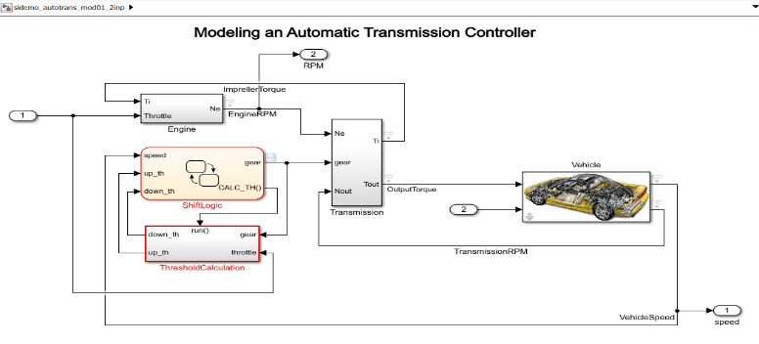
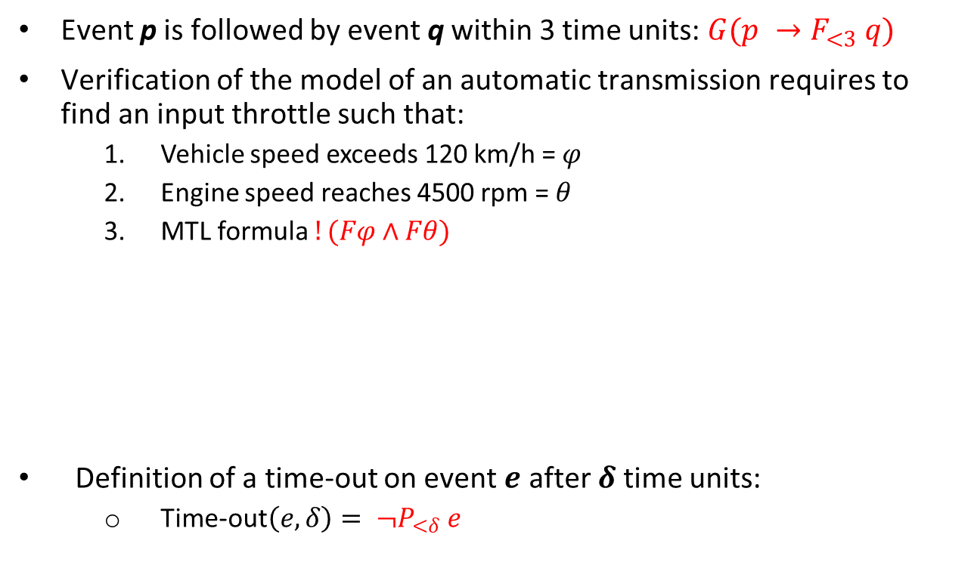
MTL examples
Event p is followed by event q within 3 time units: $G(p →F_{<3} q)$
Verification of the model of an automatic transmission requires to find an input throttle such that:
Vehicle speed exceeds 120 km/h = $φ$
Engine speed reaches 4500 rpm = $θ$
MTL formula $!(Fφ \text{∧} Fθ)$
Definition of a time-out on event $e$ after $δ$ time units:
Time-out$\left(e, δ\right)= ¬P_{<δ} e$

Slide 10

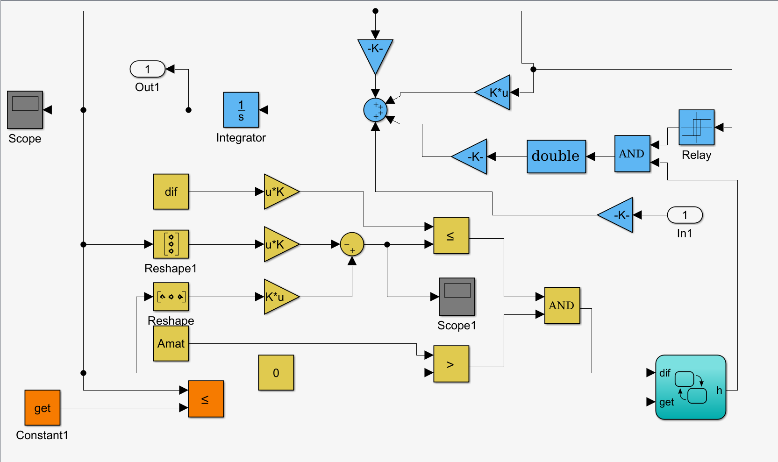
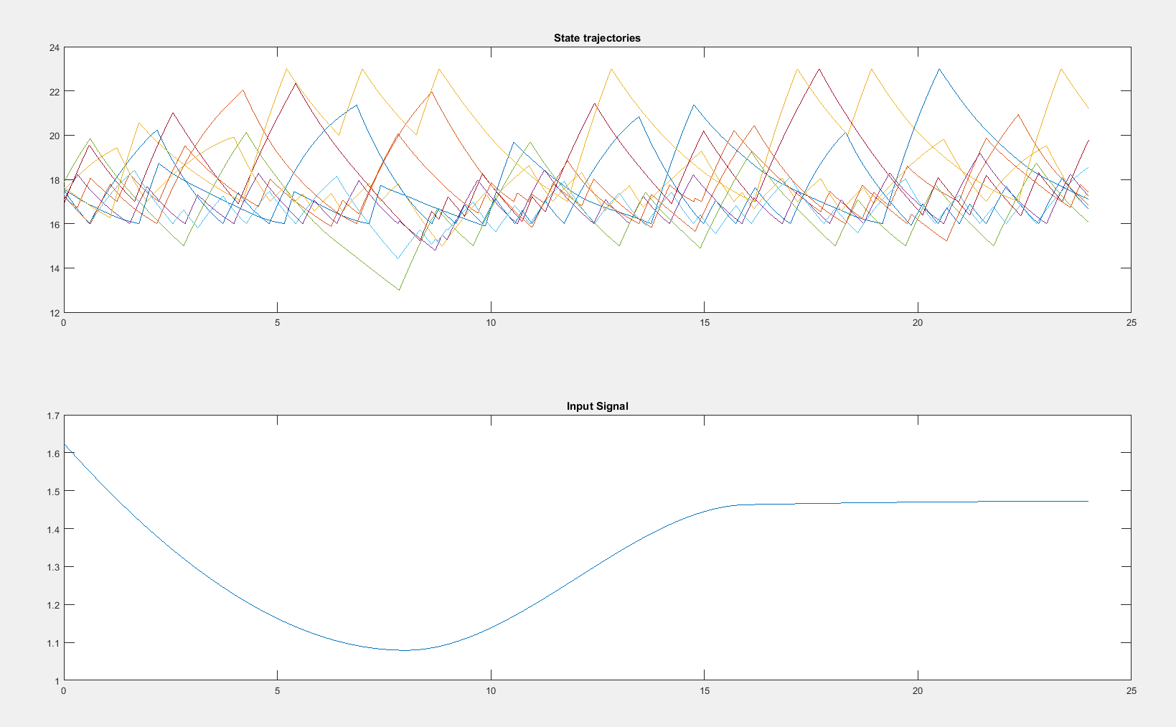
Benchmark models
Automatic Transmission Benchmark, Line Follower, 3rd order modulator
Room Heating Benchmark
A hybrid system: 10 rooms and 4 heaters which result in 3 360 discrete locations

Slide 11
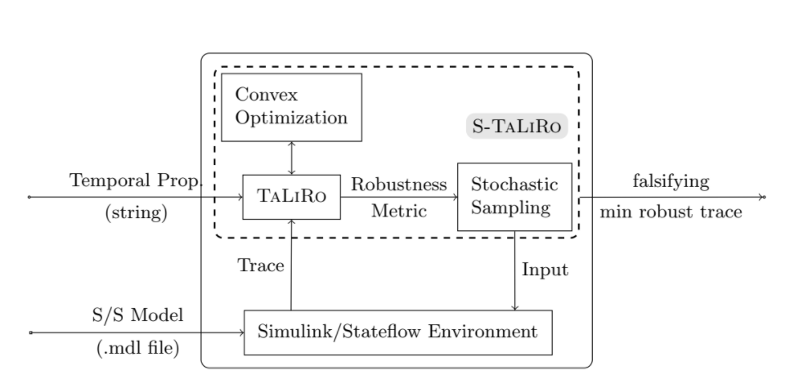
S-TaLiRo Tools
What is it?
MATLAB toolbox (Arizona State University)
What does it do?
Searches for counterexamples for MTL properties
How does it achieve it?
Minimization of a robustness metric
Multiple simulations over Simulink/Stateflow models

Slide 12
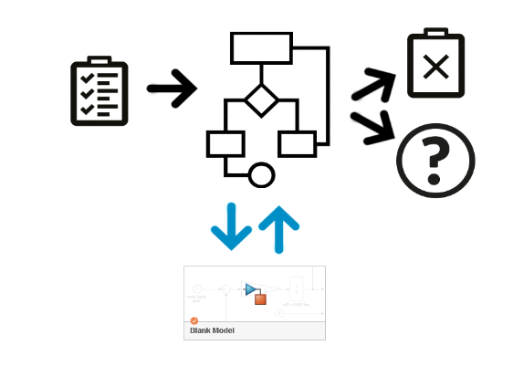

Our research
What is our goal?
Create White Box verification algorithms and techniques
How do we achieve it?
Measure S-TaLiRo on a lot of different models
Detect cases when S-TaLiRo is not performing very well
Suggest a better approach using White Box verification
Extract general verification scheme for White Box verification
What are we working on right now?
Preparing experiments (MATLAB scripts)
Measuring S-TaLiRo performance on other models of cyber-physical systems
For example: 2 degrees of freedom PID for controlling DC motor
Line Follower, iPendulum, Electric Vehicle model

Slide 13
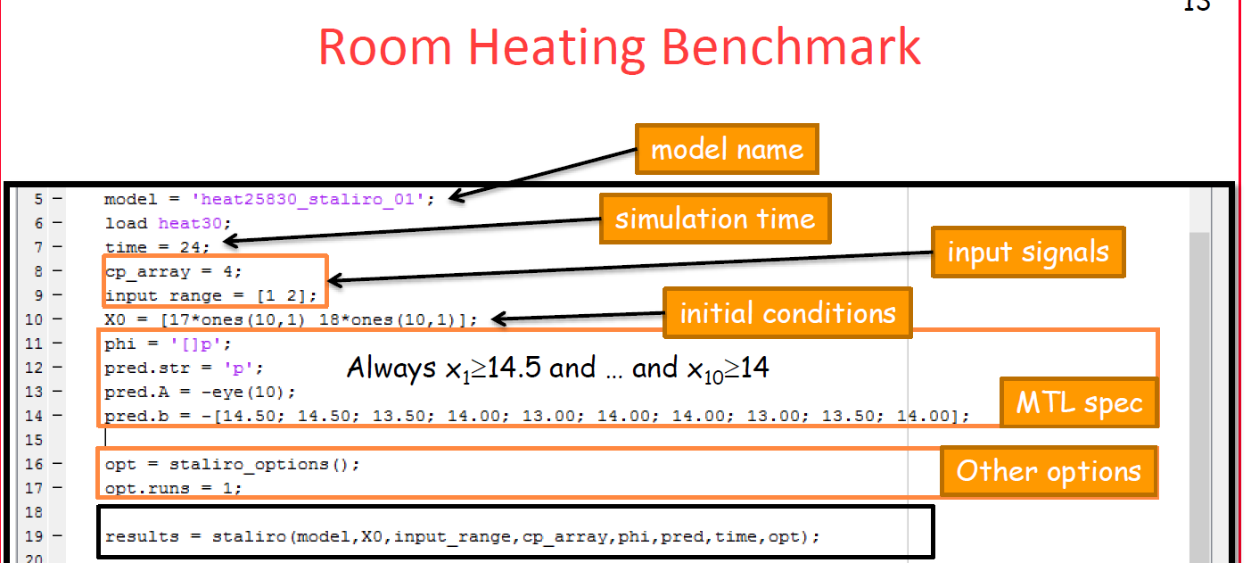
Our research
How does MATLAB script for S-TaLiRo looks like?

Slide 14
THANK YOU VERY MUCH FOR YOUR ATTENTION
Now is time for discussion.

