Slide 1
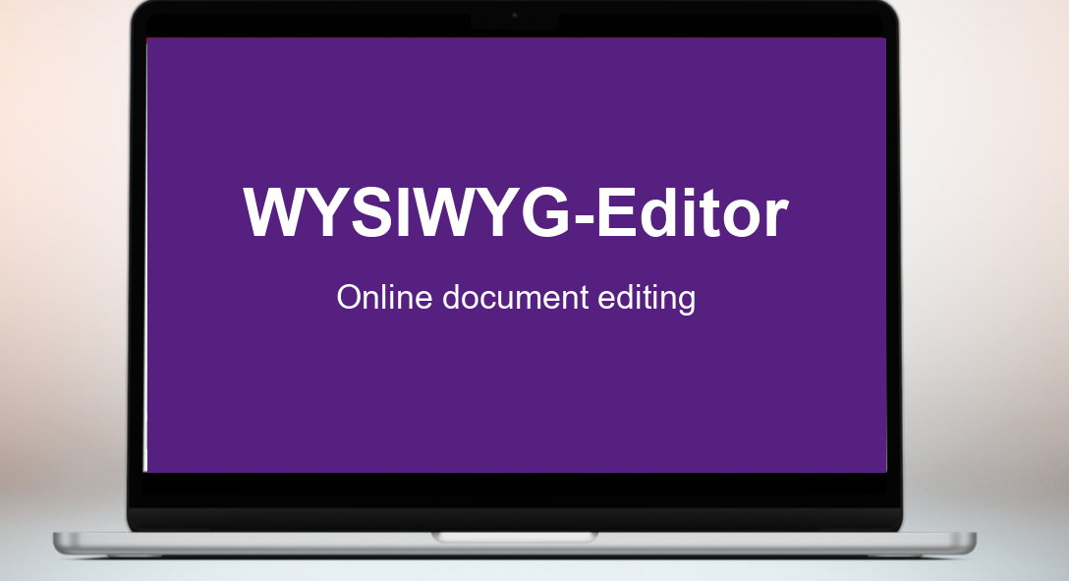
_👋 Introduction
_WYSIWYG-Editor presentation is a tool that lets you create, edit, and deliver presentations in a simple way. You can work alone on a document, or collaboratively as part of a team. This introduction template will help you get started and explore some of the main features of the product.
_Here's what you'll discover
_🖼 Slides & Layouts
_🎨 Design & Master Slides
_✏️ Style & Visual
_🎬 Slide Transitions
_🎤 Presenting
_🤝 Productivity & Collaboration
_Next Chapter: 🖼 Slides & Layouts

Slide 2
_🖼 Slides & Layouts
_Every presentation is a sequence of slides.
_Use the Slide navigation on the left to reorder them by dragging, or remove ones you don’t need.
_Each slide can use a different layout – a predefined arrangement of placeholders for titles, text, and images. Pick the layout that fits the slide’s purpose.
_➜Try it:
_Add a new slide clicking “New” in Notebook bar.
_Choose a layout for it from the layout chooser.
_Start editing your slide.
_Useful tip
_When you’re unsure which layout to pick, start with “Title, Content” – it works for almost any slide.
_Next Chapter: 🎨 Design & Master Slides

Slide 3
_🎨 Design & Master Slides
_A master slide is the template behind every slide. It defines the colours, fonts, background, and where titles and footers go. Change the master, and every slide updates at once. This makes master slides the fastest way to keep a deck consistent. Set the look once (fonts, colours, logo, footer) and every new slide picks it up automatically. When you need to rebrand or tweak the design later, you change the master, not 30 slides.
_➜Try it:
_Open the View tab in the Notebook bar.
_Click “Master View” and edit your master design.
_Once your master design is ready, click "Close Master View".
_Now your master is set and ready to use across all slides.
_Useful tip
_If a single slide needs a different look, create a second master slide and apply it just to that slide. The rest of your deck stays on the original master.
_Next Chapter: ✏️ Style & Visual

Slide 4
_✏️ Style & Visual
_There are two ways to make a slide stand out. First, format your text to give it structure and emphasis – fonts, sizes, weights, and colours guide the reader through your message. Second, add visual elements – images, shapes, icons, charts – to support your story.
_➜Try it:
_In the Notebook bar, open the Insert tab and add an object, image, table, or any other element that supports your content.
_Click on it to select it, then resize and reposition it to fit your layout.
_For editable objects like shapes or images, a contextual tab appears in the Notebook bar with all the available actions.
_Useful tip
_Less is more. One strong visual, a clear headline, and a few well-formatted lines will always beat a slide packed with text and decorations.
_Next Chapter: 🎬 Slide Transitions

Slide 5
_🎬 Slide Transitions
_A transition controls how one slide moves to the next during your slide show. The right transition makes your deck feel polished and professional, while the wrong one distracts from your message.
_➜Try it:
_Click Transition tab in Notebook bar.
_Pick a transition style you would like to use.
_Adjust other properties – set the duration, pick a variant, or choose timing.
_Click "Apply to All Slides" to use the same transition across your deck.
_Useful tip
_Use one transition across your whole deck to keep things consistent. Save a different transition for the slides you really want to stand out.
_Next Chapter: 🎤 Presenting

Slide 6
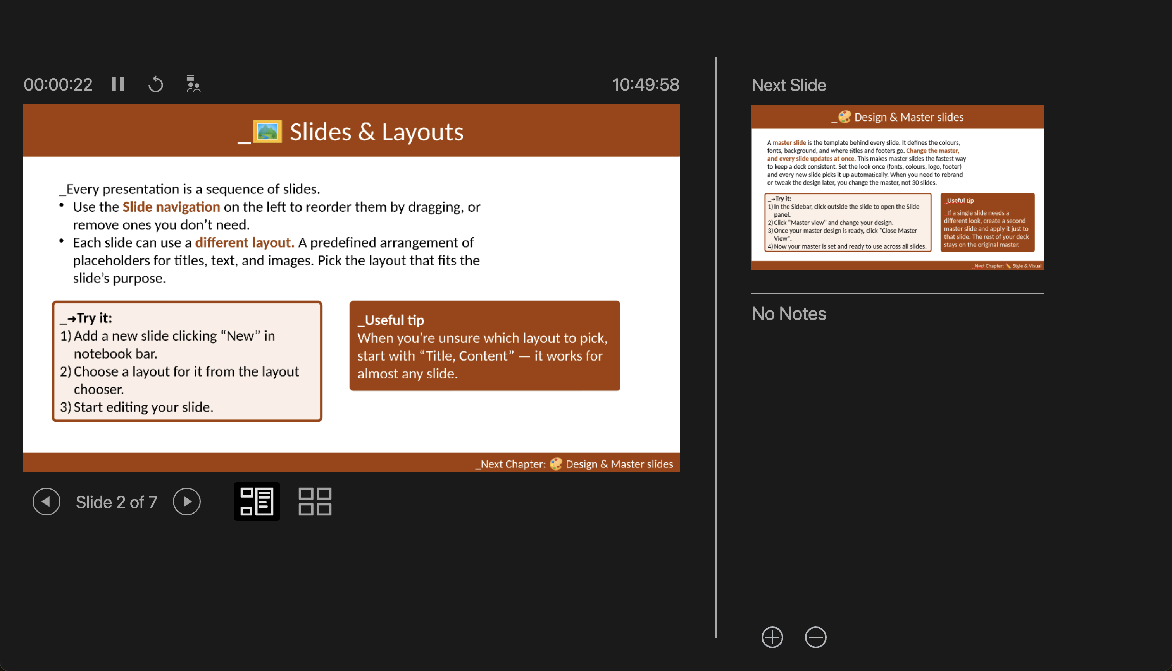
_🎤 Presenting
_When you're ready to present, start your slide show and the Presenter Console opens. You'll see your current slide, the next one coming up, a timer, and your speaker notes, while your audience sees only the slide.
_➜Try it:
_Switch to the View tab in the Notebook bar and open “Notes view”.
_Add a speaker note to your slides.
_When you're ready to present, open the Slide Show tab.
_Pick a slide show option to start presenting.
_Next Chapter: 🤝 Productivity & Collaboration

Slide 7
_🤝 Productivity & Collaboration
_A range of features helps you stay productive and collaborate with others, making it easier to work together and share your decks.
_📤 Document sharing
_Work together in real time. Multiple people can edit the same presentation at once. Click the Share button in the top right to share your document with your colleagues.
_⌨️ Shortcuts
_Keyboard shortcuts speed up your workflow. Find the full list under Help tab in Keyboard shortcuts
_▶️ Video tutorials
_Want to keep learning? Short video introductions cover additional features and help you build on what you’ve learned.
_Check out video tutorials.

