Slide 1
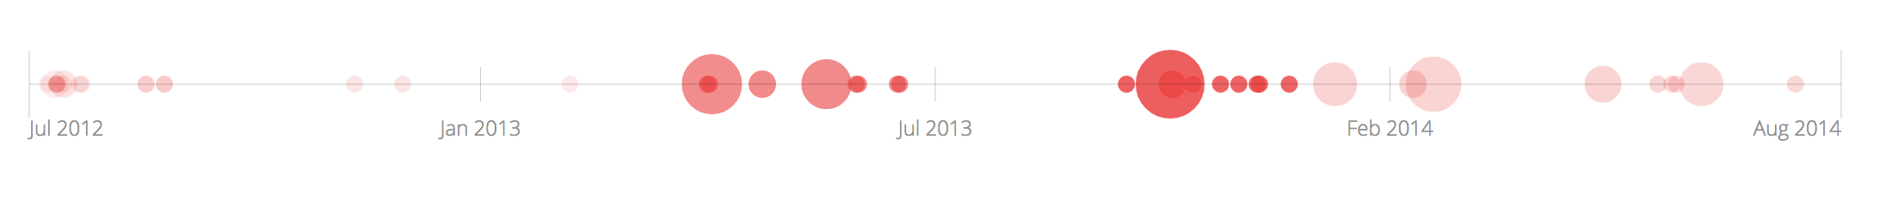
A Quick Introduction to d3.js & Reusable Charts
Olin College, November 11th 2014
Adam Pere
http://adampere.com/d3

Slide 2
Outline
DOM & SVG …so many acronyms
D3
Adding Elements & Chaining Functions
Binding Data
Data Events
Reusable Charts
Assignment

Slide 3

Dom – What is it?
Document Object Model – a tree of HTML elements

Slide 4

SVG – What is that??
Scalable Vector Graphics – A vector based image format
Notes:
Scalable (think type) (illustrator vs photoshop)
Written in xml (so easy for other languages to parse it)
Easy to edit
Easy to program

Slide 5
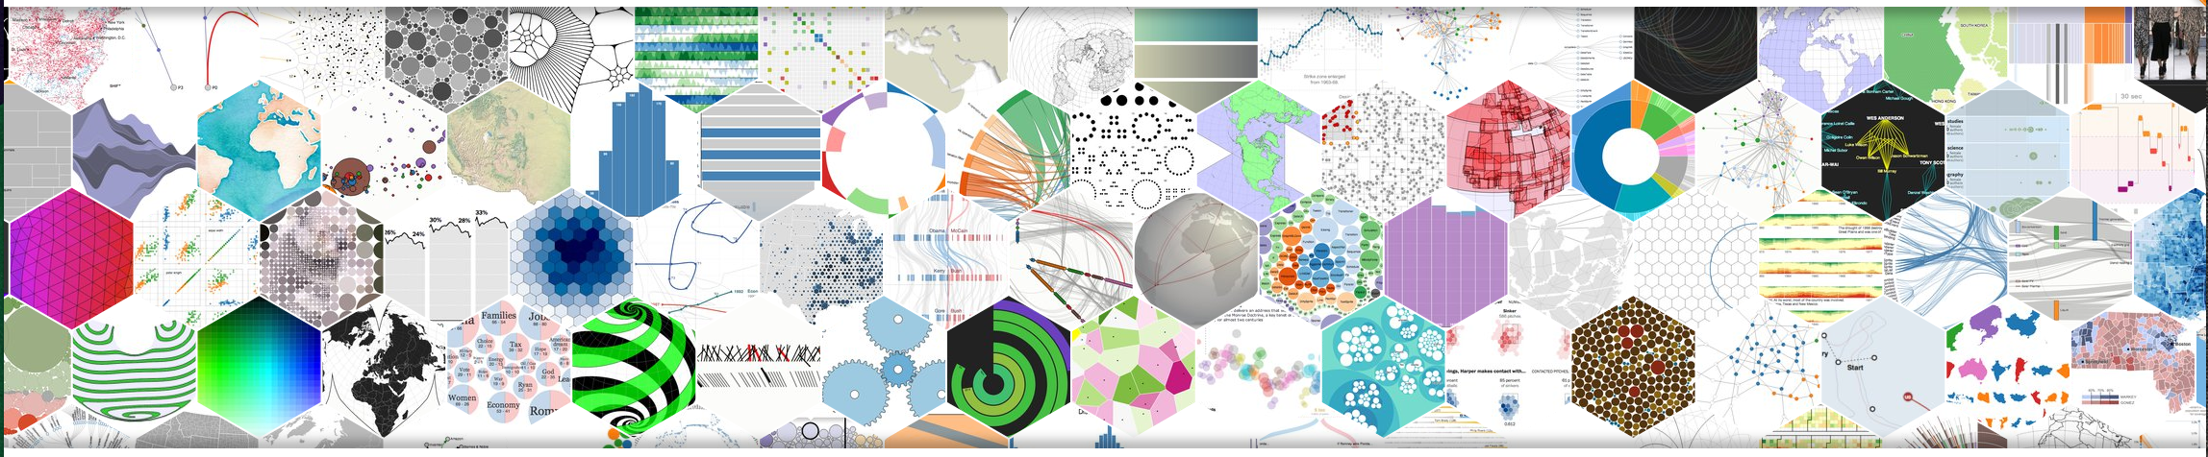
d3.js
A JavaScript Library for manipulating documents based on data.
Examples

Slide 6
d3.js: Chaining & Addition
d3.select("body").append("p").text("New paragraph!");
Making a selection
Appending a new element
Changing a property of that element
link

Slide 7

d3.js: SVG & Transitions
s = d3.select('body')
.append('svg')
.attr('width', 600)
.attr('height', 500)
.style('background-color', '#dcebe9');
Making a selection
Appending a new element
Changing a property of that element
link

Slide 8

d3.js: SVG & Transitions
c = s.append('circle')
.attr('cx', 50)
.attr('cy', 200)
.attr('r', 50)
.attr('fill', 'black')
Making a selection
Appending a new element
Changing a property of that element
link

Slide 9

d3.js: SVG & Transitions
c = s.append('circle')
.attr('cx', 50)
.attr('cy', 200)
.attr('r', 50)
.attr('fill', 'black')
Making a selection
Appending a new element
Changing a property of that element
link

Slide 10
d3.js: Binding Data
var dataset = [ 45, 80, 95, 135, 200, 250, 360 ];
elem = s.selectAll('circle').data(dataset);
Making a selection
link

Slide 11
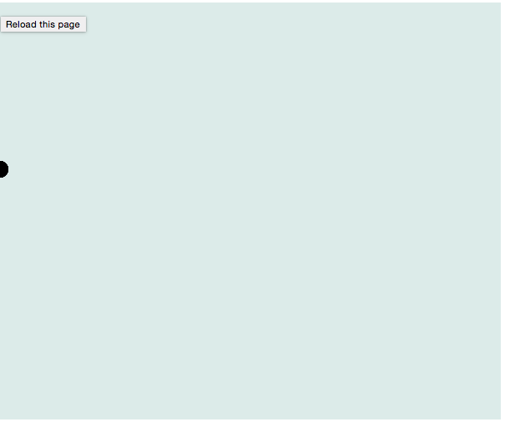
d3.js: Binding Data
elem.enter().append('circle')
.attr('cx', 0)
.attr('cy', 200)
.attr('r', 10)
.attr('fill', 'black');
Making a selection
Appending a new element
Changing a property of that element
link

Slide 12

d3.js: Binding Data
elem.transition()
.duration(1000)
.attr('cx', function(d,i){ return d; });
Making a selection
Appending a new elemen
Changing a property of that element
link

Slide 13
d3.js: Data Events
dataset.pop();
elem = s.selectAll('circle').data(dataset);
elem.exit().transition().duration(1000)
.attr('cy', -100)
.remove();
Making a selection
Changing a property of that element
Removing that element
link

Slide 14
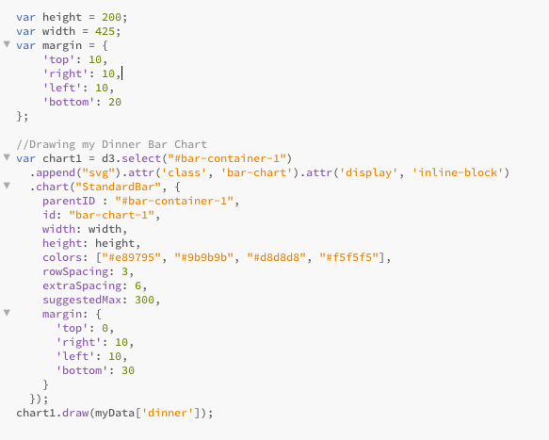
d3.charts.js
A JavaScript Library that allows you to define d3 chart objects and easily instantiate multiple instances of that chart.
Examples

Slide 15
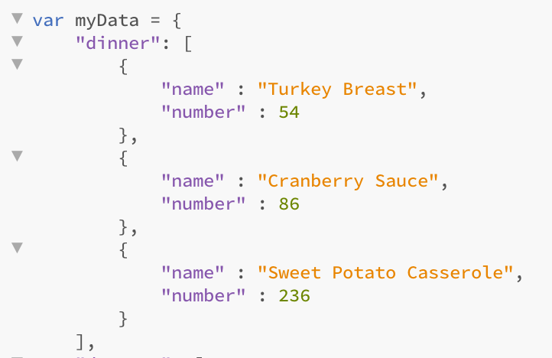
d3.charts.js – Using a Chart

Slide 16

Assignment
Using d3.js & d3.chart.js, you are going to build a simple horizontal bar chart.
Instructions:
Instructions.html

Slide 17
References
DOM Tree: http://www.w3schools.com/js/js_htmldom.asp
SVG: https://s3.amazonaws.com/mixture-mixed/161/6113/assets/images/posts/front-end-dev/im-down-with-svg/gio-difeterici.svg
D3.js http://d3js.org/
D3.chart.js http://misoproject.com/d3-chart/
D3 O’Reily http://alignedleft.com/work/d3-book

