Slide 1
PROFESSOR SCHEDULE MANAGER
Phase 1:
Team Lead : Raul Espinosa
Meeting Taker: Alejandro Perez
Time Keeper: Samuel Yorizzo
System Backup & Unit Backup: Raul Espinosa
Unit Lead & Subsystem Backup: Alejandro Perez
Subsystem Lead & System Backup: David Rocha
System Lead & Subsystem Backup: Samuel Yorizzo
System Backup & Unit Backup :Dayana Gil
Phase 2:
Team Lead : Dayana Gil
Meeting Taker: Raul Espinosa
Time Keeper: David Rocha
System Backup & Unit Backup: Alejandro Perez
System Backup & Subsystem Backup: Dayana Gil
Subsystem Lead & System Backup: Samuel Yorizzo
System Lead & Subsystem Backup: David Roach
Unit Lead & Subsystem Backup : Raul Espinosa

Slide 2
Overview of System
The system was intended to be used for scheduling and time keeping purposes by professors and staff.
The system recorded the professor’s class schedules and issued alerts at 15, 5 and 1 minutes before the end of lectures.
The system kept track of schedule dates and times and informed scheduling conflicts.

Slide 3
System Requirements for Login Use Case
System shall display the login form.
System shall validate username and password.
System shall give the option to cancel login.
System shall inform the user if any of the fields are blank.

Slide 4
System Requirements for Schedule Setup
System shall display schedule setup form.
System shall provide a template for schedule data entry.
User shall enter the following data: class name, start and end date of semester, days and time.
System shall validate data provided by user.
System shall check for conflicts in the schedule.
System shall save the new schedule.
System shall provide the option to cancel schedule setup form.

Slide 5
Overall Testing Approach: Testing techniques
Overall approach was specification-based testing.
Test set selection was done through equivalence partitioning and boundary analysis.
Test were divided into three categories: Unit test, Subsystem test, and System test.
Test cases were further divided into sunny day tests and rainy day tests.

Slide 6
Overall Testing Approach: Testing tools
Unit Testing Tools: Eclipse environment for running the program, JUnit for running test cases and Mockito for mocking classes.
Subsystem Testing Tools: Eclipse environment for running the program, JUnit for running test cases and Mockito for mocking classes.
System Testing Tools: Eclipse environment for running the program and IBM Rational Functional Tester for running test cases.

Slide 7
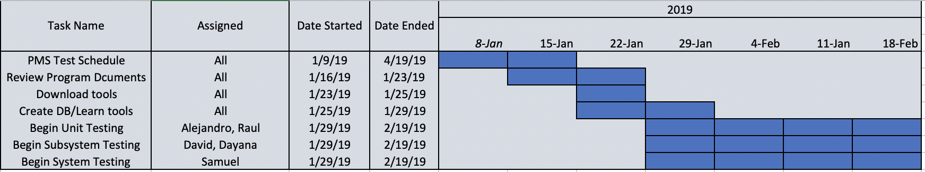
Test Schedule

Slide 8
Hardware and Software Requirements
Hardware Requirements:
Machine 1 (laptop)
Processor: 2.8GHz dual-core Intel core i7
RAM 16GB
Machine 2 (laptop)
1.6GHz Intel core i5
RAM 4GB
Machine 3 (laptop)
3.1GHz Intel core i5
RAM 8GB
Machine 4 (laptop)
2.4GHz Intel core i5
RAM 8GB
Software Requirements:
Eclipse Oxygen.3a Release (4.7.3a)
Google Chrome Browser Version 72.0.3626.109
JUnit (version 4.12): Framework for unit testing
Mockito (mockito-core 2.23.4): Framework for mocking.
MySQL (version 8.0.15): database management system
RFT (version 9.2.1): Framework for system testing.

Slide 9
Features Tested
Tested:
Login
Logout
Authenticate
Schedule Setup
Schedule Edit
Message popup
Database access

Slide 10
Features Not Tested
Not tested (or not implemented)
Password Idle
End Semester Cleanup
Presentation Setup
Exam Setup
Single Day Setup
Features
Alarm

Slide 11
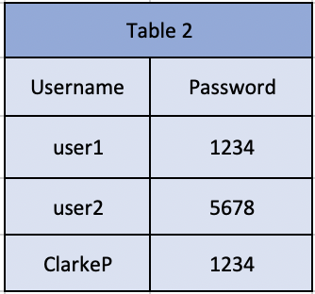
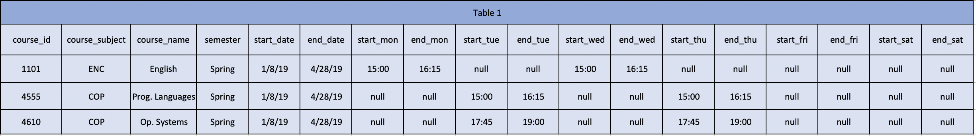
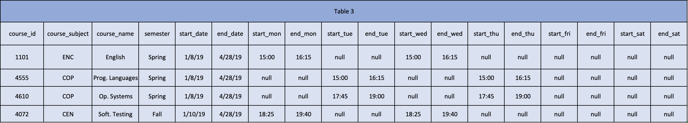
Test Reference Tables

Slide 12
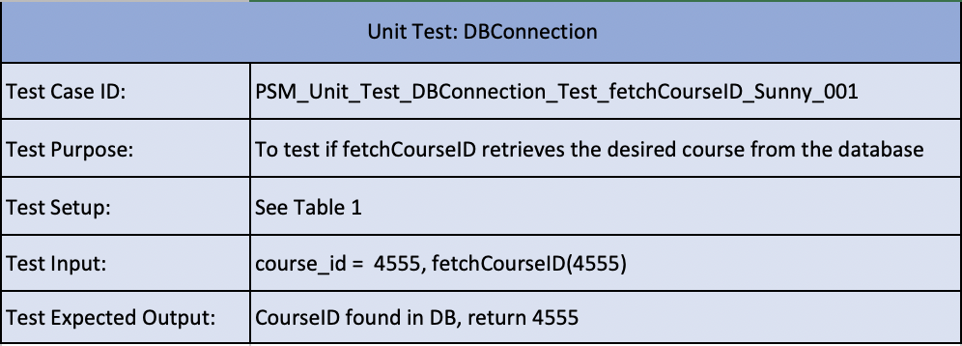
Unit Testing

Slide 13
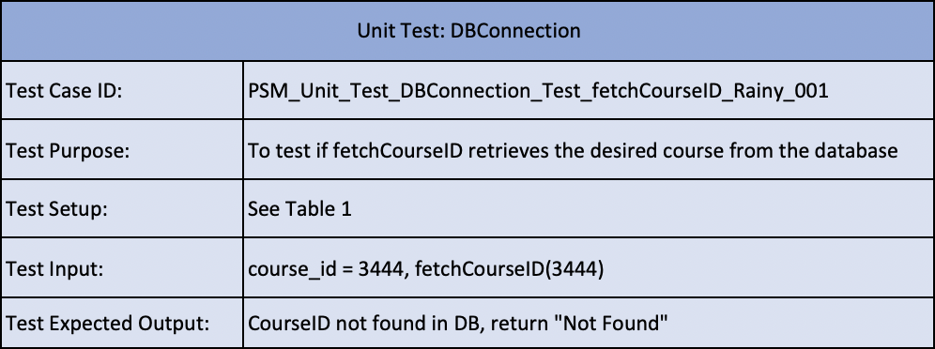
Unit Testing

Slide 14
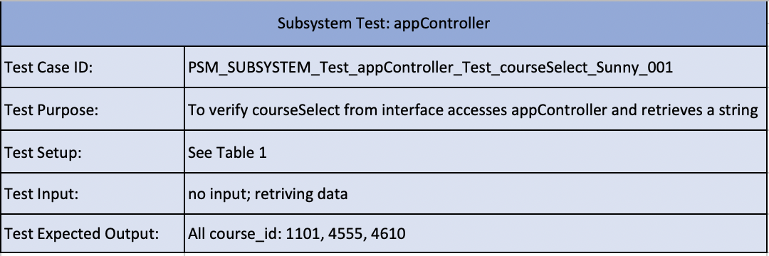
Subsystem testing

Slide 15
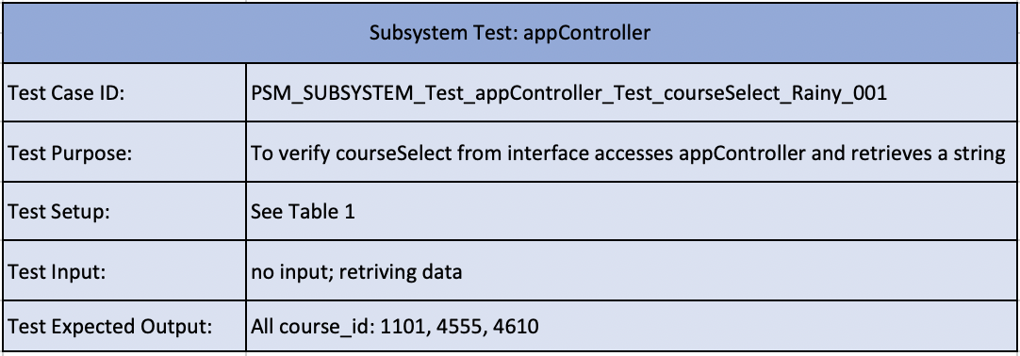
Subsystem testing

Slide 16
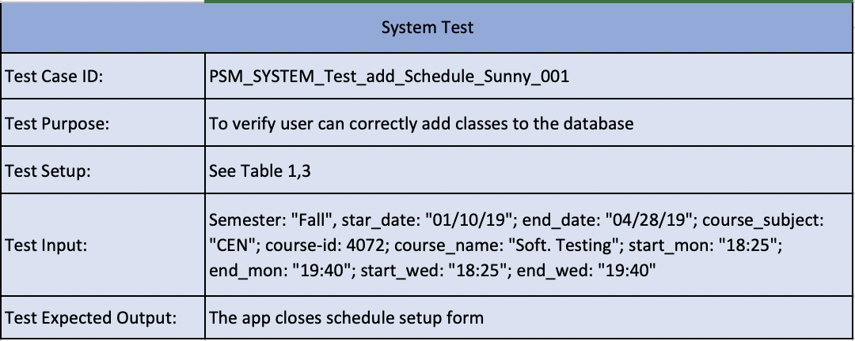
System test

Slide 17
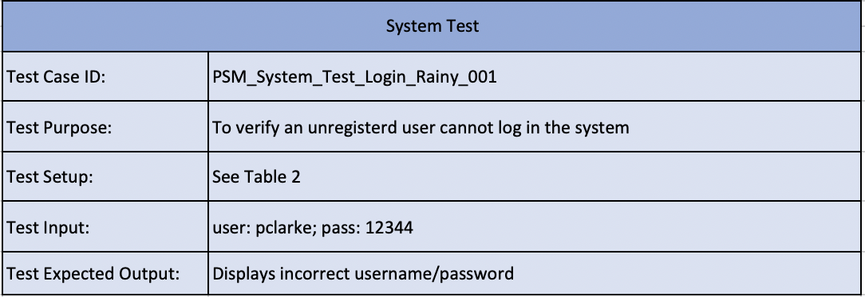
System test

Slide 18
SHOW DEMO
THANK YOU

