Slide 1

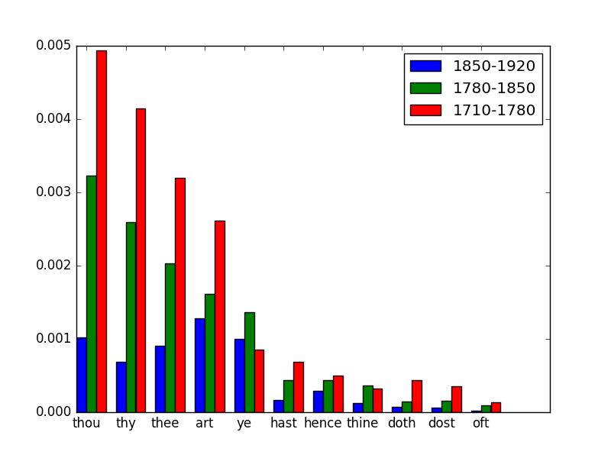
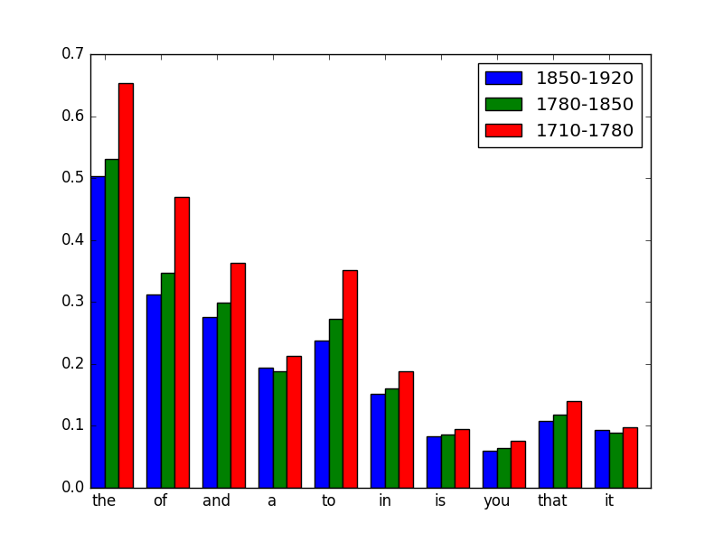
Historical Textual Analysis
Authors:
Alex Perez
Yakov Neshcheretnyy
CS 585
University of Massachusetts Amherst
Intro and Data
Research Questions
Can we look at a written document and tell you when it was made with certainty?
What can we learn about the evolution of writing over time?
Data:
Corpus of Late Modern English Texts (CLMET)
Corpus ranges from 1710’s-1920’s (333 texts)
Corpus
30 year intervals
Splitting the Data:
70 year intervals
42 year intervals
3 periods
5 periods
7 periods
Model
7 periods
Historical Text
5 periods
K-Folds
(10 folds)
Multinomial NB
Analysis
3 Periods
Predicted
Date Range
Results
Probability of Shakespearean words at each period
Probability common of word at each period
Probability
Probability
Conclusion
Using the 3 period approach we can determine the progression of words through these periods with 84.02% precision.
Lots more training data is needed to accurately predict more specific time periods.
The more specific you get the less significant difference you have between texts of that time.
By creating more classes you have to divide up your training set into all those classes therefore you need a lot more data to keep up an accurate training regiment.

