Slide 1

G2M Case Study
Company Name: XYZ Firm
Date: 21-Jan-2023
Name: Andrea Perez

Slide 2
Business Problem
The Client:
XYZ is a private firm in US. Due to remarkable growth in the Cab Industry in last few years and multiple key players in the market, it is planning for an investment in Cab industry and as per their Go-to-Market(G2M) strategy they want to understand the market before taking final decision.
Business Questions:
Does the margin proportionally increase with the number of customers?
What is the average price charged by Cab companies to customers?
Which company has the maximum Cab users at a particular time period?
What are the attributes of these customer segments?
The analysis has been divided into the following:
Data Understanding and Cleaning.
Finding whether the margin proportionally increases with an increased number of customers.
Averaging the prices charged by Cab companies.
Maximum cab users at a particular time period.
Customer attributes.

Slide 3
Data Intake Report
Name: G2M insight for Cab Investment firm
Report Date: 11-January-2023
Internship Batch: LISUM17
Features: 17
Data intake by: Andrea Perez
Cab_Data.csv
Customer_ID.csv
Transaction_ID.csv
City.csv
Final cab data

Slide 4
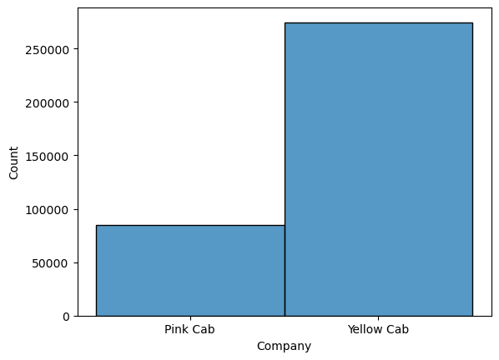
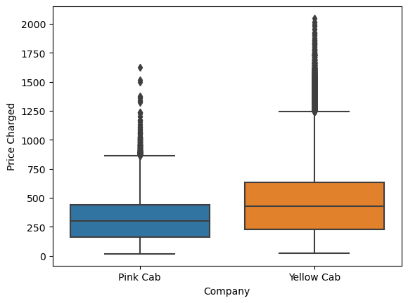
Profit Analysis
1. Does the margin proportionally increase with the number of customers?
The margin proportionally does increase because the Yellow Cab has more customers and charges more than the Pink Cab.

Slide 5
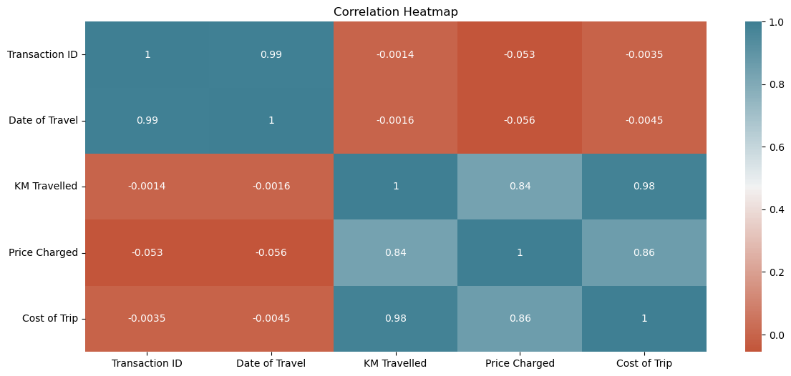
2. What is the average price charged for Cab companies to customers?
The average price charge for Cab companies is $4.23.
KM Travelled, and Cost of Trip are correlated.

Slide 6
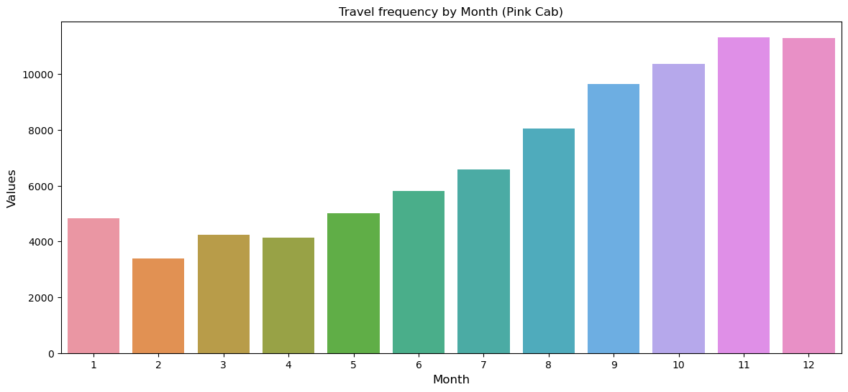
3. Which company has the maximum Cab users at a particular time period?

Slide 7
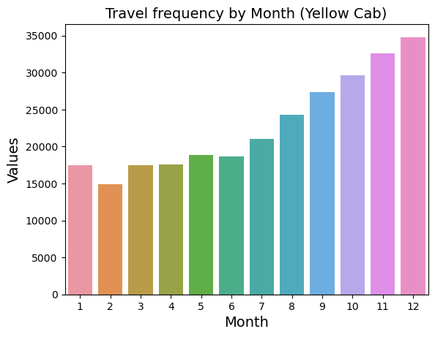
Continue…
The Yellow Cab has more customers in December during the Holidays compared to the Pink Cab.

Slide 8
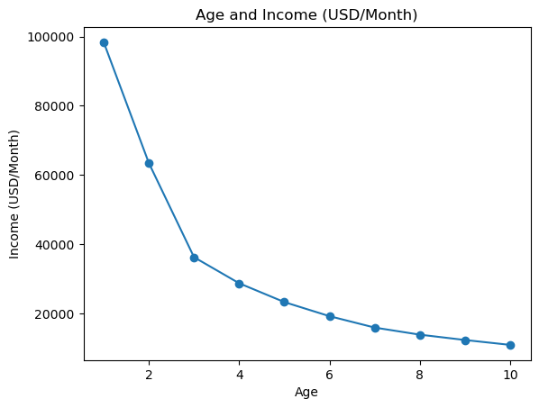
4. What are the attributes of these customer segments?
People in their early 30’s that make $30,000 or more take more cabs.

Slide 9
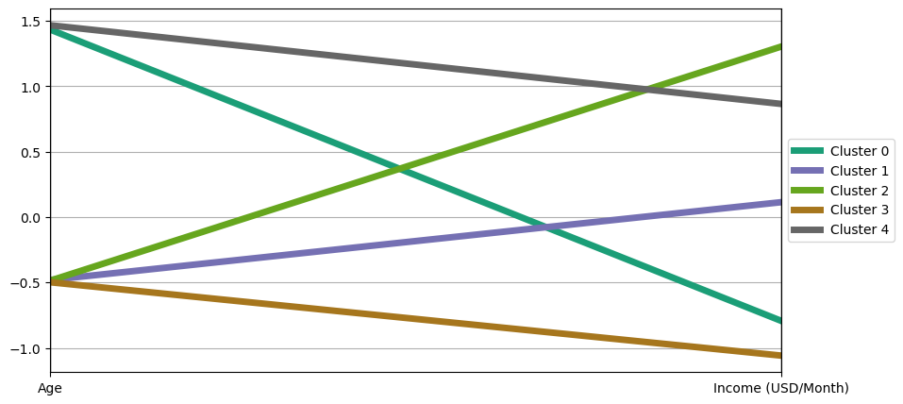
Age and Income clusters are parallel to each other.

Slide 10
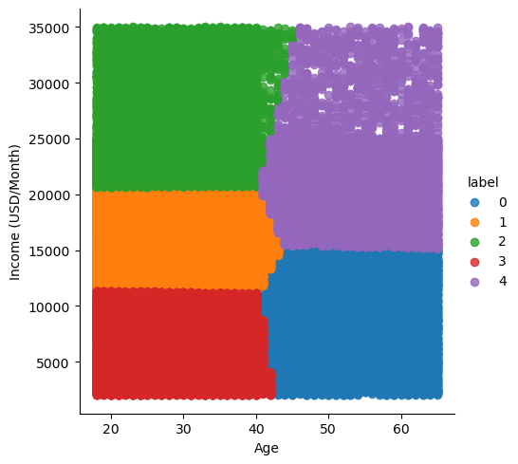
Age and Income form different clusters.

Slide 11
Recommendations
What Cab company should XYZ Firm choose?
They should choose Yellow cab because it was more customers than Pink cab, and they make more money overall.
What would be two critical factors that would help make XYZ Firm successful?
How much a customer travels and how much a customer is willing to pay for the price of a cab.
When should XYZ expect to make the most money?
They should expect to make more money during December with the Cab company Yellow Cab.
What audience should XYZ market to the most?
They should market to all genders in their early 30s, which make more than $30,000 of income.

Slide 12
Thank You So Much!

