Slide 1

Nine years of dumps at Wikimedia

Slide 2

About the speaker
Dumps wrangler for 9 years at WMF
SRE team member for $reasons
IRC: apergos or atglenn
Wikis: ArielGlenn
Gender: nonbinary
Age: git offa my lawn!
Notes:
Once upon a time in San Francisco I was cursing the (lack of) dumps, delayed yet again. I was a volunteer contributor to the projects with Greek Wiktionary as my base. The WMF was a small shop in those days, though I had no idea how small then, just 20 people! “If I ever get hired there I’m going to take over these dumps, I swear,” I grumbled under my breath as I sent them a resume.
Ten years later, here we are...

Slide 3
What are these dumps?
TL;DR: dumps of content and metadata of Wikipedia and all other Wikimedia projects
Long version: some db tables in sql format, page/revision content and metadata in xml format, edit logs in xml format, short abstracts of articles in xml format, site information in json format, checksums of everything
Cost: free to you
License: CC-BY-SA, reuse and share everything please!
More details: meta.wikimedia.org/wiki/Data_dumps
Notes:
All our content is free: free of cost but also free to read, to share, to reuse, to modify. Forever.
You want to make your own copy and do it better? Cool!
You want to make a copy of Wikipedia for offline use? Awesome!
How do you do that? First, get the content!

Slide 4
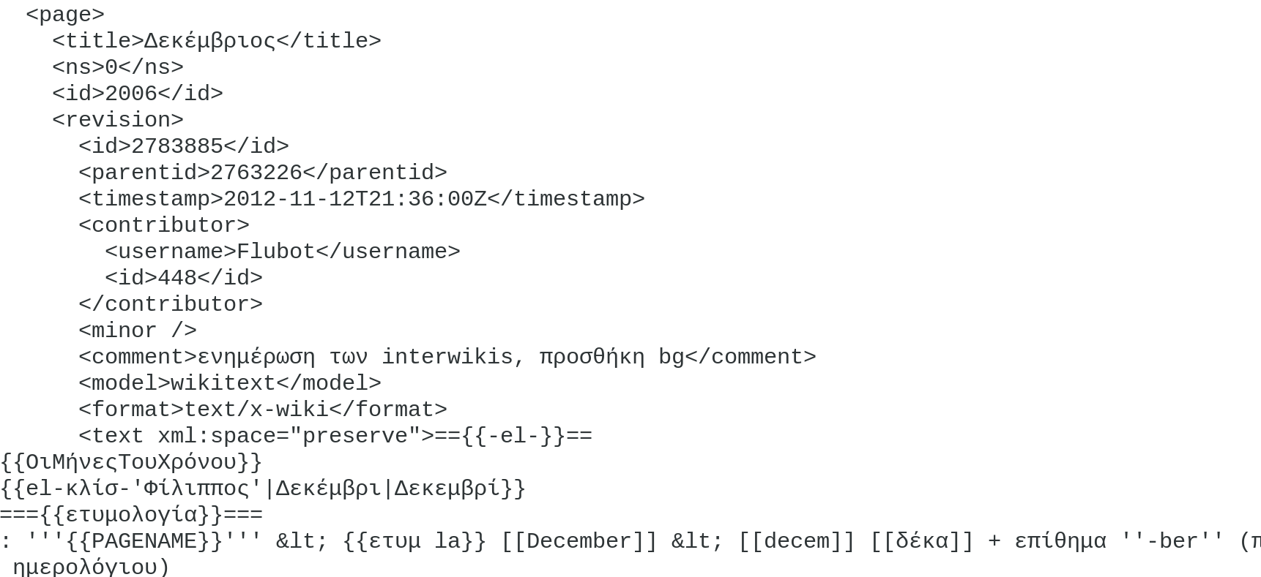
Sample xml output
Notes:
The xml formatted files are pretty readable if you have spent a little time contributing to the Wikimedia projects or if you’ve looked at the database schema at all.
Here’s the quick flyby version, in case you are coming to this for the first time:
Every article you read is a ‘page’. Every edit is a ‘revision’ and once a revision is written it never changes, it’s never truly deleted. We can hide it from the general public (or even from privileged editors) but it remains in the database.
Every edit is done by someone, either a logged in user or someone we record by their IP address.
Some edits are marked ‘minor’ by the editor because they correct a typo or some small thing like that, and many reviewers don’t bother looking at those.
Some edits might be to javascript or other things; edits to articles are generally ‘wikitext’, MediaWiki’s own markup language.

Slide 5
Who uses these?
Researchers
Editors
Sites with mirrors
Colleagues at WMF
Folks working in NLP
Offline wiki reader projects
Notes:
We don’t have a good way to keep track of who uses them. Basically, I have to google around, or I change a feature and someone using that feature tells me off…
There’s a mailing list but I’ve no idea who there are current readers, who pays attention, what they do with the dumps if anything, etc.

Slide 6
(Some) derived datasets
DBpedia (2016): NIF-annotated article texts, 6.6 million entities containing variously abstracts, geo coordinates and depictions, as RDF triples
T-REx (2017): 11 million alignments from 3.09 million DBpedia abstracts and Wikidata entity triples, in ttf or json format
HotpotQA (2018): 113k Wikipedia-based “multi-hop” question-answer pairs
Wikitext-103 (2016): 28,595 Wikipedia articles, 103 million tokens, 267,735 unique tokens, WikiText-2 (2016) 2 million tokens
DAWT (2018) 13.5 million articles in 6 languages densely annotated with Freebase IDs
SEW (2016): sense-annotated Wikipedia corpus with over 200 million annotations
Wiki-Talk (2016): 95 million user and article talk diffs, 1 million crowd-sourced annotations of 100k diffs
LTS2 NRC (2019): queryable graph dataset containing 5.7 million article and 1.7 million category nodes, along with a timeseries dataset containing page views information
...and many more
Notes:
Now that ML and especially deep learning have had a rennaisance, NLP is a fast moving field and Wikipedia is used to generate corpuses of all kinds.
DBPedia might be the first large project to put some structure on the dumps on a regular basis, but since then it’s all the rage…
Multi-hop, if you don’t know the term, means questions for which more than one sentence has to be analysed and retrieved in order to answer the question.
Graph data is another popular use, with editing networks or category mappings as the end result.

Slide 7
Generating datasets from latest dumps
https://github.com/dbpedia/extraction-framework
https://github.com/hadyelsahar/RE-NLG-Dataset
https://github.com/epfl-lts2/sparkwiki
https://github.com/yfiua/wiki-talk-parser
https://github.com/idio/wiki2vec
https://github.com/LuminosoInsight/wikiparsec
https://github.com/JonathanRaiman/wikipedia_ner
https://github.com/attardi/wikiextractor
https://github.com/facebookresearch/fastText/
…and many more
Notes:
Most researchers post their datasets, withnotable exceptions (GPT-2). Some post the code used to generate those datasets, in the cases where manual cleanup or crowdsourced annotation is not necessary. The above vary from methods of extraction of the plain text of articles to Word2Vec vectors for Dbpedia Entities to alignments between DBpedia abstracts and Wikidata triples to a representation of the network of Wikipedia editors and their interactions on talk pages.

Slide 8
Machine learning from the dumps
Building up Ontologies with Property Axioms from Wikipedia (2018)
BERT: Pre-training of Deep Bidirectional Transformers for Language Understanding (2018)
Universal Neural Machine Translation for Extremely Low Resource Languages (2018)
Automated Speech Generation from UN General Assembly Statements:Mapping Risks in AI Generated Texts (2019)
Learning to Interpret Satellite Images Using Wikipedia (2018)
A Cost Efficient Approach to Correct OCR Errors in Large Document Collections (2019)
ERNIE: Enhanced Language Representation with Informative Entities (2019)
...and many more
Notes:
Just as great strides in image classification and generation were made in 2012 by one team opening the door for others (AlexNet), so BERT and its precursors seem to have done in 2018 for NLP. The 30,000 feet flyby version: instead of downloading word2vec datasets and using them to train your model, you download a pretrained model and fine tune it for your use case.
An example: one research team took an AWD-LSTM model trained on Wikitext-103 (we saw that i the list of datasets), fine-tuned it on the UNGA speeches dataset, and used the result to generate paragraphs of text seemingly issued by the UN Sec. General. Many such snippets were passable; imagine in a few years...

Slide 9
Dump use by bots/editors
AutoWikiBrowser – script-assisted bulk editing
Wikipedia:WikiProject Check Wikipedia
Wikidata Navel Gazer (statement addition counts)
Wikipedia:Typo Team corrections of typos, grammatical errors, and so on
PyWikiBot (via replace.py)
Many uses of the wikidata entity dumps, but someone else should give that talk!
Notes:
If you’re working just with a small subset of pages, you probably want to grab them via the MediaWiki API, right off the web.
If you need to do anything that involves scanning all articles, or even most of them, dumps are the way to go.
Particularly on smaller wikis this is pretty common. When I was involved in the Greek language Wiktionary we all used these dumps all the time (hence my aggravation when they were broken :-)).
PyWikiBot is one of the most popular python bot frameworks and we used it all the time.
AWB is meant to be used for bulk corrections where a human intervenes, and it also can pull in the dumps for use.

Slide 10
Other wiki-related dumps projects
Kiwix Wikivoyage travel app
OpenZIM offline Wikipedia
XOWA local Wiki project mirror
Wikipedia-based cultural knowledge quiz (“Test Your Culture”)
Analysis of Wikipedia edit networks
WikiEd Error Corpus of corrected edits
...and, you know the drill: many more!
Notes:
Off line readers are one of the great ways to re-use these dumps. Setting up mirrors for local communities with unreliable or low bandwidth Internet access is another.
The cultural knowledge quiz is a research project masquerading as a game. For English language speakers only, however. Why not Japanese, or Arabic?
WikiEd: woops, that’s not actually Wikipedia-oriented. The corpus, originally derived from dumps of the English language Wikipedia, can be used for training models for spelling and/or grammatical corrections in English, and now also in German and Polish.

Slide 11
Dump file converters and parsers
Xml to csv: https://github.com/Grasia/wiki-scripts/tree/master/wiki_dump_parser
Load into Mongo: https://github.com/spencermountain/dumpster-dive/blob/master/README.md
Xml to JSON: https://radimrehurek.com/gensim/scripts/segment_wiki.html
Xml to SQL: https://github.com/wikimedia/mediawiki-tools-mwdumper
Load into Hadoop: https://github.com/weikaolun/wikipedia-map-reduce
Parser/querier: https://github.com/mediawiki-utilities/python-mwviews
Load into ElasticSearch: https://github.com/AlonEirew/wikipedia-to-elastic
Many Xml to text converters and extractors...
Notes:
When we talk about ‘parsing’ here, we do not mean ‘expanding the revision content, written in the dumps in its raw wikitext format, into HTML’. We mean extracting various sorts of information, either metadata or revision content, from the dumps and doing something with it.
Shovelling them into Hadoop is quite popular and used by many folks in NLP/machine learning, so there’s a number of workflows for that.
Then we have more specialized uses: JSON, cv, getting them into some database or other.
As for tools that extract the revision content and try to massage it in some way, filtering out infoboxes and tables or generating summaries or what have you, there a a number of these. Heck, I wrote a (really awful) one back when I first introduced the ‘multistream dumps’, just to show that those dumps would be useful.

Slide 12
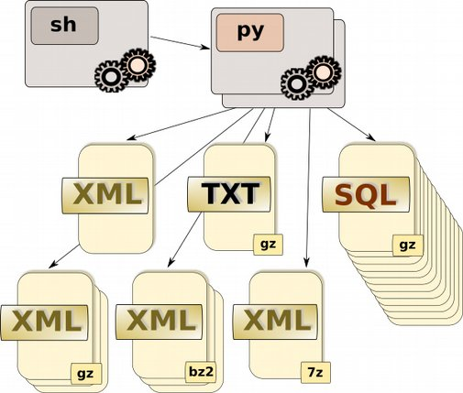
Simpler times
2 bash scripts
3 python scripts
1513 lines of code
WAT? That’s all?
Yep, that’s all!
Note: one of the two bash scripts and one of the three python scripts are just for producing the main index.html file and are not shown in the diagram.
Notes:
Back when I started on the dumps, waaaay back in 2009 which was practically aeons ago in Internet time scales, this is what the dumps looked like.
The main runners were one shell script which started one python script which read one library module, and that is all.
It was very simple indeed. Until it wasn’t.

Slide 13
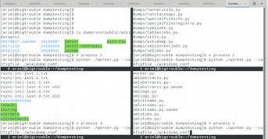
Multiple processes, one host
One process in screen session
A second process? A second window in screen session
A third process? 3 windows
27 usable cores? 27 windows…
Split each window 4 ways, still 7 windows total
Notes:
Exhibit A: starting the script.
There is a lock mechanism so that multiple copies of the script can run at once on the same or on several hosts. So, if you have a lot of wikis (even then we had a LOT of wikis), you can run several copies and they can all crunch away, starting with whichever wiki has gone longest without a dump.
But there was no nice way to start up the script. You want one copy? Start up a screen session. You want multiple copies? Start up multiple windows in a screen session. You have a beef 32 core host and want as many copies as can run (with a few spare cores)? Welp.

Slide 14

Multiple processes, multiple hosts
One host? 7 screen windows on that host
2 hosts? 14 screen windows on 2 hosts
3 hosts? You know the drill
Notes:
And now let’s say you want to expand to more than one host. Because, you know, content grows and grows and grows, and so dumps take longer and longer.
Welp. That’s tedious.

Slide 15

When does a dump run complete?
Never. It just keeps running...and running...and running
Wiki waiting longest for a dump starts next
Notes:
So the thing about a run of the dumps. There really wasn’t “one run”. Every copy of the script would just keep on looking for the oldest wiki without a dump, run that, move on to the next one… They just kept running forever.
That meant you couldn’t really start out of cron; you could take a box down for maintenance but you’d have to restart all those dang scripts by hand again, etc.

Slide 16

What if something breaks?
Notes:
I know you’re dying to ask me this. So go ahead. Ask me.

Slide 17
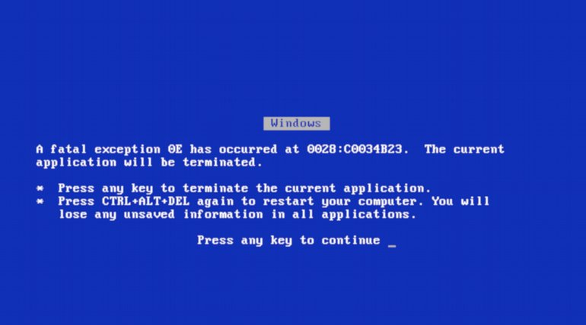
It’s broken.
Notes:
Yeah well. If it breaks, it breaks. If some item failed (like the dump of an sql table, or the dump of article content), it would be retried. If it failed more than a few times, the script would move on to the next item. Crucially, there was no way to rerun the failed items.
See, these dumps were written for a simpler time when they ran fast and just starting them over from the beginning was fine. Back when the projects were small! So to recover from a failure, you just waited for the wiki’s turn to come around again after cycling through all the other wikis.

Slide 18

Other wiki dumps run but...
One dump run = sql tables, revision metadata, revision content, logging data, site info
Days to complete
Must start over from the beginning!
Notes:
There was no way to rerun just one dump item. Page content broke? You’d be dumping all the sql tables and the stubs again first, for that wiki… when its turn came around again.
There was no way to rerun one dump item from where it broke. Page content took days to run, and it broke? Ouch.

Slide 19

Cascading failures?
We got ‘em right here.
MediaWiki deploys, bad data, one dump job dependent on the next dependent on the next, etc.
Notes:
Code that breaks the ‘stubs’ dumps (metadata for each revision) is the worst. The three types of content dumps can’t proceed without these; the multistream content dumps can’t run without the regular content dumps; and for large wikis, all the jobs that recombine content files into a single file can’t run either.
A bad revision handled poorly within MediaWiki can break stubs, abstracts and content dumps for any job containing that revision.

Slide 20

Broken
Notes:
So what do we do about it?

Slide 21
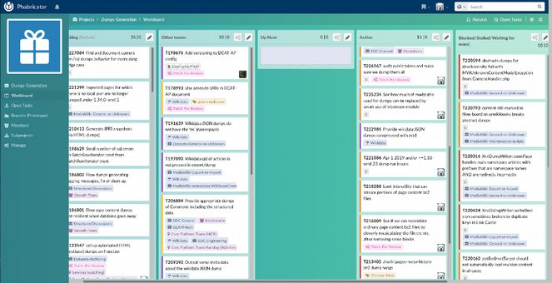
Fixing bugs is interrupt-driven
Never time to do it right
Always time to do it over
And over…and over… and over
Cheapest approach: restart broken jobs by hand, check results periodically, rest of the time write and test code
Notes:
One thing we don’t do is sit down and plan a careful strategy. Sadly, this is an interrupt-driven process. Whatever is the most urgent at the moment gets attention, until it’s mostly handled and/or the next most urgent thing emerges.
This is a consequence of the allocation of too few resources: running to stand still, firefighting rather than architecting.

Slide 22
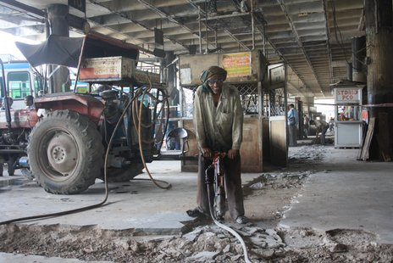
Breaking up the monolith
Each job got a separate status entry
On rerun, successful jobs skipped
Failed/waiting jobs rerun
Notes:
Nonetheless, some things got done and still get done via the interrupt-driven model.
First off was to split up a dump run for a wiki into its separate jobs and make them rerunnable by themselves.
We did this by writing status information for each job separately, and adding an option to skip successfully completed jobs when running. Not sure why it’s an option, since we always pass that flag.
Anyways, the point is that only failed jobs will be rerun, even if we restart the run from the beginning.

Slide 23

Long-running jobs are long
English language Wikipedia revision history content dump job: 16 days (2008!!)
Proof: see the March 2010 archives on https://dumps.wikimedia.org
Notes:
That’s nice and everything, but single jobs themselves can take a looooong time to run. Here’s how things were in 2008 before the dumps came to me.
Imagine the revsion history dump runs for 15 days, so close! And then the db server goes away in the middle of a connection. Welp! Guess we’ll run that job from the beginning again. See you in another two weeks.

Slide 24

Break long jobs into pieces
Revision history dumps… bz2 and 7z
Current revision dumps
Articles dumps
Metadata dumps
Notes:
If we split long running jobs into several pieces and run them in parallel, we can get done much faster.
Rerunning them is faster too.
Having some beefy machines helps with this: 32 cores, of which we use 27 for dumps and the rest for misc stuff like puppet, get the job done.
For smaller wikis, the history dumps can still take a long time. If they take longer than 2 days to complete, we promote them up to dump various page ranges in parallel.

Slide 25
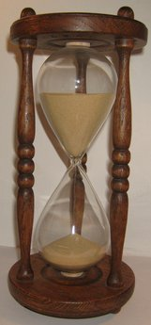
But long-running jobs are still long
27 pieces, 10 days (2011!!)
Proof: Aug 11 2011 archive.org dumps index.html for enwiki 20110722 run
Notes:
https://web.archive.org/web/20110811001813/http://dumps.wikimedia.org/enwiki/20110722/
Wikipedia keeps getting larger, so dumps will keep taking longer. So only 2 years after taking over the dumps, with parallelization, it still took 10 days to complete the revision history dumps for the Engligh language Wikipedia.

Slide 26
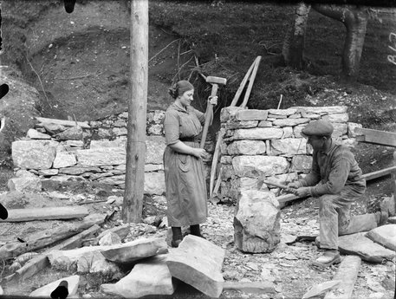
Need moar pieces!
‘Checkpoint’ files: close a file after so many hours, open a new one
Later: dump by page range, no checkpoints needed
Notes:
Suppose we closed an output file after so many hours and started a new one? If first and last page number were written into the file name, we could rerun the job by looking for incomplete files or for page ranges that were missing, and just produce those.
We didn’t want dumps users to have to download thousands of files, so 12 hours was chosen as a good compromise.
This mechanism worked but was a little clunky. Why not figure out the page ranges in advance, so that each file would take around 12 hours or less to produce, and then dump those as separate files? So that’s what we do.

Slide 27

Even moar pieces
Abstracts and page logs split up
Output for each stubs piece done in retryable batches
Later: same for abstracts, logs
Notes:
There were other long running jobs too; abstracts dumps require us to look at the current content for every page, in order to extract an ‘abstract’ of it. So these too were parallelized.
Stubs dumps were reconfigured so that metadata for a very small number of pages would be written to a temp file, and then this passed to gzip once written, to land in the output file. If the dump to the temp file failed, it could be retried a few times; this would get us past things like network connectivity issues or a database server being temporarily unavailable.
This same approach was implemented for abstract dumps, and page log information.

Slide 28

Reassembling the pieces
Dd is your friend
Gz multistream files
Bz2 multistream files
More in progress
Notes:
Now we have all these small files, each with their own XML header and footer. And many users want to download one complete file, rather than a bunch of small ones. Naturally each should have only one XML header and footer in them.
First attempts to recombine them used this horrible (b)zcat | tail (strip header) | head (strip footer) pipeline for all these files. Zcat isn’t awful as far as speed but it’s a waste of resources to uncompress and recompress all those files.
So… we wrote the XML headers and footers as gzipped entities in their own right, wrote the body as a gzipped entity, and used the fact that catting multiple gzipped things together produces valid gzip output according to the spec.
By looking for start of gzip file markers, we could find the offset of the body start/end in each file, and use dd to write the combined output.

Slide 29
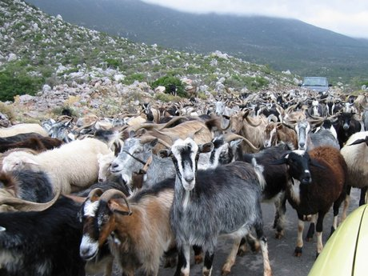
On to the next problem: fairness
Big wikis still take a long time
Small wikis get blocked waiting for big wikis to finish
Sadness!
Notes:
As one of the contributors to a small Wikimedia project, I was always waiting for enwiki and dewiki to get done before ours would have a hope of running.
And so was everyone else on a smaller project.
I know there’s a tendency to give more resources to the more successful or more visible enterprises; ‘the rich get richer’, as they say. But we wanted to operate differently.

Slide 30
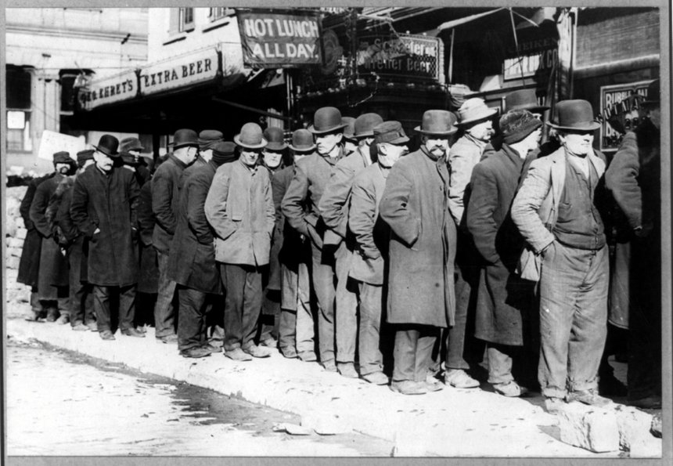
Queues
Notes:
If only there were some sort of mechanism for letting jobs wait in separate lines...

Slide 31
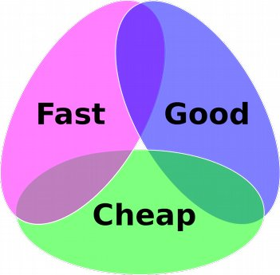
Queues on the cheap
Huge wikis in their own queues (en, wikidata)
Big wikis in a list (de, ru, zh, fr…)
Everything else in third queue
‘Everything’ jobs run before big wiki jobs, for each stage
Notes:
Like everything else, we don’t have time to do a real implementation, but we can do something fast and cheap.
Just split up the wikis into lists, so that if a big wiki is taking a long time, as it will, at least it’s only blocking the other big wikis.
Put the huge wikis each in their own queue; they take up the entire run time by themselves anyways.
The small wikis can whiz by and get done as a set before the rest, but that’s just fine!

Slide 32
Queues ~ hosts
Dedicated server for enwiki, runs other queue jobs when done
Dedicated server for wikidata, same
3 more hosts that run small/big wiki jobs
All wikis complete one job (or fail to max retries) before next one started
Notes:
The big and small wikis run jobs in groups together. First, the small wikis dump all the sql tables, and write out stub (revision metadata) files. Then the big wikis do that.
Next the small wikis write out current revision content for articles, and repackage it as a multistream dump. Then the big wikis do that.
After that the small wikis write out current metadata content for all pages… and then the big wikis.
Now the big hog: the small wikis write out revision content for all revisions, including past ones. Once they are done, the big wikis do that.
Because all the preceding steps don’t take so long, until we get to revision history content for the big wikis, most people have the files they need in short order and the rest would be waiting for big wikis to complete anyways.

Slide 33
Dump runs and stages and jobs, oh my!
Job: produce this set of files with a single command
Example: stubs (revision metadata) for articles, current revs, all revs = ONE job
Stage: run these jobs one after another, for a single wiki, then move to the next wiki
Example: stubs, then sql tables = ONE stage
Notes:
Naming is hard.
A job produces one or a set of variant output files. Stubs dumps: a job. List of all page titles: a job. Note that stubs dumps write THREE files out all at the same time, but those three are still from ONE job.
Stage: a collection of jobs to be run on each wiki in a group. We dump sql tables for a wiki and then immediately dump the revision metadata for the same wiki, so that there won’t be too much ‘drift’ between the files. That’s a ‘stage’.
Run: Dumping all the files for all the wikis and then stopping. Yes, dumps stop now! No more forever running hamsters.

Slide 34
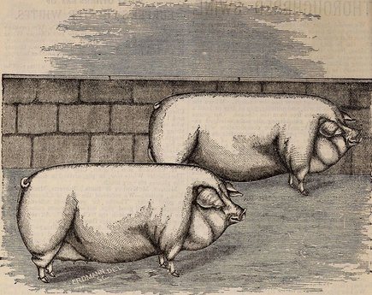
Not all dump runs are created equal
‘Full’ runs: Do every job we know about
‘Partial’ runs: skip the really long jobs (revision content for every revision ever) but still mark these dumps as ‘done’.
Rerun from command line without need to know type of run
Notes:
Just like some pigs are more equal than others, some dump runs have more to offer than others.
Those revision history content dumps take too long to produce on every run and get two runs a month out. And they will only grow slower over time.
Solution: don’t do them every run!
‘Full’ runs on the 1st of the month do everything.
‘Partial’ runs on the 20th of the month do everything but historical content.

Slide 35

Stage details
Stages are run by a per-server scheduler
Config: List of possible stages in order, resources (cores) needed per stage, # workers to run per stage
Notes:
Backstage details:
There’s a ‘scheduler’ which reads the config file listing all the stages.
A stage is described with the number of cpu cores it needs, the number of workers that should be fired up to complete it (which can be up to ‘max’, the number of cores we declare available in a central dumpsconfig), whether to give up on failure of a worker or to continue processing commands, a setting for email notification on error if desired, and the command to run.
A process can take more than one core because it runs a job via several processes in parallel (revision content dumps with several page ranges happening at once).

Slide 36
When a worker completes a stage
Stage finished for one wiki; worker checks for the next wiki.
No wikis left? Worker exits
Scheduler checks freed resources vs resources needed for next stage worker
Resources available? Worker started
Sometimes workers fail a stage
Bad data, db server went away, etc
After max retries, worker gives up on that wiki
Maybe later problem is fixed
Catch-all stage at the end runs everything, skipping completed jobs
Notes:
What happens if the stubs fail on some wiki multiple times, and ten all the stub stage workers have run?
We have a prereqs flag, so that a job that is missing its prereqs can run that command first from within the worker.
This isn’t perfect because the number of resources (cores) needed for the prereqs might be more than the stage says there are for the current job.
So far we’ve gotten away with it.
Really should redo this properly. See: cheap, fast, not good.

Slide 37
Who schedules the scheduler
One cron to rule them all
Run twice a day in case a bad deploy kills off everything
Only restart early enough in the run window that we can complete the run during window
Why a bad deploy kills off everything:
918 failures would be a HUGE mess to clean up
Die after n consecutive failures and wait for a human to fix things in the meantime
Notes:
The scheduler runs out of cron. No screen jobs.
It checks to see if it’s already running and. If so, exits.
If it’s not running, it checks to see whether it’s in the run date window (args on the command line). We don’t want e.g. to start a fresh run after a week of failures for the partial dump run on the 20th, if there’s not enough days to complete the run before the full run on the 1st of the month starts.
Run twice a day in case of sudden death: a bad mW deploy can cause every wiki for a specific job to fail, and cleaning up status files etc for over 900 wikis would suck. Majorly. So we exit after some small number of failures in a row.
When the next scheduler invocation comes around, we hope the issue has been fixed (e.g. with MW patch) and it can just pick up with the first unfinished stage.

Slide 38
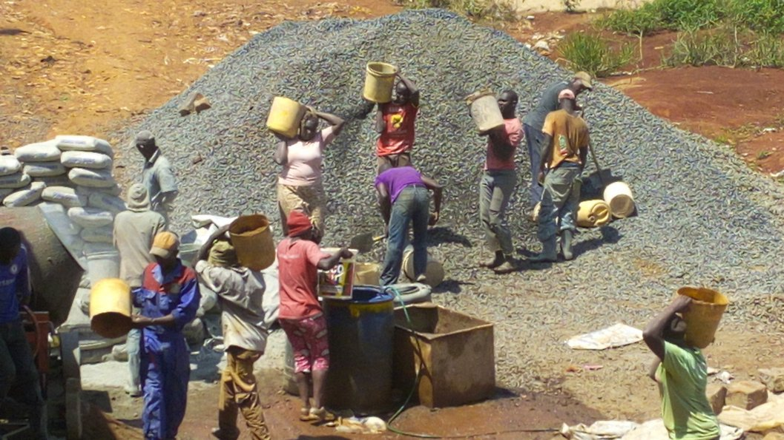
Workers
Notes:
Let’s talk about what each of these ‘workers’ does anyways.
Remember that a ‘worker’ isn’t a host or anything, it’s one python process that runs a job for some set of wikis, one at a time.

Slide 39

Reusing output
Two-pass dumps
1. Generate metadata for all revisions wanted
2. Get content for each revision
This means that content dump job requires access to ‘stubs’ (metadata output) from earlier job
Notes:
But now we’ll get a little into the details of these jobs.
As I’ve mentioned before, we do revision dumps in two passes. Pass one: dump all the metadata without any content (‘stubs’). This gives us a list of all the revisions that haven’t been hidden from the public, along with things like comments made at the time the revision was added, the user name or ip of the contributor, and other items not necessarily in the revision table. We have MediaWiki do the work of filtering out hidden revisions for us, rather than writing duplicate logic in python that would then have to be kept in sync with the MediaWiki code base.
For each entry in the stubs, we now get the revision content. Without the stubs output, content dumps don’t run.

Slide 40
More reuse during content dumps
Naive approach: request content from the external storage database cluster for each revision. Expensive!
Smart approach: check previous content dump, use revision content if present, otherwise query db. Cheap!
We can do this because REVISION CONTENT NEVER CHANGES (in theory).
Downsides: more cpu to decompress previous content dump
Notes:
I mentioned earlier that revision history content dumps are the slowest step, and that’s because we have to get the content for every revision since Wikipedia began. And that’s a lot of revisions, the number only growing bigger the longer we wait.
Asking the db for that content every time is a waste, since revision content DOES NOT CHANGE (well unless someone manually goes in and tinkers with it). Page edits are new revisions!
So why not use content from older dumps and just rewrite it into the new dumps? This way we only have to ask the db for revisions we don’t have yet, or where the old content doesn’t pass a sanity check (in this case, revision length matching the content).

Slide 41
Status file updates, lock files
One worker runs a job which fails; status file shows failure
Another worker tries that job again and it’s successful; same status file must be updated
Lock files to prevent multiple workers from claiming the same wiki’s run at the same time
Notes:
As a worker runs a job for a wiki, it writes a status file indicating that the job is in progress. At the end it writes one indicating completion and success or failure.
These status files must be readable by all workers on all hosts; a failed job must be recognized as failed by another worker running the same jobs on the same wikis, and retried if that’s all that’s left.
Multiple workers run the same job on the same set of wikis. To prevent multiple workers from running the same job on the SAME wiki, we have lock files of course. These too must be readable by all workers that might run those jobs for those wikis, on all hosts.

Slide 42
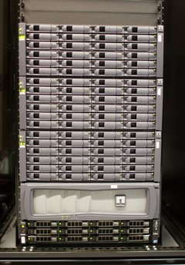
“Solution”: NFS
IOPS limits! Bandwith problems! Cache bugs! General weirdness! Here be dragons!
It still gets the job done
Notes:
And so we come to NFS. Sad but true.
I’ve had issues with soft mounts, hard mounts, NFS cache, running out of bandwidth, adding more bandwidth and running out of IOPS. You name it we’ve been there.
And yet, for all its horrors, there’s nothing that works as well until we take the leap into definitely slower distributed something-or-other, either a ceph-or-swift filesystem or some ‘shovel-the-file-over-via-http’ thing. And we’re not ready for that yet.
The NetApp in the picture is no longer in use; we used Suns and NetApps for media but never for datasets anyways.
If you’re curious, media are now housed on swift, but someone else can give that talk.

Slide 43
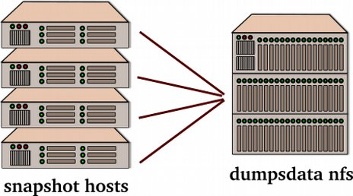
Worker Hosts
Worker hosts running dump scripts write to common NFS server
Any worker host can run any job for any dump for any wiki
Any worker host can verify results of a previous dump job for any run for any wiki
Bottlenecks: network, nfs server disk iops
Notes:
If we had lots of money we might have a couple of multiply attached arrays for reundancy (but how well does that scale if we want to build out the number of servers running dumps?)
Cheap and fast is having two nfs servers, rsyncs from primary to fallback as files complete (we skip any files in temp dirs, or with temp file suffixes).
Soon we’ll have a third where files can be written that don’t require access by more than one host and which are rsynced out to the public web server immediately upon completion and are never re-used. Wikidata entity dumps will write there.

Slide 44
Helping NFS limp along
Do’s:
Do limit bandwith on rsyncs (e.g. to failover hosts), running them sequentially and not in parallel
Do run disk-intensive jobs, such as monthly statistics reporting, on a secondary host
Do compress (almost) all output from the workers before writing it
Don’ts:
Don’t NFS mount the filesystem for other users
Don’t provide web service to the world from the NFS server
Don’t rsync to third party mirror hosts from the NFS server
(We used to do all of these things)
Notes:
In a simpler time (tm), we had one nfs server which did everything, and I mean everything. Workers wrote dump files there as they were generated; status files were written there; web service to the public was provided from there on those very files; the filesystem was NFS-mounted internally for analytics use; our third party mirrors rsynced from that server too! Poor thing.
Now we’ve split all that stuff off. The NFS server does two things:
1) dumps workers write stuff on it.
2) it rsyncs completed files plus status/html files to the fallback NFS server and to the public webserver and NFS internal mounter (those are now two separate hosts).

Slide 45

Monitoring
Notes:
I mentioned status files and html files. This is the way the public keeps track of what dump is running and which jobs are complete for which wikis.
Of course we like to keep track of a bunch of things too. So, let’s talk about monitoring the dumps.

Slide 46
Once upon a time
Dump output was written on one NFS server, also the public web server
Index.html files? Write them at dump run time, instantly available
Progress of a dump job? Write the message into the per-dump html file, instantly available
Which jobs are complete? Write the info into a text file, instantly available
But now we don’t do everything from one overloaded host. So...
Notes:
When dumps were fast, we wrote index.html files for each wiki as its dump ran, showing which jobs had run, providing progress reports on the currently running job if any, and showing which jobs were yet to run, all with timestamps and so on. A single index.html file for all wikis was also provided which showed a couple of lines of status and linked to the per-run html file.
Since all of this was written on the same server that provided web service to the public, these files were immediately readable by users.
Now the web server is a separate host, so no instant access.

Slide 47

Rsync to the rescue… or not
We do rolling rsync of dump files as they are completed
Rsync of html files before the files they link to are copied? Unhappy downloaders!
Same for text file with info about complete dump jobs… if the job output isn’t there yet.
Notes:
We rsync files over to the web server from the NFS server where they are written.
If we rsynced an entire directory over in the usual way, the index.html file for the run for a wiki could arrive before the files it links to, meaning that users could get 404s when clicking through.
There’s the dumpruninfo.txt file too which lists whch jobs are complete, and it too, if copied before the dump output files, could reflect info about files not yet there.
Same for the files with md5/sha1 sums for dump output files.

Slide 48

Rsync for the impatient
Step one: stash all html files with download links, job info files, into a tarball
Step two: rsync dump job output files
Step three: rsync html/job info tarball
Step four: script checks every five minutes for new content, unpacks if needed
Impatient downloaders may find files with no links, but not links with no files!
Notes:
So we make sure these files get copied over last of all but that they reflect the state of things at the beginning of the rsync.
This too might be wrong, in that an index.html file might NOT provide a link for an output file that is actually there.
But we don’t mind that sort of problem; it won’t cause downloaders trouble. And if a downloading script wants to try to grab unannounced files because the downloader really really doesn’t want to wait, that’s fine too.

Slide 49
Provided for watchers
‘latest’ directory: dumps.wikimedia.org/<project>/latest/
RSS files: <wiki>-latest-<jobname>.<type>.<ext>-rss.xml
Symlinks to latest versions of dump jobs
For each run: dumpstatus.json, dumpruninfo.json, dumpspecialfiles.json
For each run: index.html, status.html, dumpruninfo.txt
For each run: <wiki>-<date>-md5sums.json and .txt, sha1sums.json and .txt
Centrally: index.json, backup-index.html, backup-index-test-bydb.html
Notes:
For folks who want to keep track of what’s happening with a given dump, or with all of them, we have various ways to get at the info:
1) human-readable: index.html per dump run/wiki or for all the wikis’ latest run
2) machine-readable: dumpstatus.json with info on each job and the files it produced, dumpruninfo.json/txt which contains one line about each job with status
3) files with hash sums of all the dump output files
4) RSS feed describing output files of jobs as they are produced
5) ‘latest’ directory with symlinks to the latest output files for folks who don’t want to programmatically determine the most recent run

Slide 50
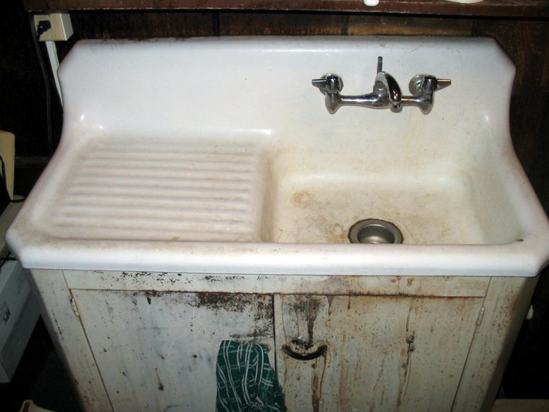
More
Notes:
Have a bit of miscellaneous info about the current dumps setup that didn’t fit somewhere else in the slides. :-P

Slide 51
Stuff we dump
Full xml/sql dumps, with all content for all versions of every page (whew!), monthly
Partial xml/sql dumps, with current page versions only, monthly
‘Adds-changes’ dumps with new edits since the previous run, daily
Wikidata entity dumps in json and rdf format, weekly
Cirrus search indexes, suitable for loading into ElasticSearch, weekly
Translation corpora by language pair, weekly
Category dumps, Global block listings, Short url mappings, weekly
...and more!
Notes:
Besides the xml/sql dumps (full and partial runs) that we’ve talked about already, there are a good number of other datasets produced on a regular basis.
We have xml output of new revisions to the projects every day; these are not true incremental dumps because they do not account for page moves and deletions, but they have been useful for folks maintaining mirrors or doing analysis of the content.
We produce dumps of all Wikidata entities once a week, in rdf and json format. Widely used.
The search indexes used by CirrusSearch are dumped once a week, and while you might think these are somewhat esoteric and useless except for loading into the same search setup, NLP researchers have already used them for producing corpuses for training models.
Etc! And more to come.

Slide 52

You have mail
Monthly FAQ email: uncompressed sizes of dumps for enwiki plus random other wiki
Bimonthly run time checker for big wiki jobs, once for each run
Job watcher notifies about stuck jobs (no output for longer than n hours)
Notes:
There are a few email scripts we run.
I got tired of answering the same question all the time ‘how big are the English Language Wikipedia dumps uncompressed’? Now an email sends that information to the xmldatadumps-l email list once a month. And no one reads it :-D
I wanted a convenient way to decide which wikis are candidates for configuration as ‘big wikis’ (dumping with parallel processes); a script checks run time of various jobs and emails us after each run with the numbers.
Reruns of a job, and in particular a piece of a job, can indicate MediaWiki problems if they repeat over and over. A script watches for active processes with old output files and emails about them. It doesn’t cover all cases but it’s been quiet helpful.

Slide 53

Organically Grown
Notes:
Just as bug fixing is interrupt-driven, so code development is more or less ‘omg this needs to get done now’ rather than by a nice plan. Typically, ‘this job is too slow on these wikis’ is the driving factor.
So we get organically grown code rather than nicely architectured code.

Slide 54
Organic growth pros
Update code incrementally
Improvements target area of biggest impact
Faster to develop/deploy than major refactor
Great if things already broken, need a quick fix
Notes:
Of course that has its up sides. It’s easier to make small fixes (both for writing and reviewing them) than a massive refactor. And since these are driven by need, they always, by definition, are responsive to whatever is most important at the time.
See: fast, cheap… to a point.

Slide 55

State of the code
total scripts in dumps repo: 47 + 4
lines of python in dumps repo: 17764
lines of sh in dumps repo: 696
lines of sh in puppet repo: 2445
lines of python in puppet repo: 1119
total lines of c in utils repo: 5756
Notes:
But it can also mean pretty messy code over time. Remember in the beginning when we had 3 python scripts and two shell scripts and that was all?
Sure, we have more files because a few classes were moved out into their own modules. But primarily we have more files because a lot more code was written. Really a lot.
And the dumps don’t live in complete isolation. We need to set up config files, cron jobs, the servers where they run, etc. We use puppet for server configuration so there are some manifests for those, which include some of the shell scripts for email notification I mentioned earlier.

Slide 56
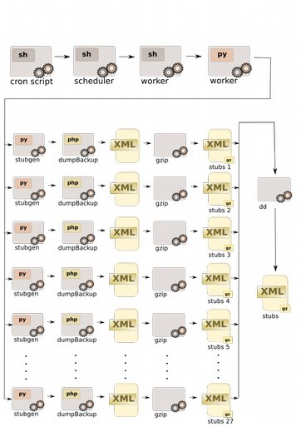
State of the code: a simple visual aid
Here’s xml stub generation. I left out the python dump library scripts and the C MediaWiki/bz2 utilities.
Page logs and abstracts also look like this.
Then there’s the revision content dumps, the sql table dumps, the site and namespace information dumps, the json status files, the adds/changes dumps, the page title dumps
And the page rebalance script, the cleanup script, the monitoring script, the admin script, the rsync script, the job watcher script, the stats collection script, the...
Notes:
This image represents the processing done in order to produce revision metadata (‘stub’) dumps for one of the big wikis. 27 page ranges are produced at once, and at the end these are combined using the dd trick to produce a single… well actually three… stub files, one for current articles, one for all current pages, and one for all revisions.
The 27 output files are done like so: we write stubs for a tiny tiny page range to a temp file. This is then catted into stdin of a gzip process which writes the 2nd or the 25th or whichever output piece. Why do this? So that if the query for the temp file fails because the db server went away or whatever, we can retry a few times without restarting from the beginning.
Abstract and page log dumps use this same mechanism.

Slide 57
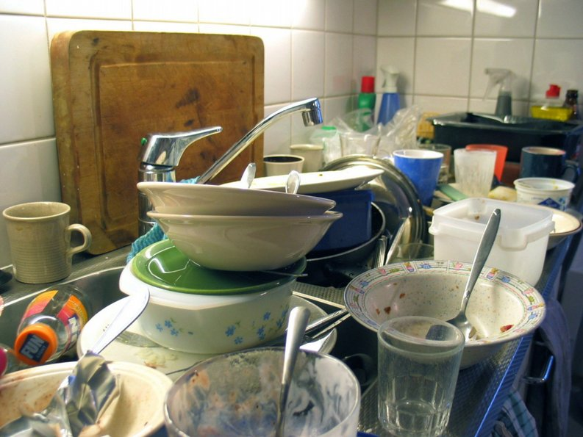
Dirty Data
Notes:
One of the things you learn about the data in our wikis when running these dumps, is just how grubby some of it is. There have been all kinds of bugs and the data has not always been repaired once the bug was fixed.
This doesn’t usually impact regular users of Wikipedia and related projects because they only see the current revision (readers) or the last few (editors).
But we get it all.

Slide 58

Neither snow nor rain nor heat nor gloom of night...
18 years of data
18 years of MediaWiki commits… and bugs!
Dumps must be resilient against all errors for isolated revisions:
Addresses pointing to nowhere, empty user fields, revision texts bigger than the current limit, broken serialization…
Notes:
In theory the US Post Office delivers your (snail)mail regardless of the weather conditions etc.
Similarly, the dumps have to run regardless of all these horrors. And they do. Over time we’ve made them pretty resistant to exceptions thrown from within MediaWiki.
Here are some of the fun things we have just lying around...

Slide 59
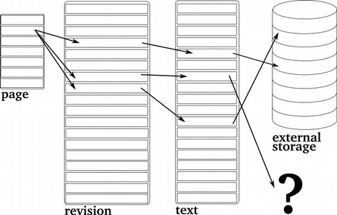
Text addresses pointing to nowhere
Each page record points to several revision records
Each revision record points to one text record
Each text record points to an entry in the external storage cluster…
Or not?!
Notes:
Pointers in the text table to db servers in our ‘external storage’ cluster should look like this:
DB://cluster24/207519399
But we get some that point to
DB://cluster14/158
Where the cluster just doesn’t exist, or
DB://cluster20/0
Where the id of the entry in the cluster is 0 and that’s no good, or
O:15:"historyblobstub":2:{s:6:"mOldId";s:7:"8100986";s:5:"mHash";s:32:"e10f00e2098d583029e8d3c660871301";}
Which is a pointer to an object, with oldid 8100986, and that text row doesn’t even exist. Revision from 2004 (!)

Slide 60
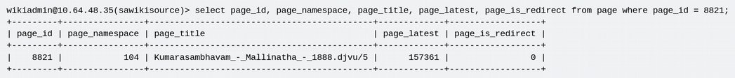
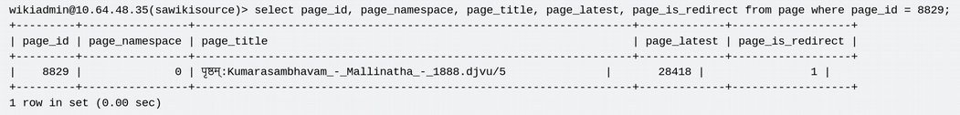
Names and Namespaces
Prefix for namespace 104: पृष्ठम्
Full name of first page: पृष्ठम्:Kumarasambhavam_-_Mallinatha_-_1888.djvu/5
Full name of second page: yup, same as the first page
Notes:
Wikis have a concept of ‘namespaces’; all entries in a namespace might be handled differently (could show up or not in default search, could be treated as privileged for editing, could trigger message notification to a user when an edit is left there, and so on. Various MediaWiki extensions create their own namespaces too. Format for these: Myprefix:
All of these internally are mapped to a number, Pages with no prefix are mapped to 0 (main namespace) and are called ‘articles’. Their talk pages all start with Talk: and are mapped to 1. Etc.
In some cases a page may be created with the name, MyPrefix:RestOfTitle where there’s no actual namespace starting with that. Later the namespace is introduced; the old page is still there but someone creates in MyPrefix the page with RestOfTitle… now we have two pages with same fully qualified title. Woops! Main script can fix but is not always run and etc.

Slide 61
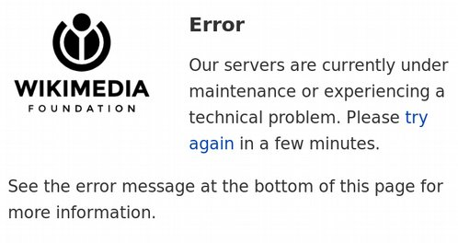
Huge revisions are huge
Limit in configuration files (KB):
$wgMaxArticleSize = 2048;
Max revision size in the database?
Over 10 MB!
Don’t try this at home:
https://en.wikipedia.org/w/index.php?
title=User:ColenFace&
oldid=39456244
Notes:
There’s a 3.7MB revision in ja wp with nothing but a short signature string repeated over and over again:
--[[利用者:Tniop|Tniop]]（[[利用者‐会話:Tniop|会話]]） 2016年9月10日 (土) 12:52 (UTC)
No, I”m not actually joking. If it’s gone by the time you get there, the page id is 3484718 and the revision id is

Slide 62
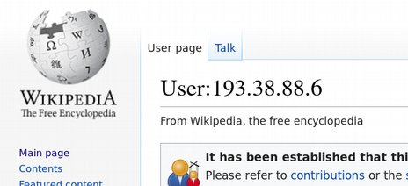
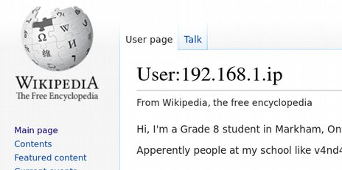
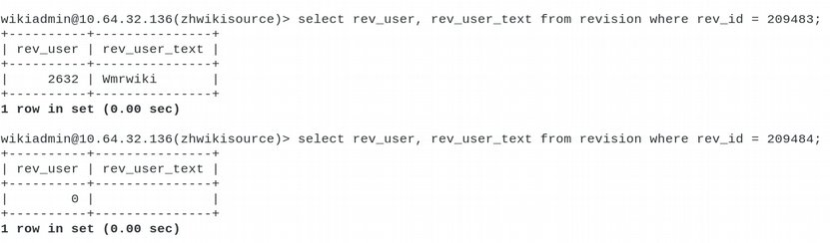
User names vs. IPs vs. nothing
Notes:
There are users who create user names that look like partial Ips. Why? Because they can.
There are revision entries in the db with user id 0 for the user that made them. Why? $reasons. OK, some are because the revision was imported from another wiki and there is no local user that corresponds. Some are from bugs.
There are revision entries in the db with empty user names (no ip, no text, just empty). Why? Bugsbugsbugs.

Slide 63
Lessons learned after 9 years
Everything is an edge case
No really, everything
You haven’t found all of the edge cases yet
You will never find all of the edge cases
This is your dev(ops) life
Notes:
“Living on the edge”, they can just put that on my tombstone.

Slide 64

Consistency
Notes:
I get asked a lot about whether the dumps are consistent, meaning that the table dumps and the content dumps and the stub dumps all reflect a single instant in time of the database state.
It would be really really rude to just burst out laughing here, right?

Slide 65
The hobgoblin of little minds?
MediaWiki version can change in the middle of stubs/content run
A page can be moved in the middle of being dumped
Revisions may be hidden after stubs dump and before content dump
Namespace configuration can change in the middle of stubs/content run
Tables aren’t locked while being mysqldump-ed.
Dumps of one part of the database are done at different times than other parts, so they may reflect different states
And much more...
Notes:
There are a few ways we could ensure more consistency of the dumps:
Lock the database for the duration of all jobs for a wiki (but large wikis take over 10 days for the database-related part of the run to complete)
Use a snapshot (mysqldump or other) of the database and generate results from that (but this would be much slower, for any information retrieved by queries to the db rather than straight sql dumps)
Lock the database just for the mysql dumps portion (still several hours for the largest wikis), dump the revision table at that time as well for internal use, filter out rows that are hidden or deleted, and retrieve all metadata from there when writing xml stubs files (but this would entail maintaining code that duplicates MediaWiki logic regarding access to deleted/hidden revisions)

Slide 66
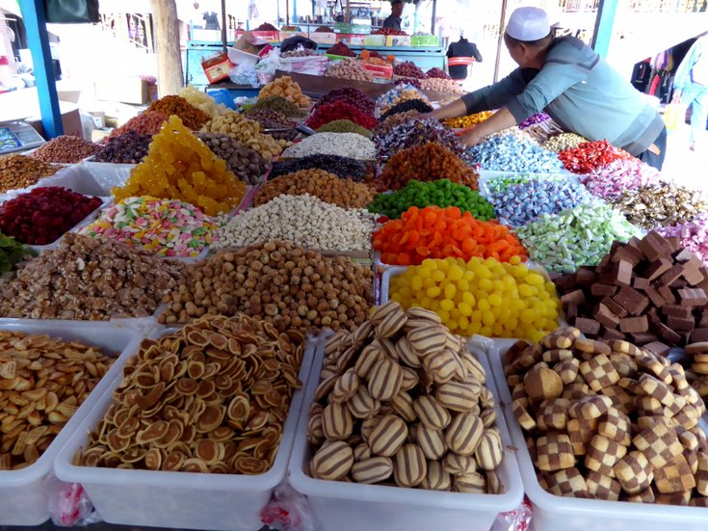
Imports
Notes:
We haven’t talked about how to use this data as honest to goodness wiki pages yet. Let’s do that.

Slide 67

Why import?
Local testing of a new feature
Having your own copy for research and analysis
Sharing with a community that has slow/no Internet
Added value (features or data not available on the original site, such as annotations or a different skin)
Right to fork!
Notes:
Why would we want to set up a copy of Wikipedia or one of the other projects, besides the coolness factor?
Maybe you want to test a new feature on a decent sized collection of articles.
Maybe you want to do research or analysis on Wikipedia articles, and quering the database yourself is the way to go.
Maybe you are a member of or in touch with a community that has limited bandwidth, sporadic acess or no access to the Internet.
Maybe you want to add a feature that the Wikimedia servers don’t support or are unlikely to support. Or maybe you want to select content for a particular audience (students, folks interested in a specific topic or culture…)
The GFDL as an insurance policy against WMF turning evil :-)

Slide 68
Official tools
MediaWiki maintenance script: Import.php
Slow.
No, really. As molasses.
The only tool expected to work (everything else may be outdated, missing fields, etc)
Mwdumper (Java)
Handles multiple versions
Can write sql output instead of importing directly
Often out of sync with current MediaWiki version
Still slow, but better than Import.php
Notes:
There’s only one parser that does it all: MediaWiki. In the same way, there’s only one guaranteed importer: MediaWiki’s Importer.php. Unfortunately it’s very very VERY slow.
Java: mwdumper. Not kept in sync unless someone steps up to do it. So far it’s done ad hoc by some folks at WMF and some volunteers. Can write sql output which is MUCH preferred.
Hey, anyone want to sign up to co-own mwdumper? For real. We need it.

Slide 69
Needed for import
Page, revision, text (and now slot, content, actor, comment) tables
Related (page properties, page restrictions, restricted titles, categories, all link tables, users, user groups…)
Wikidata items for wikis that include them
Wikidata items for modules that render maps via WDQS
Media locally uploaded and from Commons
Some items not dumped, must be generated (user info)
Notes:
To import the dumps you need to grab these fields at a minimum, and the rest can be hand-waved.
Unfortunately, for rendering some wiki pages you now need a standalone installation of Wikidata with the referenced items in it.
Example: Some map pages on some wikis use queries of Wikidata to construct overlays that are displayed on the map.
There is no provision for using Wikidata as a ‘foreign Wikibase’ repo, as one can do with Commons media. So while you need not download the respective media from Commons for your copy of Wikipedia to work (unless you are offline), you must download the relevant Wikidata entitites and import them into a local copy.
The only workaround for this is to store HTML renderings of the live WMF pages and use those offline.

Slide 70
Unofficial tools
Various, generate revision and text tables from xml content dumps
None deal with Wikidata inclusion
None deal with maps rendering
None handle slots and content tables
None write out actor, comment tables
Notes:
There are some unofficial tools around, the marjority in python and some older ones in perl.
Most of them are quite old and not kept up to date with the current MediaWiki schema.
We need someone(s) to adopt one of these old projects and maintain it. Or I need a clone.
Wikidata will still be an issue.
Commons and locally uploaded images will still be an issue.

Slide 71
Alternate approaches
Parse the dumps directly, for research or analysis [tools here please]
Kiwix, XOWA, for offline readers
HTML dumps (when they come!)
…?
Notes:
Instead of importing, you could…
Parse the dumps directly. A fair number of tools in various languages from go to java to python do this.
Use an offline reader if you’re interested primarily in the content rather than in analysis. Bundles are available for download periodically from Kiwix, for example. (Plug: they can always use help and offers for storage.)
Download HTML dumps once we have them. Yes, we will have them in time.

Slide 72

Future
Notes:
A friend asked me about a year ago, what I was working on at the WMF. I said, ‘oh, the dumps.’ ‘But,’ my friend said, ‘you were working on that 5 years ago. Aren’t you done yet?’
As you’ve seen already, there’s lots more work to do. Here’s some of it.

Slide 73

Dump MOAR, finish on time
English language Wikipedia is not small
Wikidata is larger
Commons is huge and Structured Data will make it a monster
New tables as they are added
- growth of wd
Notes:
We are hoping for 18% more content anually from 2025 on, see https://meta.wikimedia.org/wiki/Wikimedia_Foundation_Medium-term_plan_2019/Thriving_movement
and 25% increase in rich media content in the next year, see https://meta.wikimedia.org/wiki/Wikimedia_Foundation_Medium-term_plan_2019/Platform_evolution
That’s a lot more to dump. We want to get it all done in the time frame currently allotted for the two monthly runs, without throwing a ton of hardware at the problem.
RIGHT NOW Wikidata averages about 300 edits per second, or between 400 and 600 thousand edits a day. At its current rate of growth it will double in size within 3 years.
OUCH!!

Slide 74

What about...
More datasets?
Media?
HTML?
Other formats?
Importable sql, or downloadable mysql dbs?
All the new stuff we haven't heard of yet?
Notes:
We don’t want to stop there, of course. Other datasets will be added over time, and other formats of existing datasets.
I want to bring back some version of media dumps, most likely an rsyncable copy of media in use on the projects, hosted on a third party site.
People have been clamoring for HTML dumps for years and rightly so.
Suppose we could hand folks a set of sql files that could be directly imported into a database, suitable for the latest version of MediaWiki!
How about Structured Data dumps? (Coming soon for Commons!)

Slide 75

Moar Future
Notes:
Besides all the new content and formats, there’s other work to do. I’m pining to get more than 5 minutes to stare longingly at the Dumps 2.0 Rewrite project…

Slide 76

Still moar to do
make jobs 15 minutes long so reruns are cheap cheap cheap
no-decompression bz2 file recombines (yes it can be done!)
Easily expandable worker pool, no shuffling jobs and wikis around
some fscking pylint and refactoring
MORE MIRRORS
Notes:
Some smaller todos:
Right now we break (most) jobs into smaller pieces, but some of those ‘small’ pieces are up to 12 hours long. We don’t make them smaller because the dumps enduser would be downloading thousands of small files.
So we need a way to recombine bz2 files without decompression (in progress!), and then we can split up one class of jobs into chunks that take no more than 15 minutes per piece.
We need a real worker pool and real job queues so that as soon as one piece of a job completes, another one starts. No stages and no ‘wait for all 6 or all 27 of these processes to complete before starting another group’. And the worker pool should be easier to expand, with minimal config.
And wow there’s some huge classes with way too many attributes in there. Organic code growth much?

Slide 77

Final Thoughts
Notes:
I had no idea what I was getting into when I took responsibility for the dumps 9 years ago. I still have that hamster on the wheel feeling, but at least I know where the wheel is going.

Slide 78
Nine years of ‘learning experiences’:
How the Mariadb optimizer lies and/or makes bad choices
How weird bugs in MediaWiki core can go undiscovered for over a decade (the '===' bug)
How Wikidata will eat us all for lunch
How scale and edge cases are everything
How to survive a in framework written for fast stateless web requests, with slow stateful dump jobs
Notes:
I’ve also learned the joys of producing data used by the Wikimedia community and by researchers more generally. It’s wonderful to see these files being used to understand Wikimedia projects better, to improve the content on the projects, or to share the content more widely.
Beyond that, it’s amazing to me that these files are being used in cutting edge NLP research, an unexpected way that the WMF projects contribute to the collection and dissemination of open content and open knowledge.
I wonder what new uses will be discovered for the dumps over the next 9 years!

Slide 79

The End
Notes:
Thanks for accompanying me on this road trip through 9 years of rambling history. It’s been real! Time to stock up on supplies and get ready for the next leg of the journey.

Slide 80
Credits: commons.wikimedia.org
File:2013.08.03.195132_Catis_Dominoeffekt_Neustadt.jpg
File:Amboy_(California,_USA),_Hist._Route_66_--_2012_--_1.jpg
File:Ana_Dulce_F%C3%A9lix_Daegu_2011.jpg
File:Bowery_men_waiting_for_bread_in_bread_line,_New_York_City,_Bain_Collection.jpg
File:Burpee%27s_farm_annual_-_garden,_farm,_and_flower_seeds,_thoroughbred_stock_(1884)_(20484358136).jpg
File:Children_watch_with_binoculars,_birdwatching.jpg
File:ConCon_bsod.png
File:Construction_site_workers_loading_water,_sand,_ballast_and_cememt_into_a_concrete_mixer_in_Embu,_Kenya_6.jpg
File:Custom-watch-clock-face-dial-wiki-attempt1.png
Notes:
All of the files in this slide deck were taken/derived from images on Commons or were produced by the author. Those from Commons are listed on this and the following slides. Please visit the listed page on commons.wikimedia.org in order to view the original version of the file, the author, the license, and all other information we have about the media.
There are over 51 million other images where these came from, all free to use, remix and share. Please do so!

Slide 81
Credits, continued
File:Dirty_dishes.jpg
File:Disassembled-rubix-1.jpg
File:Dumps_logo_black_and_white.svg
File:Gojira_1954_Japanese_poster.jpg
File:Grand_Bazaar_Qarqan_Xinjiang_China_%E6%96%B0%E7%96%86_%E4%B8%94%E6%9C%AB_%E5%A4%A7%E5%B7%B4%E6%89%8E_-_panoramio.jpg
File:Herd_Of_Goats.jpg
File:Humble_sink.jpg
File:JackhammerDelhi.JPG
File:La_Pensierosa.png

Slide 82
Return of the credits
File:Leonard_Cohen_Albert_Hall_Backstage_Pass_25_May_1976.png
File:Martin_Jetpack_Unveiling,_Liftoff!_(2714934801).jpg
File:New_River_Gorge_Bridge_Day_envelope_1985.jpg
File:Nurul_Izzah_reporters.jpg
File:Organic_Peroxide.png
File:Phodopus_sungorus_-_Hamsterkraftwerk.jpg
File:Progress_MS-01_docked_to_ISS_(ISS046-E-043290).jpg
File:Project-triangle.svg
File:Pull_hair.jpg

Slide 83
Revenge of the credits
File:Reduce_Reuse_Recycle.jpg
File:SFFf-1989091.162777_(4544868563).jpg
File:Sisifus_the_faculties.jpg
File:STS-135_final_flyaround_of_ISS_1.jpg
File:Superman_Clipart.svg
File:The_nickel_and_dime_store,_WPA_poster,_ca._1941.jpg
File:The_Scream_Pastel.jpg
File:Try_Again.jpg

Slide 84
Credits: the final chapter
File:Ttukbaegi-spaghetti.jpg
File:Wikimedia_Foundation_Servers-8055_01.jpg
File:Wooden_hourglass_2.jpg

Slide 85

Questions?
Notes:
If you don’t get your question answered today or you think of one later, I’m reachable on irc. Find me there! apergos on irc.freenode.net, channel: #wikimedia-tech. Pings welcome!

