Slide 1
WMF MediaWiki Database Servers: an SRE-centric overview
March 28, 2019
ariel@wikimedia.org

Slide 2
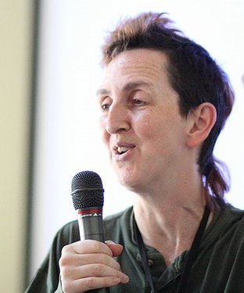
who the F* am I?
I am not, nor have ever been a dba
I don't even play one on TV
I do use the dbs and have even cloned a couple in the remote past
No databases were harmed in the making of this presentation

Slide 3
this whirlwind tour covers...
MediaWiki db configuration files
sql script for connecting to the right db
replication lag issues
tendril db monitoring tool
a cute baby cow

Slide 4
this tour specifically excludes:
retrieving revision content from the db; it’s incredibly annoying to try to get the DEFLATEd string out of there, INFLATE it and then maybe deserialize it, all by hand
or really, anything at all about the external storage cluster; it exists, that’s all we need to know
query optimizing; see https://github.com/jynus/query-optimization for Jaime’s excellent slides instead

Slide 5







db-like things in use at WMF
CURRENT:
MariaDB (MediaWiki and other uses)
PostgreSQL (maps)
Cassandra (RESTBase)
Hadoop (analytics)
BerkeleyDB (gridengine)
SQLite (grafana, hhvm, servermon, openstack)
Redis (change propagation, ores, ...?)

Slide 6
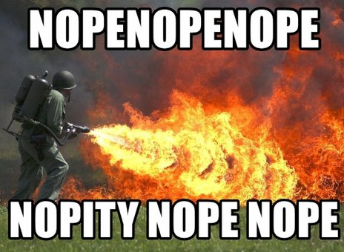
db-like things in use at WMF
Past:
CDB (interwiki links)
Avoided So Far:
MongoDB

Slide 7
MariaDB at the WMF
MediaWiki-related:
MediaWiki page metadata (s1...s8)
MediaWiki page content ("external storage cluster") (e1, e2, e3)
parser cache (pc1 pc2 pc3)
Echo (MediaWiki notifications) (x1)
Flow, CentralUser, etc (x1)

Slide 8
MariaDB at the WMF (2)
Other:
Wikitech
Analytics (used with Hive)
Cloud (santized replicas for use with tools or on cloud instances)
Phabricator (m3)
Bacula, etherpad, librenms, puppet, racktables, rt (m1)
Debmonitor, otrs, wikimania scholarships (m2)

Slide 9
focus on main wiki dbs
‘core’ servers
primary data for wiki projects except revision content
groups of wikis served by different hosts: ‘sections’ s1, s2, … s8
NOT SHARDS! Shards are hard and awful.

Slide 10
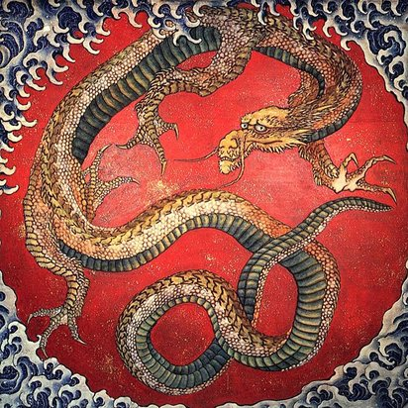
shards: Here be dragons!

Slide 11
“Jaime: partitioning vs sharding? Actually I'm totally against sharding. :)”
(https://www.mediawiki.org/wiki/Wikimedia_Developer_Summit/2017/Scaling_the_Wikimedia_database_schema)

Slide 12
section definitions
mediawiki-config/wmf-config/db-<cluster>.php
used by CommonSettings.php
clusters: eqiad, codfw, labs
cluster chosen according to value in /etc/cluster on a given host
MediaWiki instances in eqiad will only connect
to dbs in eqiad!

Slide 13
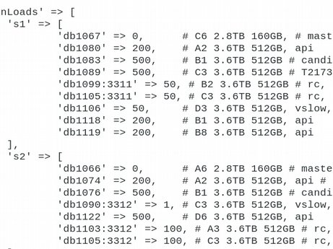
from config file, we can find out...
which hosts serve a given wiki
which host is the master (so we can not use it)
which hosts are regular replicas (so we can use one)

Slide 14
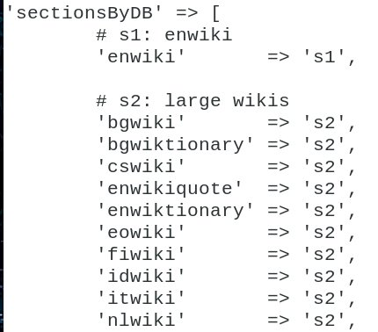
step 1: find section for a wiki
look for sectionsByDB definition
find wiki in list
not there?

Slide 15
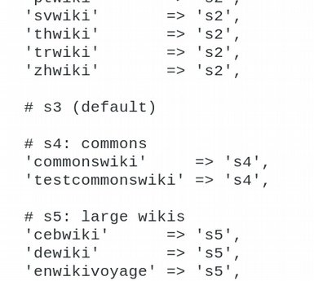
step 1 (continued)
we have over 800 wikis, so...
we don’t list them all
wikis not listed are in ‘default’ section

Slide 16
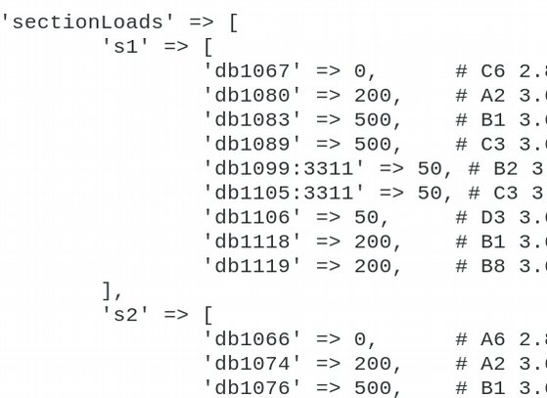
finding the right host (1)
look for ‘sectionLoads’ definition
first entry is always the master, skip!
NOPE NOPE NOPE NOPE

Slide 17
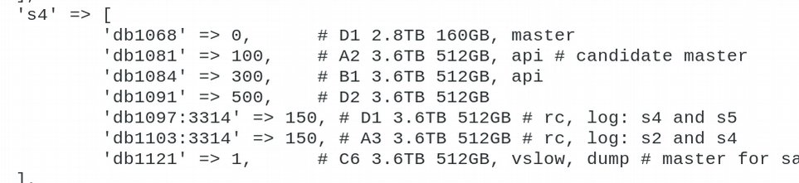
finding the right host (2)
replica choice:
rc, log hosts may have unusual indexing
vslow, dumps are for very slow queries, may be lagged
choose anything else

Slide 18
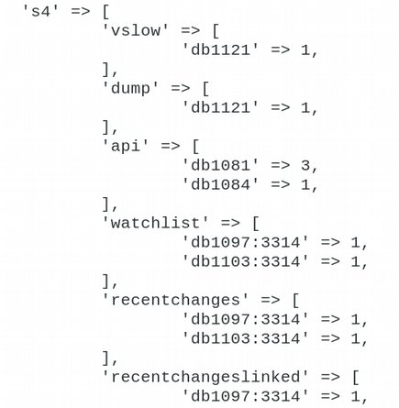
finding the right host (3)
(optional) doublecheck:
check the ‘groupLoadsBySection’ definition for your section and host
you want host to be missing or in vslow/dumps/api list)

Slide 19
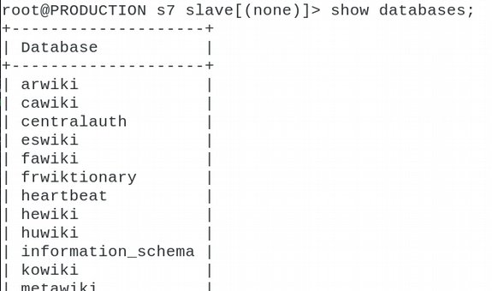
running a query
ssh to the host
be root with root’s environment
this gives you root’s mysql config (and pager!)
mysql (-A on S3, too many dbs/tables!)
choose a database

Slide 20
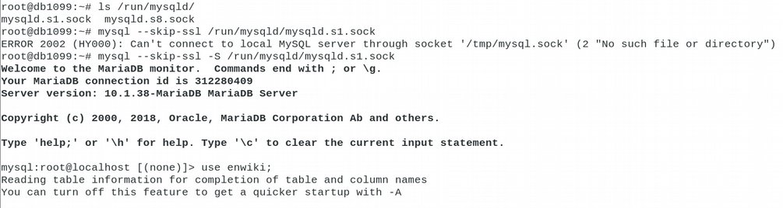
digression: mysql on multi-instance host
check /run/mysqld for the socket files
or remember: mysqld.s<section-number>.sock
-S path-to-socket-file

Slide 21
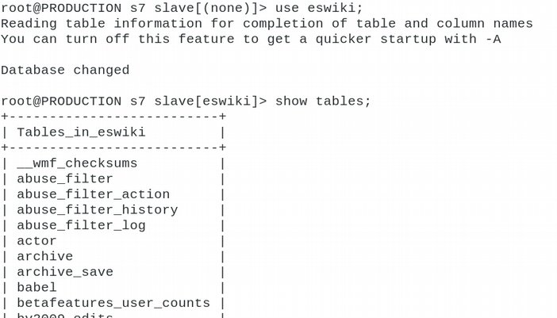
running a query (2)
‘use’ the db
find the tables you want

Slide 22
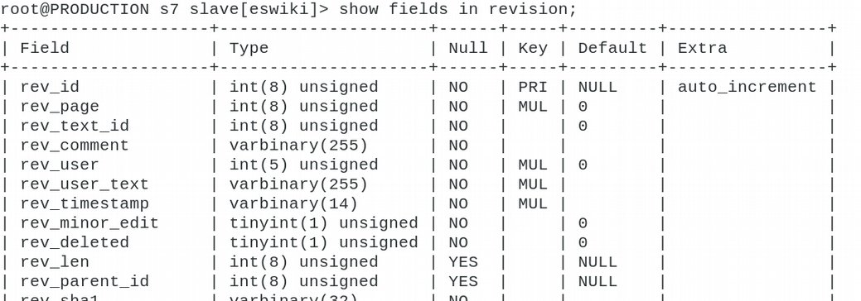
running a query (continued)
What did we want to look up in the revision table again?

Slide 23
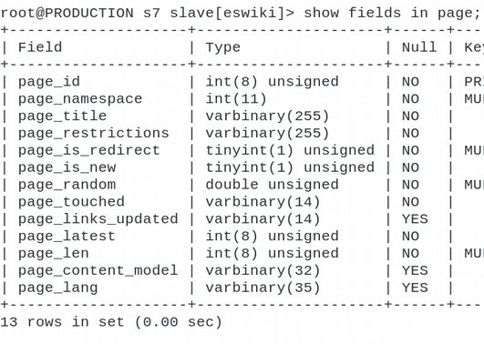
looking for pages
page title isn’t in revision table, because...
page title is not enough; namespace needed too (also it’s too long to be a foreign key :-P)
namespaces: 0 (article), 1 (talk page), 2 (user page), etc.
article page and article’s talk page have same title, different namespaces
get page id from page table given title, namespace

Slide 24
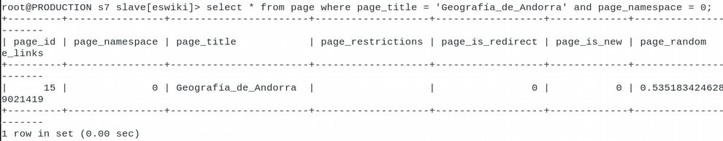
finding pages (2)
note: spaces in the title are converted to underscores before it is stored in the db

Slide 25
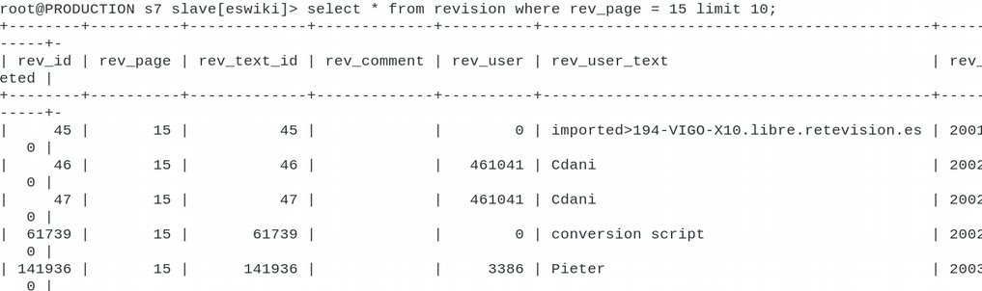
running a query (continued)
page id 15, look up the revisions for the page...

Slide 26

running a query: CAUTION
root user from mysql client can do anything
slow-query-killer DOES NOT shoot root queries
always use LIMIT on your selects
check that your selects use indexes if you ORDER BY
SHOW EXPLAIN to double-check
be ready to kill the query via another mysql client if needed; a ^C in the running mysql client will not necessarily do it

Slide 27
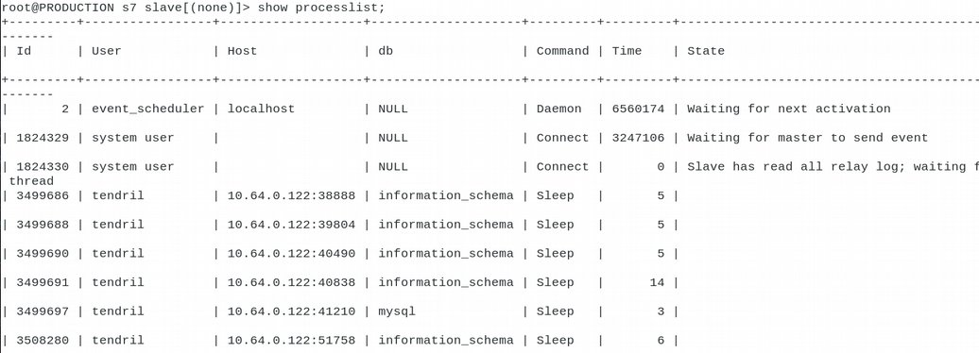
checking running queries
SHOW PROCESSLIST is your friend

Slide 28
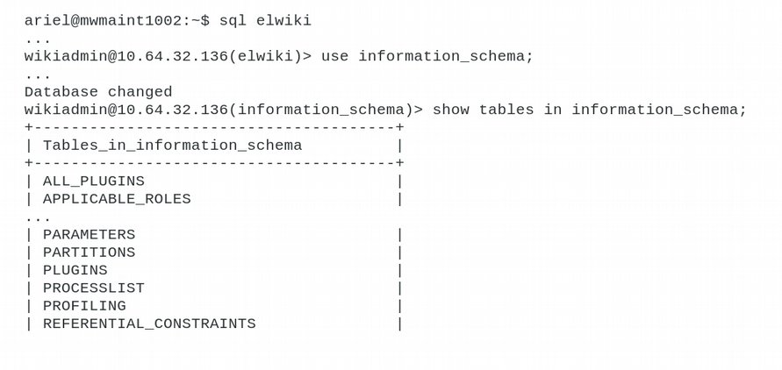
use your privilege! information_schema table

Slide 29
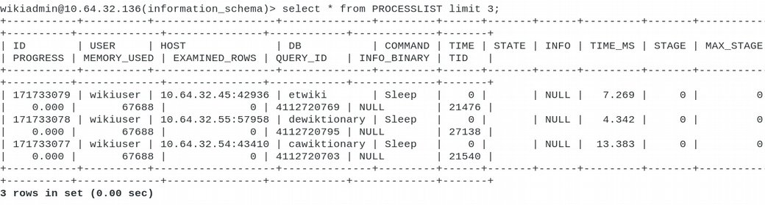
the process list, redux
SELECT * from PROCESSLIST is non-blocking!

Slide 30
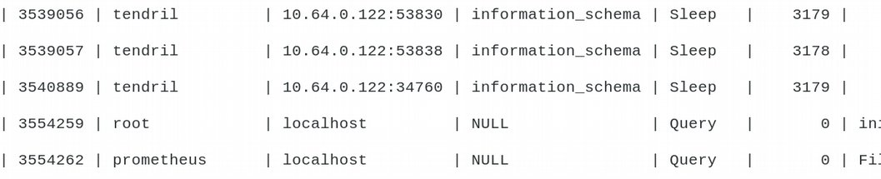
killing that query
query id is in first column, user (root!) in second
kill <id-number-here> kills the query
query command truncated? SHOW FULL PROCESSLIST

Slide 31
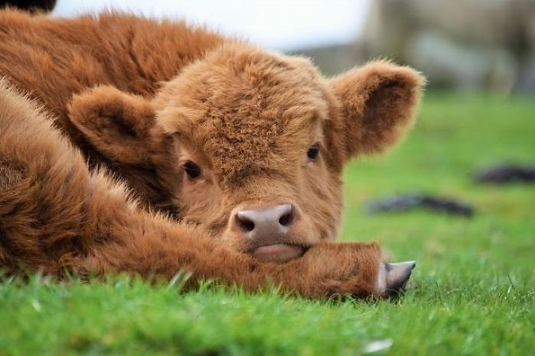
a cute baby cow

Slide 32
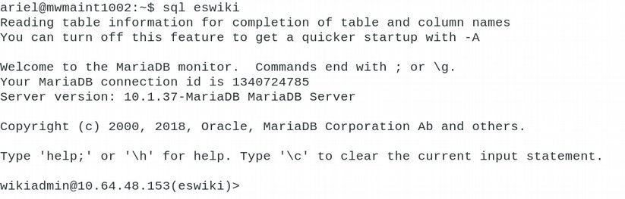
the RIGHT way to run a query
don't do any of that!
ssh as regular user to mwmaintxxx
run ‘sql’: bash wrapper around MW script mysql.php, finds the right server for you, parsing db-<cluster>.php
a replica is chosen unless writes requested

Slide 33
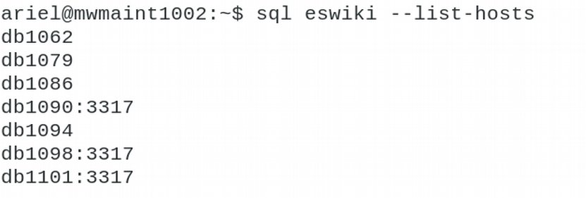
sql: listing servers for a wiki
no indication of which are replicas :-(

Slide 34
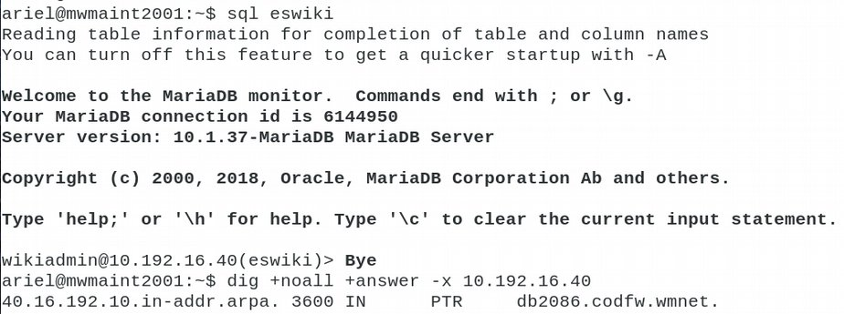
BETTER: sql in inactive dc (1)

Slide 35
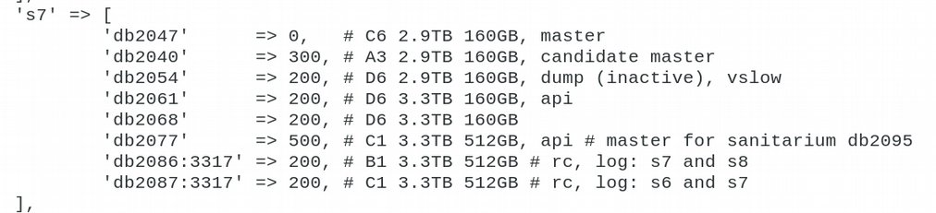
sql in inactive dc (2)
random replica chosen
I have seen a master chosen, be careful!

Slide 36
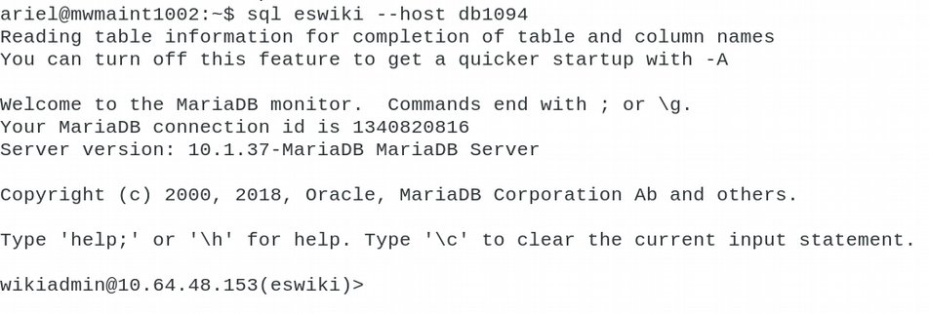
sql: connect to a specific host

Slide 37
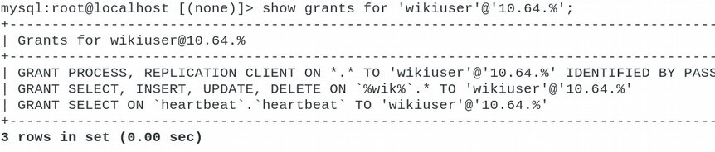
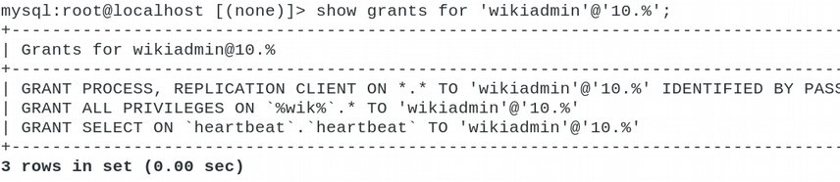
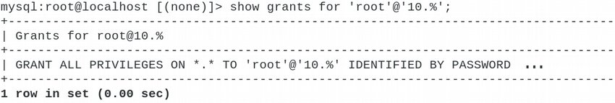
mysql users overview

Slide 38
mysql users privileges
wikiuser: SELECT, INSERT, UPDATE, DELETE on wiki databases
wikiadmin: EVERYTHING on wiki databases
root: EVERYTHING on ALL databases
wiki* users may also SHOW PROCESSLIST and check replication status (useful for replag checks)

Slide 39
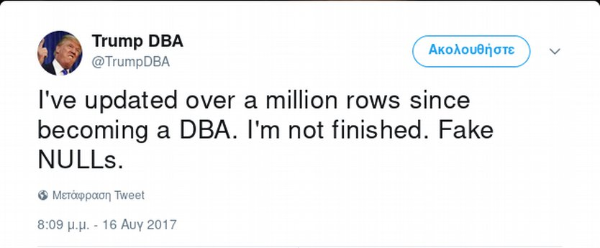
humour break!

Slide 40
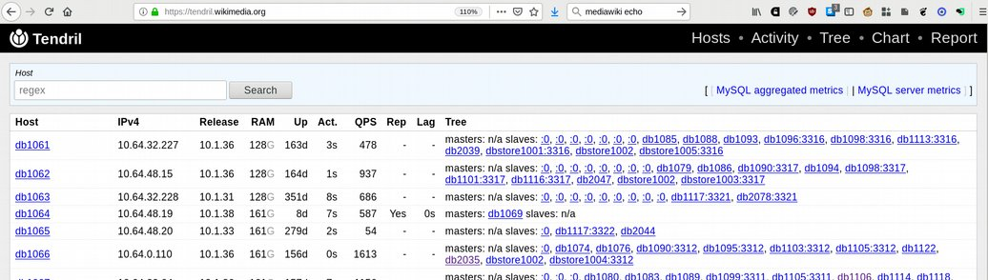
what’s going on: Tendril
https://tendril.wikimedia.org
log in with wikitech account name, LDAP password

Slide 41
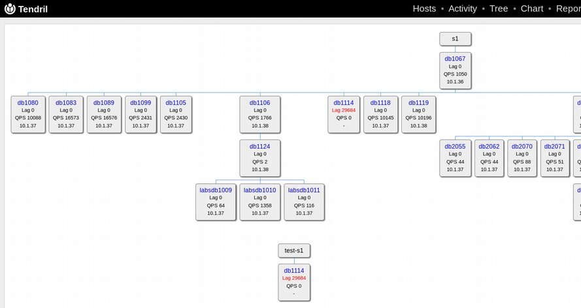
Tendril: tree view
section
master
codfw
replicas
secondary master
labs dbs!

Slide 42
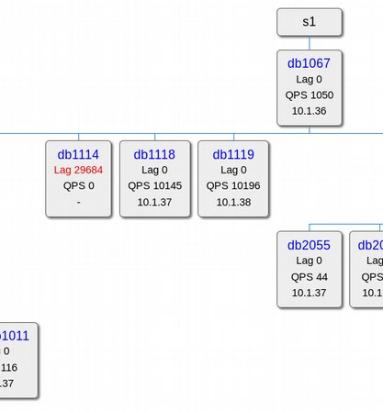
Tendril: tree view (detail)
hostname
ip address
replication lag
queries per second

Slide 43
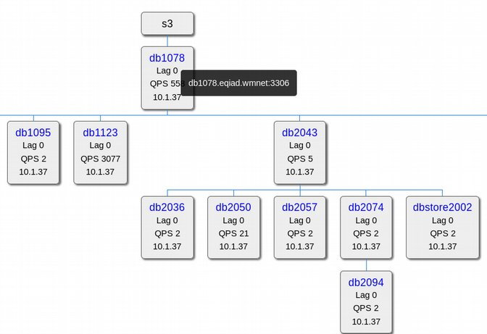
Tendril: tree view (more)
hover to see port number
(We have
multi-instance
servers!)

Slide 44
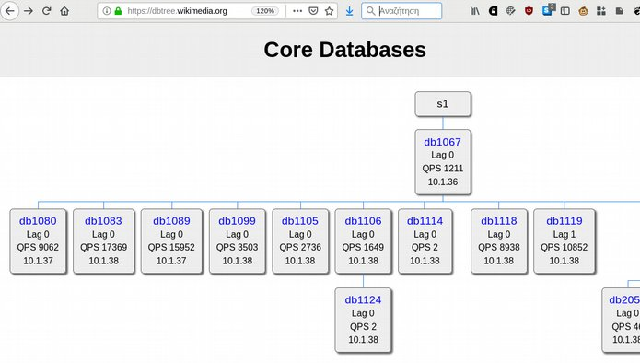
no tendril for you? no problem
welcome to dbtree.wikimedia.org

Slide 45
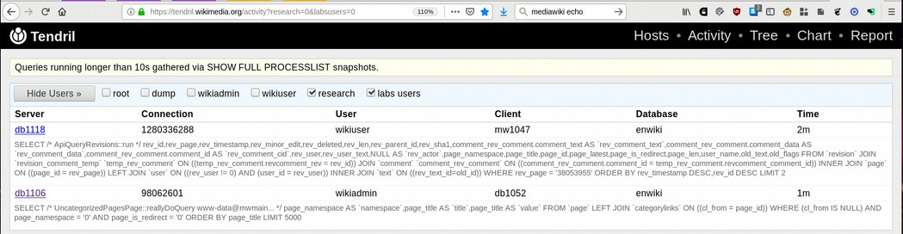
Tendril: Activity
user filtering:
dump – database snapshots
wikiadmin – maintenance scripts and xml/sql dumps
wikiuser – most mediawiki queries
research – folks on stat100* hosts
labs users – WMCS

Slide 46
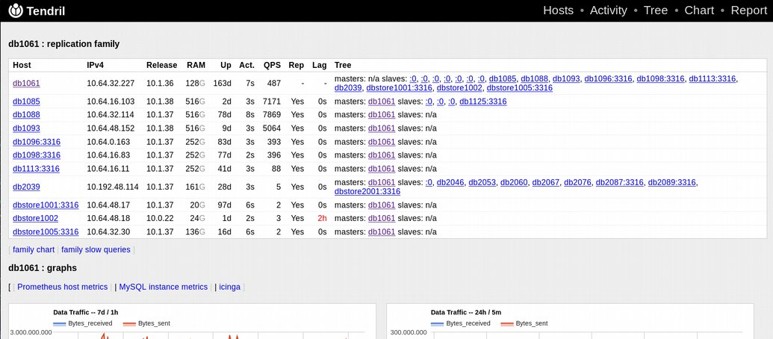
Tendril: host info
all hosts in same part of the tree
handy cinga/grafana links

Slide 47
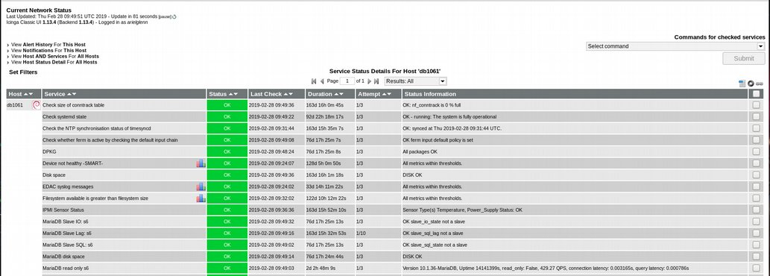
one click to Icinga

Slide 48
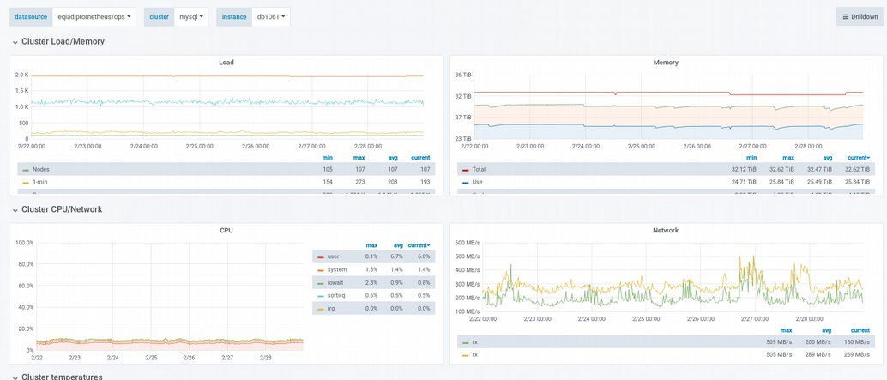
one click to grafana

Slide 49
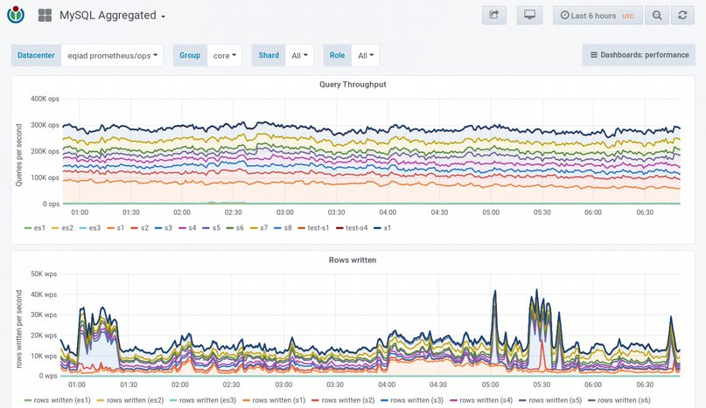
more grafana: aggregated stats

Slide 50
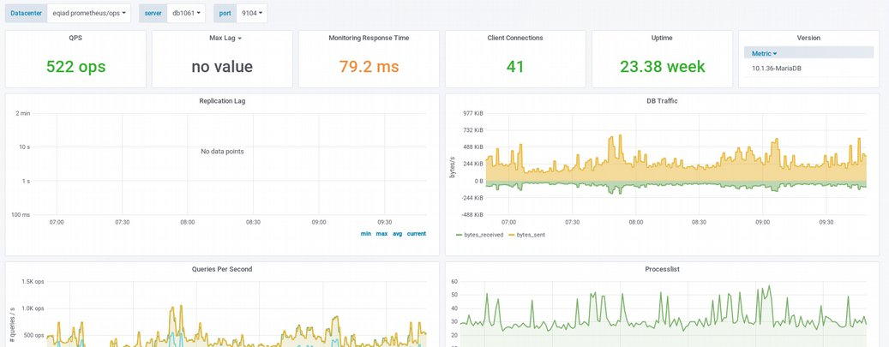
one click to mysql stats

Slide 51
let’s talk about replag
changes to dbs on master transmitted to replicas
One replica thread stores master changes in a log file
second replica thread reads log, applies changes
lag means reads return stale data
> 600 edits a second on Wikidata, any lag is bad!
icinga: WARN at 60 secs, CRITICAL at 300 (5 min)

Slide 52
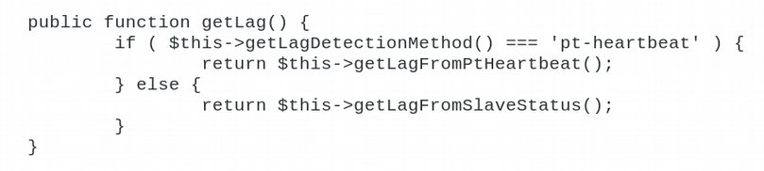
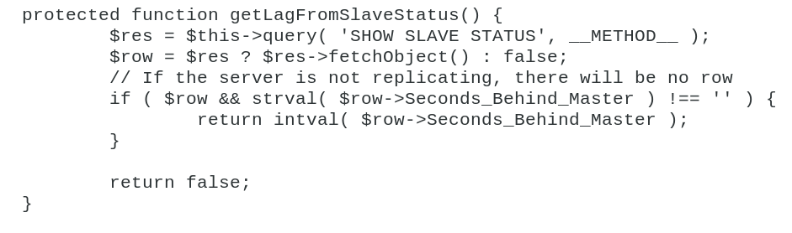
MediaWiki replag checks

Slide 53
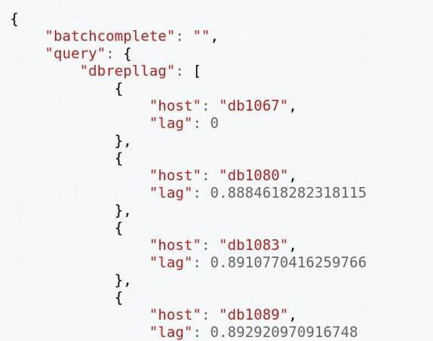
checking replag via MediaWiki api
https://en.wikipedia.org/w/api.php
?action=query
&meta=siteinfo
&siprop=dbrepllag
&sishowalldb=

Slide 54
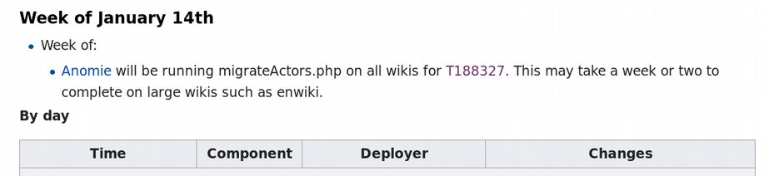
more about replag
OH NO I see a CRIT!
is it in codfw (inactive dc)? codfw servers are slower: no SSDs!
maintenance jobs/schema updates running in codfw?
check https://wikitech.wikimedia.org/wiki/Deployments

Slide 55
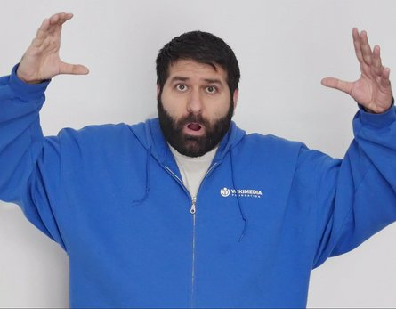
even more about replag
replication broken/stopped:
in codfw (inactive dc)? probably can wait (<1 day) for dbas’ working hours; send email anyways
in eqiad (active dc)? other replicas might handle load but call anyways
causes: failed hardware, corrupt db (drift), …
typical fix for corrupt db: reclone from replica (backup source host if possible)
don’t try to fix, just ping, email or CALL

Slide 56
and speaking of depooling...
on host reboot mysql does not start; intentional!
bad RAID can crash a host which then reboots
whatever the cause, if mysql isn’t available DON’T RESTART.
ping dbas if around; otherwise depool the host
not strictly necessary (MediaWiki should redirect traffic), depooling still preferred
how to depool is beyond the scope of these slides, but see:
https://wikitech.wikimedia.org/wiki/MariaDB/troubleshooting#Depooling_a_slave

Slide 57
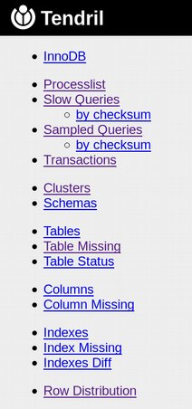
Tendril reports
many report types
most of interest only to dbas
slow queries, processlist, sampled queries, maybe transactions, for the rest of us

Slide 58
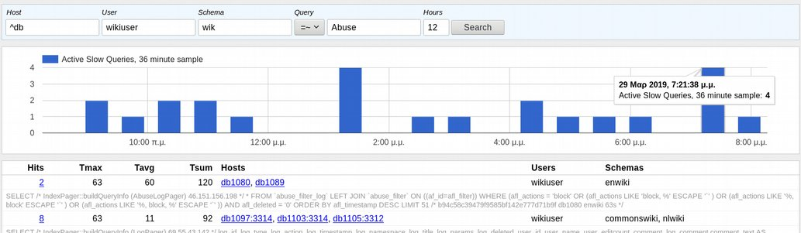
slow query monitoring example
AbuseFilter log display is slow:
IndexPager::buildQueryInfo (AbuseLogPager)...

Slide 59
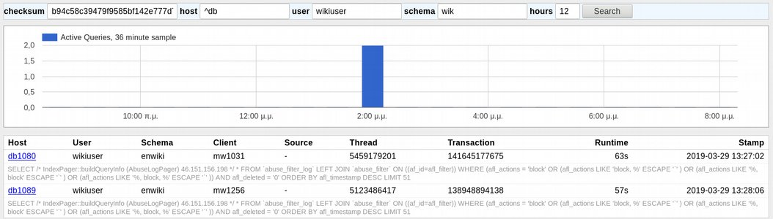
slow query monitoring example (2)
the two queries, displayed by checksums, with runtimes, transaction ids for checking logs

Slide 60
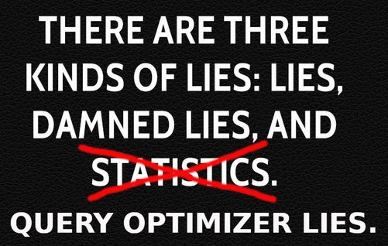
slow queries, the bad news
SHOW EXPLAIN doesn’t always
MariaDB optimizer sometimes lies!
it’s better than nothing, but…
better still is checking the live query!

Slide 61

Tendril reports continued
table status report: rough space estimates

Slide 62


Tendril: enwiki vs wikidata
index size
data size
rows

Slide 63

Tendril reports: row distribution

Slide 64


Tendril row distribution (cont)
when row distr is skewed, we partition certain hosts (rc/log)

Slide 65

Tendril reports: cluster
hostname, schema, data size, index size, total
WHAT IS THIS??

Slide 66

another cute baby cow

Slide 67

Tendril: charts

Slide 68

Tendril: charts (2)

Slide 69

lag revisited
custom charts! labels might be a bit off though
??

Slide 70

Tendril charts: what to check
variable names autosuggest drop-down list!

Slide 71

Tendril charts: queries killed

Slide 72

Tendril: queries killed (2)
host details graphs also show this

Slide 73

Tendril charts: more

Slide 74
summing up
mysql –skip-ssl on the host is nice
sql <wikidbname> is nicer when you can
Tendril is even nicer
nicest of all: our DBAs who keep it all together
cute baby cows make everything better

Slide 75
image credits
me: https://commons.wikimedia.org/wiki/File:Ariel_Glenn_at_Wikimania_2010.jpg
baby cows: https://www.boredpanda.com/cute-baby-highland-cattle-calves/
nope meme: https://memegenerator.net/instance/43196286/nope-nope-nope-nope-nopenopenope-nopity-nope-nope
dragon: https://commons.wikimedia.org/wiki/File:Hokusai_Dragon.jpg
jynus: https://jynus.com/gif/mind_blown.gifv
lies: http://www.quotehd.com/quotes/benjamin-disraeli-statesman-there-are-three-kinds-of-lies-lies-damned-lies-and
caution: https://commons.wikimedia.org/wiki/File:Caution_sign_on_ski_slope.jpg
emoji: https://upload.wikimedia.org/wikipedia/commons/thumb/1/1b/Emojione1_1F606.svg/48px-Emojione1_1F606.svg.png

Slide 76
Credits for content
good content ultimately came from springle, jynus, marostegui because I learned whatever I know from them
mistakes or crap content is my fault and no one else’s

Slide 77

Thanks!
Questions? Ask jynus or marostegui
irc: apergos
email: ariel@wikimedia.org

