Slide 1
Analysis of House Sales Dataset
By Aperi Jessyca

Slide 2
Problem Statement (Motivation)
I am hired by a start-up that intends to venture into the real estate space. The firm finds already existing houses, renovates them if necessary and resells them. The business problem i intend to solve is: Analyze the data and find what
three factors are highly associated with highly priced houses so that they are
considered during the initial buy and are also exploited during
renovations to maximize profits.

Slide 3
Descriptive Statistics

Slide 4
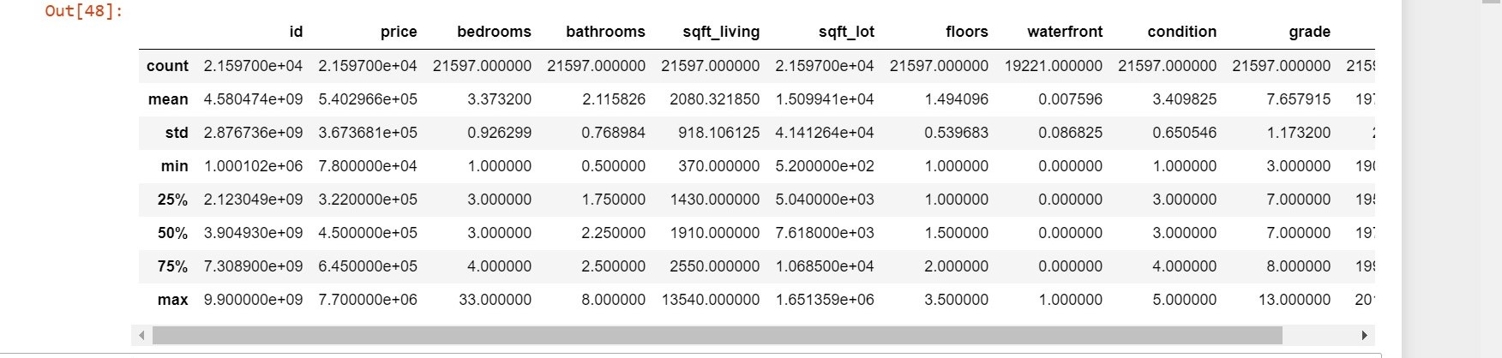
In order answer the research questions, during data pre-processing, I had to deal with null values and outliers by dropping them .
Also during data preprocessing , I dropped the irrelevant columns and conducted feature selection of the best features to create my linear regression model. I dropped columns that might lead to multicollinearity.
Dataset overview

Slide 5
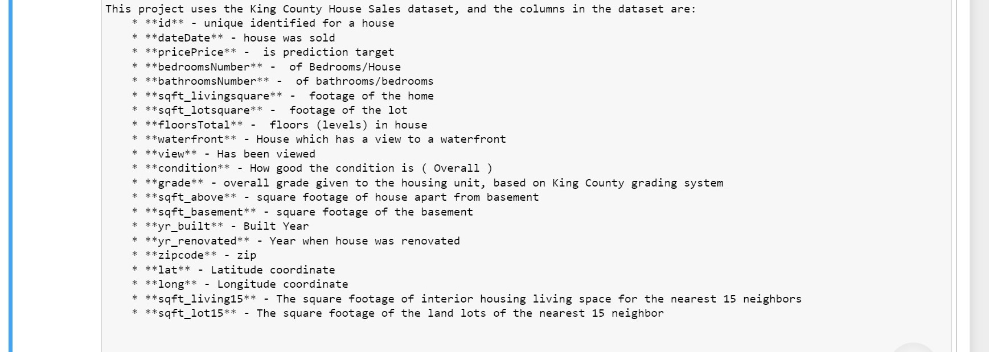
Feature explanation
The features are from columns I had to create from the dataset.
They are pretty self explanatory from the names except ‘tconst’ that is an identifying column.

Slide 6
Methodology
Data Exploration
Drawing Conclusions
Data Cleaning

Slide 7
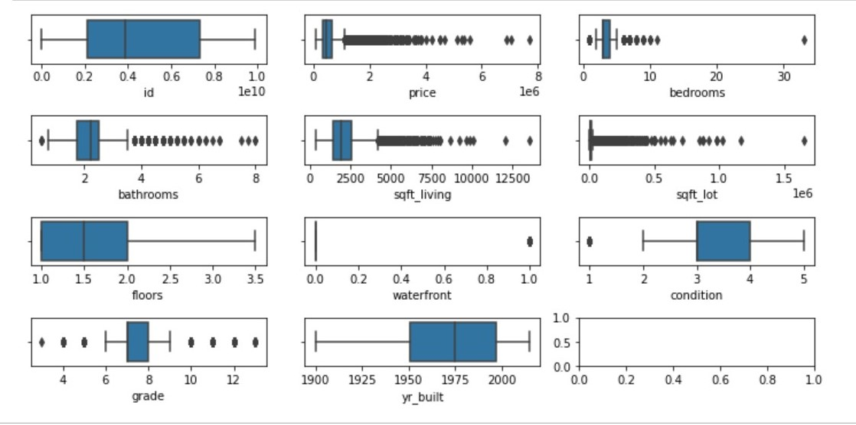
Data Cleaning
I cleaned the data by detecting null values and outliers, and dropped them. For instance here are boxplots I used to detect and drop outliers before and after.

Slide 8
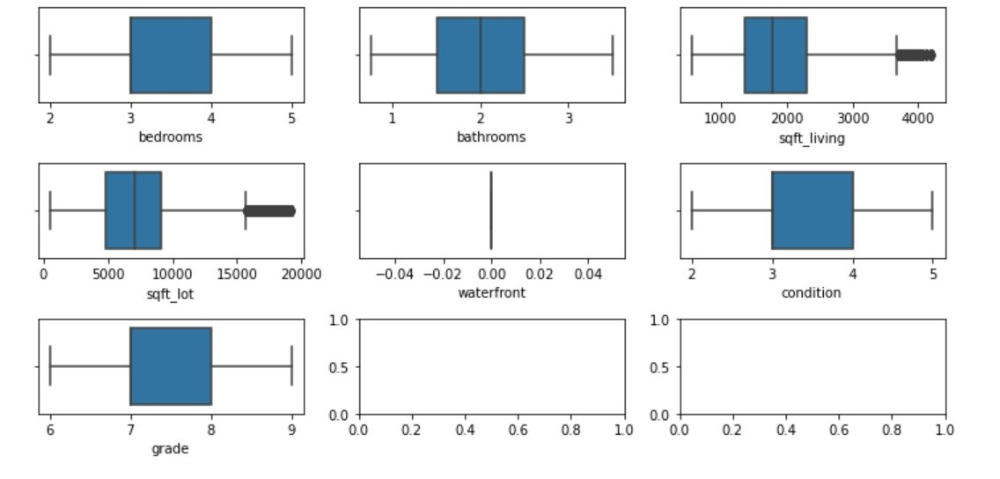

Slide 9
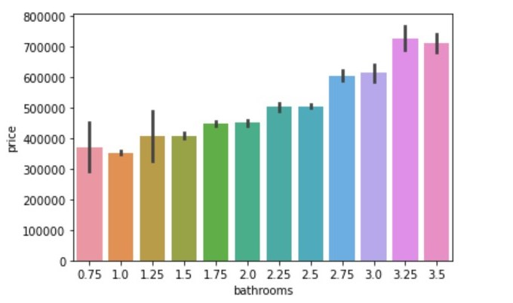
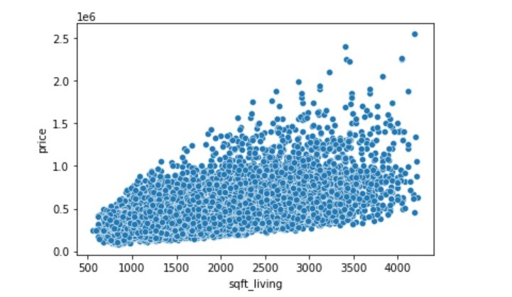
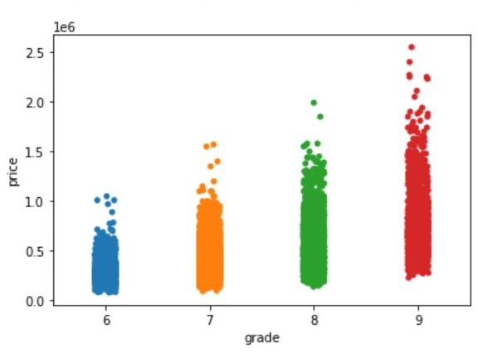
Data Exploration
From my analysis, I found that square feet of the house, the grade and the number of bedrooms had the highest association with price and should be considered most.

Slide 10
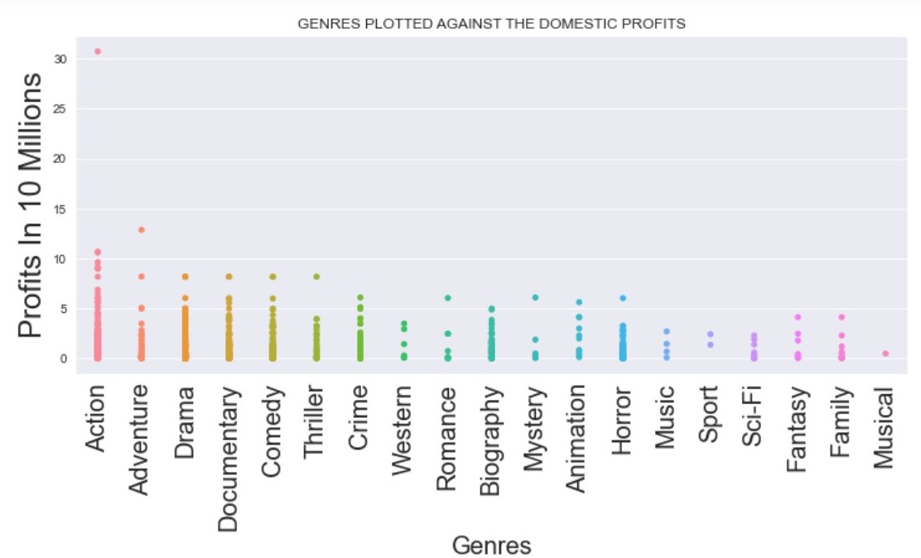

Slide 11
Findings and Recommendations

Slide 12
Findings
From the plots above : you observe that square – feet of the living area, the grade of the house and the number of bathrooms are the factors that should be greatly considered.

Slide 13
Recommendations.
I would recommend that the From the plots above : you observe that square – feet of the living area, the grade of the house and the number of bathrooms are the factors that should be greatly considered when buying and reselling houses

