Slide 1
Exploratory Data Analysis of
The Movies Dataset
By Aperi Jessyca

Slide 2
Problem Statement (Motivation)
My motivation is to investigate the most profitable movies in order to understand their characteristics in terms of what genre they are, when they are released(summer or winter) and whether or not the length of the movie affects its gross profits.
The answers to these questions will arm the Microsoft execs with the correct information to maneuver and conquer the movie making industry

Slide 3
Descriptive Statistics

Slide 4
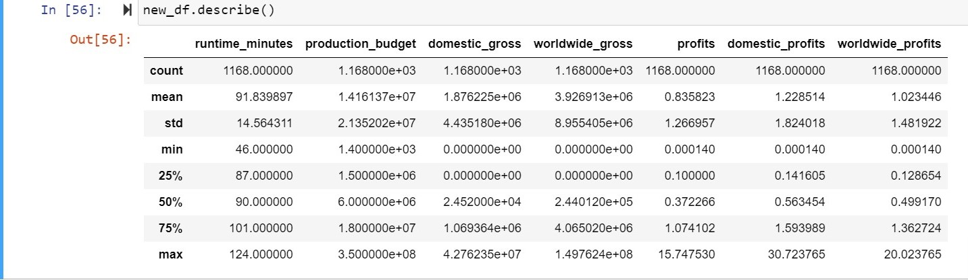
In order answer the research questions I had do merge different datasets together and drop others on each research question.
I also dealt with null values and outliers by dropping them and replacing others with outliers
Dataset overview

Slide 5
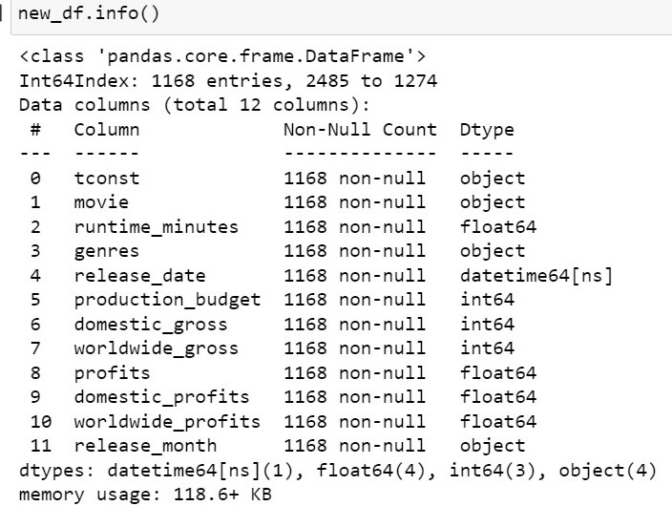
Feature explanation
The features come from columns I had to create from the dataset.
They are pretty self explanatory from the names except ‘tconst’ that is an identifying column.

Slide 6
Methodology
Data Exploration
Drawing Conclusions
Data Cleaning

Slide 7
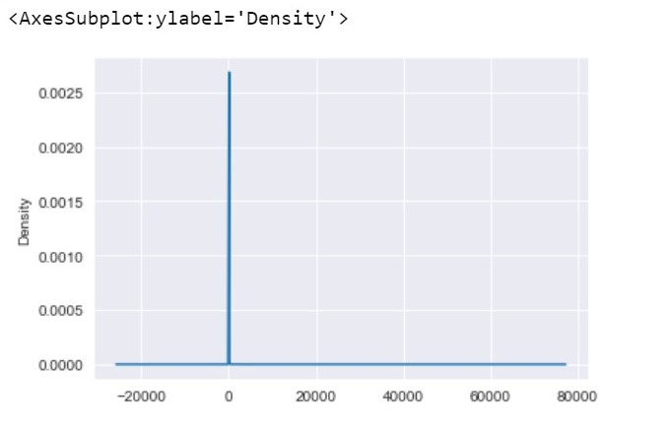
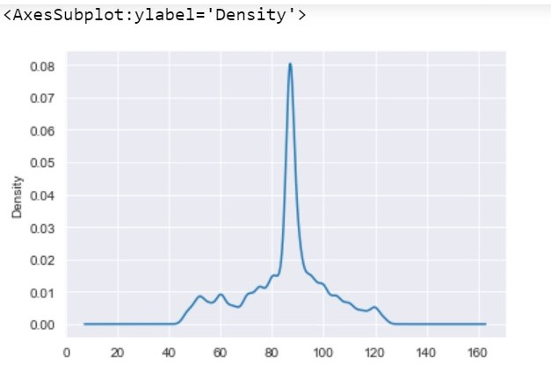
Data Cleaning
I cleaned the data by detecting null values and outliers, depending on the type of data and its distribution I dropped some of it replaced it with its mode for categorical data or dropped the outliers.
For instance here is a distribution plot of the column running time minutes(duration) before and after dropping nulls respectively.

Slide 8
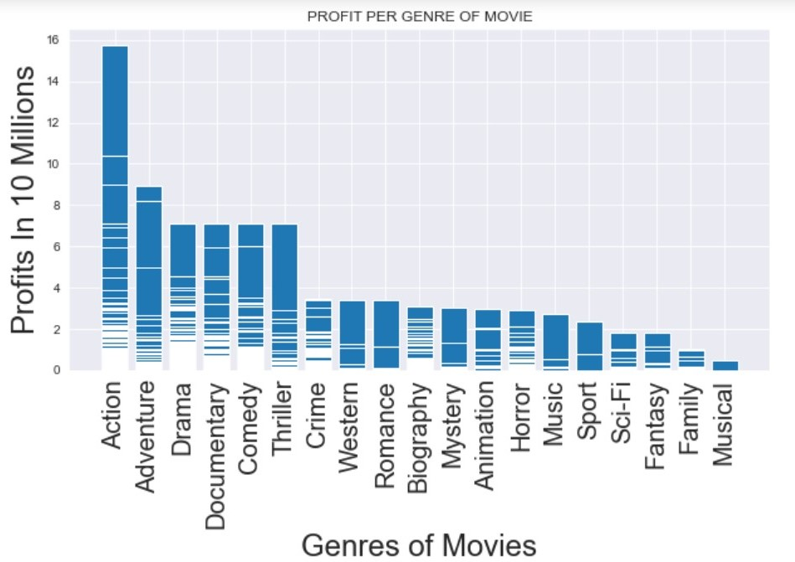
Data Exploration
To find the most profitable movie genre I plotted the genres against the profits

Slide 9
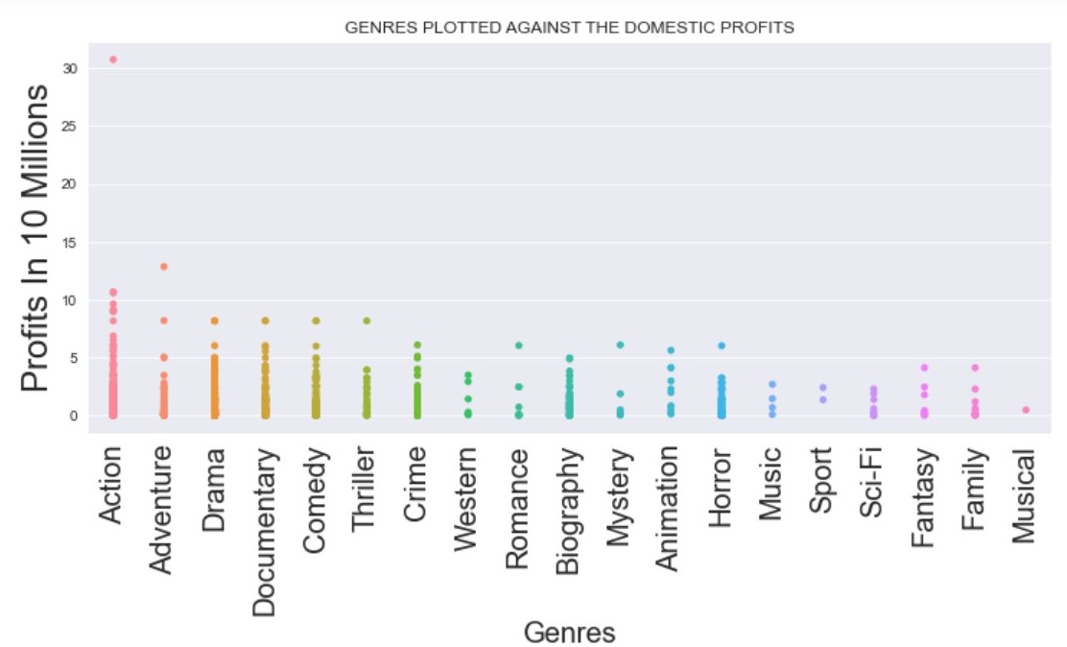

Slide 10
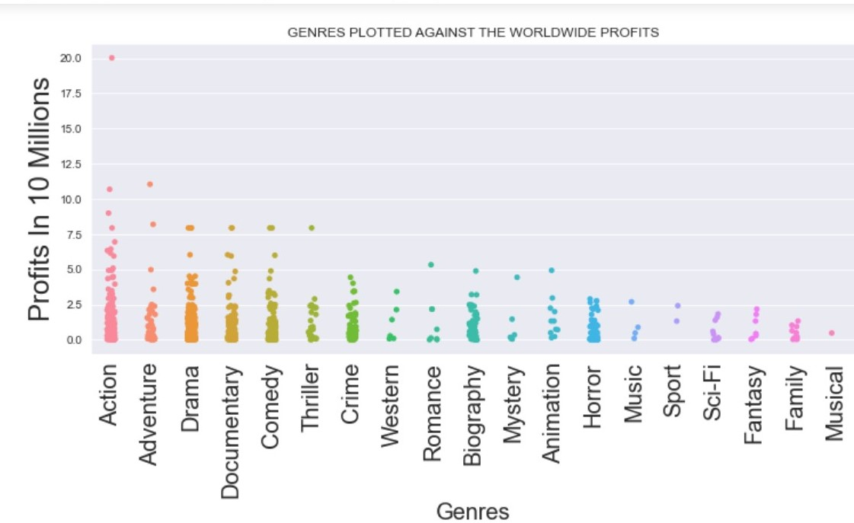

Slide 11
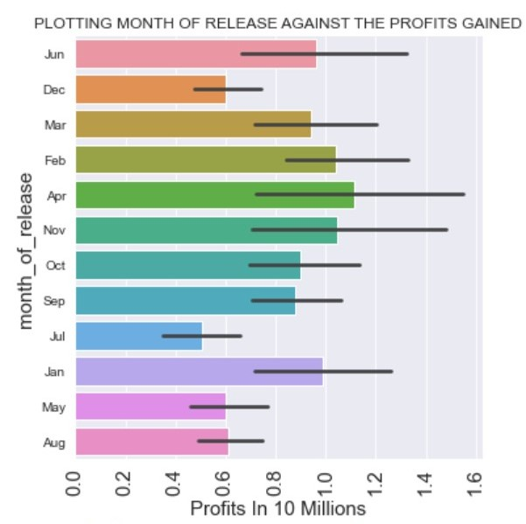
The release months with the highest profits are April, November, January. There are months where people experience Winter.

Slide 12
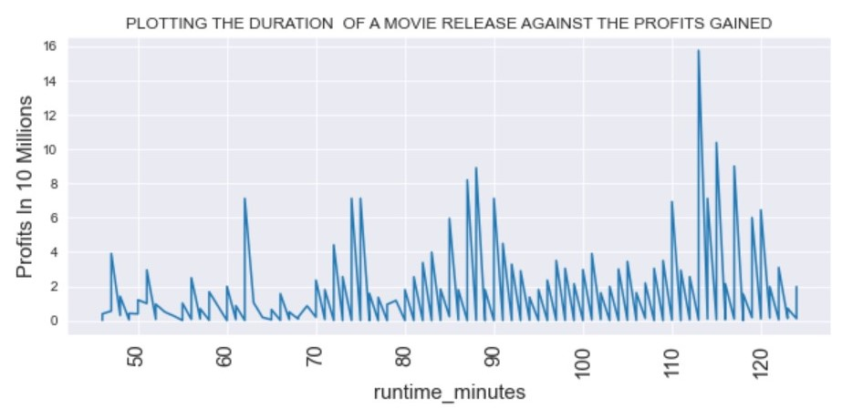

Slide 13
Findings and Recommendations

Slide 14
Findings
From the plots above : you observe that the most profitable movie genres to produce are: Action, Adventure, Drama, Documentary and Comedy.
The most profitable movies were released in the winter months of October, November, December and even January.
My final conclusion is that longer movies do not always get the most profits and that movie length is not directly proportional to profits accrued

Slide 15
Recommendations.
I would recommend that Microsoft allocate a larger portion of their budget to producing the following genres Action, Adventure, Drama, Documentary and Comedy
I would encourage them to plan their production so that release dates mostly fall on the winter
Finally I would recommend that they should not limit the length of a movie as it has no bearing on profits made

