Slide 1
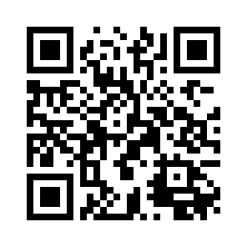
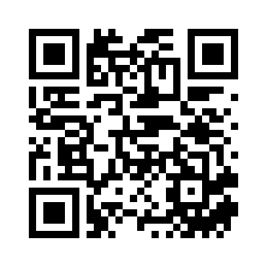
TECHNOMANTIC
CODING WORKSHOP
BUSINESS
CARD ->
<- GITHUB
Magic & Technology // Computation as Ritual
Github repo: https://github.com/aperry2/technomanticCodingWorkshop
NMCS 2026
~60 min

Slide 2
// GUIDED WORKFLOW
0–10 min
Introduction & theory
Technomancy, Cramer, Chun, Spare
10–20 min
Sigilization
Write intent, reduce letters, draw sigil
20–25 min
Mode 0 → 1: Threshold
Frame sigil, adjust to find threshold cutoff
25–35 min
Mode 2: Newtonian Hue
Explore hue speed, saturation, color lock
35–45 min
Mode 3: Radial Symmetry
Segments, rotation, zoom, & saving frames
45–60 min
Reflection & discussion
Ownership, forgetting, authorship

Slide 3
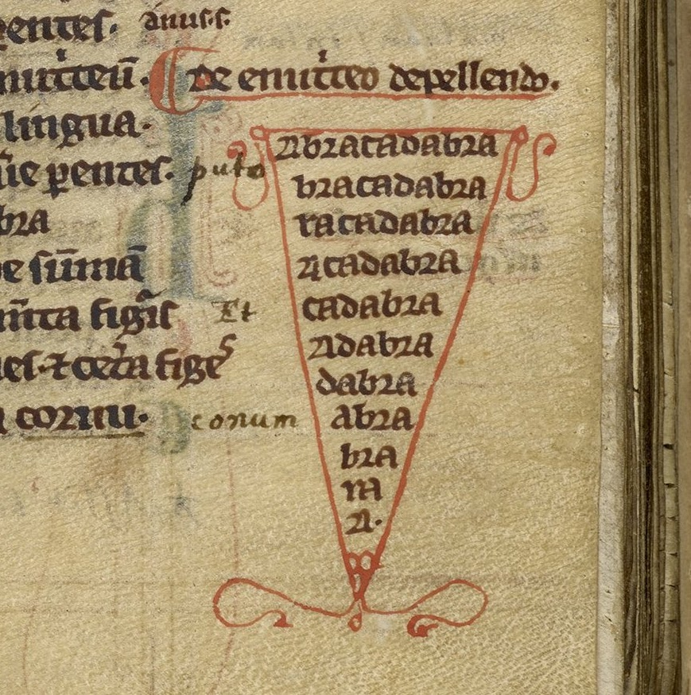
// WHAT IS TECHNOMANTIC CODING?
MAGIC
An “utterance” of symbolic language (verbal or otherwise) that produces an effect.
ABRACADABRA — "I will create as I speak."

Slide 4
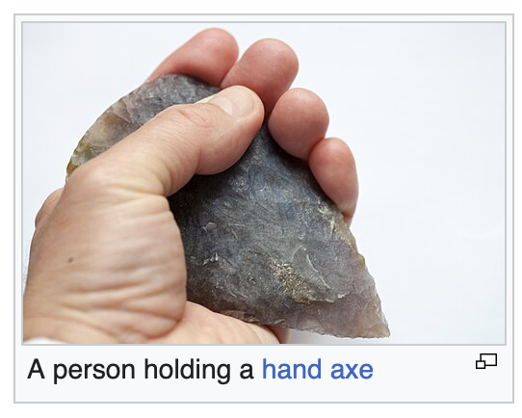
// WHAT IS TECHNOMANTIC CODING?
TECHNOLOGY
An extension of the human.
Ernst Kapp's "organ projection” (1877)
McLuhan's "extension of human faculties” (1964)

Slide 5
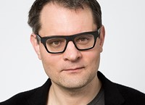
// THEORISTS
FLORIAN CRAMER
Words Made Flesh (2005)
Main Claim: Software is the first writing that literally does what it says.
Cramer traces a lineage from Kabbalistic letter permutation through Raymond Llull’s Ars Magna to executable code.
Key: Executable language

Slide 6
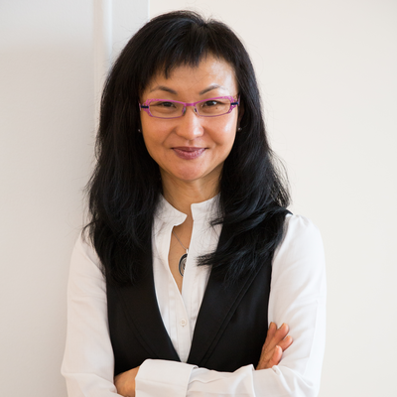
// THEORISTS
WENDY CHUN
Programmed Visions (2011)
Code functions through "sourcery”, or source code as sorcery. We trust code, but its execution is invisible. This faith mirrors magical practice.
Key: Sourcery

Slide 7
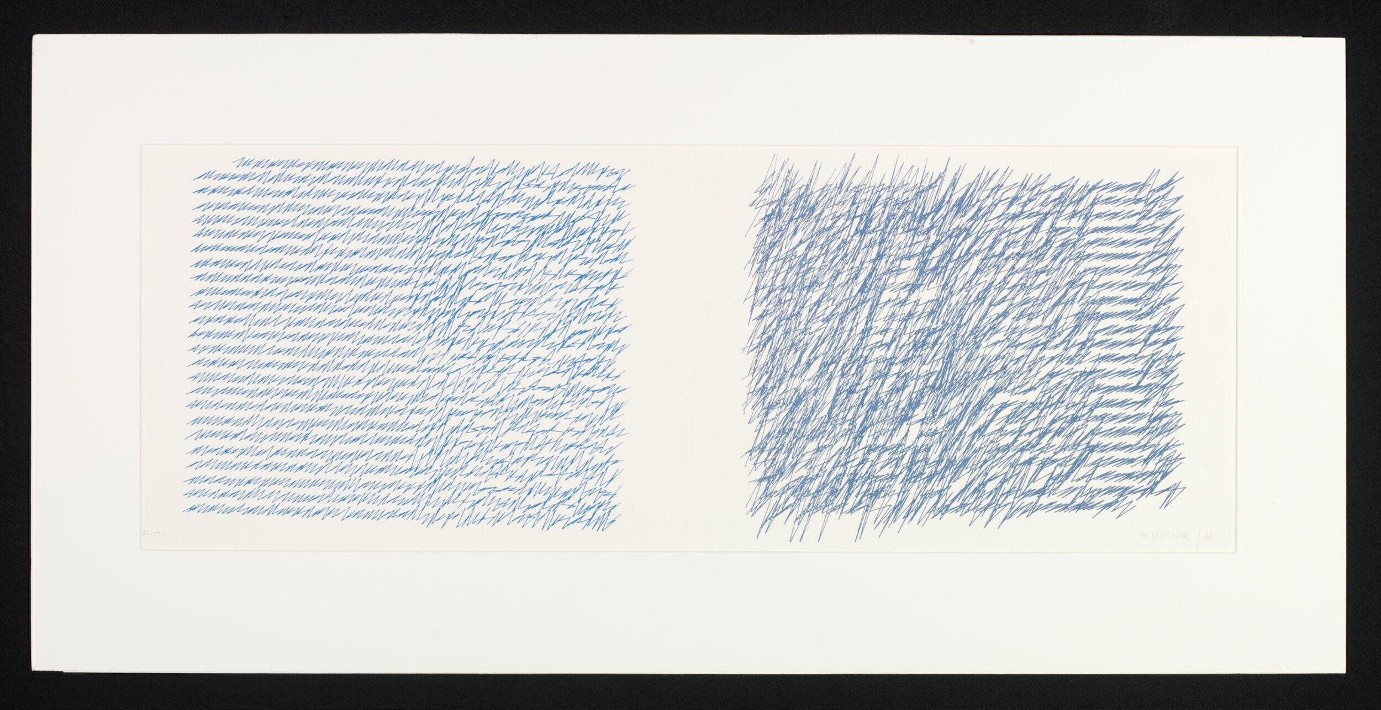
// ARTISTS
VERA MOLNÁR
“Vera Molnár (born 1924), Hungarian artist and pioneer of computer art, used the term machine imaginaire (imaginary machine) to express a shared visual language between the humanness of handwork and the precision of mathematical algorithms.”
- Zarna Hart writing for the Victoria & Albert Museum
Letters from my Mother, Vera Molnár, 1988
Notes:
https://www.vam.ac.uk/blog/museum-life/vera-molnar-machine-imaginaire-the-dance-of-hands-and-machine-thinking

Slide 8
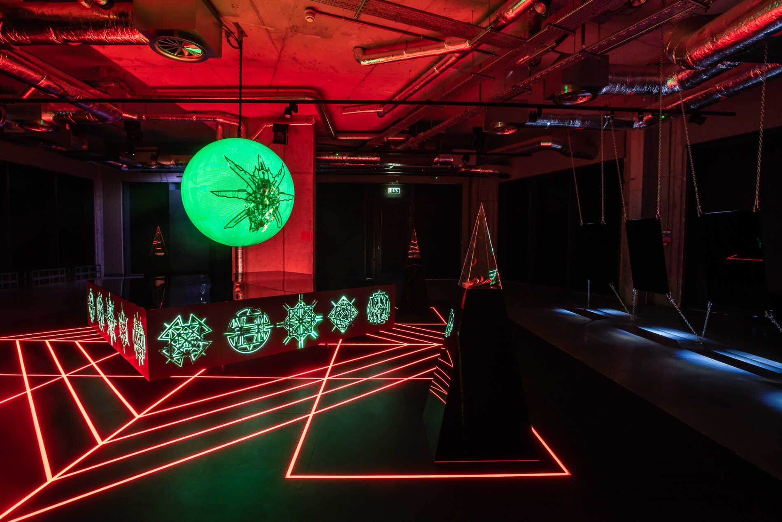
// ARTISTS
ZACH BLAS
“CULTUS (2023) is a multimedia installation that addresses a burgeoning AI religiosity in the tech industry. … CULTUS reconfigures the Elizabethan mathematician and occultist John Dee’s Holy Table, an esoteric device of sigils, seals, and a crystal ball, with which Dee communed with angels to gain access to God. “
Notes:
https://zachblas.info/works/cultus/

Slide 9
// CHAOS MAGIC & SIGILS
AUSTIN OSMAN SPARE (1886–1956)
Write a statement of desire or intent, remove repeating letters, and then recombine the remaining letterforms into an abstract symbol. Then forget the original intention.
PROCESS
1. Statement of intent
2. Remove duplicate letters
3. Combine into symbol
4. Capture as input
For Spare, the forgetting was crucial. He believed conscious fixation blocked realization. The sigil must bypass the conscious mind through moments of “gnosis”.

Slide 10
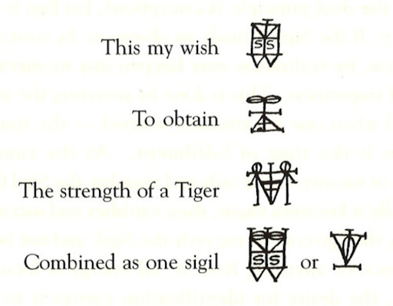
// CHAOS MAGIC & SIGILS
PROCESS
1. Statement of intent
2. Remove duplicate letters
3. Combine into symbol
4. Capture as input

Slide 11
// COLOR AS MAGICAL SUBSTANCE
CAUDA PAVONIS
MUSICA UNIVERSALIS CORRESPONDENCES
Latin for "peacock’s tail”, in alchemy this is a momentary iridescence between albedo and rubedo in the stages of the alchemical Great Work. It represents all the colors prior to the final fixing of the rubedo stage.
COLOR
NOTE
PLANET
Red
D
Mars
Orange
E
Sun
Yellow
F
Venus
The cycling hue mode references a computational cauda pavonis.
Green
G
Saturn
Blue
A
Jupiter
Indigo
B
Mercury
Violet
C
Moon
NIGREDO
ALBEDO
CAUDA PAVONIS
RUBEDO

Slide 12
// OPERATION
01
02
03
04
INTENTION
SIGILIZATION
CODING
TRANSFORMED
IMAGE
Formulate a desire and
write it as a clear statement.
Transform the statement into a visual symbol or glyph.
“Rescan” the sigil through the webcam and toolkit to operate on the image.
Save your output for use as a digital talisman.

Slide 13
// TOOLKIT — MODES
0
RAW FEED
Unprocessed input. Frame your sigil.
1
THRESHOLD
Binary black/white. The image becomes decisive.
2
NEWTONIAN HUE
Threshold + cycling color from Newton’s 7-tone spectrum.
3
RADIAL SYMMETRY
Mandala-like mirroring. Sacred geometry on the sigil.

Slide 14
// TOOLKIT — CONTROLS
KEYS
PARAMETERS (TAB to select) + DEFAULTS
0 1 2 3
Switch mode
THRESHOLD
0.70
Brightness cutoff
TAB
Cycle active parameter
HUE SPEED
0.020
Color cycle rate
UP / DOWN
Adjust active parameter
SATURATION
80
Color intensity
LEFT / RIGHT
Radial segments ± 2
COLOR LOCK
CYCLE
Lock to one color
i
Toggle invert
c
Cycle input source
ROT SPEED
0.010
Radial rotation
s
Save frame as PNG
ZOOM
1.00
Radial zoom
t
Toggle HUD display

Slide 15
// REFLECTION
OWNERSHIP
Did the sigil ever stop feeling like "yours"? When?
FORGETTING
Did parameter-tweaking displace your focus from the original intention?
RITUAL & RUPTURE
Is computation an extension of a ritual, or a break from it?
AUTHORSHIP
Where is authorship: intention, hand, algorithm, or machine?
EXTENSION
Does the computational step extend human faculty or overwrite human faculty?

Slide 16
// SUGGESTED READINGS
Florian Cramer, Words Made Flesh (2005)
Wendy Chun, Programmed Visions (2011)
Austin Osman Spare, The Book of Pleasure (1913)
Phil Hine, Condensed Chaos (1995)
Documents of Contemporary Art: Magic (2021)
TECHNOMANTIC CODING WORKSHOP

