Slide 1
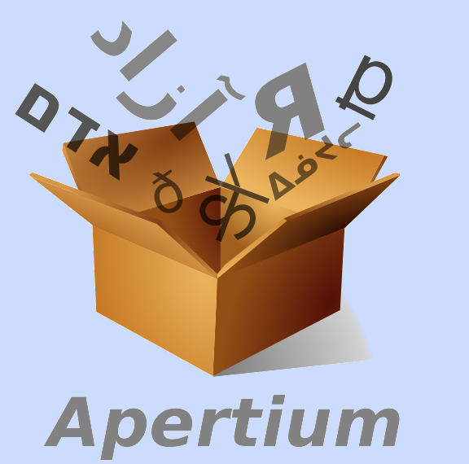
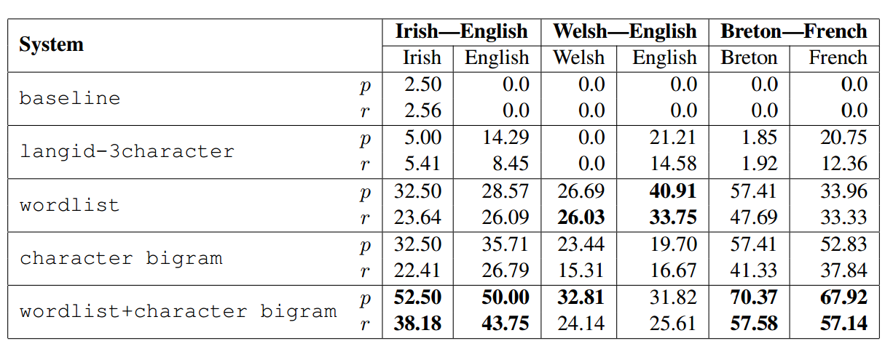
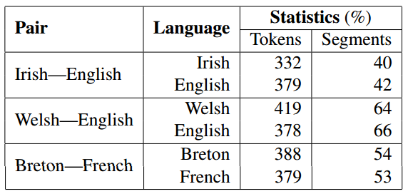
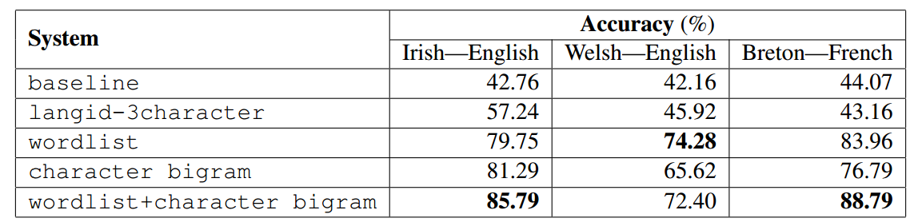
Subsegmental language detection in Celtic language text
Akshay Minocha Francis Tyers Special Thanks to,
IIIT-Hyderabad(India) UiT Norgga árktalaš universitehta Kevin Scannell
akshay.minocha@students.iiit.ac.in francis.tyers@uit.no
Introduction
Methodology
Evaluation
We aim to perform language identification on sub segmental basis -
Typical case is to detect the language of documents and sentences.
We are focussing on cases where - A single sentence may have different code switching points
[en You’re a] [ga Meiriceánach, cén fáth] [en are you] [ga foghlaim Gaeilge?!]
@afaltomkins [cy gorfod cael bach o tan] [en though init]
[en omg] [cy mar cwn bach yn] [en black and tan] [cy a popeth,] [en even cuter!!]
Alphabet n-gram Approach -
  Character Language model
  Using IRSTLM we build a language model for the five languages
  For English and French - Europarl [1]
  Breton, Welsh and Irish - Corpora of text crawled from the web
  Size of the corpus from which this language model was built - 1.5 million tokens
  Example - ‘slainte!’ would be -
  { ‘ s’, ‘s l’, ‘l a’, ‘ ´ a i’, ‘i n’, ‘n t’, ‘t e’, ‘e !’, ‘! ´ ’ }
Word-based Prediction -
  Generate word lists for the languages using aspell which is widely used on Unix systems.
  Word are labeled according to their presence in the particular word list.
  In case of a confusion the word is added to the previous segment
Word-based prediction with character backoff
  Same as Word-based prediction, but in case of confusion this falls back to the Alphabet bi-gram approach.
Baseline
  Using langid.py[2] labeled all the lines in a particular dataset according to the majority classification
Langid character trigram prediction
Trigram probabilities from langid were taken into account.
All other heuristics and chunking algorithm are same as for other methods.
  We followed the footsteps of CoNLL 2000 shared task on language independent named entity recognition.
  Divide the text into non-overlapping segments.
  Precision - percentage of correctly detected phrases.
  Recall - number of phrases in the data that were found by the chunker.
Dataset
Results
Simplifying the task by taking into account Celtic languages and a corresponding majority language.
Manual annotation of about 40-50 tweets for each of the three language pairs.
Chunking algorithm
Require: s : sentence to chunk
buffer = [ ] /*Undecided expanding window of chunk*/
chunks = [ ] /*Decided labelled segment*/
buffer language ← LANGPREDICT(s[0]) /*Language of ﬁrst word */
ﬂag ← 0
for all w ∈ s do
if LANGPREDICT(w)=buffer language then
if ﬂag = 1 then
buffer ← buffer + [word buffer, w ]
flag ← 0
else
buffer ← buffer + [ w ]
if LANGPREDICT(w)≠buffer language then
if ﬂag= 0 then
ﬂag ← 1
word buffer ← w
continue
else
chunks←chunks + [(buffer,buffer language)]
buffer←[word buffer,w]
buffer language←LANGPREDICT(w) /*Language of new expanding chunk */
ﬂag ← 0
if length(buffer)≠0 then
chunks ← chunks + [(buffer,buffer language)]
Conclusions
A very preliminary investigation into subsegment language identification in Celtic language texts.
We would like to include supervised methods and features talked about by King and Abney (2013) [3]
We would also like to check our methods with higher order n-grams and more options in backoff.
Explore a lattice technique where each word is a lattice node and the inclusions of the words are done using probability.
References
[1] Philipp Koehn. 2005. Europarl: A parallel corpus for statistical machine translation. In MT summit, volume 5, pages 79–86.
[2] Marco Lui and Timothy Baldwin. 2012. langid. py: An off-the-shelf language identiﬁcation tool.
[3] Ben King and Steven P Abney. 2013. Labeling the languages of words in mixed-language documents using weakly supervised methods. In HLT-NAACL, pages 1110–1119.

