Slide 1
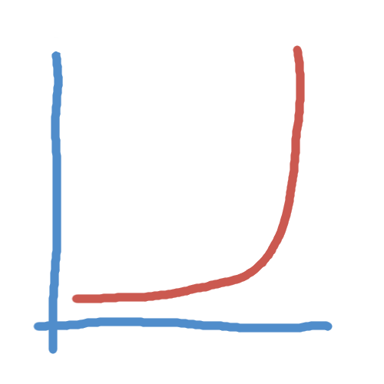
The bank slide

Slide 2
Data structure

Slide 3
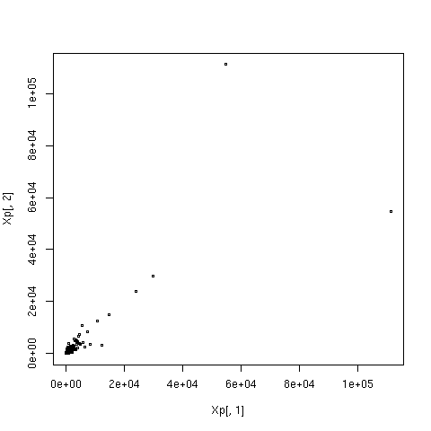
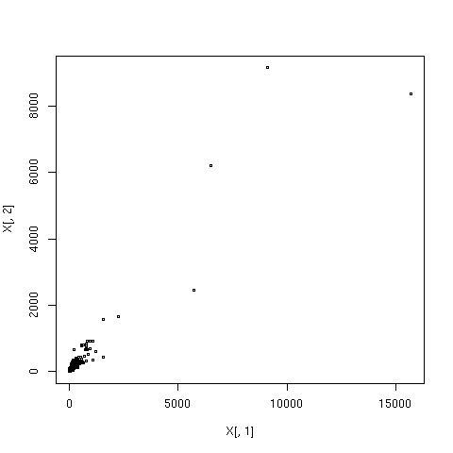
Preprocessing, normalisation, modelling
Remove samples and transcripts that have little variance
Quantile normalise

Slide 4
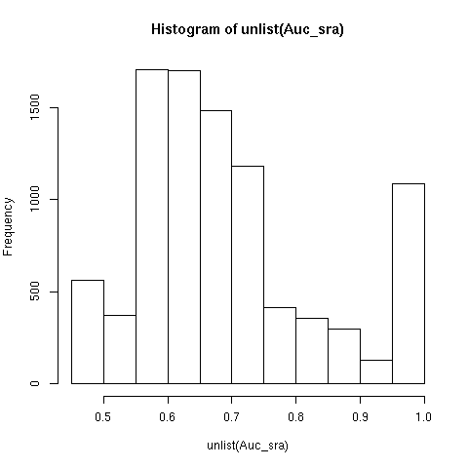
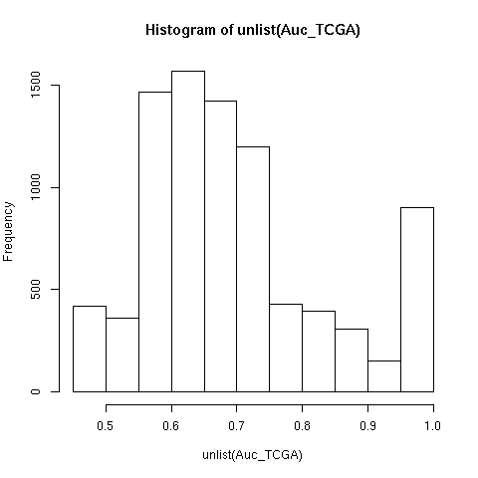
Early function prediction
K nearest neighbours (k=50)
Determined by Fisher exact test

Slide 5
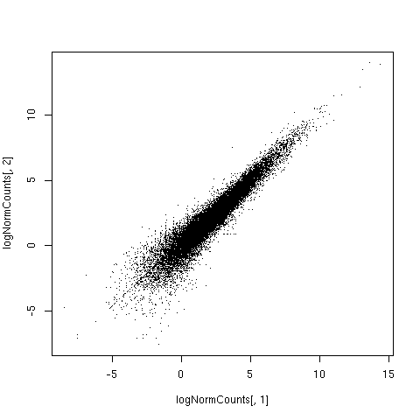
What next?
Different normalisation methods
Hyperparameter optimisation

Slide 6
Hyperparameter optimisation
Are predictions with this many neighbours informative at all?
modelID | dataSource | model | hyperparameters | AUC | path
Truth | GO annotations | NA | NA | 1 | NA
Model49 | SRA | KNeighborsClassifier | algorithm="kd_tree",n_neighbors=200 | 0.6637581049 | /dat2/SRA_ss_prepr.tsv
Model46 | SRA | KNeighborsClassifier | algorithm="kd_tree",n_neighbors=100 | 0.6608741061 | /dat2/SRA_ss_prepr.tsv
Model50 | SRA | KNeighborsClassifier | algorithm="kd_tree",n_neighbors=400 | 0.6548451159 | /dat2/SRA_ss_prepr.tsv
Model41 | SRA | KNeighborsClassifier | algorithm="kd_tree",n_neighbors=100 | 0.6522424415 | /dat2/expression.gene.v2.tsv
Model45 | SRA | KNeighborsClassifier | algorithm="kd_tree",n_neighbors=50 | 0.6494760674 | /dat2/SRA_ss_prepr.tsv
Model47 | SRA | KNeighborsClassifier | algorithm="kd_tree",n_neighbors=200 | 0.6493044514 | /dat2/expression.gene.v2.tsv
Model40 | SRA | KNeighborsClassifier | algorithm="kd_tree",n_neighbors=50 | 0.6434734525 | /dat2/expression.gene.v2.tsv
Model48 | SRA | KNeighborsClassifier | algorithm="kd_tree",n_neighbors=400 | 0.6366917252 | /dat2/expression.gene.v2.tsv
Model44 | SRA | KNeighborsClassifier | algorithm="kd_tree",n_neighbors=20 | 0.6243033761 | /dat2/SRA_ss_prepr.tsv
Model28 | SRA | LogisticRegression | C=2.0,class_weight="balanced" | 0.6228193181 | /dat2/expression.gene.v2.tsv
Model2 | SRA | LogisticRegression | class_weight="balanced" | 0.6226806338 | /dat2/expression.gene.v2.tsv
Model29 | SRA | LogisticRegression | C=3.0,class_weight="balanced" | 0.6225972706 | /dat2/expression.gene.v2.tsv
Model26 | SRA | LogisticRegression | C=0.5,class_weight="balanced" | 0.6222473985 | /dat2/expression.gene.v2.tsv
Model25 | SRA | LogisticRegression | C=1.0,class_weight="balanced" | 0.6221525895 | /dat2/expression.gene.v2.tsv
Model27 | SRA | LogisticRegression | C=0.75,class_weight="balanced" | 0.6214018474 | /dat2/expression.gene.v2.tsv
Model4 | SRA | LogisticRegression | C=2.0,class_weight="balanced" | 0.6212337966 | /dat2/expression.gene.v2.tsv
Model39 | SRA | KNeighborsClassifier | algorithm="kd_tree",n_neighbors=20 | 0.6188288406 | /dat2/expression.gene.v2.tsv
Model34 | SRA | LogisticRegression | C=2.0,class_weight="balanced" | 0.6093809719 | /dat2/SRA_ss_prepr.tsv
Model32 | SRA | LogisticRegression | C=0.5,class_weight="balanced" | 0.6092275135 | /dat2/SRA_ss_prepr.tsv
Model35 | SRA | LogisticRegression | C=3.0,class_weight="balanced" | 0.6084063598 | /dat2/SRA_ss_prepr.tsv
Model31 | SRA | LogisticRegression | C=1.0,class_weight="balanced" | 0.6083302514 | /dat2/SRA_ss_prepr.tsv
Model20 | SRA | LogisticRegression | class_weight="balanced" | 0.6079023102 | /dat2/SRA_ss_prepr.tsv
Model33 | SRA | LogisticRegression | C=0.75,class_weight="balanced" | 0.6064455788 | /dat2/SRA_ss_prepr.tsv
Model22 | SRA | LogisticRegression | C=2.0,class_weight="balanced" | 0.6059440343 | /dat2/SRA_ss_prepr.tsv
Model43 | SRA | KNeighborsClassifier | algorithm="kd_tree",n_neighbors=10 | 0.601133877 | /dat2/SRA_ss_prepr.tsv
Model38 | SRA | KNeighborsClassifier | algorithm="kd_tree",n_neighbors=10 | 0.5963545601 | /dat2/expression.gene.v2.tsv
Model10 | GPL | LogisticRegression | C=2.0,class_weight="balanced" | 0.5914081341 | /dat2/GPL_ss_prepr.tsv
Model8 | GPL | LogisticRegression | class_weight="balanced" | 0.5903668615 | /dat2/GPL_ss_prepr.tsv
Model18 | TCGA | KNeighborsClassifier | algorithm="kd_tree" | 0.5881302119 | /dat2/TCGA_ss_prepr.tsv
Model17 | TCGA | KNeighborsClassifier | algorithm="auto" | 0.5872576403 | /dat2/TCGA_ss_prepr.tsv
Model11 | GPL | KNeighborsClassifier | algorithm="auto" | 0.5853008399 | /dat2/GPL_ss_prepr.tsv
Model12 | GPL | KNeighborsClassifier | algorithm="kd_tree" | 0.5850947967 | /dat2/GPL_ss_prepr.tsv
Model16 | TCGA | LogisticRegression | C=2.0,class_weight="balanced" | 0.5823786898 | /dat2/TCGA_ss_prepr.tsv
Model14 | TCGA | LogisticRegression | class_weight="balanced" | 0.5823021637 | /dat2/TCGA_ss_prepr.tsv
Model9 | GPL | LogisticRegression | C=2.0 | 0.5809544827 | /dat2/GPL_ss_prepr.tsv
Model7 | GPL | LogisticRegression |  | 0.5801482556 | /dat2/GPL_ss_prepr.tsv
Model24 | SRA | KNeighborsClassifier | algorithm="kd_tree" | 0.5793160262 | /dat2/SRA_ss_prepr.tsv
Model23 | SRA | KNeighborsClassifier | algorithm="auto" | 0.5792755257 | /dat2/SRA_ss_prepr.tsv
Model36 | SRA | KNeighborsClassifier | algorithm="kd_tree" | 0.5788374483 | /dat2/SRA_ss_prepr.tsv
Model42 | SRA | KNeighborsClassifier | algorithm="kd_tree",n_neighbors=5 | 0.5786711364 | /dat2/SRA_ss_prepr.tsv
Model30 | SRA | KNeighborsClassifier | algorithm="kd_tree" | 0.5733215489 | /dat2/expression.gene.v2.tsv
Model37 | SRA | KNeighborsClassifier | algorithm="kd_tree",n_neighbors=5 | 0.5727027042 | /dat2/expression.gene.v2.tsv
Model6 | SRA | KNeighborsClassifier | algorithm="kd_tree" | 0.572541259 | /dat2/expression.gene.v2.tsv
Model5 | SRA | KNeighborsClassifier | algorithm="auto" | 0.5722754115 | /dat2/expression.gene.v2.tsv
Model21 | SRA | LogisticRegression | C=2.0 | 0.5699323514 | /dat2/SRA_ss_prepr.tsv
Model19 | SRA | LogisticRegression |  | 0.5683604297 | /dat2/SRA_ss_prepr.tsv
Model13 | TCGA | LogisticRegression |  | 0.5362831273 | /dat2/TCGA_ss_prepr.tsv
Model15 | TCGA | LogisticRegression | C=2.0 | 0.5356574251 | /dat2/TCGA_ss_prepr.tsv
Model1 | SRA | LogisticRegression |  | 0.5298290955 | /dat2/expression.gene.v2.tsv
Model3 | SRA | LogisticRegression | C=2.0 | 0.5292462752 | /dat2/expression.gene.v2.tsv
Grid
model | HP | dataset
kNN | n_neighbours
LogReg | C
...

Slide 7
Hyperparameter optimisation
OK Add a table from a Predictions object with different models' AUC
This and this seems to work better than the rest on used data (in terms of AUC)
Generally SRA data
Also add a cute picture of micro AUC plotted

Slide 8
Relative expression level of txs compared to “consistency” as defined by dr Wren
10th Feb 2015

Slide 9
Comparison between datasets: correlations, anticorrelations
Not much consistency
coor approximatey 2x more consistent tha anticorr
But still mean about 6-10% same (in 100 top corr with ~16000 txs)
Some transcripts are consistent (WHAT ARE THOSE TRANSCRIPS?)
% overlapping transcripts
Need to show the curve enough times before to make it memorable

Slide 10
Comparison between datasets
Pearson correlation
Comparison for SKA3 based on 1282 human genes shared between three matrices:
  In TCGA-derived and colour 2-derived correlation matrices results were somewhat similar: out of top 100 correlated genes 61 were same
  SRA-derived matrix versus either of the others: out of top 100 correlated 14 and 20 were same

Slide 11
“Purified” datasets - subset tissues

Slide 12
“Purified” datasets – only samples where the expression for given transcript is > mean + sd()

Slide 13
TCGA: what kind of data, how much, etc

Slide 14
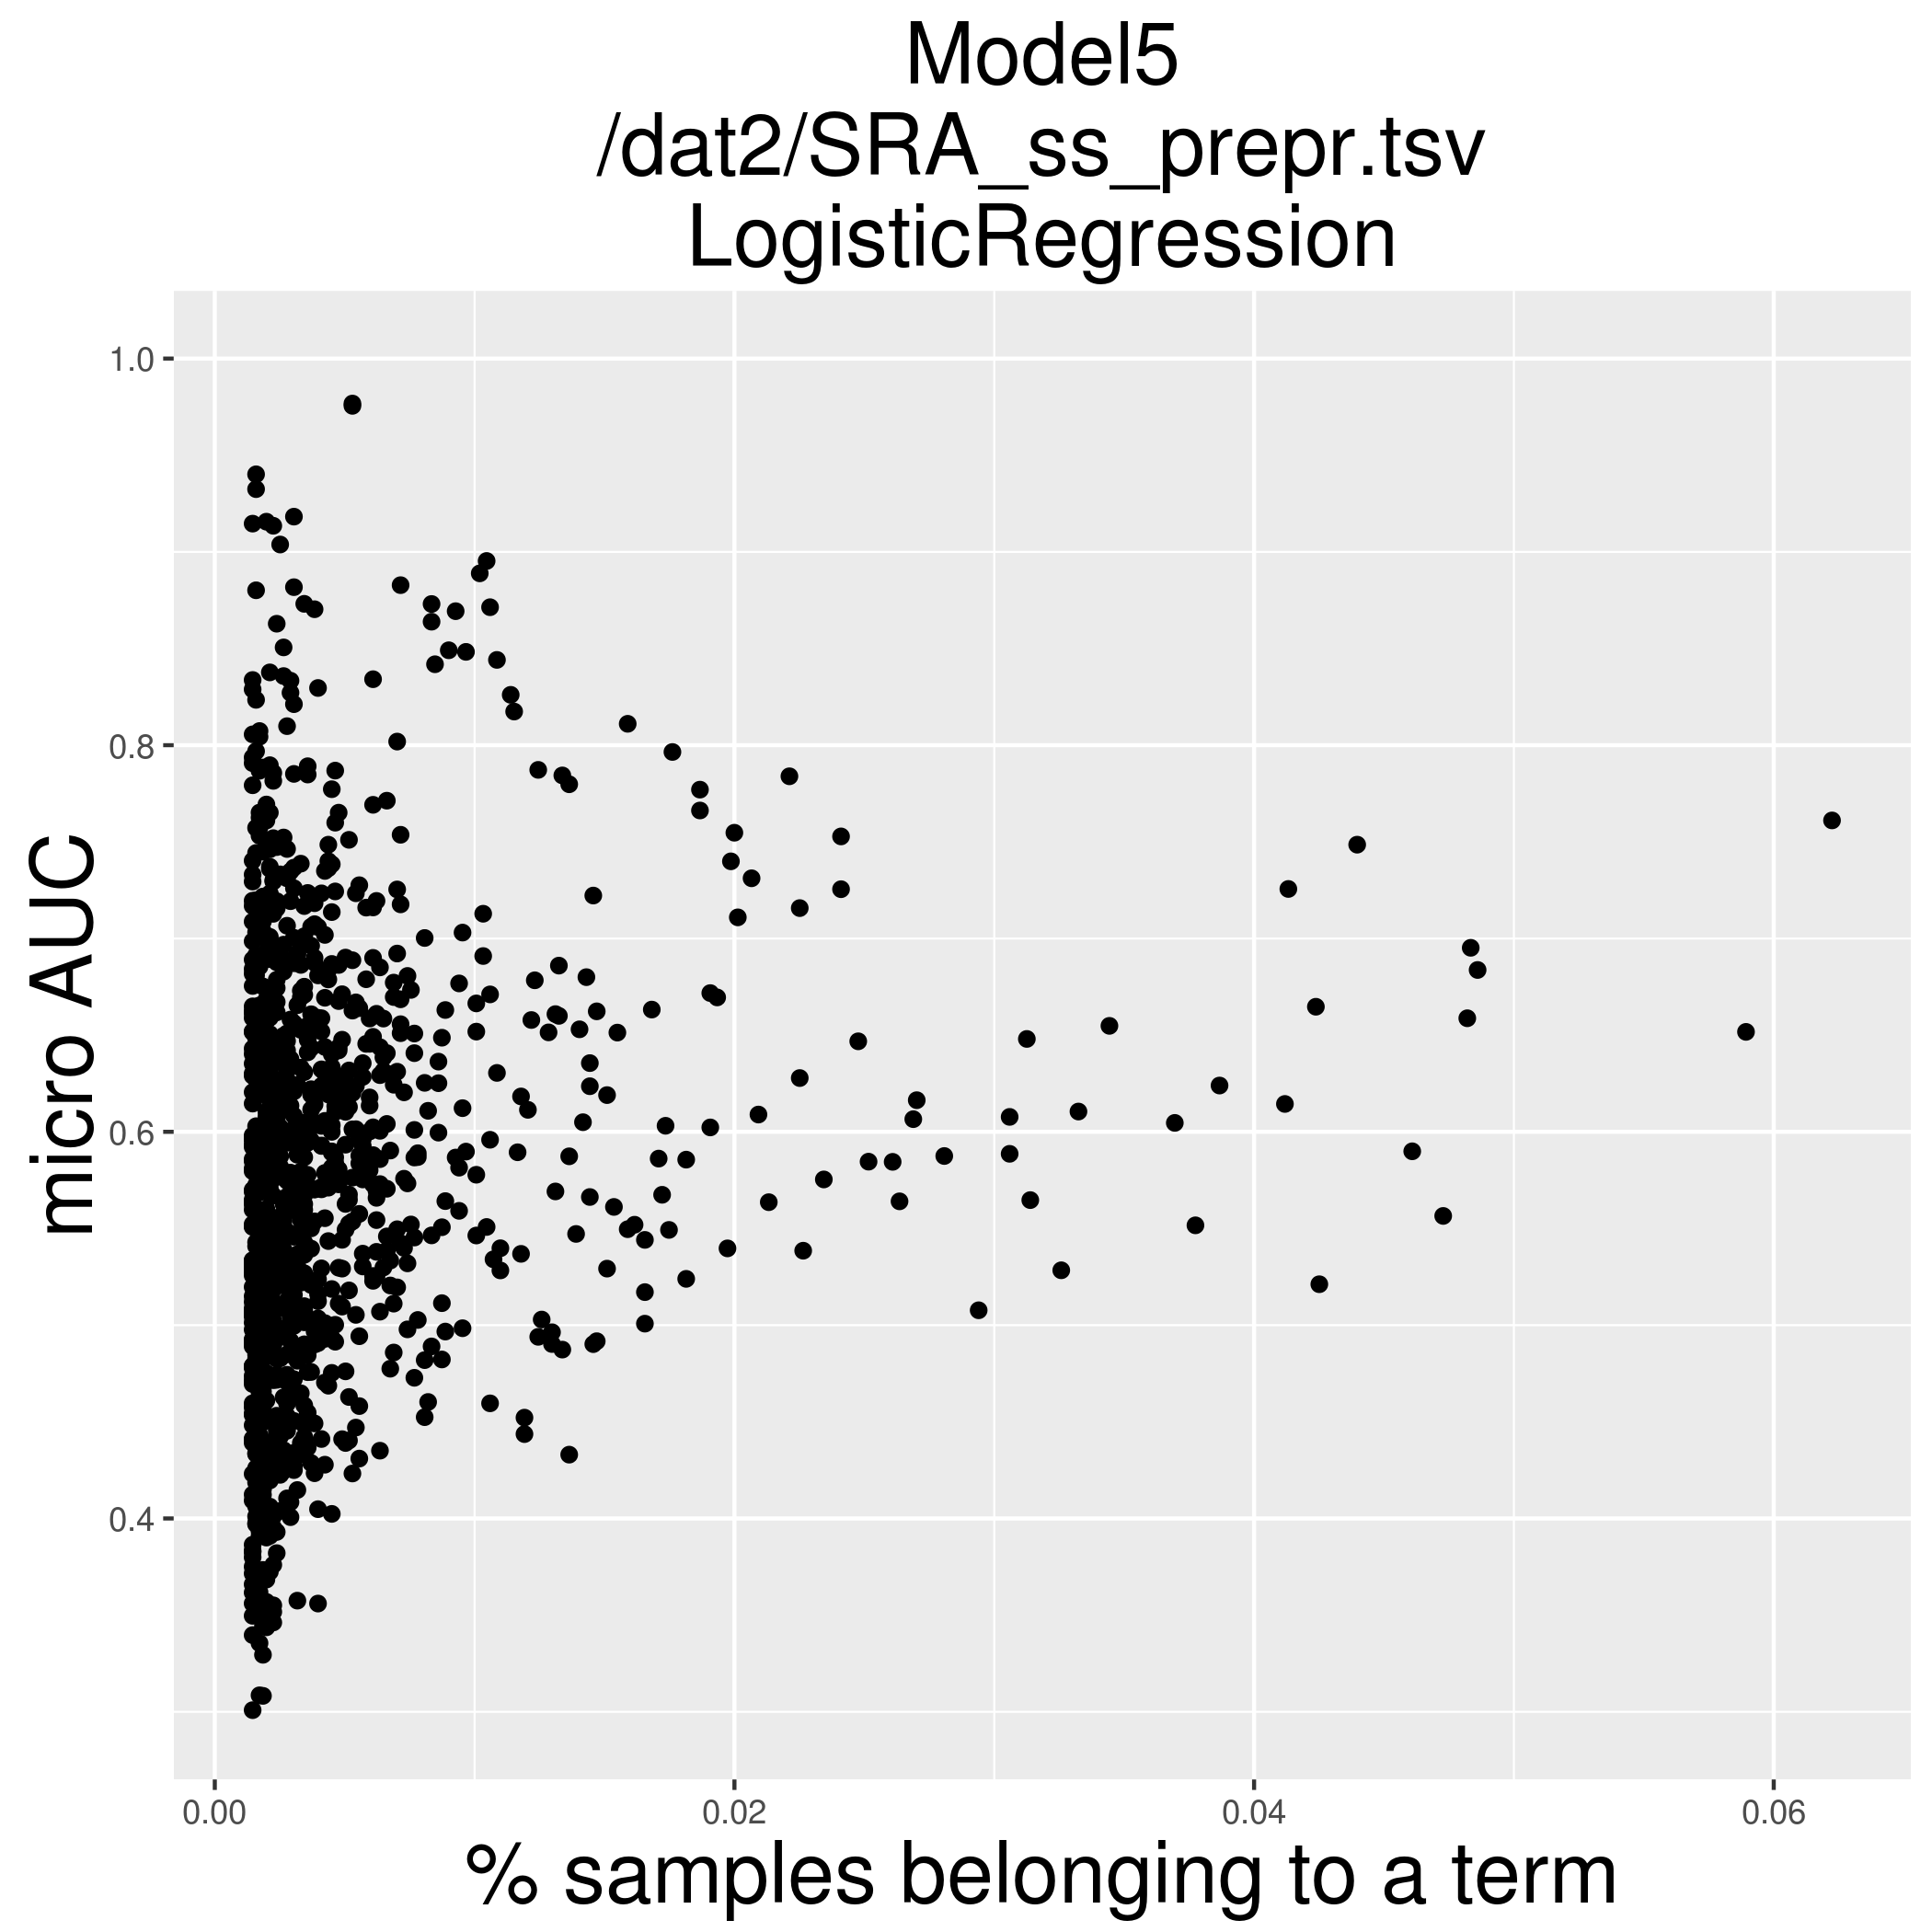
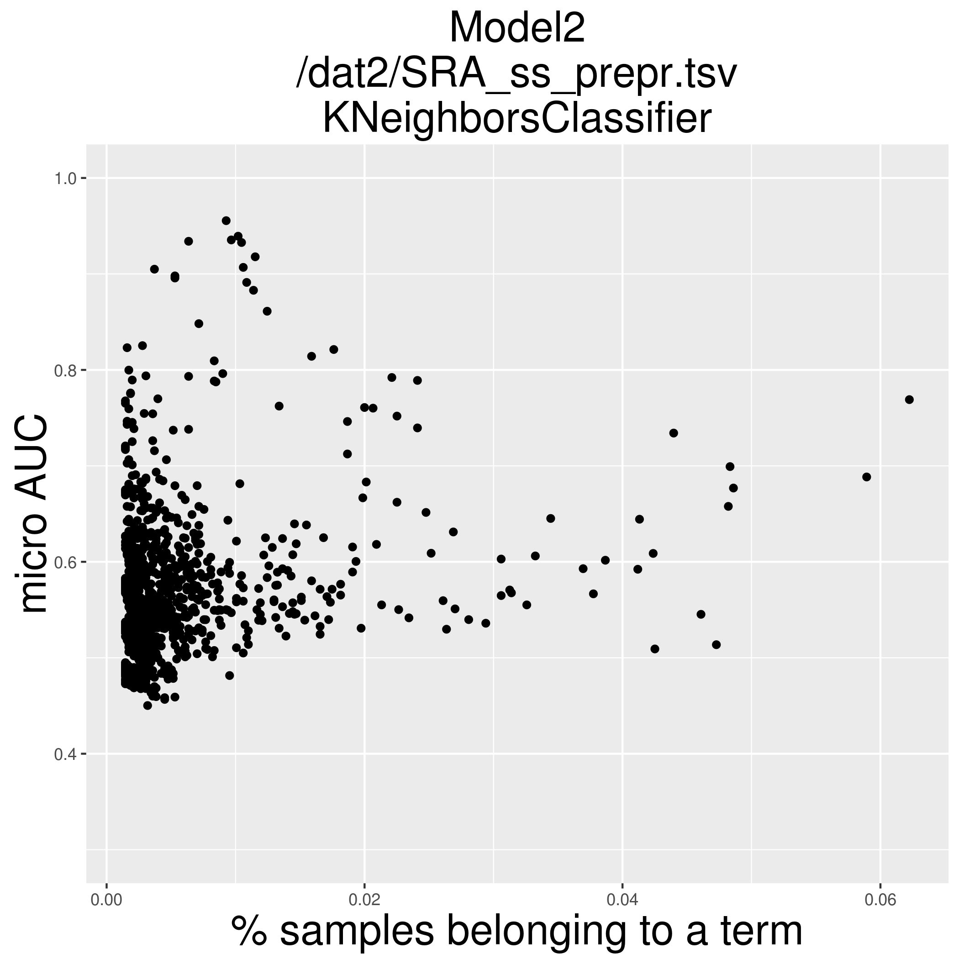
Micro AUC and GO term size
What are those that are predicted with highest accuracy?

Slide 15
Micro AUC and GO term size
GO_term_ID | GO_term_description | How_many_transcripts_in_SRA_belong
1000 | auditory receptor cell morphogenesis | 2
10006 | positive regulation of myeloid cell apoptotic process | 1
10008 | bitter taste receptor activity | 20
1001 | polyprenyltransferase activity | 1
10011 | sweet taste receptor activity | 1
10013 | regulation of chromosome organization | 2
10018 | Rad51B-Rad51C-Rad51D-XRCC2 complex | 1
10020 | isoquinoline alkaloid metabolic process | 1
10022 | immature T cell proliferation in thymus | 1
10023 | regulation of T cell differentiation in thymus | 1
10029 | positive regulation of immature T cell proliferation in thymus | 2
1003 | tRNA wobble uridine modification | 3
10037 | mitochondrial respiratory chain complex assembly | 2
1004 | tRNA wobble adenosine to inosine editing | 1
10042 | negative regulation of RNA splicing | 4
10043 | positive regulation of RNA splicing | 7
10046 | positive regulation of histone phosphorylation | 3
10047 | acetylcholine receptor binding | 3
10048 | negative regulation of glucokinase activity | 1
10051 | regulation of peptidyl-serine phosphorylation | 6
10052 | serine phosphorylation of STAT3 protein | 2
10053 | negative regulation of peptidyl-serine phosphorylation | 10
10055 | positive regulation of peptidyl-serine phosphorylation of STAT protein | 2
10059 | positive regulation of intracellular steroid hormone receptor signaling pathway | 1
10062 | positive regulation of intracellular estrogen receptor signaling pathway | 3
Terms with highest AUC across all models in the particular run
Not sure about what those may have in common
Pred__X_all_A_all
Micro AUC cutoff = 0.7
min_occurences = 5

Slide 16
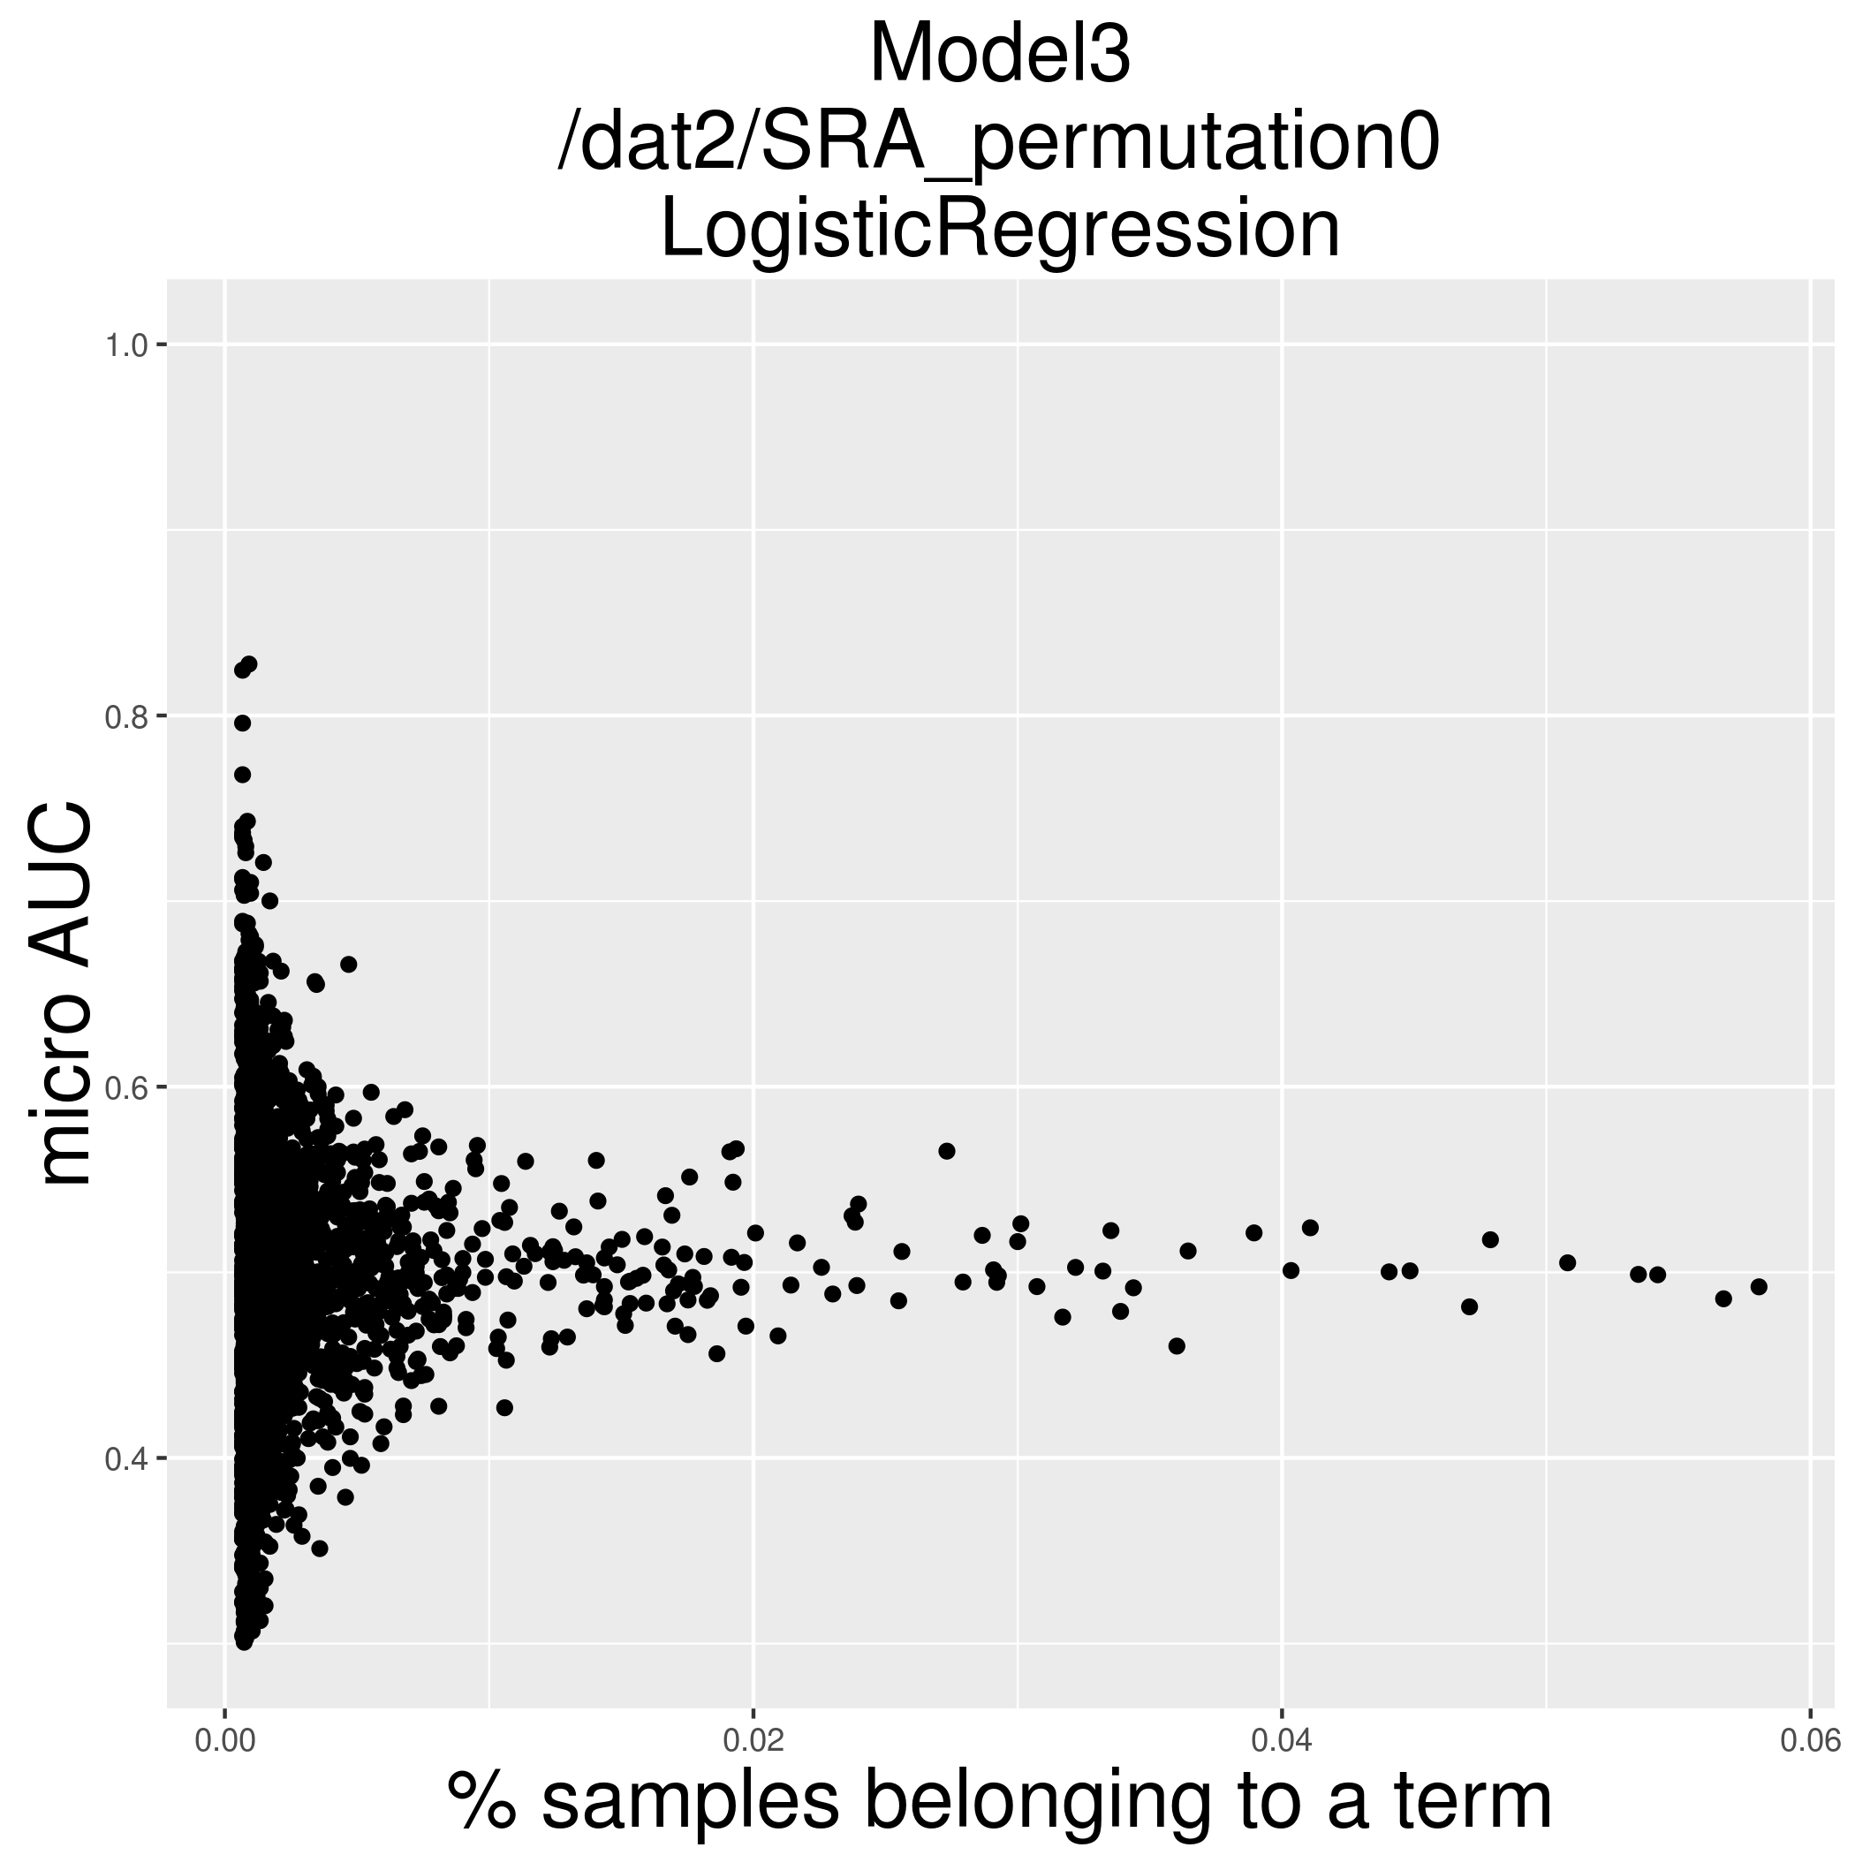
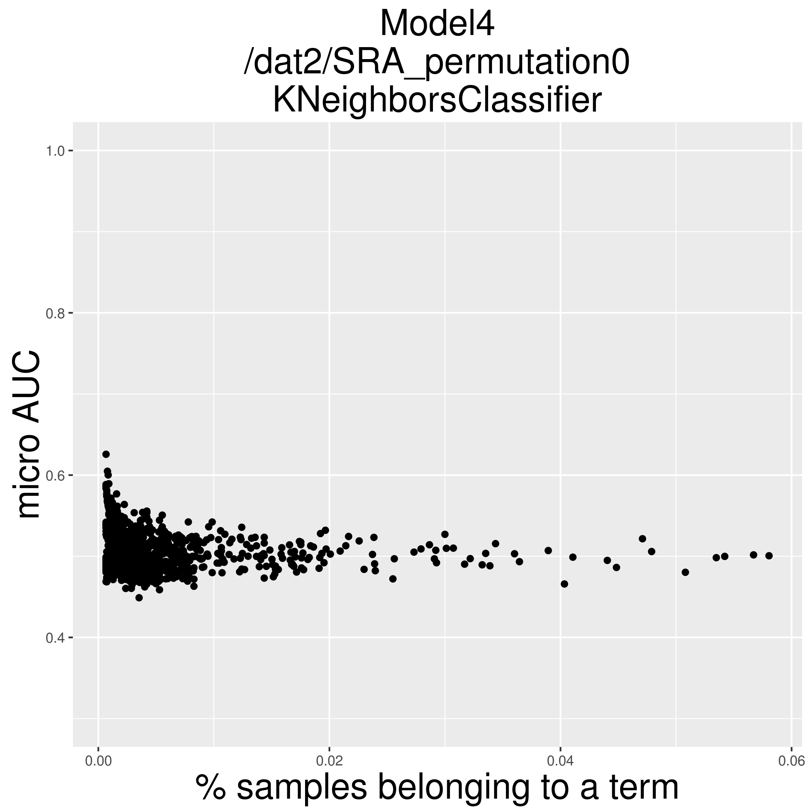
Comparison to row-permuted matrices
“randomly” both good and bad predictions for lowly represented GO terms
kNN is different; ?

