Slide 1
The problem
An example
There are too many images to analyze manually
Automated confocal microscopy image analysis
How much zinc goes to the lysosomes?

Slide 2
1. Split the image into three images corresponing to each channel
Red: lysotracker
Green: free intracellular zinc
Blue: nuclei

Slide 3
2. Measure the colocalization of labels of interest

Slide 4
3. Count cells

Slide 5
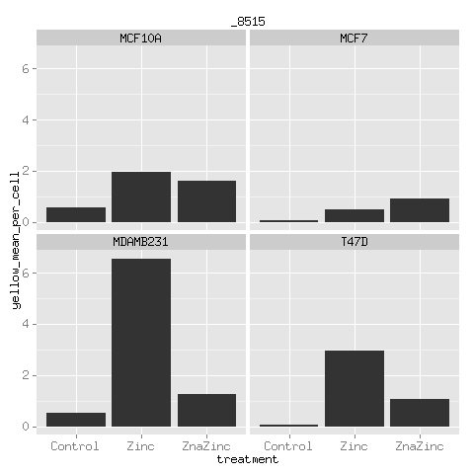
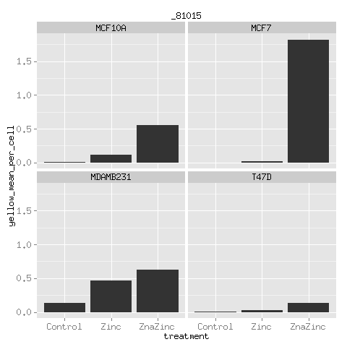
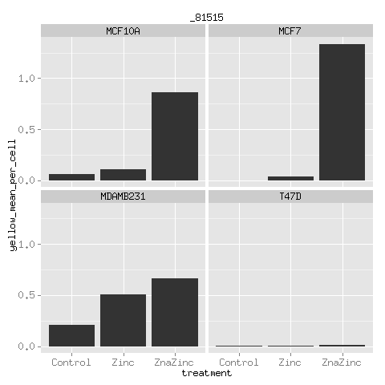
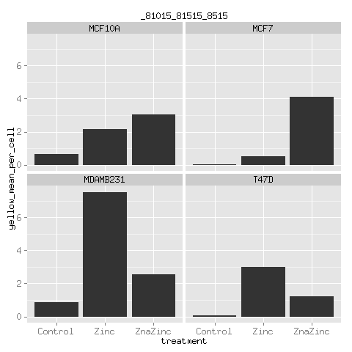
4. Summarize and present results
MCF10A – normal breast cell line
MCF7, MDAMB231, T47D – cancer cell lines

