Slide 1
The point
Confocal microscopy image analysis
A compound that kills only cancer cells
But how
How much zinc goes to the lysosomes?

Slide 2
Red: lysotracker
Green: free intracellular zinc
Blue: nuclei

Slide 5
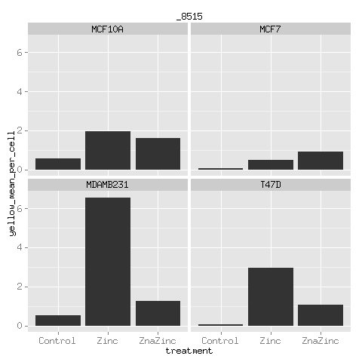
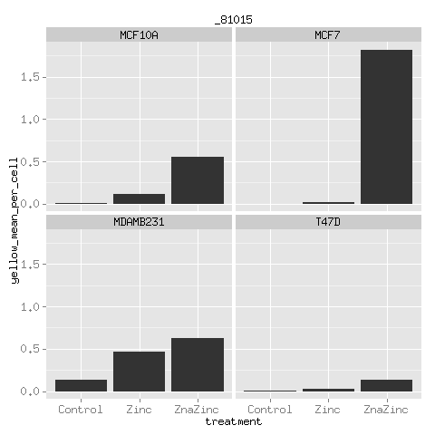
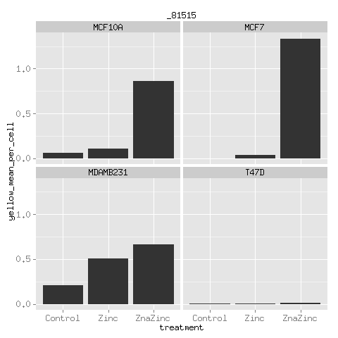
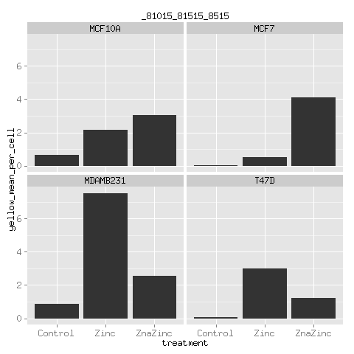
MCF10A – normal breast cell line
MCF7, MDAMB231, T47D – cancer cell lines

