Slide 1
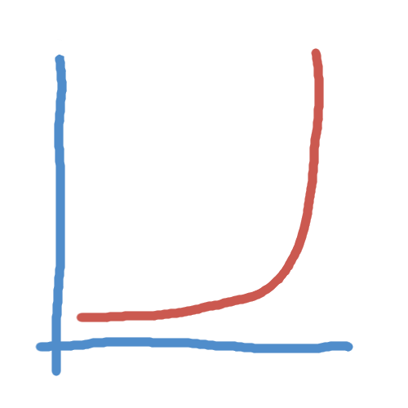
The bank slide

Slide 2
Aleksandra Perz
Wren Lab
Oklahoma Medical Research Foundation
Explain
Class, group: a category to which a sample belongs, given some characteristics of this category, e.g. human samples, gut samples
Label: a class for a particular sample
* Metagenomic sample
Be able to explain
AUC,precision, recall, …
16S rRNA and wwhy there are unknown taxa
Why class sizes matter (guesses based on prior knowledge)

Slide 3
Overview
MNEMONIC
  Goals
  Data acquisition and processing
  Results and current state
PubQC
  Goals
  Results so far

Slide 4
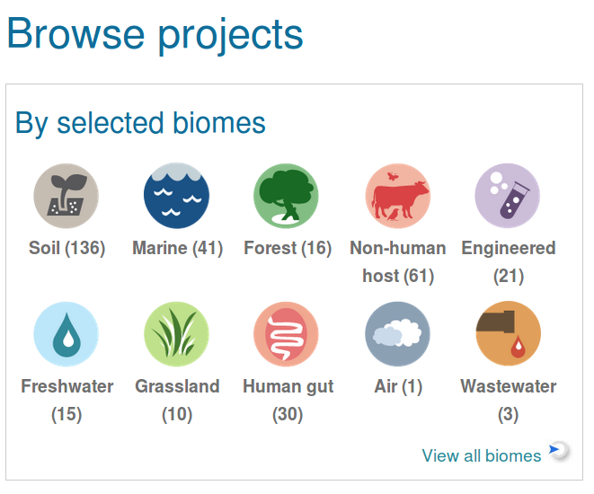
Metagenomics
Genetic material taken directly from a sample
Is a better representation of taxonomic diversity than cultured samples
16S rRNA gene used for phylogenetic classification
Two main methods: amplification of, whole genome
https://www.ebi.ac.uk/metagenomics/

Slide 5
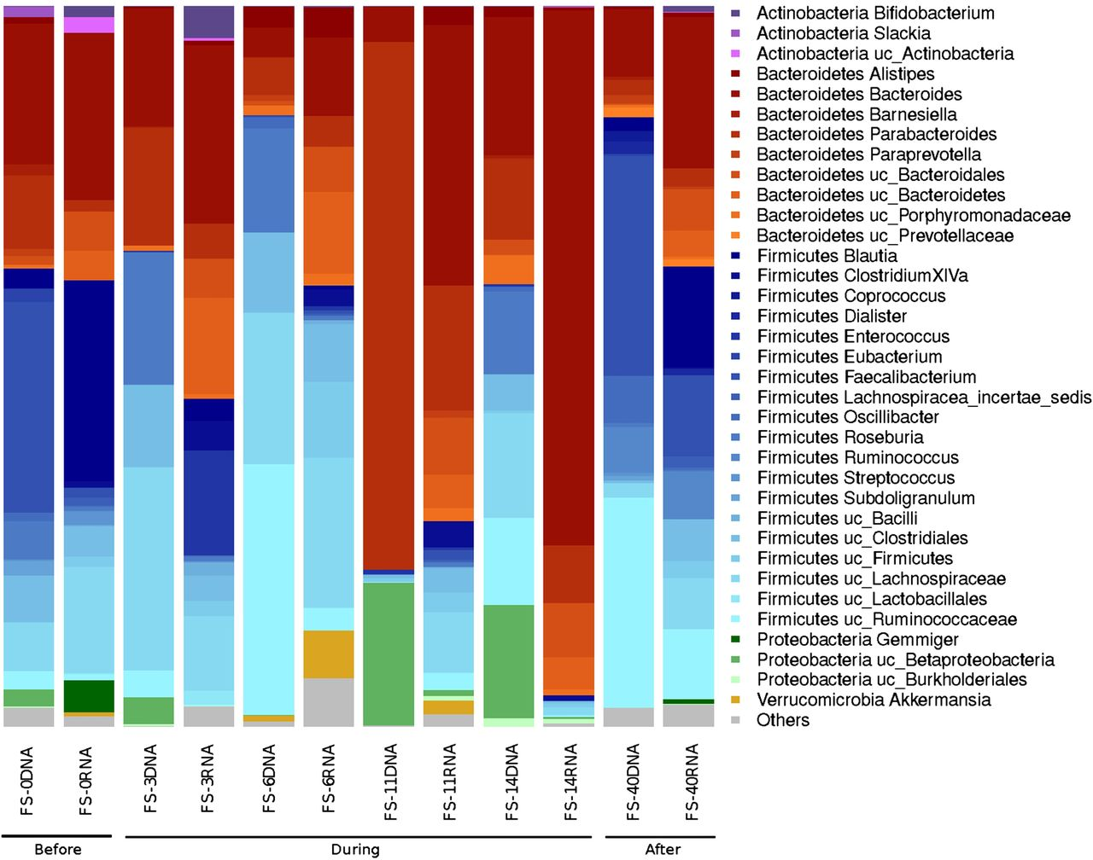
Inspiration
Gut bacterial composition.
FS-0, FS-3, FS-6, FS-11, FS-14: respective days of antibiotic treatment.
FS-40: 40 days after end of treatment.
early reduction in Gram-negative organisms (day 6)
overall collapse in diversity
Gut microbiota disturbance during antibiotic therapy: a multi-omic approach (Pérez-Cobas et al., Gut, 2013)

Slide 6
There is knowledge out there: objectives
Bring in the already available knowledge to interpret a new finding
Make and evaluate statements about global relationships between entities
Find samples that are similar:
learn something new about
the finding based on the literature
A researcher’s
interface to database
Compare shifts observed
between conditions:
find samples that exhibit similar
changes in taxonomic abundance
Predict characteristics
of the finding:
confirm the finding
Notes:
Just write and memorise for this slide

Slide 7
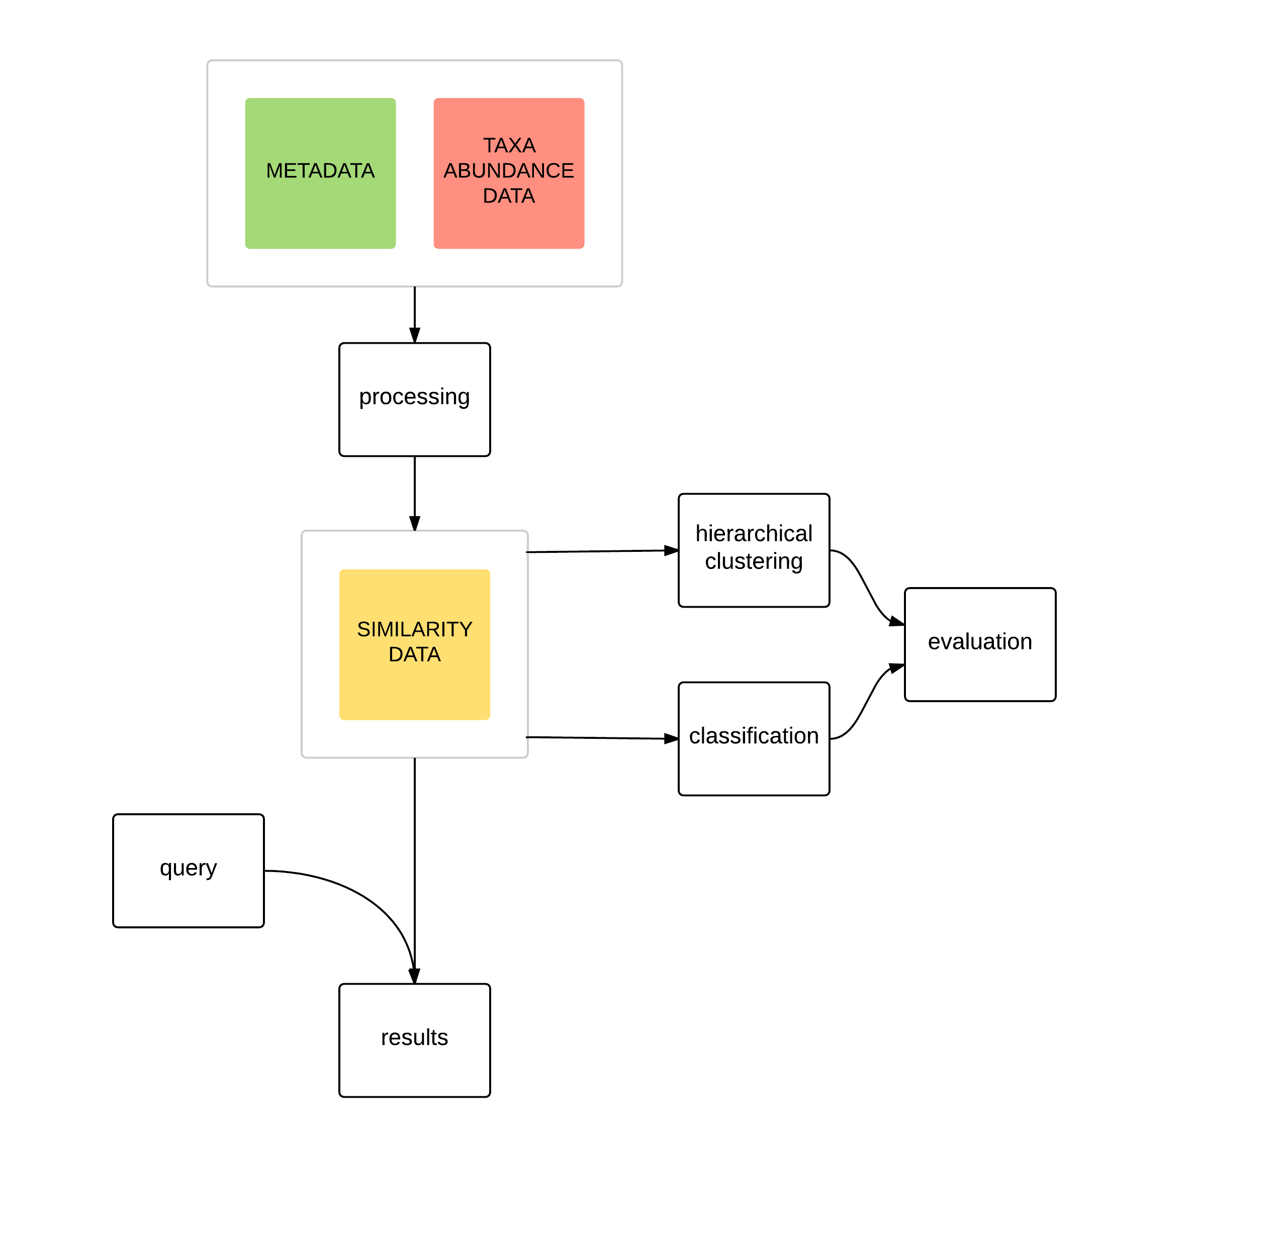
Systematic evaluation
Is it possible to predict a query samples' classes based on the taxonomic abundance?
graphical representation
Which samples are the closest to the query?
The measure of similarity is mathematical distance of one sample to another

Slide 8
Metadata, label extraction (kwrds, groups, age?)
Study ID | ERP001506
Study title | Beta Lactam Antibiotics and Human Gut Microbiota
Sample ID | ERS149134
Sample classification | Host-associated:Human > Digestive system > Large intestine > Fecal
Sample description | Total DNA was extracted from human faecal samples using QIAamp® DNA Stool Kit (Quiagen) following the manufacturer's instructions
Sample name | Human gut metagenome, 40 days after antibiotics
Run IDs | ERR139700
Keywords | gut intestine faecal fecal human
http://10.84.146.16:9000/metadata_stats
Entered manually
Erroneous or incomplete metadata: automated extraction of labels developed
Keywords extracted
(e.g.“human”, “soil”, “diabetic”)

Slide 9
Data
Batch-download count data from EBI
Represent counts as a fraction of total count within a sample (compositional data)
Set low-count observations to zero
TF-IDF transform counts
(term frequency - inverse document frequency)
Calculate cosine distances
Entities and entity hierarchy:
Samples
  Projects
  Biomes
  Keywords
  Contrasts
Taxa
  Genera
  Families
  …
Genes
  Functions
*Log2 transform
Standardise: sum to one (col or row?)
Take only samples that have sum of counts between 0.1 and 0.9 percentile
Take only taxa that have sum of counts non-zero at this point
CA-based
Count data batch downloaded from EBI
Differences in taxonomic abundance:
  biological
  technical
  (limited by the technology and its ability to distinguish between taxa)
  16S rRNA sequencing
  different identification levels
Irregular class sizes
wildly varying

Slide 10
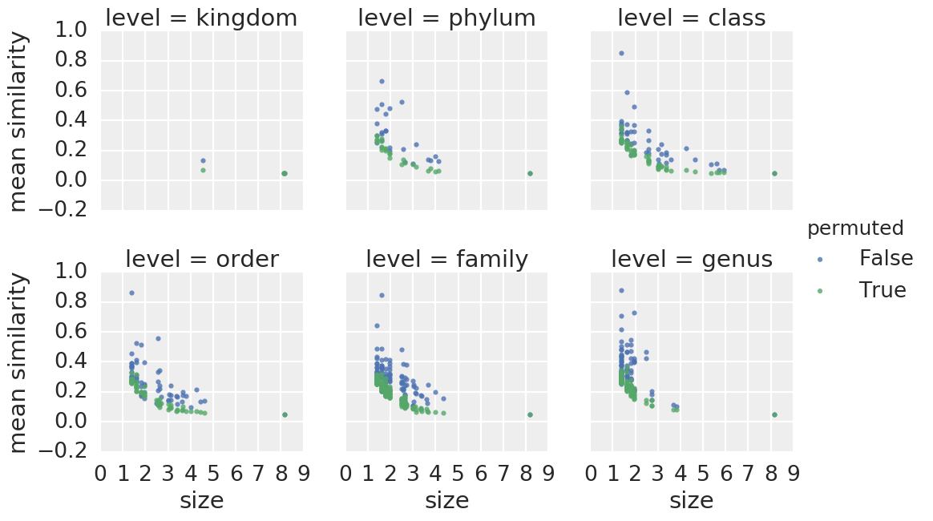
Validation?
Comparison of results for sample-sample cosine distance between taxonomic data and functional data
Mantel test: 0.28
Permuted: ~0.00
(10439 samples)
Comparison of mean similarity within taxonomic levels against permuted values

Slide 11
Where I stand
Metadata browsing
Sample-sample (also project-project, biome-biome)
Taxon-taxon
Contrasts (differential abundance)
Data management, optimization: getting results for > 300 samples and 3000 taxons is very slow!
http://10.84.146.16:9000/home
http://10.84.146.16:9000/projects/ERP010458
http://10.84.146.16:9000/biomes/Fecal
http://10.84.146.16:9000/taxa/k__Bacteria;%20p__Firmicutes;%20c__Clostridia;%20o__Clostridiales;%20f__Peptostreptococcaceae;%20g__[Clostridium];%20s__difficile
http://10.84.146.16:9000/contrasts/soil-fecal

Slide 12
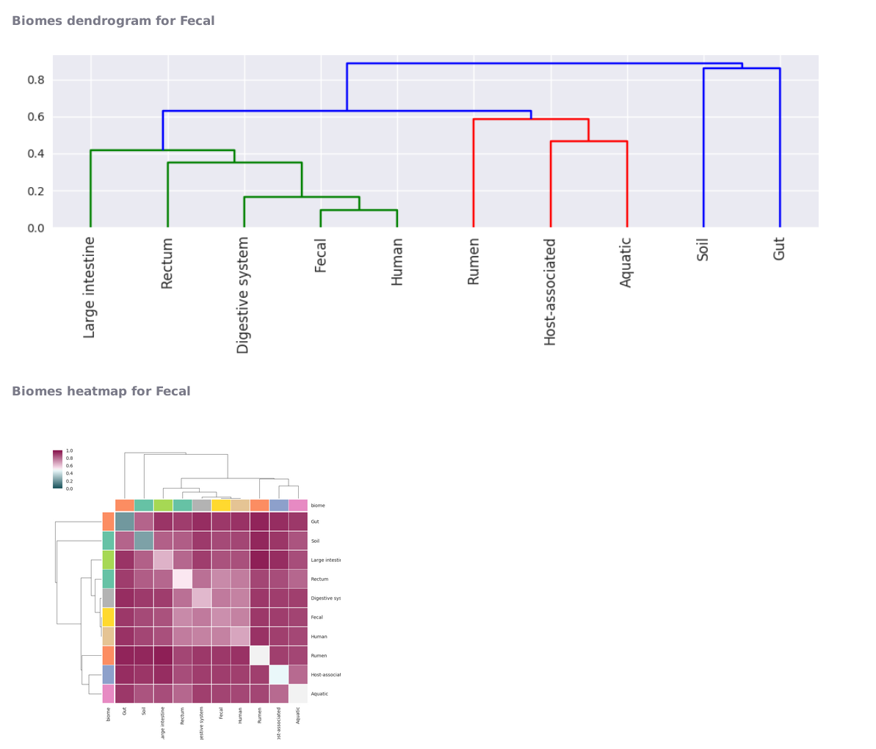
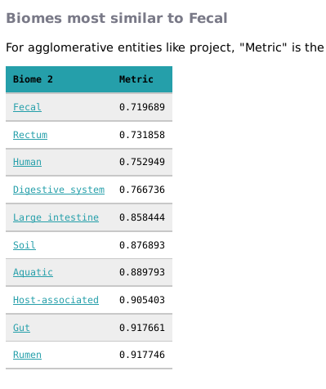
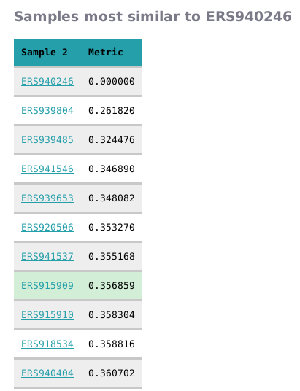
Sample, project, biome results
Precalculated distance matrix for all sample-sample relationships
Collapsing and averaging for a higher-level entity (e.g. project)
TODO:
Include more metrics (already implemented in taxon comparison)

Slide 13
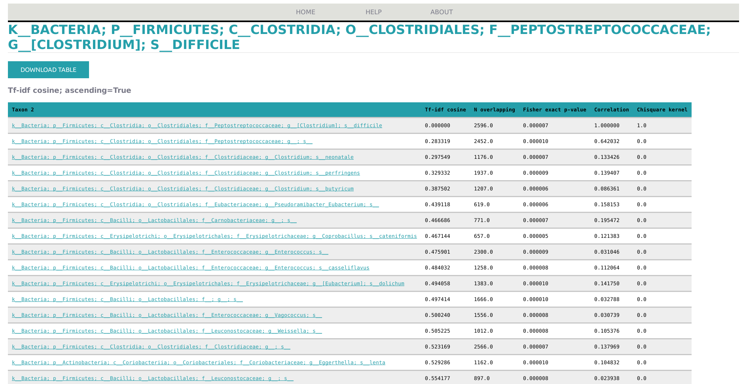
Taxon results
TODO:
Add genus, family, … collapsing
Draw plots for taxon results similar to sample results

Slide 14
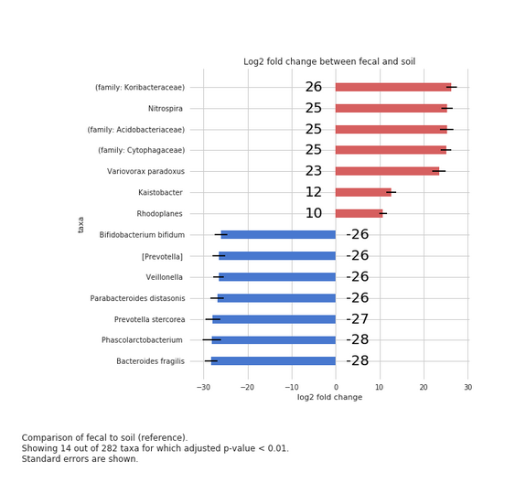
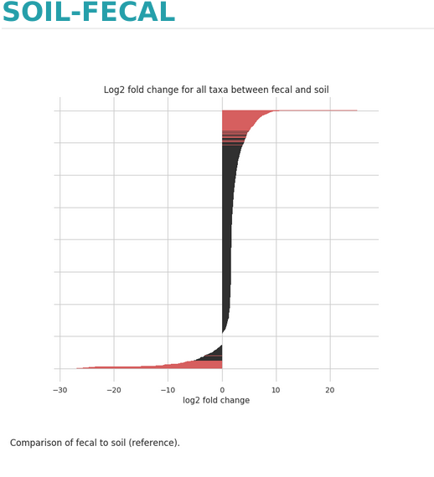
Contrasts
TODO:
Add a possibility to specify arbitrary groups of samples
Log fold change plots for higher taxonomy levels

Slide 15
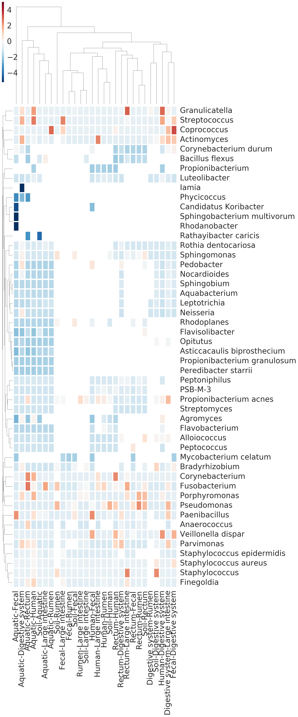
One step higher: cluster contrasts

Slide 16
PubQC
Correct errors in scientific publications submitted to journals (“Reviewer n+1” scheme)
Analyze the errors in scientific literature in the wild
Compare shifts observed
between conditions:
find samples that exhibit similar
changes in taxonomic abundance
Be able to compare arbitrary
groups of samples
Predict characteristics
of the finding:
confirm the finding
Notes:
Just write and memorise for this slide

Slide 17
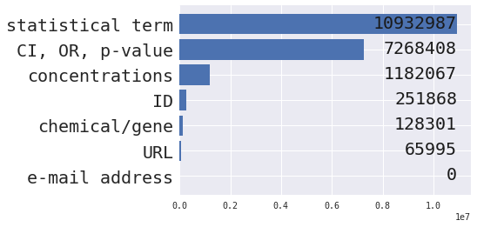
PubQC
Total accessible abstracts: 27,444,507
(all abstracts)
(almost all abstracts)
(script was interrupted)
(all abstracts)
(subset abstracts)
(all abstracts)
(subset abstracts)
http://10.84.146.16:9001/home
http://10.84.146.16:2460/notebooks/pubqc_test_results.ipynb

Slide 18
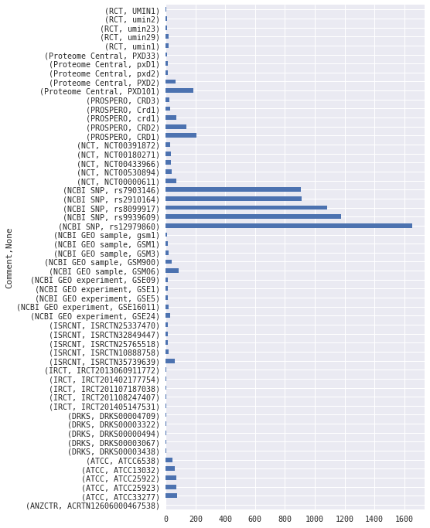
PubQC – IDs (regex)
251,868 found
Belinostat (PXD101) is a novel HDAC inhibitor with IC50 of 27 nM in a cell-free assay, with activity demonstrated in cisplatin-resistant tumors
rs12979860 is a SNP near the IL28B gene, encoding interferon-lambda-3 (IFN-lambda-3)
rs9939609 is a SNP in the fat mass and obesity associated FTO gene, aka the "Fat Gene"
ATCC 33277 Porphyromonas gingivalis genome - human pathogen
rs8099917 is related to hepatitis C treatment response
GSE16011 is a glioma cohort
(TODO) GSM1 is a protein, GSM06 is a cell line, CRD1 a protein domain, etc.

Slide 19
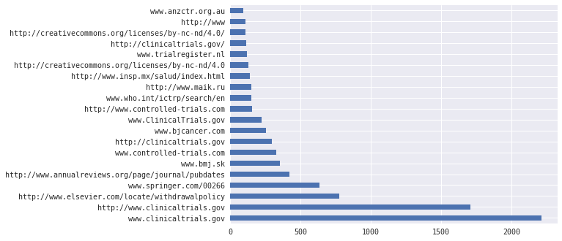
PubQC – URLs (regex)
65,995 found
www.springer.com/00266 - aesthetic plastic surgery (??)
(TODO) 'http://www' is almost always matched when there's a space after the 'www.'
(TODO) spaCy results were rubbish – why?
(TODO) programatically get respone from the server

Slide 20
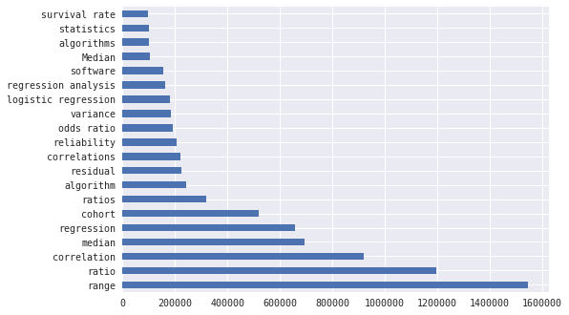
PubQC – terms (simple pattern match)
10,932,987 found
(TODO) ignore case

Slide 21
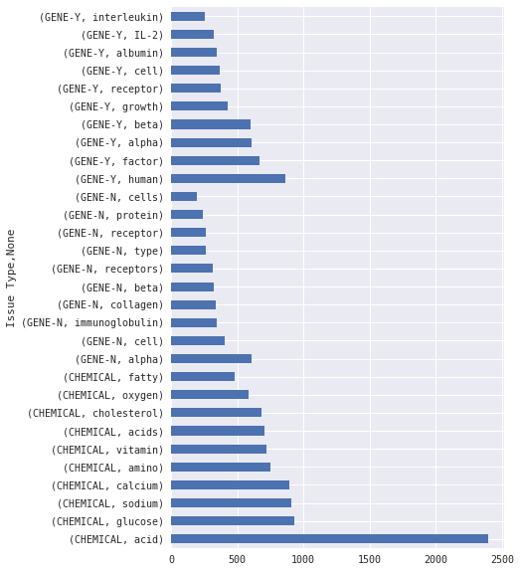
PubQC – chemicals, genes (spaCy)
128,301 found, but...

Slide 22
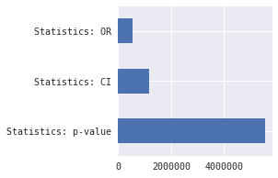
PubQC – CI, OR, p-value
Number of values associated with each
Statistics: CI 3 12043
4 545
2 12
5 5
6 4
Statistics: OR 1 6208
2 1
Statistics: p-value 1 63403
(TODO) scientific notation
(TODO) recalculate statistics
Extracted p-values
0.050000 13836
0.001000 11933
0.010000 8188
0.000100 3201
0.020000 1857
0.000000 1543
...
1.000000 184
...
648.000000 1
6.540000 1

Slide 23
PMID | Pattern | Location | value | Lower | Upper | Recalculated OR | Pattern | Location | Context
3384186 | 95% CI (Cl)=(0.93, 3.17 | (762, 785) | [95.0, 0.93, 3.17] | 0.93 | 3.17 |  | OR)=1.71 | (752, 760) | ve to the NHWs [odds ratio (OR)=1.71; 95% CI (Cl)=(0.93, 3.17)]. The risk of severe retinopathy (pr
3387899 | 95% CI, 1.5-3.5 | (943, 958) | [95.0, 1.5, 3.5] | 1.5 | 3.5 |  | OR=2.3 | (935, 941) | eir place of residence indicated (OR=2.3; 95% CI, 1.5-3.5). There was a trend for patients to repor
3387899 | 95% CI, 0.9-6.7 | (1032, 1047) | [95.0, 0.9, 6.7] | 0.9 | 6.7 |  | OR=2.4 | (1024, 1030) | s to report an unhappy childhood (OR=2.4; 95% CI, 0.9-6.7). Being unmarried, undergoing parental se
3389360 | 3.94, CI=1.52-10.20 | (849, 868) | [3.94, 1.52, 10.2] | 1.52 | 10.2 |  | OR=3.94 | (846, 853) | d an elevated risk for brain cancer (OR=3.94, CI=1.52-10.20). In addition, there was a linear relat
3389361 | 1.72, CI 1.09-2.97 | (750, 768) | [1.72, 1.09, 2.97] | 1.09 | 2.97 |  | OR 1.72 | (747, 754) | the reduction division of the plant (OR 1.72, CI 1.09-2.97) including, in particular, Soderberg (OR
3389361 | 1.71, CI 1.07-2.72 | (810, 828) | [1.71, 1.07, 2.72] | 1.07 | 2.72 |  | OR 1.71 | (807, 814) | including, in particular, Soderberg (OR 1.71, CI 1.07-2.72) and prebake (OR 2.26, CI. 1.27-4.02) po
3389361 | 2.26, CI. 1.27-4.02 | (846, 865) | [2.26, 1.27, 4.02] | 1.27 | 4.02 |  | OR 2.26 | (843, 850) | (OR 1.71, CI 1.07-2.72) and prebake (OR 2.26, CI. 1.27-4.02) potroom workers. The risk of IHD did n
3394698 | 95% CI=1.6-4.9 | (877, 891) | [95.0, 1.6, 4.9] | 1.6 | 4.9 |  | OR)=2.8 | (868, 875) | eral cancer (adjusted odds ratio (OR)=2.8, 95% CI=1.6-4.9). Further, this relation was modified by t
3394698 | 95% CI=1.2-3.0 | (1003, 1017) | [95.0, 1.2, 3.0] | 1.2 | 3 |  | OR=1.9 | (995, 1001) | initial cancer diagnosis (ratio of OR=1.9, 95% CI=1.2-3.0 for a five-year differential in time since
3394698 | 95% CI=0.3-1.2 | (1191, 1205) | [95.0, 0.3, 1.2] | 0.3 | 1.2 |  | OR=0.6 | (1183, 1189) | h a 36% decrease in risk (adjusted OR=0.6, 95% CI=0.3-1.2); this estimate excluded the magnitude of
3394707 | 95% CI=1.1-2.2 | (520, 534) | [95.0, 1.1, 2.2] | 1.1 | 2.2 |  | OR)=1.6 | (511, 518) | showed that male sex (odds ratio (OR)=1.6, 95% CI=1.1-2.2), maternal five-year age increase (OR=1.3,
3394707 | 95% CI=1.1-1.5 | (578, 592) | [95.0, 1.1, 1.5] | 1.1 | 1.5 |  | OR=1.3 | (570, 576) | , maternal five-year age increase (OR=1.3, 95% CI=1.1-1.5), plural birth (OR=3.0, 95% CI=1.2-7.1) an
3394707 | 95% CI=1.2-7.1 | (617, 631) | [95.0, 1.2, 7.1] | 1.2 | 7.1 |  | OR=3.0 | (609, 615) | .3, 95% CI=1.1-1.5), plural birth (OR=3.0, 95% CI=1.2-7.1) and black maternal race (OR=0.0, 95 perce
3395581 | 95% CI=1.0-2.6 | (634, 648) | [95.0, 1.0, 2.6] | 1 | 2.6 |  | OR)=1.6 | (625, 632) | icultural production (odds ratio (OR)=1.6, 95% CI=1.0-2.6). A concomitant increase was detected for
3395581 | 95% CI=1.0-2.5 | (708, 722) | [95.0, 1.0, 2.5] | 1 | 2.5 |  | OR=1.6 | (700, 706) | increase was detected for farmers (OR=1.6, 95% CI=1.0-2.5) when 35 major occupational titles were ex
21358884 | 95% CI 11.2 to 161.7 | (1435, 1455) | [95.0, 11.2, 161.7] | 11.2 | 161.7 |  | OR 36.9 | (1426, 1433) | atment group (four of 43 [9%]; OR 36.9; 95% CI 11.2 to 161.7; P<0.000001). The mean observed duratio
21358884 | 95% CI 0.18 to 0.78 | (1942, 1961) | [95.0, 0.18, 0.78] | 0.18 | 0.78 |  | OR 0.38 | (1933, 1940) | 9 [18%] versus 37 of 98 [38%]; OR 0.38; 95% CI 0.18 to 0.78; P=0.003). The present study supports r
21358962 | 95% CI, 1.18 to 3.16 | (1207, 1227) | [95.0, 1.18, 3.16] | 1.18 | 3.16 |  | OR, 1.94 | (1197, 1205) | 0 or fewer years in practice (OR, 1.94; 95% CI, 1.18 to 3.16), and practices with university affilia
21358962 | 95% CI, 1.44 to 3.37 | (1284, 1304) | [95.0, 1.44, 3.37] | 1.44 | 3.37 |  | OR, 2.20 | (1274, 1282) | with university affiliations (OR, 2.20; 95% CI, 1.44 to 3.37). Physicians with fewer than 25% of the
21358962 | 95% CI, 0.25 to 0.92 | (1396, 1416) | [95.0, 0.25, 0.92] | 0.25 | 0.92 |  | OR, 0.48 | (1386, 1394) | diagnosed with breast cancer (OR, 0.48; 95% CI, 0.25 to 0.92) and practices with fewer than three ph

Slide 24
PubQC – concentrations, percentages
2.2%
Percent
(838, 842)
xed meat or chicken or pork or beef contributes 2.2%), the GHG emission is estimated to be 0.28 or 0
meat (CHEMICAL); chicken (CHEMICAL); pork (CHEMICAL)
0.5%
Percent (178, 182)
sound biomicroscopy. To determine the effect of 0.5% tropicamide and the resultant mydriasis on the
tropicamide (CHEMICAL)
84%
percent
(635, 638)
c SBR became fully granulated and finished with 84% and 99% of nitrogen and phosphorus removal, res
nitrogen (CHEMICAL)
19.73ng/ml
concentration
(556, 567)
. Cutoff value for detecting stage B HF was 19.73ng/ml for catestatin with 90% sensitivity and 50.9
catestatin (CHEMICAL)
(TODO) Get chemicals in the proximity (extract noun?)
1:1 385
2:1 178
18:2 143
18:1 121
16:0 106
...
100mg/kg) 8
50mg/kg) 8
12:0 8
200mg/kg) 7
5mg/kg) 7
19:00 7
95% 10130
50% 3683
10% 2510
20% 2378
100% 2207
5% 2033
30% 1892
90% 1857
80% 1794
40% 1744
25% 1550
60% 1487
70% 1465
1% 1369

Slide 25
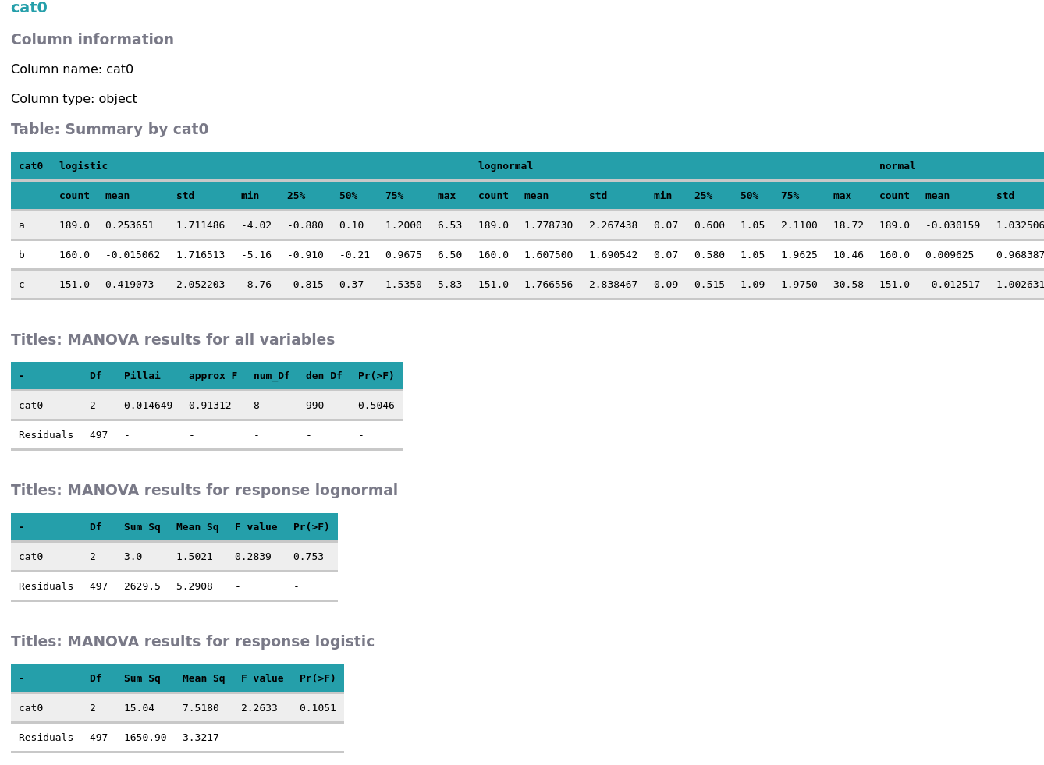

Slide 26
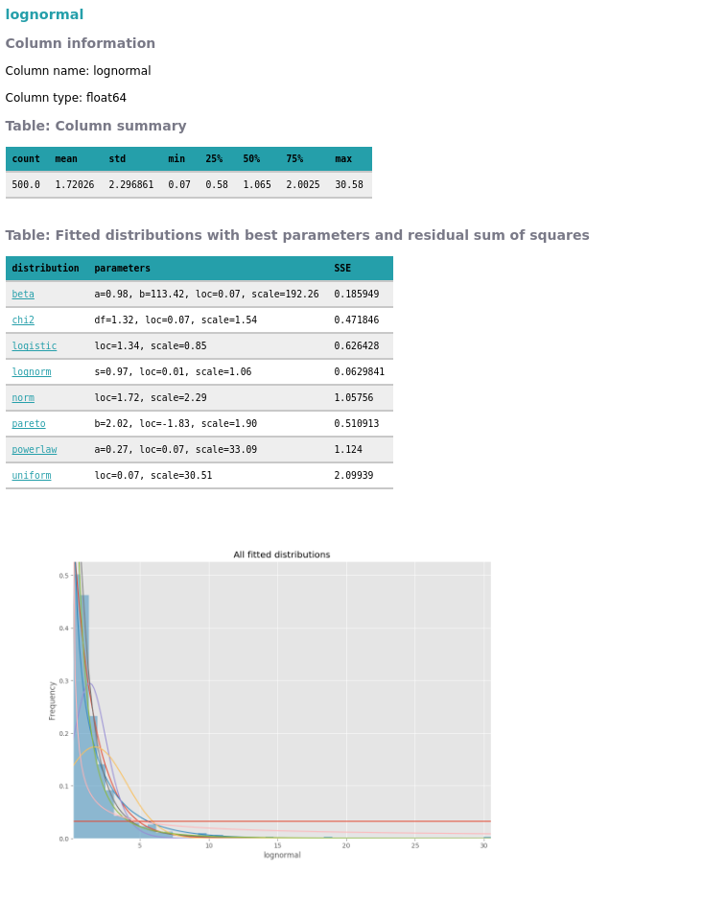

Slide 27
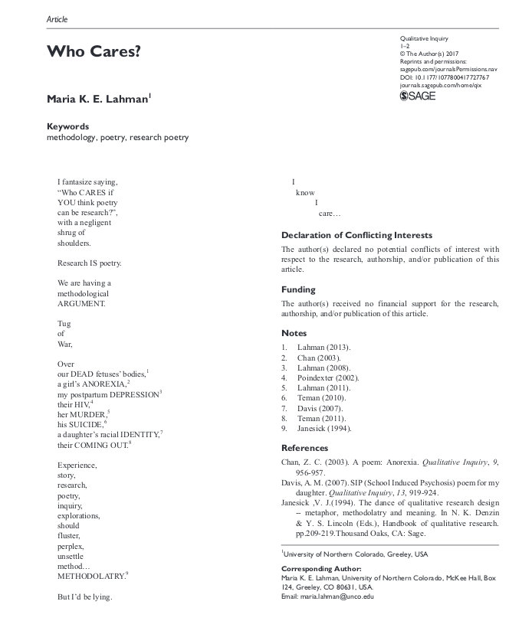

Slide 33
Supplementary material

Slide 34
Gut microbiota disturbance during antibiotic therapy: a multi-omic approach
Ana Elena Pérez-Cobas, María José Gosalbes, Anette Friedrichs, Henrik Knecht, Alejandro Artacho
2013 Gut 62(11), 1591-1601

Slide 35
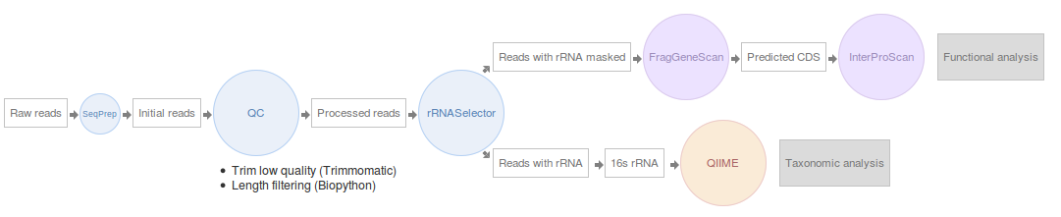
EBI
Unique studies: 180
Unique samples: 17269
Human samples: 12331
American gut: 8037
Classes: 152
https://github.com/ProteinsWebTeam/ebi-metagenomics/blob/master/memi/memi-web/developers/python/mgportal_bulk_download.py

