Slide 1
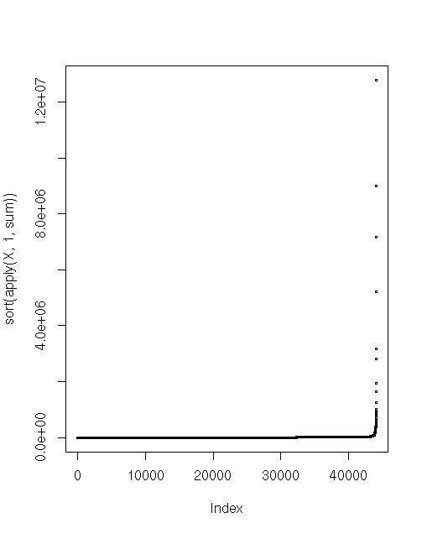
Data structure

Slide 2
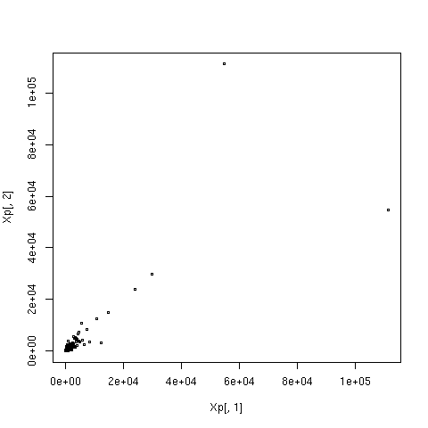
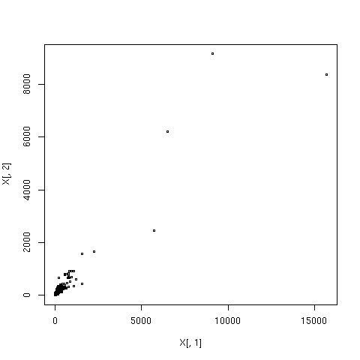
Preprocessing, normalisation, modelling
Remove samples and transcripts that have little variance
Quantile normalise

Slide 3
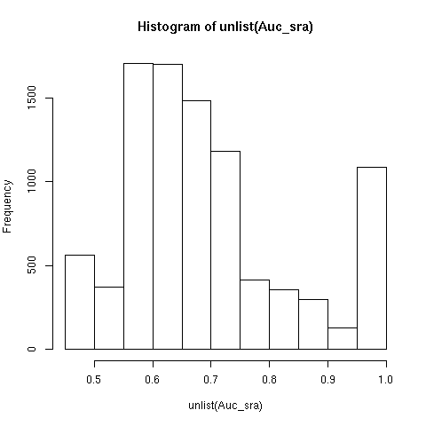
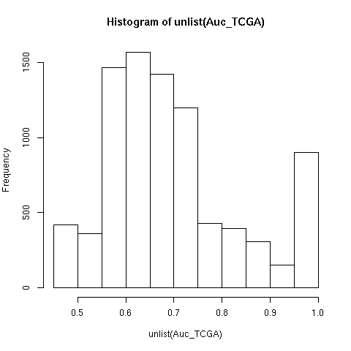
Function prediction
K nearest neighbours (k=50)
Determined by Fisher exact test

Slide 4
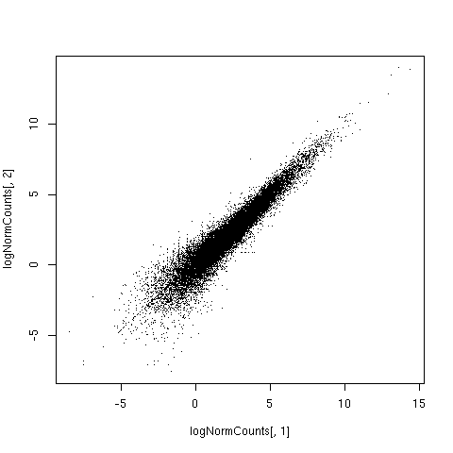
What next?
Different normalisation methods
Hyperparameter optimisation

Slide 5
Relative expression level of txs compared to “consistency” as defined by dr Wren
10th Feb 2015

Slide 6
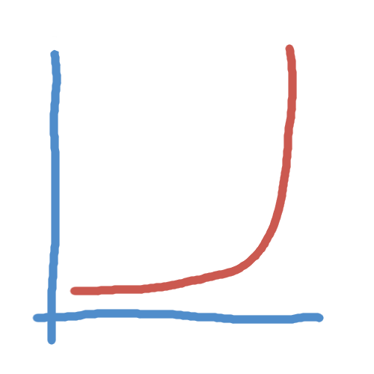
Comparison between datasets: correlations, anticorrelations
Not much consistency
coor approximatey 2x more consistent tha anticorr
But still mean about 6-10% same (in 100 top corr with ~16000 txs)
Some transcripts are consistent
% overlapping transcripts

Slide 7
Comparison between datasets
Pearson correlation
Comparison for SKA3 based on 1282 human genes shared between three matrices:
  In TCGA-derived and colour 2-derived correlation matrices results were somewhat similar: out of top 100 correlated genes 61 were same
  SRA-derived matrix versus either of the others: out of top 100 correlated 14 and 20 were same

Slide 8
“Purified” datasets (subset tissues)

Slide 9
TCGA: what kind of data, how much, etc

Slide 10
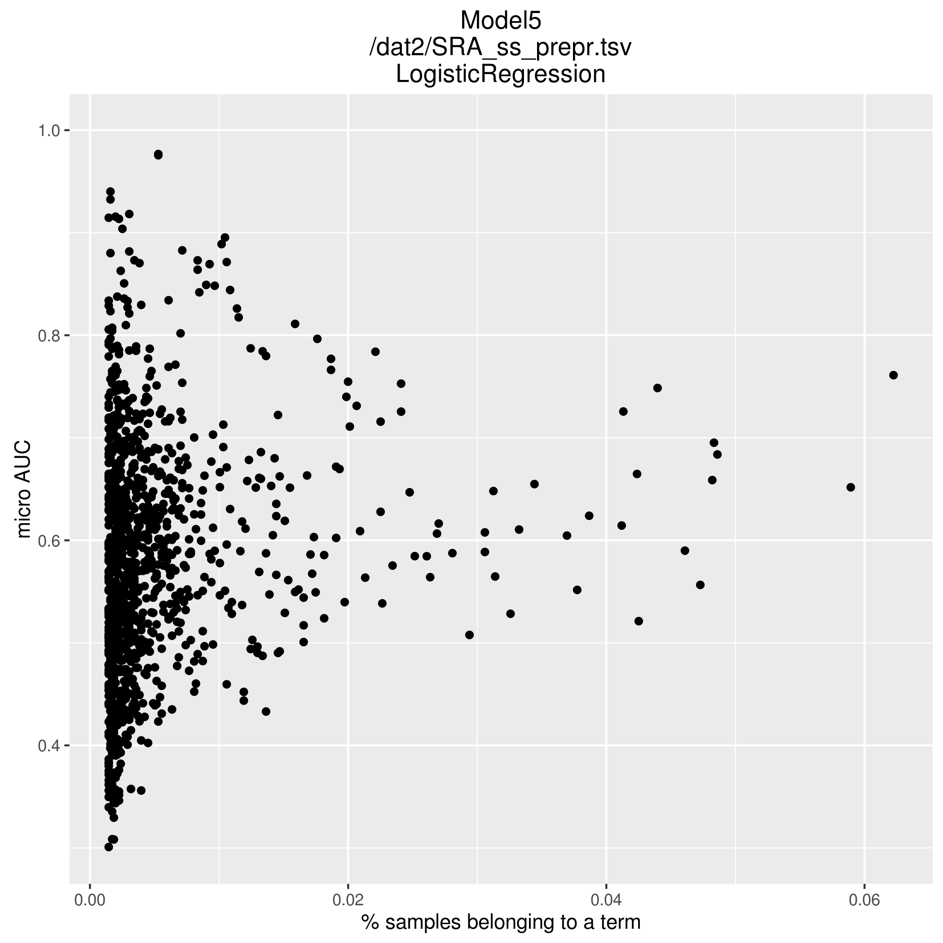
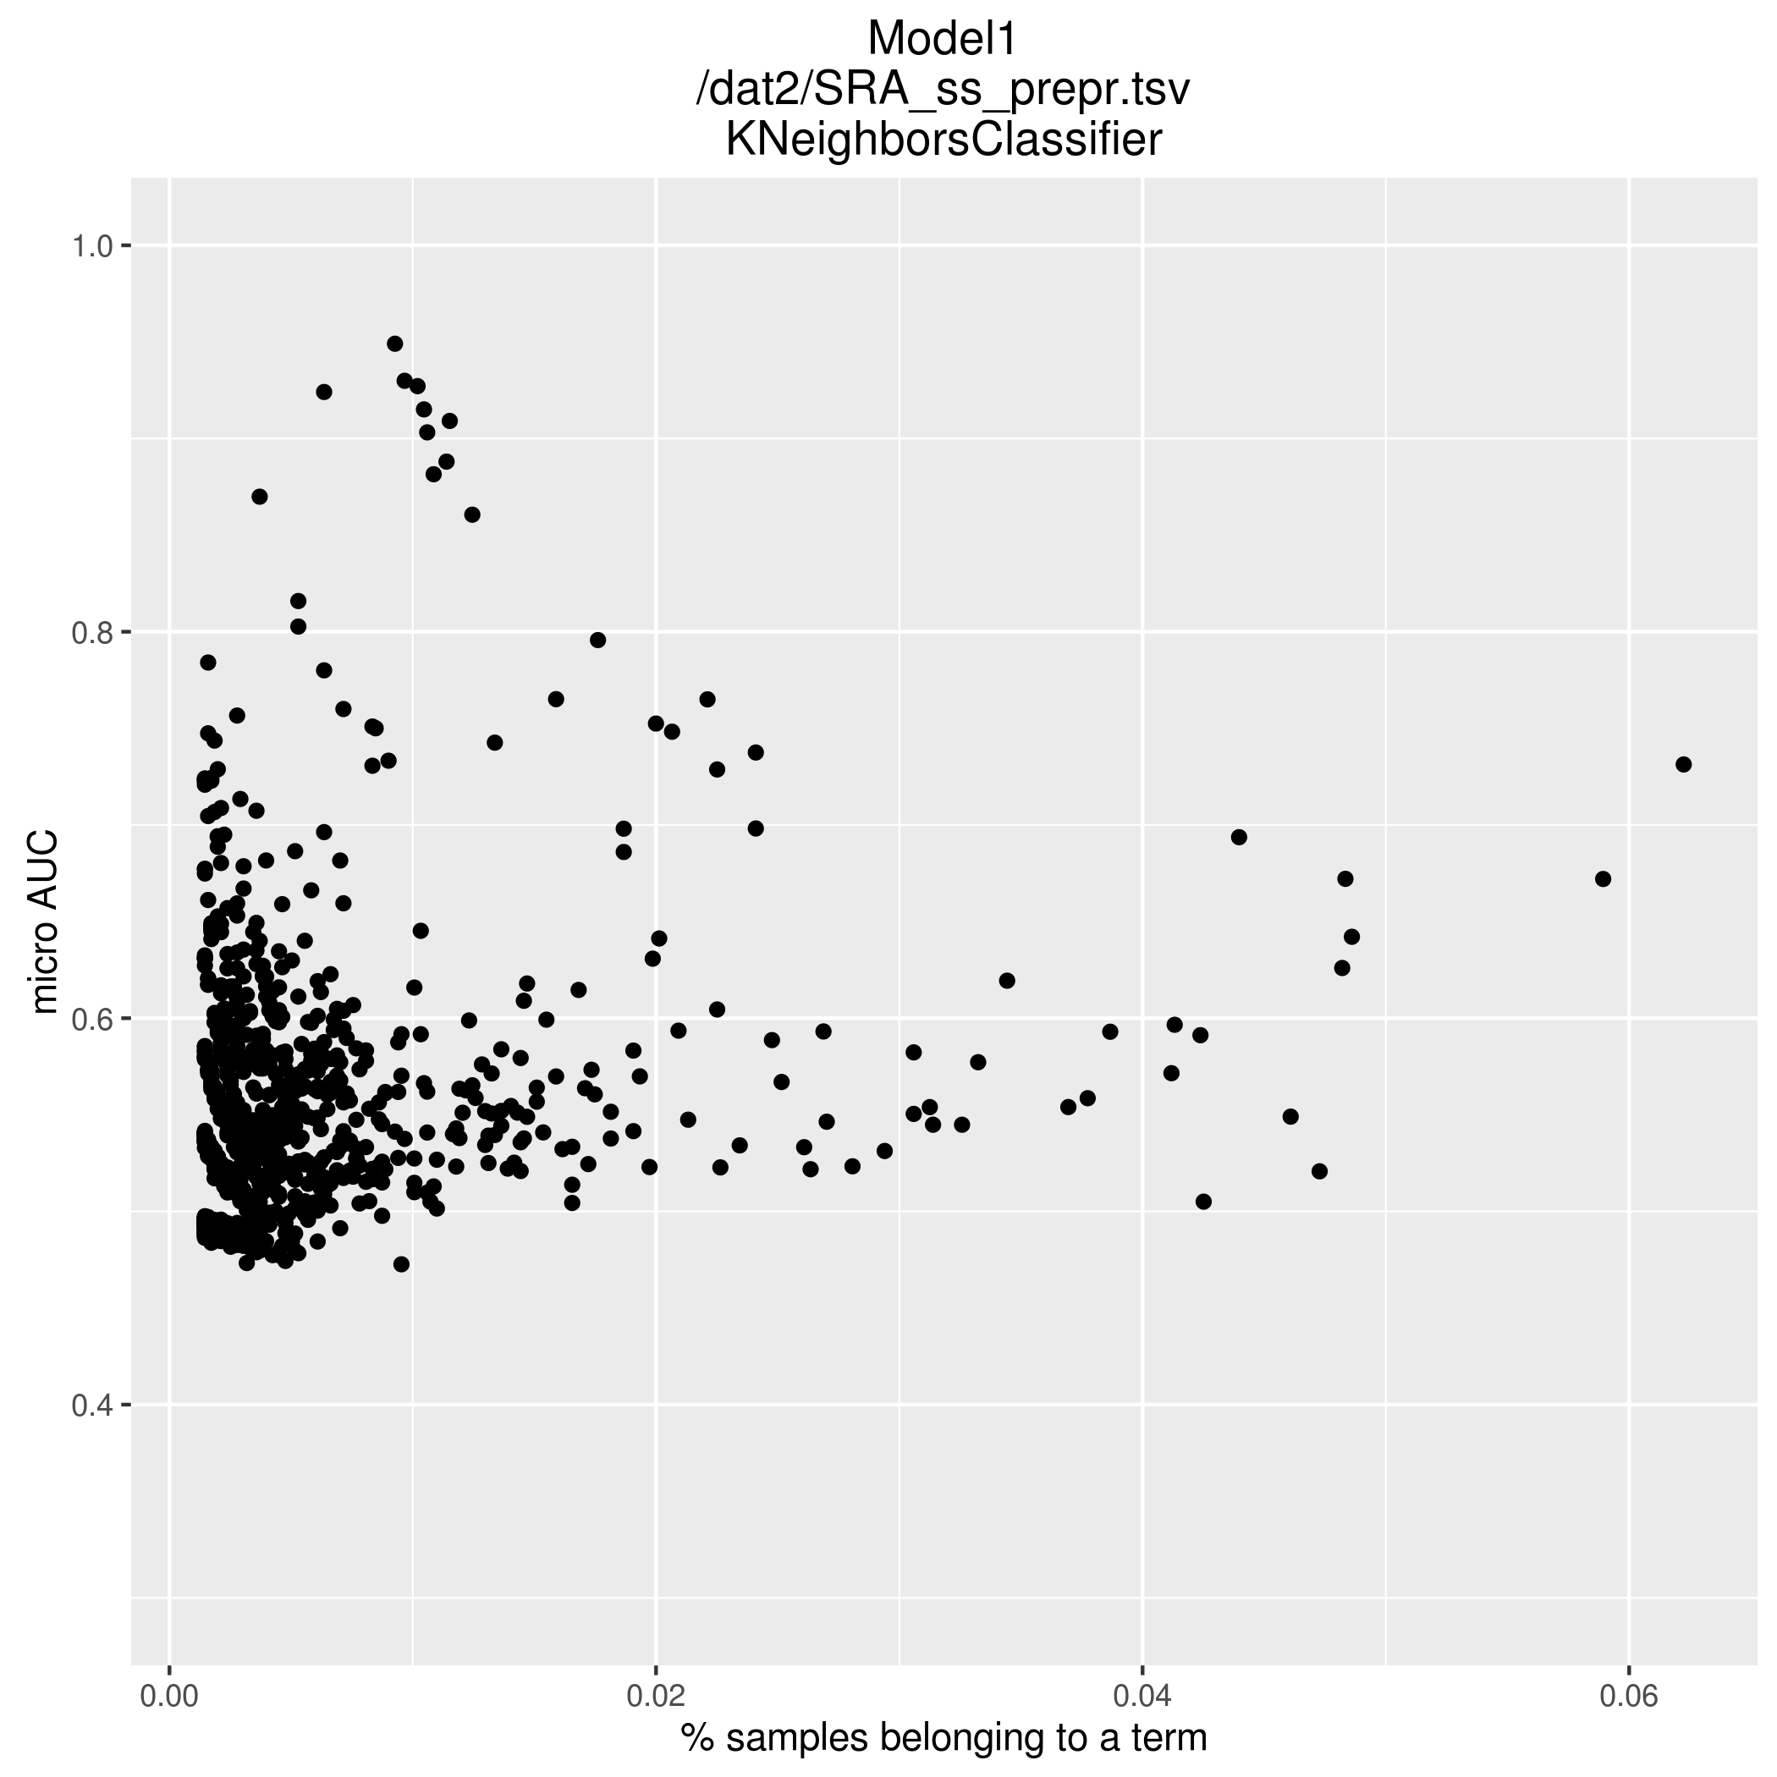
Micro AUC and GO term size
What are those that are predicted with highest accuracy?

Slide 11
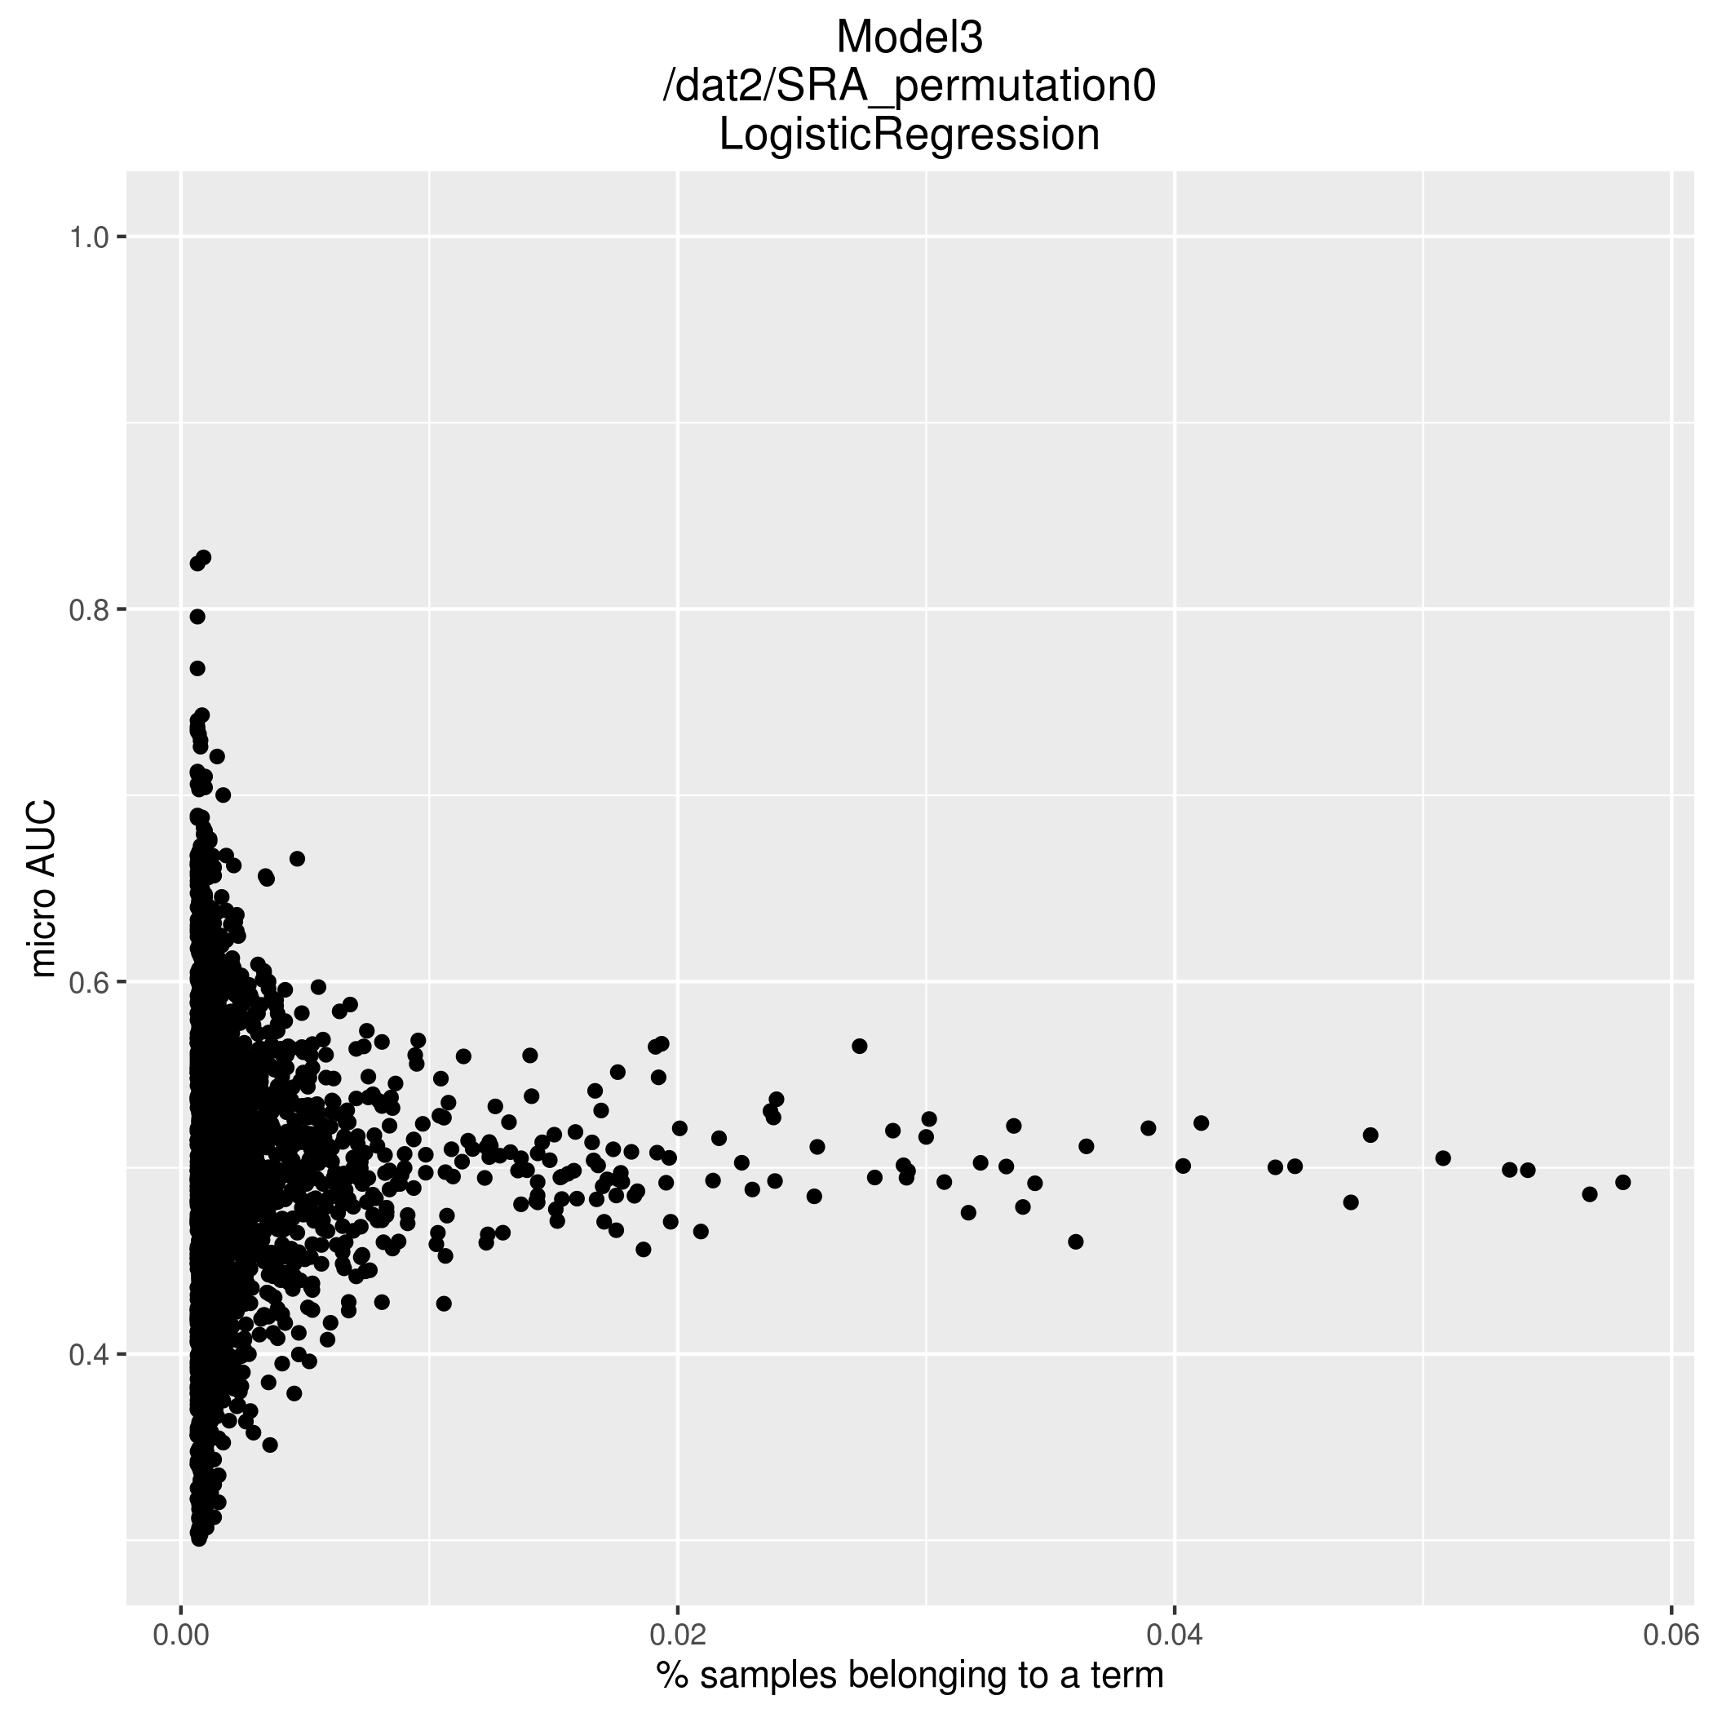
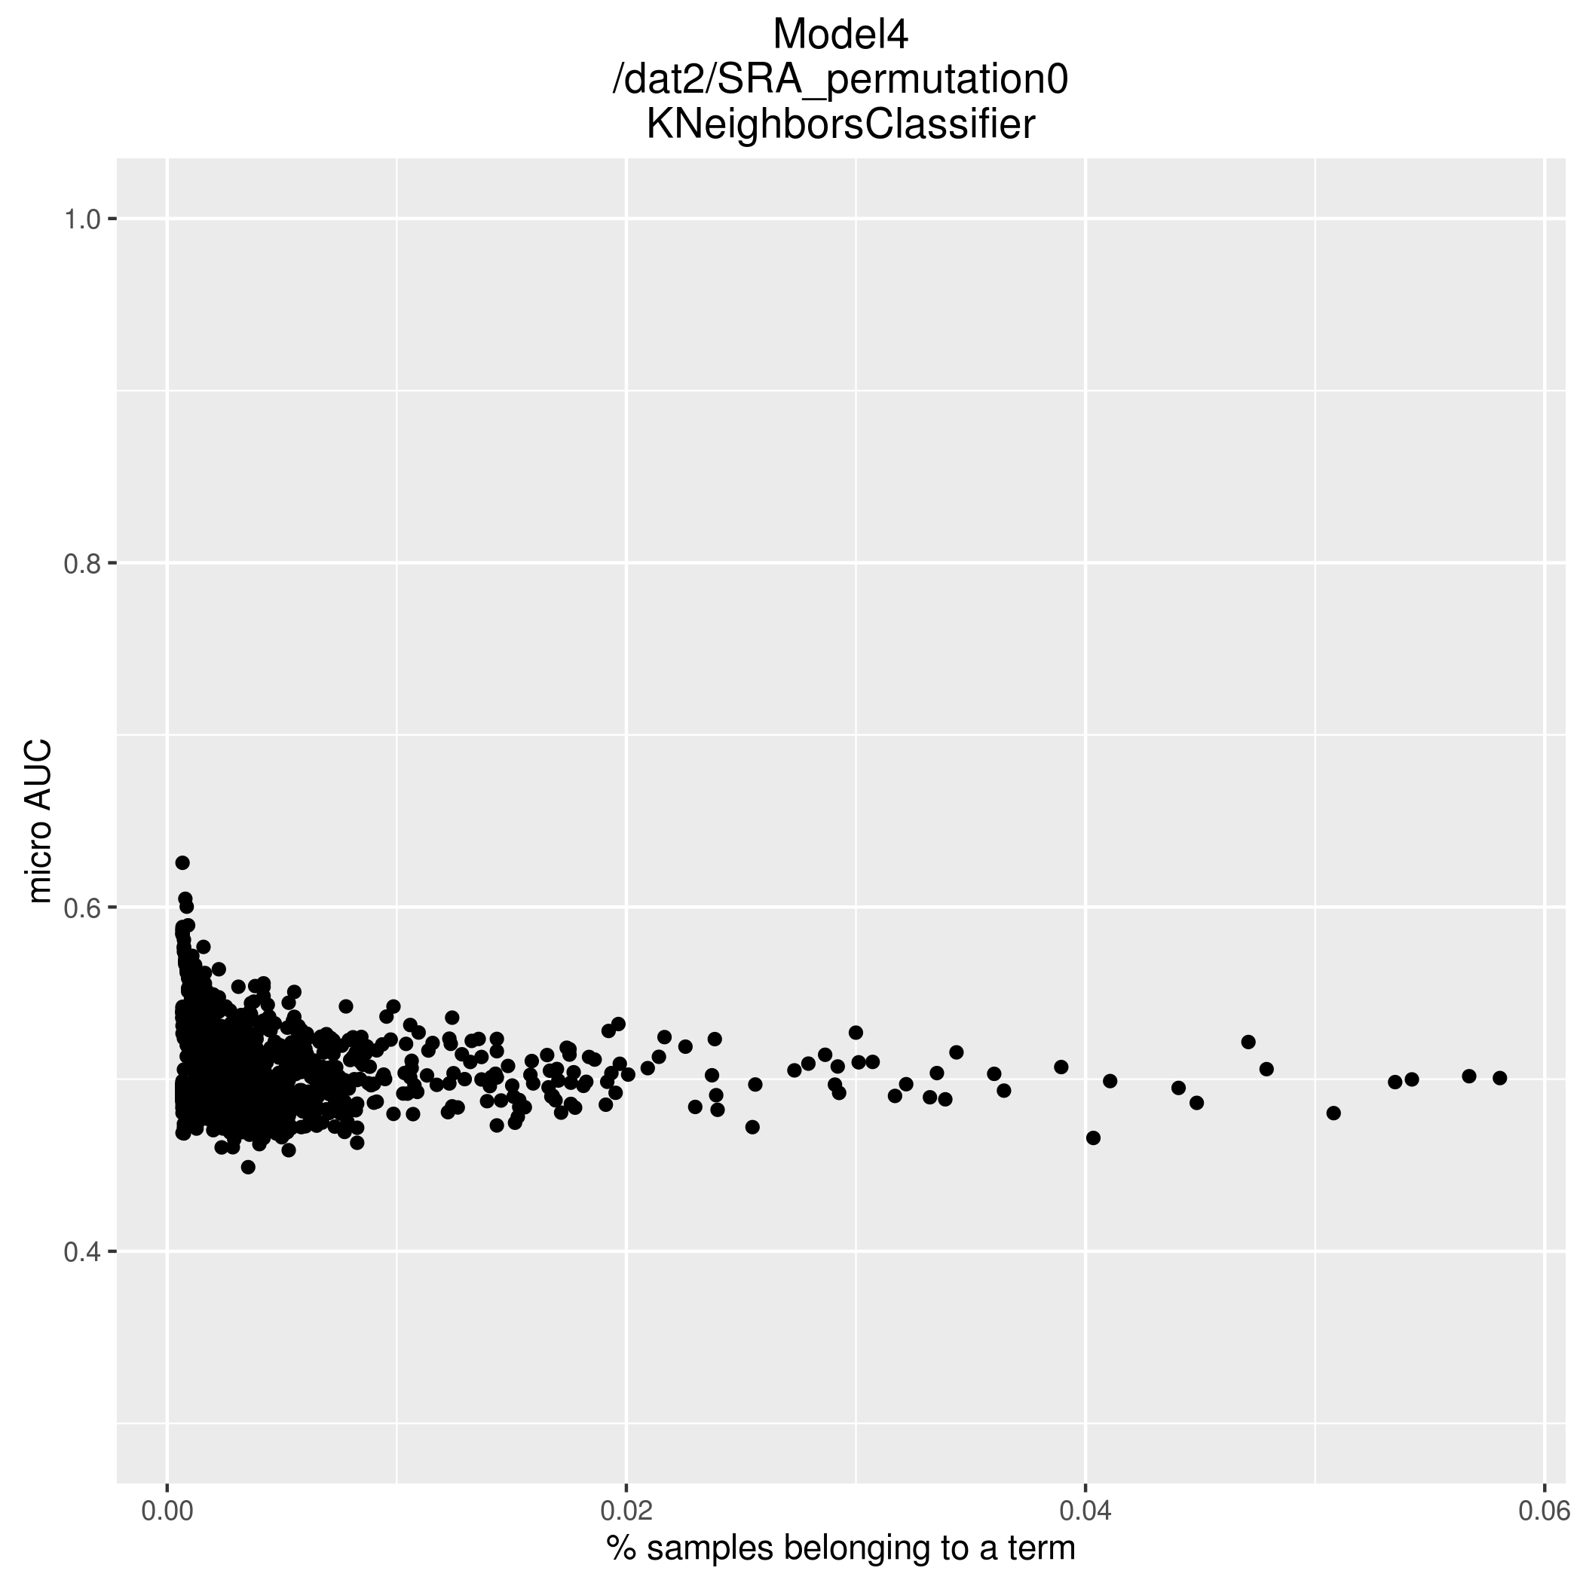
Comparison to row-permuted matrices
“randomly” both good and bad predictions for lowly represented GO terms
kNN is different; ?

