Slide 1
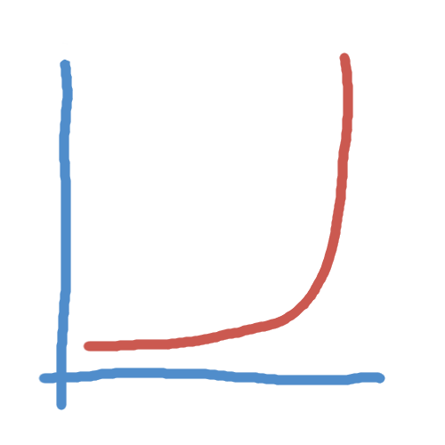
The bank slide

Slide 2
The next level of abstraction: a meta-metagenomic analysis
Aleksandra Perz
Research Trainee at Wren Lab
Oklahoma Medical Research Foundation
Explain
Class, group: a category to which a sample belongs, given some characteristics of this category, e.g. human samples, gut samples
Label: a class for a particular sample
* Metagenomic sample
Be able to explain
AUC,precision, recall, …
16S rRNA and wwhy there are unknown taxa
Why class sizes matter (guesses based on prior knowledge)

Slide 3
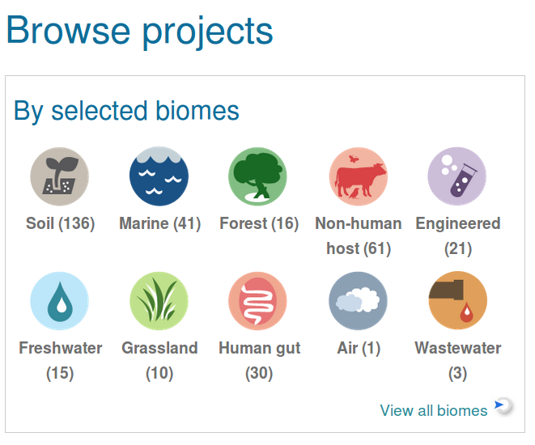
Metagenomics
Genetic material taken directly from a sample
Is a better representation of taxonomic diversity than cultured samples
16S rRNA gene used for phylogenetic classification
https://www.ebi.ac.uk/metagenomics/

Slide 4
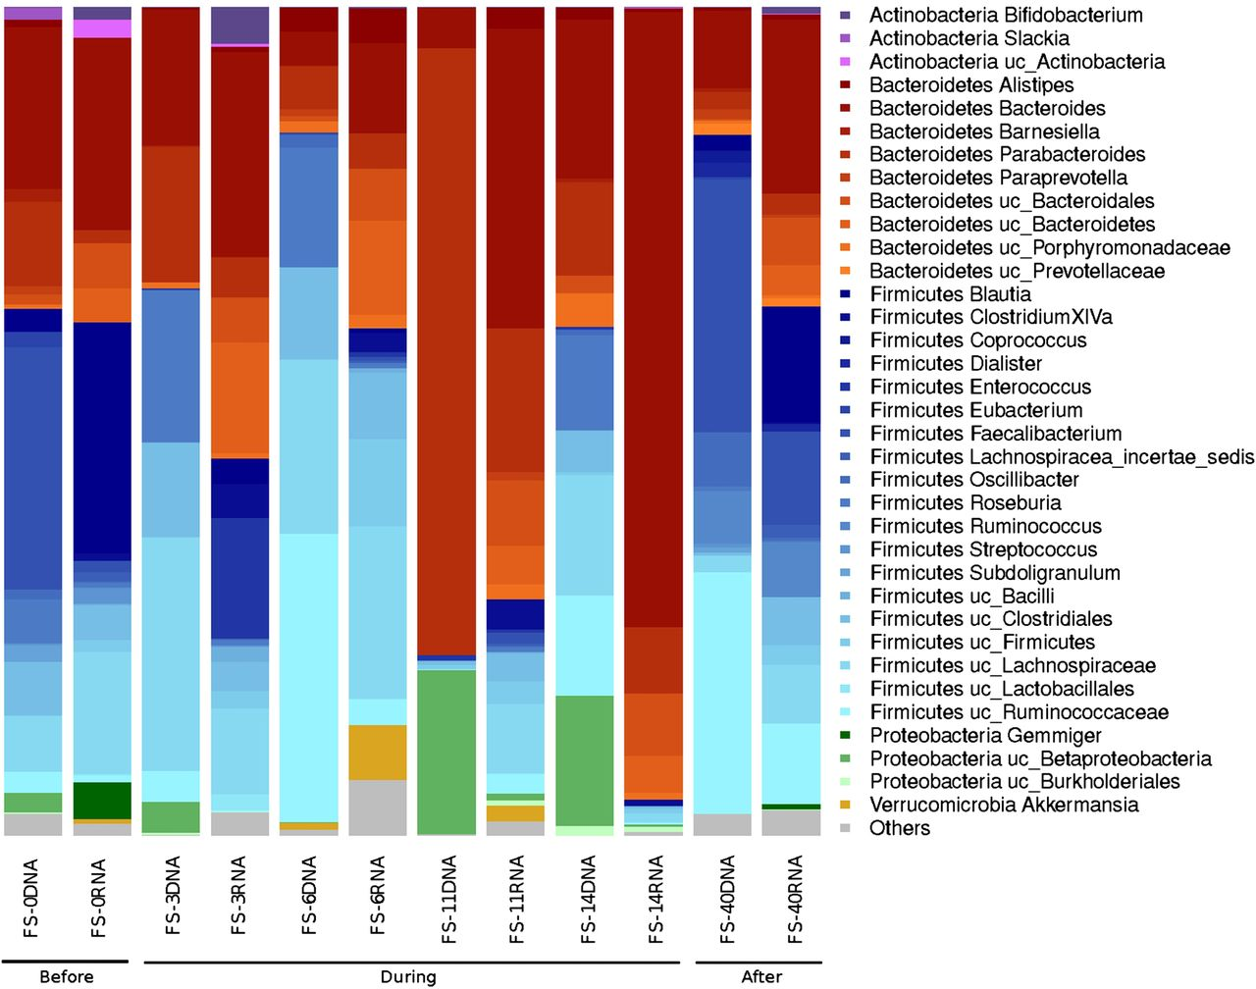
Inspiration
Gut bacterial composition.
FS-0, FS-3, FS-6, FS-11, FS-14: respective days of antibiotic treatment.
FS-40: 40 days after end of treatment.
early reduction in Gram-negative organisms (day 6)
overall collapse in diversity
Gut microbiota disturbance during antibiotic therapy: a multi-omic approach (Pérez-Cobas et al., Gut, 2013)

Slide 5
There is knowledge out there
Bring in the already available knowledge to interpret a new finding
Find samples that are similar:
learn something new about
the finding based on the literature
Compare shifts observed
between conditions:
find samples that exhibit similar
changes in taxonomic abundance
Predict characteristics
of the finding:
confirm the finding
Notes:
Just write and memorise for this slide

Slide 6

The data
contains information about the sample and the studies
a representation of how many of each taxonomic unit there is in each sample
Obtained from European Bioinformatics Institute

Slide 7

Metadata preparation
Study ID | ERP001506
Study title | Beta Lactam Antibiotics and Human Gut Microbiota
Sample ID | ERS149134
Sample classification | Host-associated:Human > Digestive system > Large intestine > Fecal
Sample description | Total DNA was extracted from human faecal samples using QIAamp® DNA Stool Kit (Quiagen) following the manufacturer's instructions
Sample name | Human gut metagenome, 40 days after antibiotics
Run IDs | ERR139700
Keywords | gut intestine faecal fecal human
Erroneous or incomplete metadata: automated extraction of labels developed
Keywords extracted
(e.g.“human”, “soil”, “diabetic”)
Entered manually

Slide 8
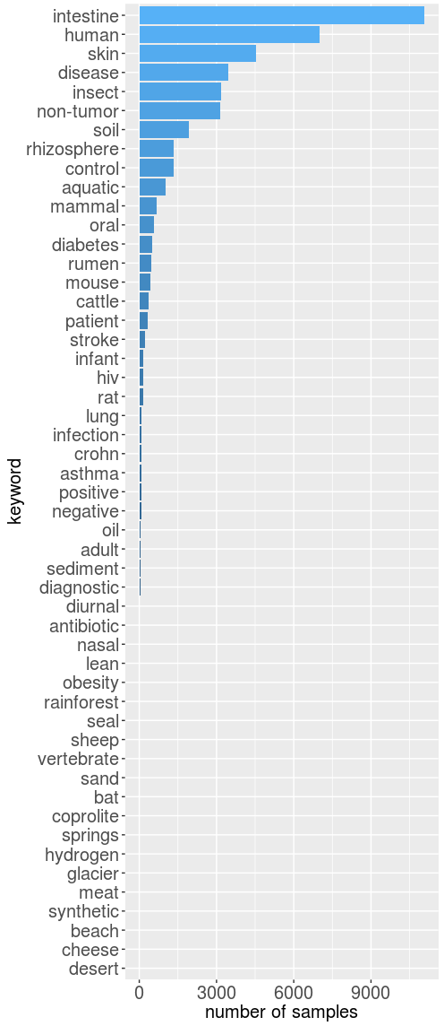
Metadata preparation
Erroneous or incomplete metadata: automated extraction of labels developed
Keywords extracted
(e.g.“human”, “soil”, “diabetic”)
Entered manually

Slide 9
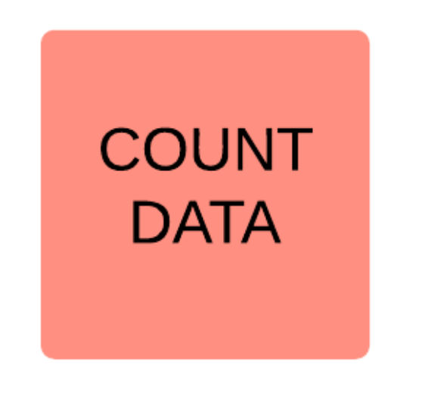
Count data preprocessing
Counts based on 16S rRNA sequencing reads
Batch downloaded from EBI
Cut out lowly represented samples
*Log2 transform
Standardise: sum to one (col or row?)
Take only samples that have sum of counts between 0.1 and 0.9 percentile
Take only taxa that have sum of counts non-zero at this point
CA-based
Count data batch downloaded from EBI
Differences in taxonomic abundance:
  biological
  technical
  (limited by the technology and its ability to distinguish between taxa)
  16S rRNA sequencing
  different identification levels
Irregular class sizes
wildly varying

Slide 10
Count data preprocessing
Count data batch downloaded from EBI
https://github.com/ProteinsWebTeam/ebi-metagenomics/blob/master/memi/memi-web/developers/python/mgportal_bulk_download.py
Differences in taxonomic abundance:
  biological
  technical
  (limited by the technology and its ability to distinguish between taxa)
Irregular class sizes
Take only samples that have sum of counts between 0.1 and 0.9 percentile
Standardize: represent counts as a fraction of total count within a sample
Take only taxa that have sum of counts non-zero at this point
Correspondence analysis-based preprocessing
*Log2 transform
Standardise: sum to one (col or row?)
Take only samples that have sum of counts between 0.1 and 0.9 percentile
Take only taxa that have sum of counts non-zero at this point
CA-based
Count data batch downloaded from EBI
Differences in taxonomic abundance:
  biological
  technical
  (limited by the technology and its ability to distinguish between taxa)
  16S rRNA sequencing
  different identification levels
Irregular class sizes
wildly varying

Slide 11
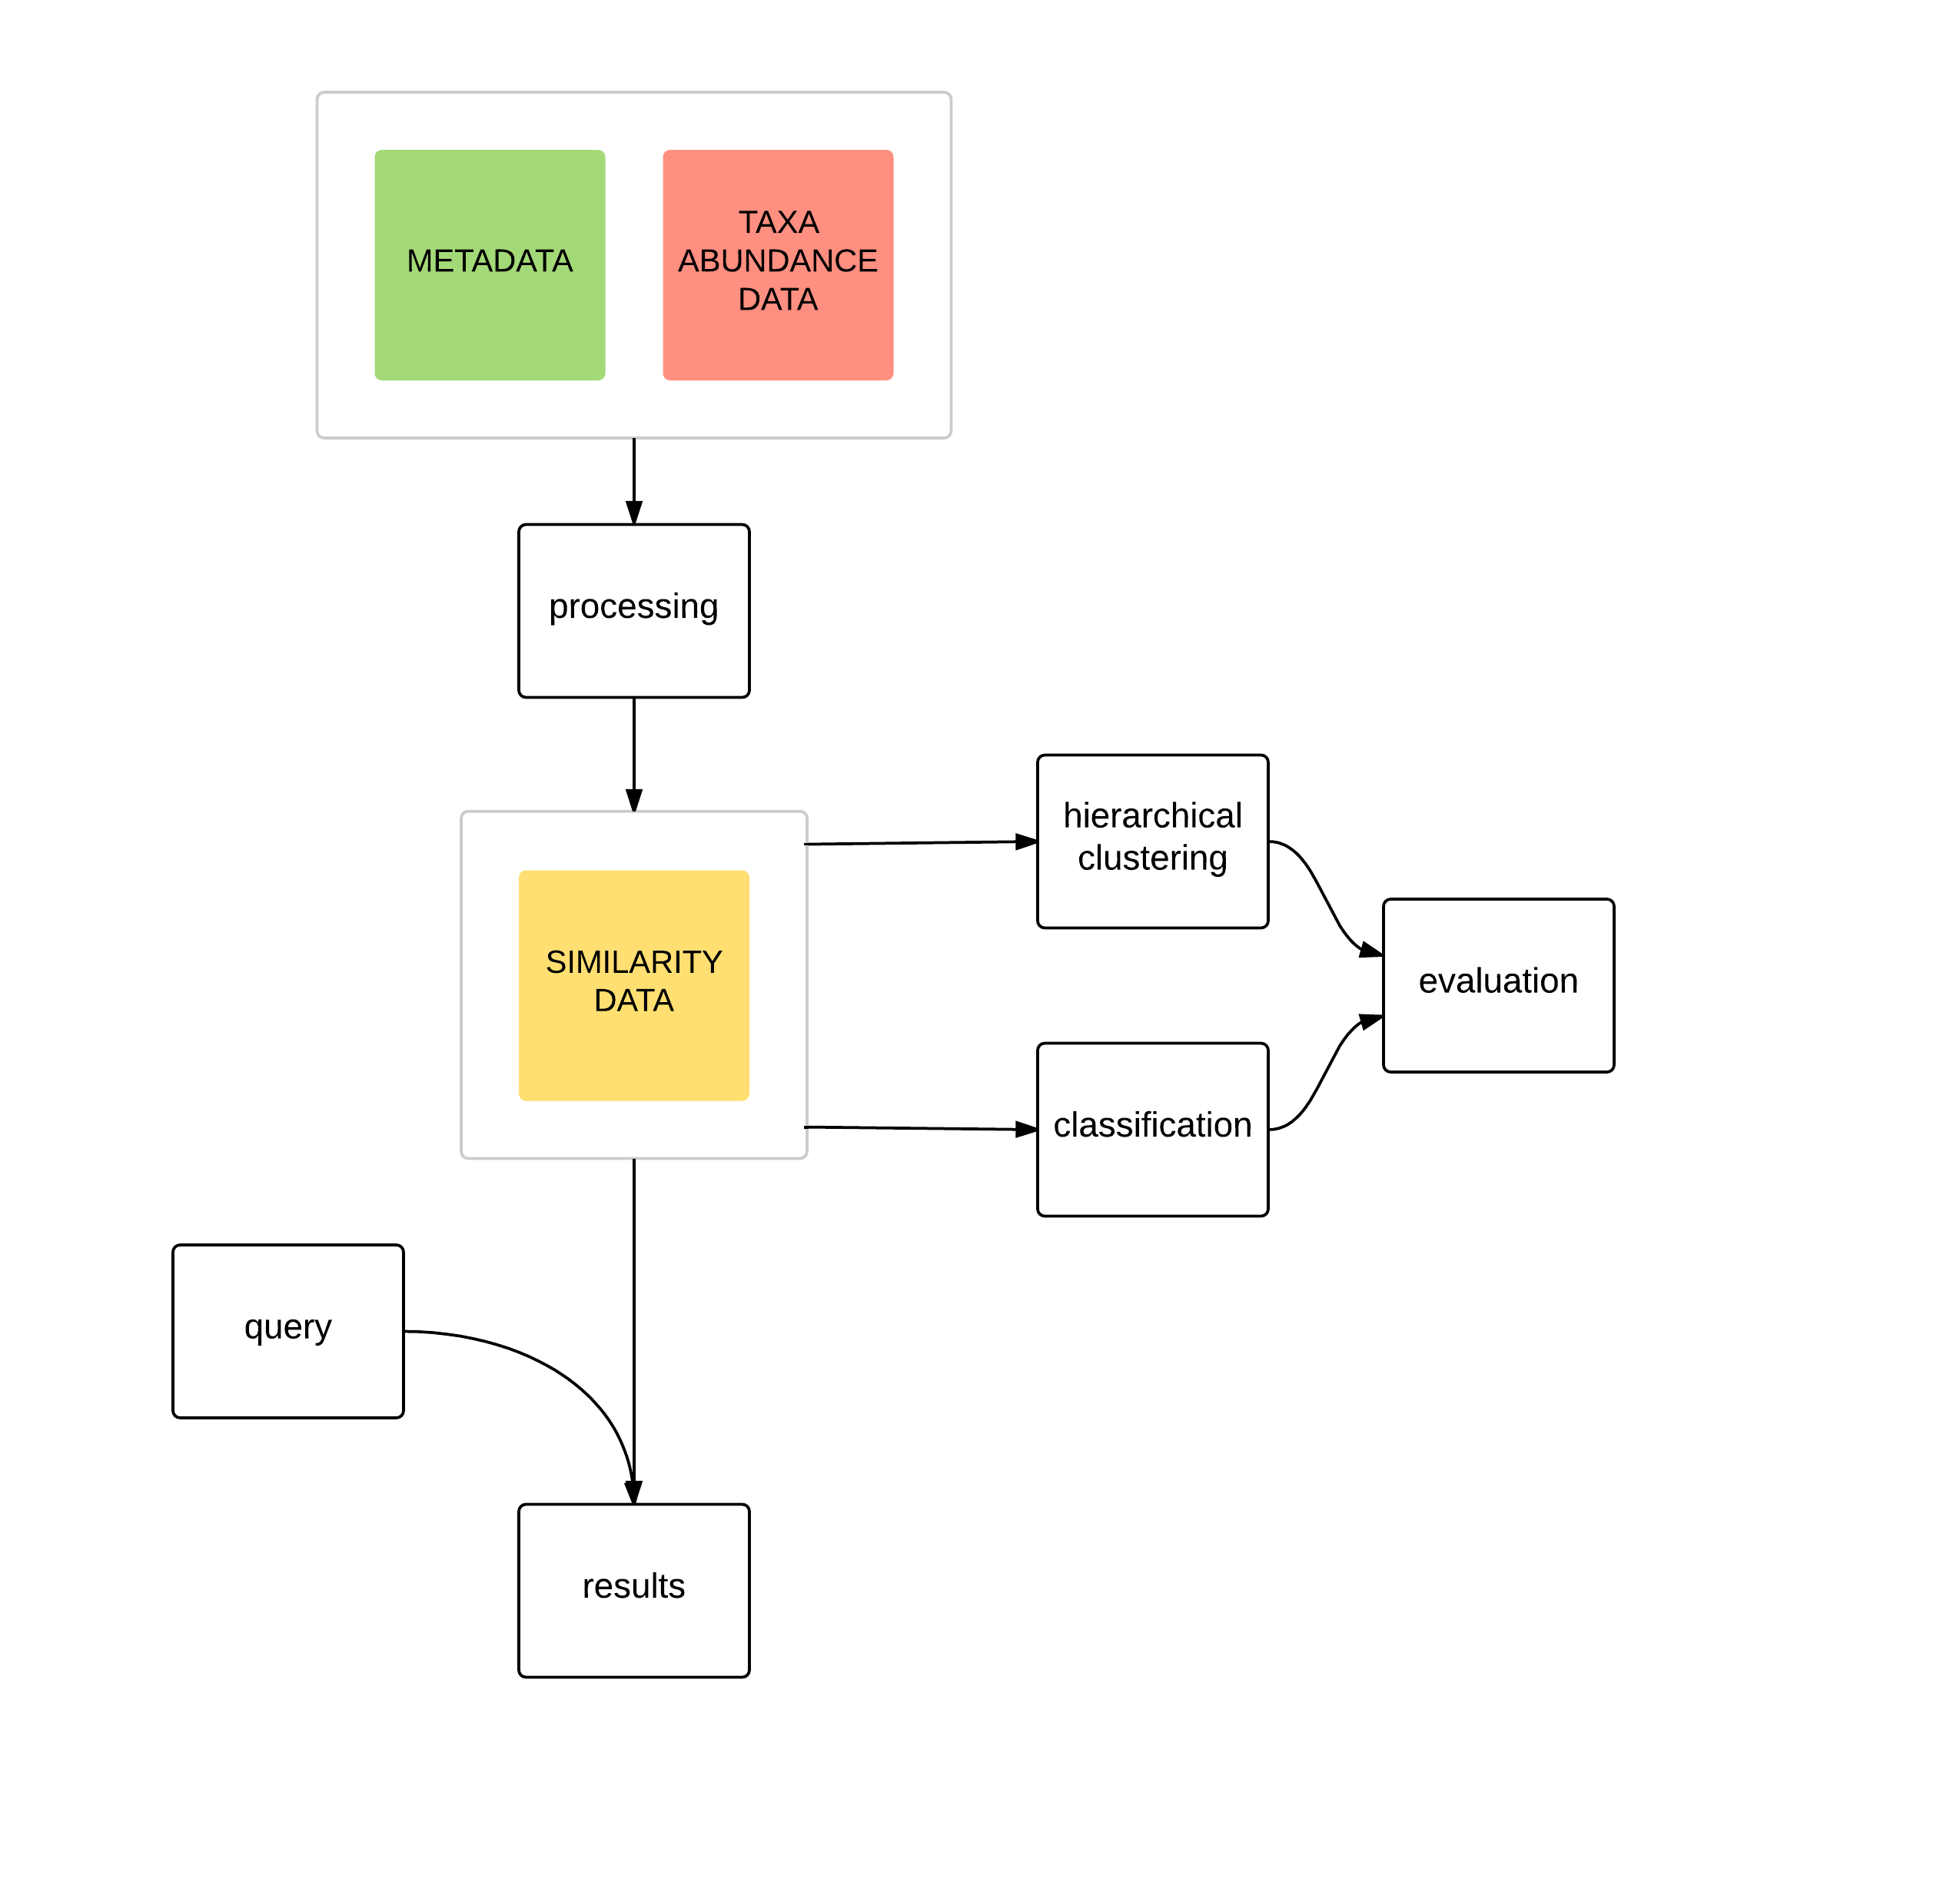
Systematic evaluation
Is it possible to predict a query samples' classes based on the taxonomic abundance?
graphical representation
Which samples are the closest to the query?
The measure of similarity is mathematical distance of one sample to another

Slide 12
Classification
How well the algorithm
predicts sample labels
based on the taxonomic abundance?
Which of the labels are well predicted, which are not?
ML approach
k Nearest Neighbors
Cross-validated
Claim 1: I have classes that are wll predicted and poorly, it makes sense because some of the classes are “control”
Claim 2: I can predict classes well (and only use classes that can potentially be predicted well, e.g. “soil”)

Slide 13
precision | recall | f1.score | samples belonging to class | class name
0.91 | 0.98 | 0.94 | 9398 | intestine
0.9 | 0.96 | 0.93 | 342 | mouse
0.84 | 0.99 | 0.91 | 212 | cattle
0.93 | 0.8 | 0.86 | 1659 | soil
0.83 | 0.84 | 0.83 | 4487 | skin
0.84 | 0.77 | 0.81 | 5250 | human
0.91 | 0.1 | 0.19 | 592 | aquatic
... | ... | ... | ... | ...
0 | 0 | 0 | 72 | positive
0 | 0 | 0 | 74 | rat
0 | 0 | 0 | 1258 | rhizosphere
0 | 0 | 0 | 14 | seal
0 | 0 | 0 | 18 | sheep
0 | 0 | 0 | 233 | patient
0 | 0 | 0 | 12 | vertebrate

Slide 14
f1.score | samples belonging to class | class name
0.94 | 9398 | intestine
0.93 | 342 | mouse
0.91 | 212 | cattle
0.86 | 1659 | soil
0.83 | 4487 | skin
0.81 | 5250 | human
0.19 | 592 | aquatic
... | ... | ...
0 | 72 | positive
0 | 74 | rat
0 | 1258 | rhizosphere
0 | 14 | seal
0 | 18 | sheep
0 | 233 | patient
0 | 12 | vertebrate
Good predictions
Useless predictions
or not predicted at all

Slide 15
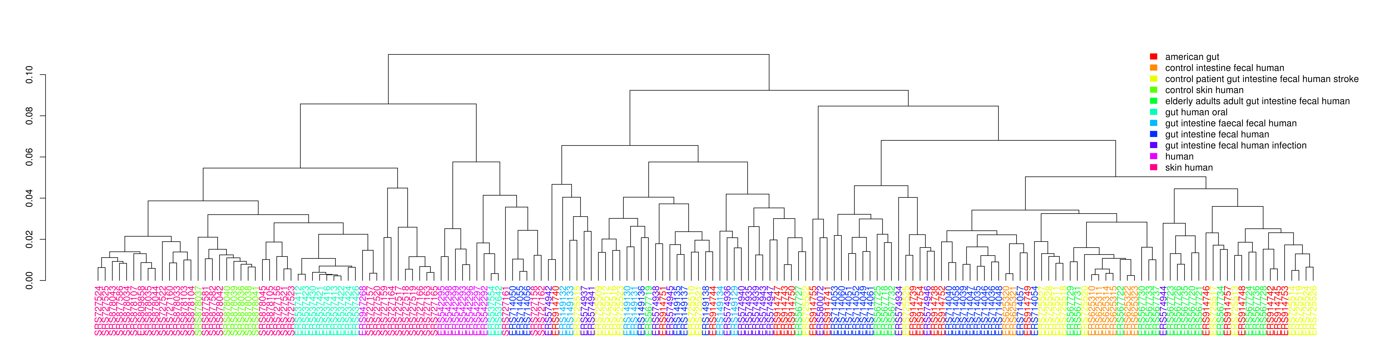
Hierarchical clustering
(full hclust plot, with a circle over some example region)
I need to refine the classes still, and refresh this picture
Cluster samples based on the similarity metric

Slide 16
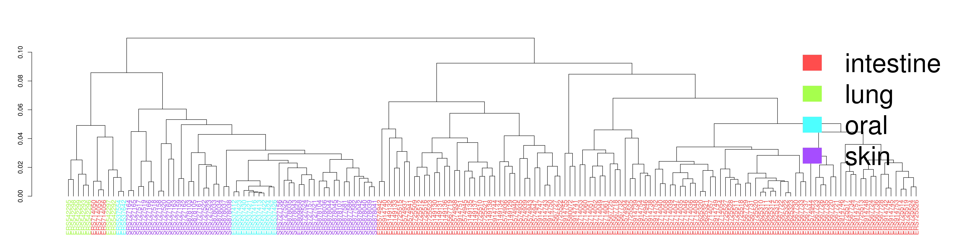
Hierarchical clustering
(full hclust plot, with a circle over some example region)
Cluster samples based on a similarity metric

Slide 17
Study_title | Sample_classification | Sample_name | Study_id
Beta Lactam Antibiotics and Human Gut Microbiota | Host-associated:Human > Digestive system > Large intestine > Fecal | Human gut metagenome, 14 days after antibiotics | ERP001506
Changes imposed by Clostridium difficile infection on the human gut microbiome | Host-associated > Human > Digestive system > Large intestine > Fecal | 16S rRNA | ERP008562
Gut microbiota of stroke patients differentiates from healthy controls | Host-associated > Human > Digestive system > Large intestine > Fecal | stroke_sectional_Co01 | ERP010458

Slide 18
Example with some REAL data
Sample_id | control | intestine | human
ERS149129 | 0 | 0.2 | 0.2
ERS149130 | 0 | 1 | 1
ERS149131 | 0 | 1 | 1
ERS149132 | 0 | 1 | 1
ERS149133 | 0 | 1 | 1
ERS149134 | 0 | 0.8 | 0.8
ERS149135 | 0 | 1 | 0.8
ERS149136 | 0 | 1 | 1
ERS149137 | 0 | 1 | 1
ERS149138 | 0 | 1 | 1
ERS149139 | 0 | 1 | 1
ERS149140 | 0.8 | 1 | 1
Probabilities that the sample belongs to the class

Slide 19
sample name | control | intestine | mouse | rat
OCR.OU34.C10 | 0 | 1 | 1 | 0
OCR.OU35.C11 | 0 | 1 | 1 | 0
OCR.OU38.D2 | 0 | 1 | 1 | 0
OCR.OU42.D6 | 0 | 1 | 1 | 0
OCR.OU44.D8 | 0 | 1 | 0.19 | 0.8
OAL.OU41.D5 | 0.21 | 1 | 0.79 | 0
OAL.OU47.D11 | 0 | 1 | 0.40 | 0.20
OAL.OU48.D12 | 0 | 1 | 0.80 | 0.20
OAL.OU49.E1 | 0 | 1 | 0.80 | 0
OAL.OU50.E2 | 0.21 | 1 | 0.80 | 0
OAL.OU51.E3 | 0.40 | 1 | 0.60 | 0
YCR.OU67.F7 | 0 | 1 | 1 | 0
YCR.OU68.F8 | 0 | 1 | 1 | 0
YCR.OU69.F9 | 0 | 1 | 1 | 0
YCR.OU70.F10 | 0 | 1 | 1 | 0
YCR.OU71.F11 | 0 | 1 | 1 | 0
YAL.OU52.E4 | 0 | 1 | 1 | 0
YAL.OU53.E5 | 0 | 1 | 0 | 1
YAL.OU54.E6 | 0 | 1 | 1 | 0
YAL.OU55.E7 | 0 | 1 | 1 | 0
YAL.OU56.E8 | 0 | 1 | 1 | 0

Slide 20
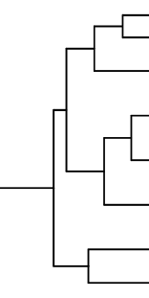
Hierarchical clustering
query
Sample_id | Study_title | Sample_description | Sample_name
ERS149132 | Beta Lactam Antibiotics and Human Gut Microbiota | Total DNA was extracted from human faecal samples (...) | Human gut metagenome, 11 days after antibiotics
ERS574934 | Changes imposed by Clostridium difficile infection on the human gut microbiome | 16S rRNA | 16S rRNA
ERS915363 | American Gut Project | American Gut Project Stool sample | 10317
This is example of how something may make sense, like perhaps our sample has actually something to do with clostridium infection. It may be worthwhile to go look this project up, and perhaps there is some relevant information there. Perhaps not. There are hundreds project available out there, and this is the one that's more likely to help.

Slide 21
Room for improvements
Refine group names and/or keyword extraction
Try out different algorithms and different parameters (logreg)
Try out multilabel classificaton, see which labels can be well predicted
Probably won't talk about these

Slide 22
Other things I've been doing
GAMMA-seq
Functional prediction for lncRNAs
Data: expression levels for transcripts
Automated confocal microscope image analysis
Measure intensity of each dye, colocalization, count cells, etc.

Slide 23
Thank them.
They are quite awesome.
Thank you for attention.
Jonathan Wren
Constantin Georgescu
Cory Giles
Christopher Reighard
Xiavan Roopnarinesingh

Slide 24
Thank you, Wren Lab.
Thank you, for attention.
Thank you for a chance to contribute to what I think important.
Jonathan Wren
Constantin Georgescu
Cory Giles
Christopher Reighard
Xiavan Roopnarinesingh
Thank you for indispensable support
in contributing
to what I think is important.

Slide 25
Supplementary material

Slide 26
Gut microbiota disturbance during antibiotic therapy: a multi-omic approach
Ana Elena Pérez-Cobas, María José Gosalbes, Anette Friedrichs, Henrik Knecht, Alejandro Artacho
2013 Gut 62(11), 1591-1601

Slide 27
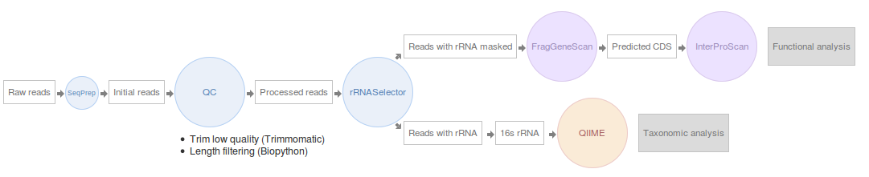
EBI
Unique studies: 180
Unique samples: 17269
Human samples: 12331
American gut: 8037
Classes: 152
https://github.com/ProteinsWebTeam/ebi-metagenomics/blob/master/memi/memi-web/developers/python/mgportal_bulk_download.py

Slide 28
Confocal image analysis
cell_line | treatment | cell_count | red_area_fraction | red_mean | red_stdev | yellow_area_fraction | yellow_mean_per_cell | green_in_nuclei_area_fraction | yellow_area_um
cell line 1 | control | 8.4 | 0.00 | 0.12 | 3.37 | 0.00 | 0.01 | 0.03 | 34.60
cell line 2 | treatment 1 | 19.8 | 0.06 | 4.33 | 26.09 | 0.01 | 0.06 | 0.02 | 180.30
cell line 1 | treatment 2 | 13.8 | 0.02 | 1.08 | 12.93 | 0.00 | 0.03 | 0.00 | 69.93
cell line 2 | treatment 1 | 20 | 0.15 | 12.10 | 44.16 | 0.07 | 0.51 | 0.01 | 1199.43

