Slide 1
Labour Force, Disability and Child Labour in Bangladesh, 2022
A data-driven 2D and 3D analysis of NCLS, LFS and DILFS 2022
Presenter: Mst. Najnin Sultana
ID: 25868400021
Course: Special Topics in Data Analytics
Course Code: 826818
Notes:
Introduce presenter, course and topic.

Slide 2
Problem and data
Official labour statistics are scattered across dozens of tables
Question: how do disability, age, education and child work shape labour-market outcomes?
Goal: merge, clean, chart (2D vs 3D), test, and explain
NCLS 2022
Working children, hazards, schooling, income
LFS 2022 · Ch. 8
Unemployment by age, education, sex, area
DILFS 2022 · Ch. 4
Labour force of persons with disabilities
1,869 values from 52 BBS tables merged into one file
Mst. Najnin Sultana · ID 25868400021 · Special Topics in Data Analytics (826818) | 2

Slide 3
Objectives and agenda
Objectives
Agenda
Merge NCLS, LFS and DILFS tables into one tidy file
Compare the same numbers as 2D and 3D charts
Test whether male–female unemployment gaps are significant
Deliver dashboards, notebook, report and slides
Problem, data and method
Labour force, disability and unemployment
Child labour and schooling
2D versus 3D comparisons
Statistical tests and limitations
Conclusions and references
Mst. Najnin Sultana · ID 25868400021 · Special Topics in Data Analytics (826818)
Notes:
Four objectives: merge, compare 2D and 3D, test the male-female gap, deliver dashboards and a report.

Slide 4
Method and tools
Load & merge
Clean & check
Chart 2D / 3D
Test & trend
Dashboards
Cleaning: no missing values or duplicates; IQR outliers reviewed, none removed
Python: pandas, SciPy, Plotly, Matplotlib; Streamlit app with 7 chart styles
Paired t-test and Wilcoxon test for male–female unemployment gaps
ERP-style dashboard: left sidebar, drop-down lists, benchmark input, results table and graph (HTML/CSS/JS and PHP)
Mst. Najnin Sultana · ID 25868400021 · Special Topics in Data Analytics (826818) | 3

Slide 5
Unemployment is a youth problem
10.97%
unemployment at ages 15–24
65%
of the unemployed are aged 15–24
12.0%
tertiary graduates (18.9% women)
Mst. Najnin Sultana · ID 25868400021 · Special Topics in Data Analytics (826818) | 4

Slide 6
Disability: low participation, not low need
22.5%
participation with disabilities (others 62.3%)
11.3%
women with disabilities
87.2%
of employed with disabilities are informal
Mst. Najnin Sultana · ID 25868400021 · Special Topics in Data Analytics (826818) | 5

Slide 7
Child labour: work competes with school
3.54 million
working children aged 5–17
99%
work informally
1.07 million
in hazardous child labour
Mst. Najnin Sultana · ID 25868400021 · Special Topics in Data Analytics (826818) | 6

Slide 8
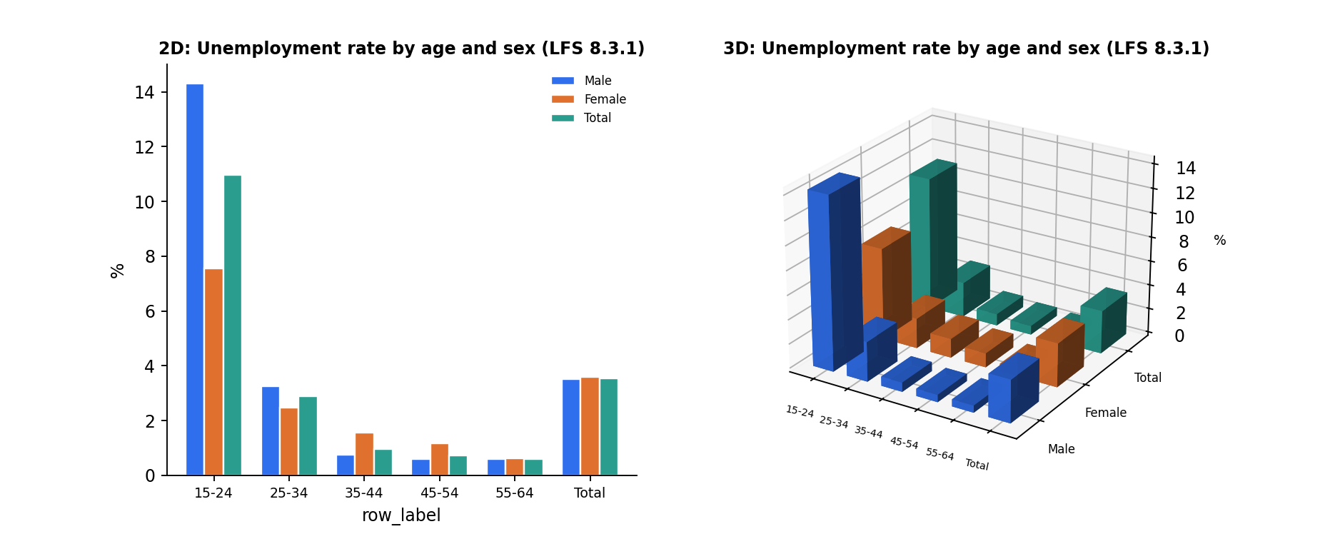
2D vs 3D: unemployment by age and sex
2D shows the 15–24 peak (14.3% men, 7.5% women) at a glance; 3D hides the short bars.
Mst. Najnin Sultana · ID 25868400021 · Special Topics in Data Analytics (826818)
Notes:
Figure 4.5 of the report. Same LFS 8.3.1 numbers drawn twice. The 2D bars are easier to read exactly; the 3D version adds depth but occludes the small values.

Slide 9
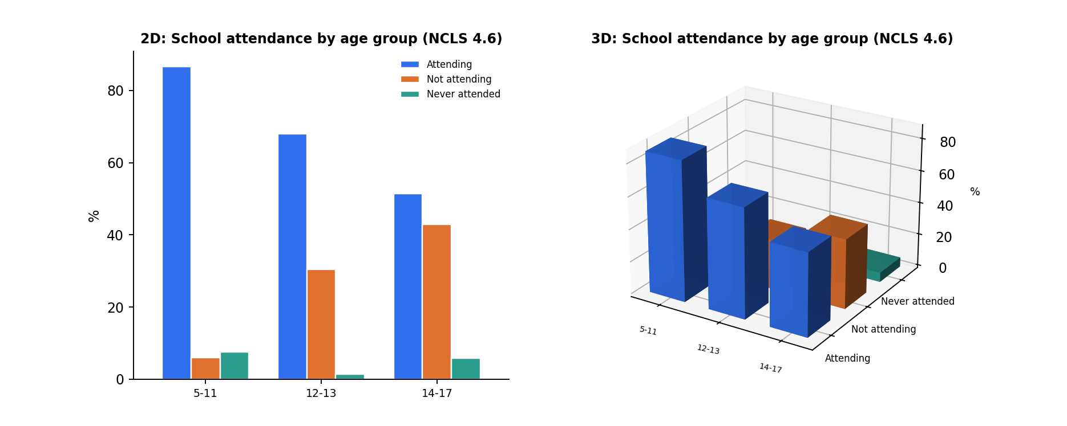
2D vs 3D: school attendance of working children
Attendance falls from 86.6% (ages 5–11) to 51.4% (ages 14–17).
Mst. Najnin Sultana · ID 25868400021 · Special Topics in Data Analytics (826818)
Notes:
Figure 5.4 of the report, NCLS Table 4.6. Stacked 2D bars compare shares directly.

Slide 10
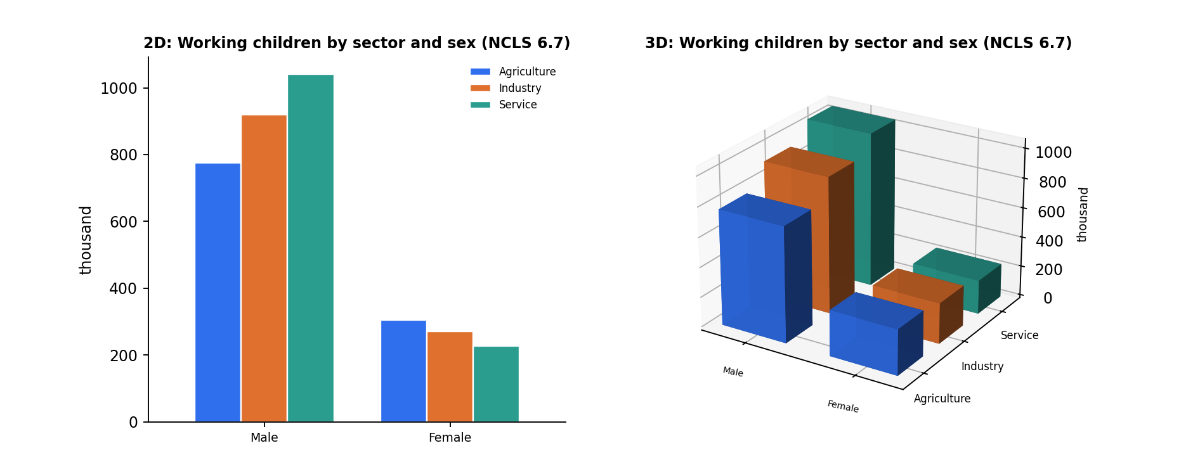
2D vs 3D: working children by sector and sex
Sector patterns differ by sex; 2D makes the ranking easier to see.
Mst. Najnin Sultana · ID 25868400021 · Special Topics in Data Analytics (826818)
Notes:
Figure 5.2 of the report, NCLS Table 6.7, in thousands.

Slide 11
Are male–female unemployment gaps significant?
Breakdown | n | Male % | Female % | p t-test | p Wilcoxon
Age – Rural | 5 | 3.95 | 2.22 | 0.389 | 0.813
Age – Urban | 5 | 3.75 | 5.74 | 0.151 | 0.188
Age – Bangladesh | 5 | 3.90 | 2.67 | 0.432 | 1.000
Education – Rural | 6 | 5.94 | 5.54 | 0.794 | 0.688
Education – Urban | 6 | 3.76 | 7.28 | 0.245 | 0.313
Education – Bangladesh | 6 | 5.00 | 5.88 | 0.653 | 1.000
No p-value is below 0.05: the sex gap is not statistically significant (small samples, published aggregates).
Mst. Najnin Sultana · ID 25868400021 · Special Topics in Data Analytics (826818)
Notes:
Paired t-test and Wilcoxon signed-rank on LFS 8.3.1 (age groups, n=5) and 8.4.1 (education levels, n=6). No p-value is below 0.05, but samples are small.

Slide 12
Limitations
Published aggregates: descriptive analysis, not predictive modelling
No age × disability table, so unemployment by age is shown for all persons
No training or literacy variables in the tables used (DILFS_2022_LFS_2022.csv was not supplied)
Table 4.7 covers persons with disabilities only, so no sector comparison with others
Source quirks (e.g. 11,522.72 vs 11,552.72 urban earnings) kept as printed
Mst. Najnin Sultana · ID 25868400021 · Special Topics in Data Analytics (826818)
Notes:
Published aggregates only, so the analysis is descriptive.

Slide 13
Conclusions and recommendations
Findings
Recommendations
Low, equal unemployment hides youth and graduate problems
Participation, not unemployment, shows disability exclusion
Child work is informal and rises into hazardous sectors with age
Gender gaps in unemployment are not statistically significant
Youth and graduate job-matching programmes
Accessible workplaces and skills support for people with disabilities
Enforcement in manufacturing, construction and trade; school-retention support for ages 12–17
Publish age × disability and training tables
Thank you · Mst. Najnin Sultana
Mst. Najnin Sultana · ID 25868400021 · Special Topics in Data Analytics (826818) | 7

Slide 14
References
Bangladesh Bureau of Statistics (2022). NCLS, LFS and DILFS 2022. Dhaka: Statistics and Informatics Division.
ILO (1982). 13th ICLS resolution on economically active population, employment and unemployment.
ILO (2013). 19th ICLS resolution on work, employment and labour underutilization.
ILO (1973; 1999). Conventions No. 138 and No. 182.
Student (1908). The probable error of a mean. Biometrika, 6(1).
Wilcoxon, F. (1945). Individual comparisons by ranking methods. Biometrics Bulletin, 1(6).
McKinney (2010); Hunter (2007); Plotly (2015); Tufte (2001).
Mst. Najnin Sultana · ID 25868400021 · Special Topics in Data Analytics (826818)
Notes:
Full list of 13 references is on the last page of the report.

