Slide 1

Machine Learning
Introduction

Slide 2
Data and Learning
Machine Learning
Supervised Learning
Unsupervised Learning
Reinforcement Learning
Outline
Data and Learning
Machine Learning
Supervised Learning
Unsupervised Learning
Reinforcement Learning
CSE 411: Machine Learning

Slide 3
“Alb–ert Einstein
Wisdom is not a product of schooling but of the lifelong attempt to
acquire it.
”

Slide 4

Data and Learning
Machine Learning
Supervised Learning
Unsupervised Learning
Reinforcement Learning
Data and Learning
CSE 411: Machine Learning

Slide 5

Data and Learning
Machine Learning
Supervised Learning
Unsupervised Learning
Reinforcement Learning
Big Data
Widespread use of personal computers and wireless communication leads to “Big Data”
We are both producers and consumers of data
Data is not random, it has structure, e.g., customer behavior
We need “big theory” to extract that structure from data for:
  Understanding the process
  Making predictions for the future
CSE 411: Machine Learning

Slide 6
Data and Learning
Machine Learning
Supervised Learning
Unsupervised Learning
Reinforcement Learning
Why “Learn”?
Machine learning is programming computers to optimize a performance criterion using example data or past experience.
There is no need to “learn” to calculate payroll
Learning is used when:
Human expertise does not exist (navigating on Mars),
Humans are unable to explain their expertise (speech recognition) Solution changes in time (routing on a computer network) Solution needs to be adapted to particular cases (user biometrics)
CSE 411: Machine Learning

Slide 7
Data and Learning
Machine Learning
Supervised Learning
Unsupervised Learning
Reinforcement Learning
What We Talk About When We Talk About “Learning”
Learning general models from a data of particular examples
Data is cheap and abundant (data warehouses, data marts); knowledge is expensive and scarce.
Example in retail: Customer transactions to consumer behavior:
People who buy “Toothbrush” also buy “Toothpaste” (e-commerce sites)
Build a model that is a good and useful approximation to the data.
CSE 411: Machine Learning

Slide 8
Data and Learning
Machine Learning
Supervised Learning
Unsupervised Learning
Reinforcement Learning
Data Mining
Retail: Market basket analysis, Customer relationship management (CRM)
Finance: Credit scoring, fraud detection
Manufacturing: Control, robotics, troubleshooting
Medicine: Medical diagnosis
Telecommunications: Spam filters, intrusion detection
Bioinformatics: Motifs, alignment
Web mining: Search engines
⋯

Slide 9
Data and Learning
Machine Learning
Supervised Learning
Unsupervised Learning
Reinforcement Learning
Machine Learning
CSE 411: Machine Learning

Slide 10
Data and Learning
Machine Learning
Supervised Learning
Unsupervised Learning
Reinforcement Learning
What is Machine Learning?
Optimize a performance criterion using example data or past experience.
Role of Statistics: Inference from a sample
Role of Computer science: Efficient algorithms to:
Solve the optimization problem
Representing and evaluating the model for inference
CSE 411: Machine Learning

Slide 11
Data and Learning
Machine Learning
Supervised Learning
Unsupervised Learning
Reinforcement Learning
Applications
Association
Supervised Learning
Classification
Regression
Unsupervised Learning
Reinforcement Learning

Slide 12
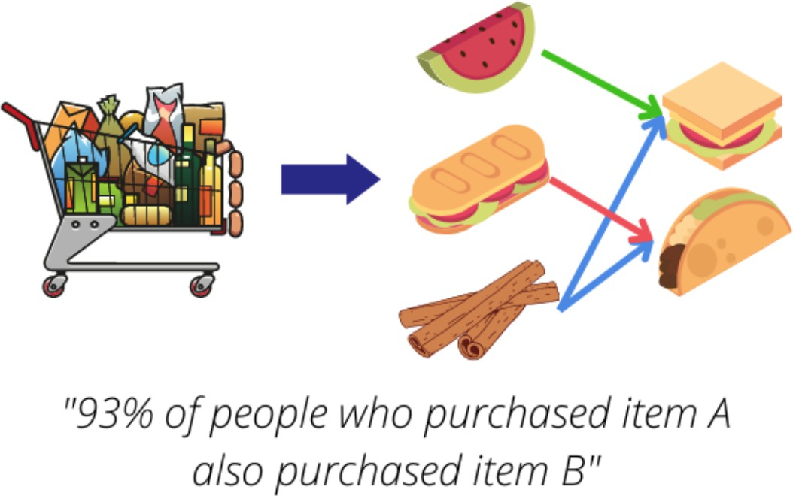
Data and Learning
Machine Learning
Supervised Learning
Unsupervised Learning
Reinforcement Learning
Learning Associations
Basket analysis: P (Y ∣X) probability that somebody who buys X also buys Y
where X and Y are products/services.
Example: P (chips∣beer) = 0.7

Slide 13
Data and Learning
Machine Learning
Supervised Learning
Unsupervised Learning
Reinforcement Learning
Learning Association: Question
Question
In basket analysis, we want to find the dependence between two items X and Y . Given a database of customer transactions, how can we find these dependencies? How would we generalize this to more than two items?

Slide 14
Data and Learning
Machine Learning
Supervised Learning
Unsupervised Learning
Reinforcement Learning
Supervised Learning
CSE 411: Machine Learning

Slide 15
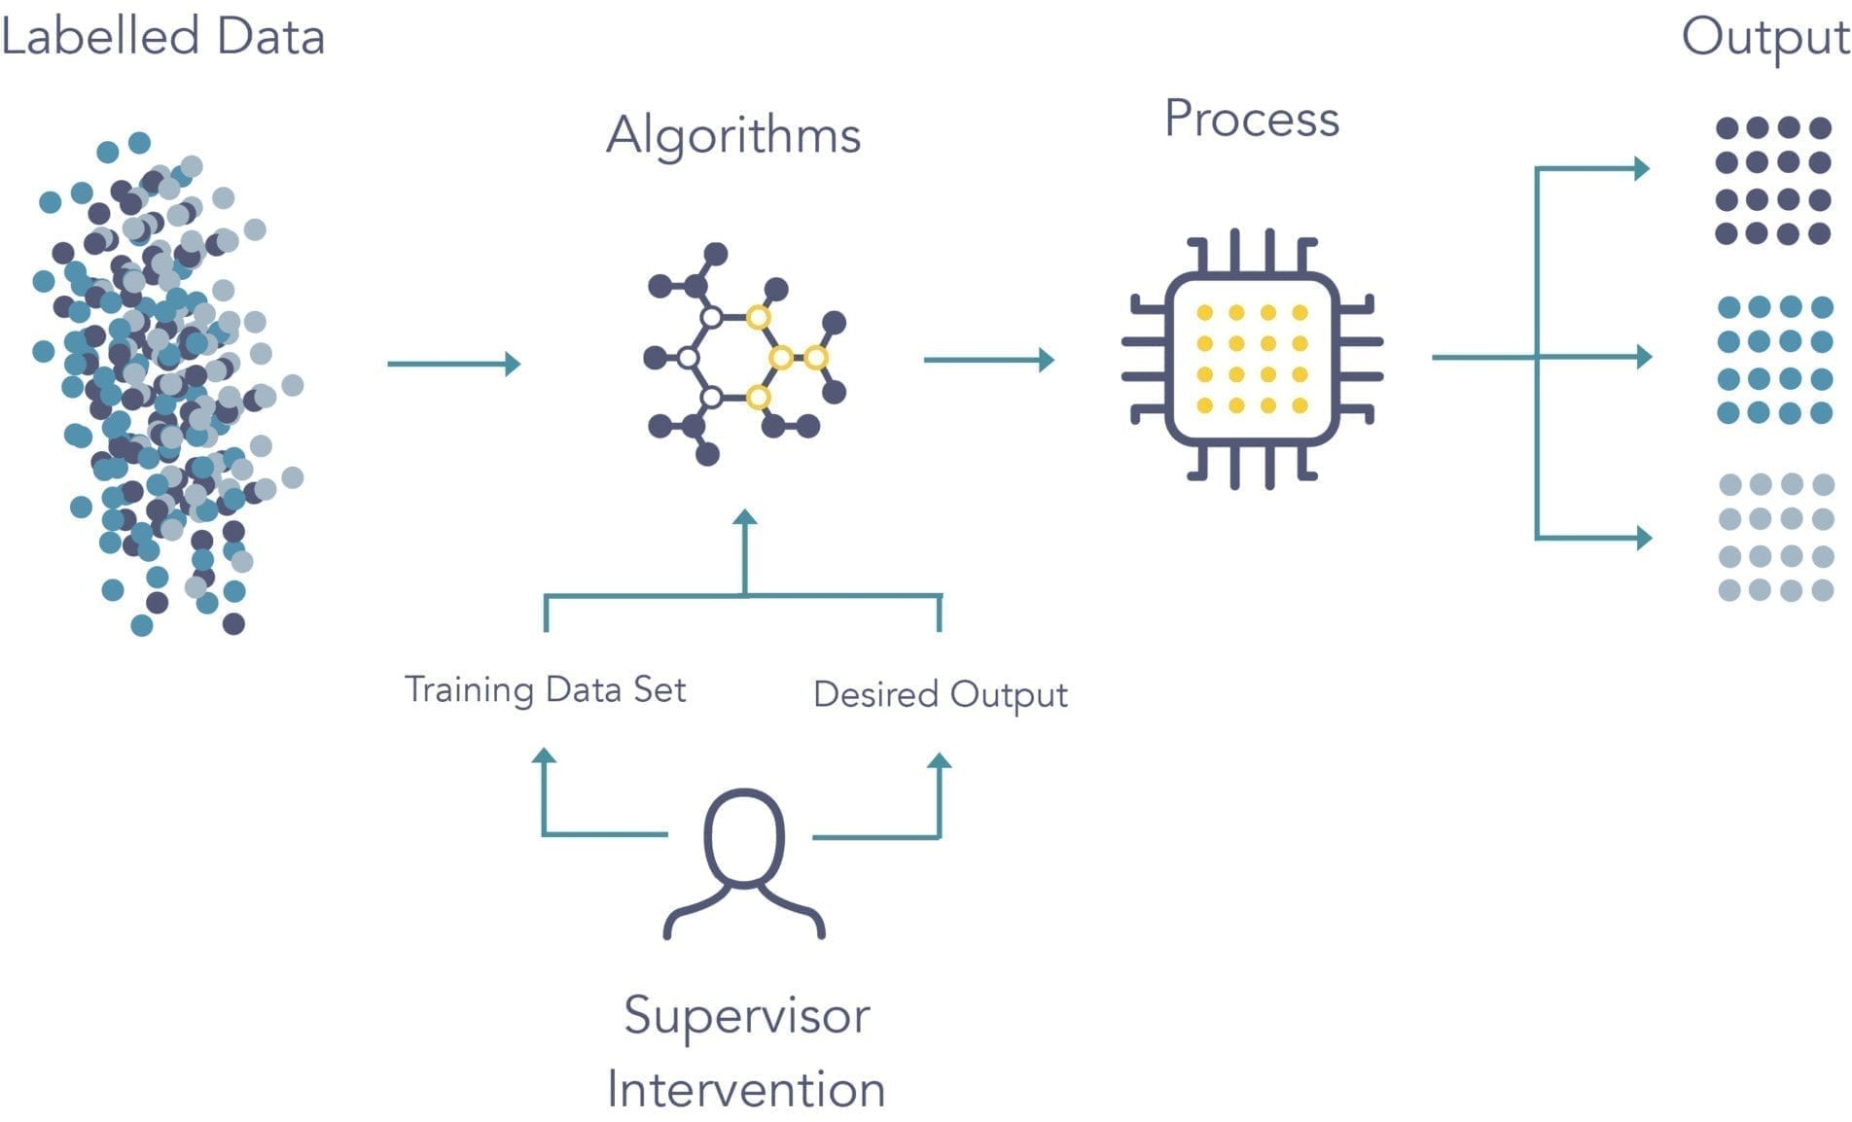
Data and Learning
Machine Learning
Supervised Learning
Unsupervised Learning
Reinforcement Learning
Supervised Learning

Slide 16
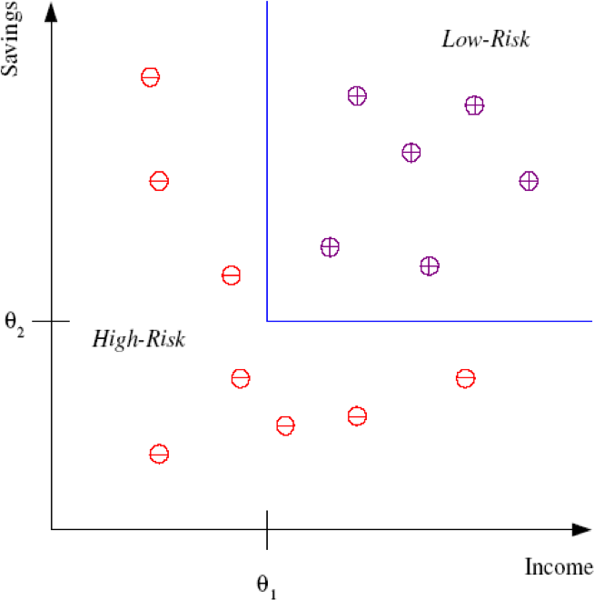
Data and Learning
Machine Learning
Supervised Learning
Unsupervised Learning
Reinforcement Learning
Supervised Learning: Classification
Example: Credit scoring
Differentiating between low-risk and high-risk customers from their income and savings
Discriminant: IF income > θ₁ AND savings > θ₂ THEN low-risk ELSE high-risk

Slide 17
Data and Learning
Machine Learning
Supervised Learning
Unsupervised Learning
Reinforcement Learning
Classification: Applications
Also known as, Pattern recognition
Face recognition: Pose, lighting, occlusion (glasses, beard), make-up, hairstyle
Character recognition: Different handwriting styles.
Speech recognition: Temporal dependency.
Medical diagnosis: From symptoms to illnesses
Biometrics: Recognition/authentication using physical and/or behavioral characteristics: Face, iris, signature, etc
Outlier/novelty detection:

Slide 18
Data and Learning
Machine Learning
Supervised Learning
Unsupervised Learning
Reinforcement Learning
Classification: Question
Question
In a daily newspaper, find five sample news reports for each category of politics, sports, and the arts. Go over these reports and find words that are used frequently for each category, which may help you discriminate between different categories. For example, a news report on politics is likely to include words such as “government,” “recession,” “congress,” and so forth, whereas a news report on the arts may include “album,” “canvas,” or “theater.” There are also words such as “goal” that are ambiguous.

Slide 19
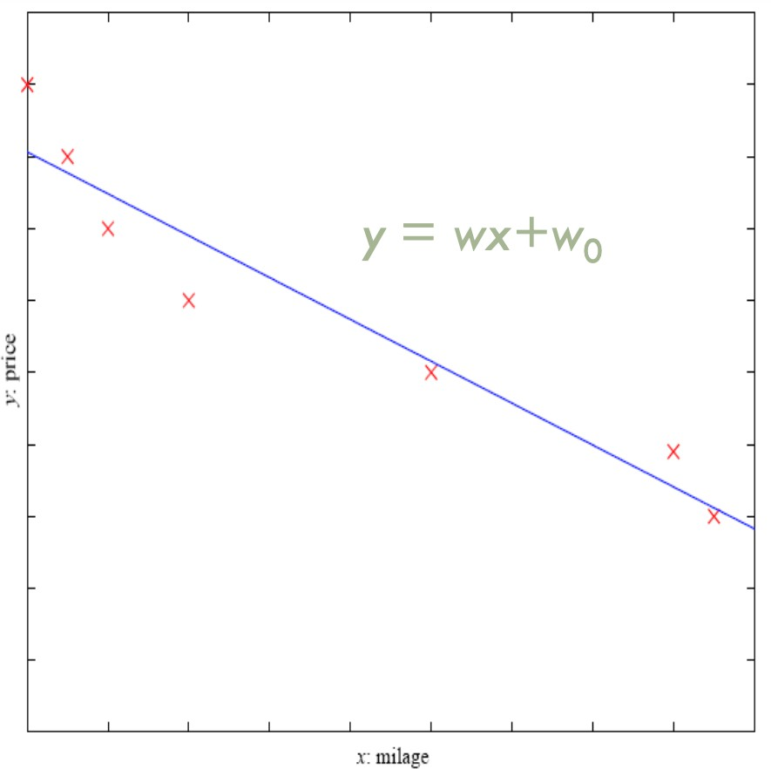
Data and Learning
Machine Learning
Supervised Learning
Unsupervised Learning
Reinforcement Learning
Supervised Learning: Regression
Example: Price of a used car
x : car attributes
y : price
y = g(x∣q)
g() model
q parameters

Slide 20
Data and Learning
Machine Learning
Supervised Learning
Unsupervised Learning
Reinforcement Learning
Regression: Question
Question
In estimating the price of a used car, it makes more sense to estimate the percent depreciation over the original price than to estimate the absolute price. Why?
CSE 411: Machine Learning

Slide 21
Data and Learning
Machine Learning
Supervised Learning
Unsupervised Learning
Reinforcement Learning
Supervised Learning: Uses
Prediction of future cases: Use the rule to predict the output for future inputs
Knowledge extraction: The rule is easy to understand
Compression: The rule is simpler than the data it explains
Outlier detection: Exceptions that are not covered by the rule, e.g., fraud
CSE 411: Machine Learning

Slide 22
Data and Learning
Machine Learning
Supervised Learning
Unsupervised Learning
Reinforcement Learning
Unsupervised Learning
CSE 411: Machine Learning

Slide 23
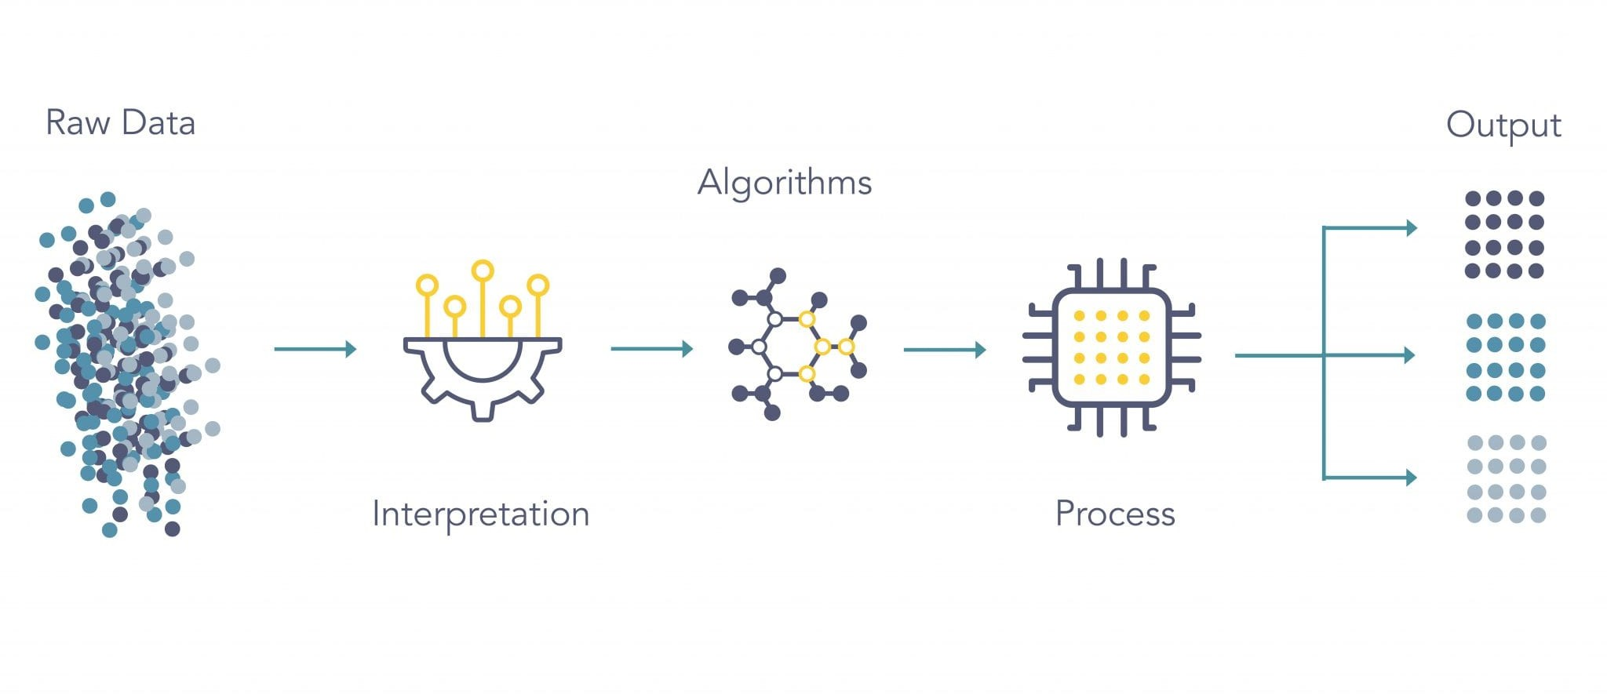
Data and Learning
Machine Learning
Supervised Learning
Unsupervised Learning
Reinforcement Learning
Unsupervised Learning
CSE 411: Machine Learning

Slide 24
Data and Learning
Machine Learning
Supervised Learning
Unsupervised Learning
Reinforcement Learning
Unsupervised Learning
Learning “what normally happens”
Clustering: Grouping similar instances
Example applications
Genetics: for example, clustering DNA patterns to analyze evolutionary biology. Recommender systems: which involve grouping together users with similar viewing patterns in order to recommend similar content.
Anomaly detection: including fraud detection or detecting defective mechanical parts.
CSE 411: Machine Learning

Slide 25
Data and Learning
Machine Learning
Supervised Learning
Unsupervised Learning
Reinforcement Learning
Reinforcement Learning
CSE 411: Machine Learning

Slide 26
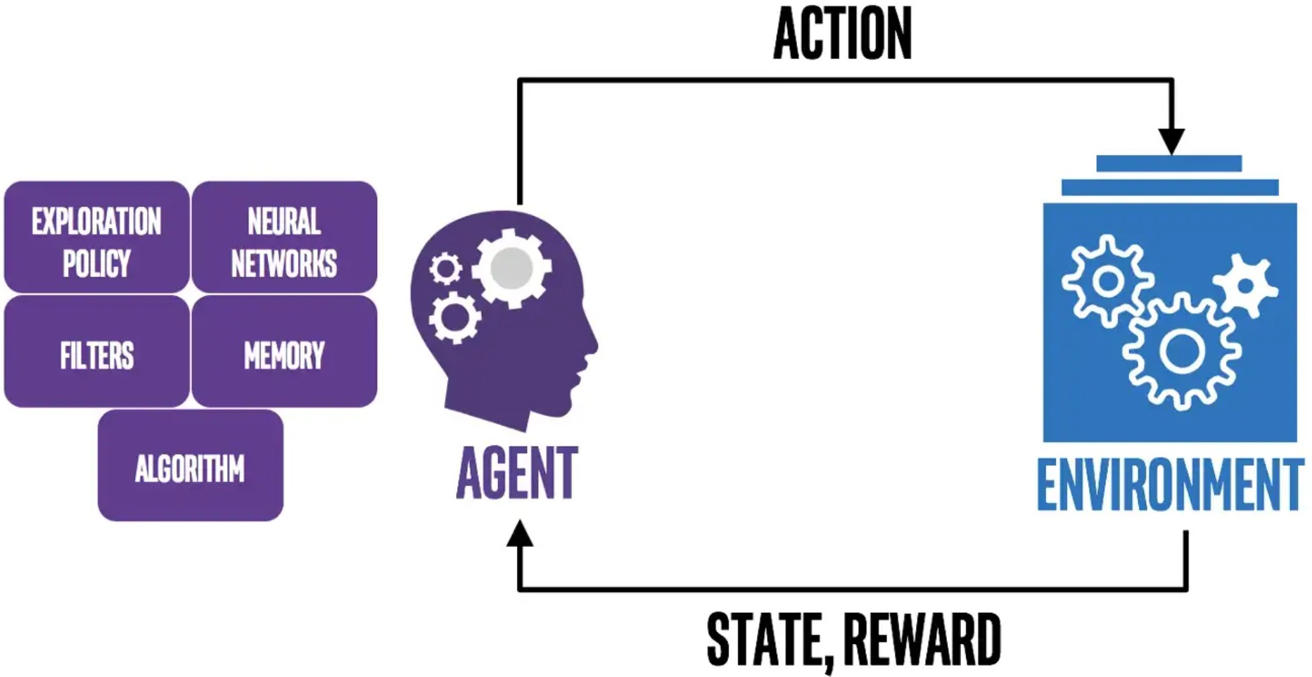
Data and Learning
Machine Learning
Supervised Learning
Unsupervised Learning
Reinforcement Learning
Reinforcement Learning
CSE 411: Machine Learning

Slide 27
Data and Learning
Machine Learning
Supervised Learning
Unsupervised Learning
Reinforcement Learning
Reinforcement Learning
Learning a policy: A sequence of outputs
No supervised output but delayed reward
Applications:
Credit assignment problem Game playing
Robot in a maze
Multiple agents, partial observability, ...
CSE 411: Machine Learning

Slide 28
Data and Learning
Machine Learning
Supervised Learning
Unsupervised Learning
Reinforcement Learning
Reinforcement Learning: Question
Question
How would you approach a computer programming competition?
CSE 411: Machine Learning

Slide 29
Thank You!

