Slide 1


Slide 2
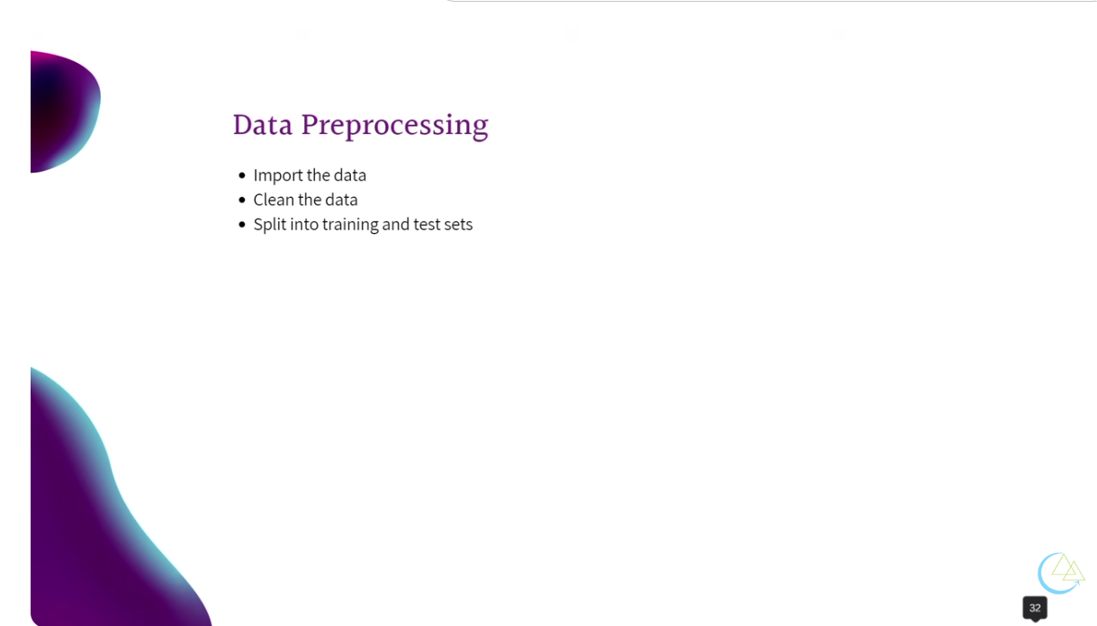

Slide 3
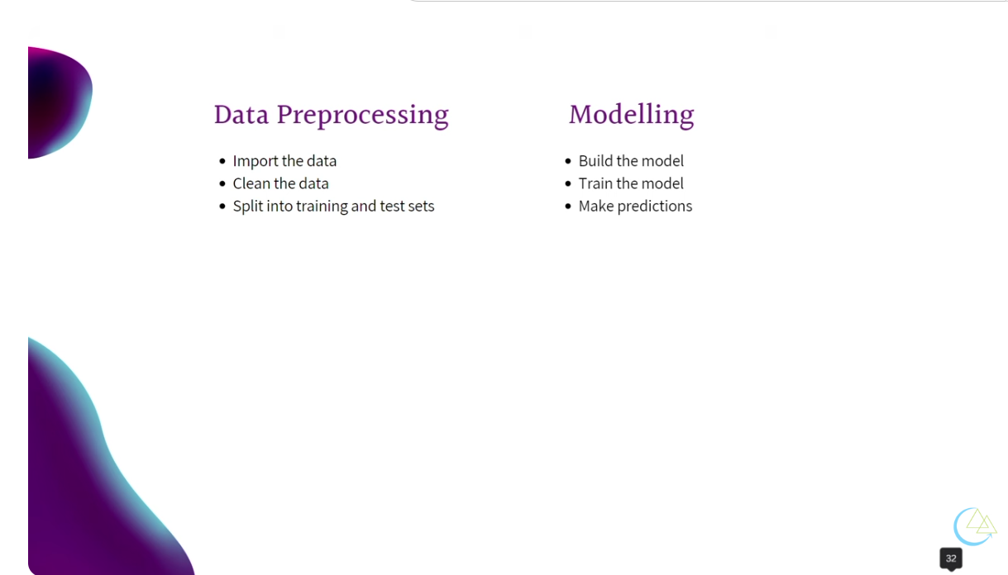

Slide 4
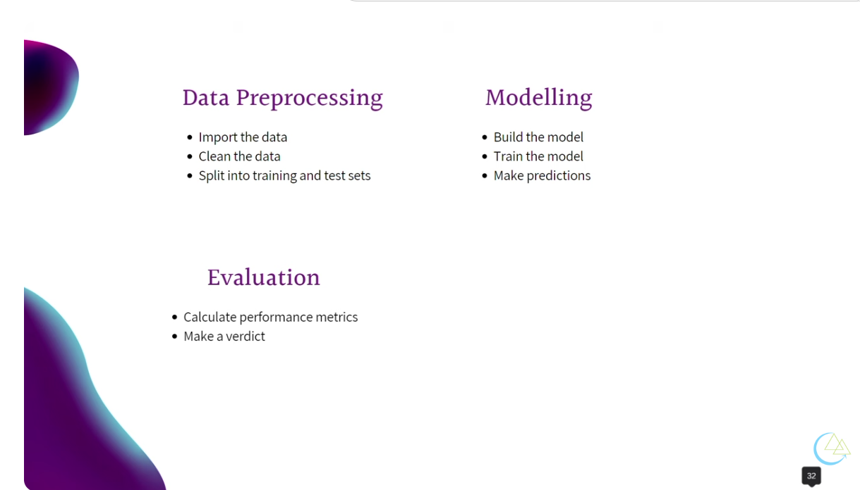

Slide 5
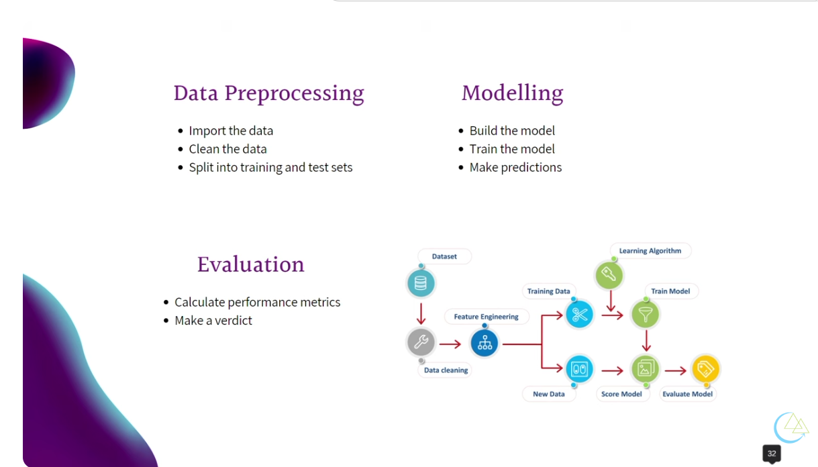

Slide 6
DATA IMPORTING

Slide 7
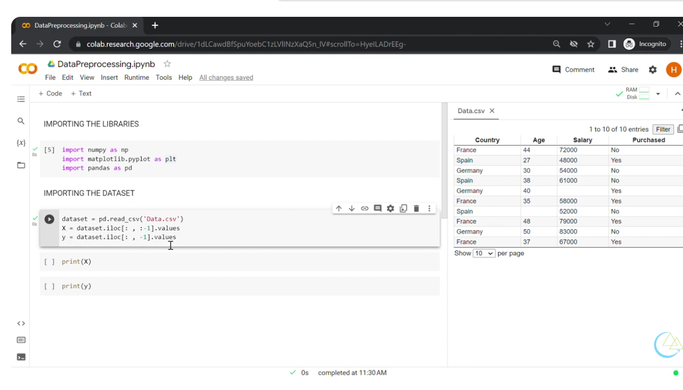

Slide 8
Importing Data From Scikit-learn
1. Using Built-in "Toy" Datasets
These are small datasets installed directly with the library. They are perfect for quickly testing a model or practicing a new technique.
Common datasets include:
Iris: load_iris() (Classification)
Digits: load_digits() (Image classification)
Wine: load_wine() (Multi-class classification)
Example Code:
from sklearn.datasets import load_iris
# Load the data
data = load_iris()
# Access features (X) and target (y)
X = data.data
y = data.target
# Get feature names
print(data.feature_names)

Slide 9
Importing Data From Scikit-learn (Contd.)
2. Downloading Real-World Datasets (`fetch`)
For larger datasets, `sklearn` provides "fetchers" that download data from the internet (and cache it locally for future use). These are typically used for more complex benchmarks.
* California Housing: `fetch_california_housing()`
* Olivetti Faces: `fetch_olivetti_faces()`
* MNIST: `fetch_openml('mnist_784')`
Example Code:
from sklearn.datasets import fetch_california_housing
housing = fetch_california_housing()
print(housing.target_names) # Median house value

Slide 10
Importing Data From Scikit-learn (Contd.)
4. Converting to Pandas DataFrames
By default, `sklearn` returns data as NumPy arrays or Bunch objects (which act like dictionaries). However, most modern workflows use Pandas for exploration. You can force `sklearn` to return a DataFrame directly.
from sklearn.datasets import load_breast_cancer
# This returns a Bunch object containing a Pandas DataFrame
data = load_breast_cancer(as_frame=True)
df = data.frame
print(df.head())
3. Generating Synthetic Data (`make`)
If you need to test how a model handles specific problems—like highly correlated features or non-linear data—you can create your own data from scratch.
* Blobs: `make_blobs()` (Clustering)
* Classification: `make_classification()` (Binary or multi-class)
* Regression: `make_regression()`

Slide 11


Slide 12
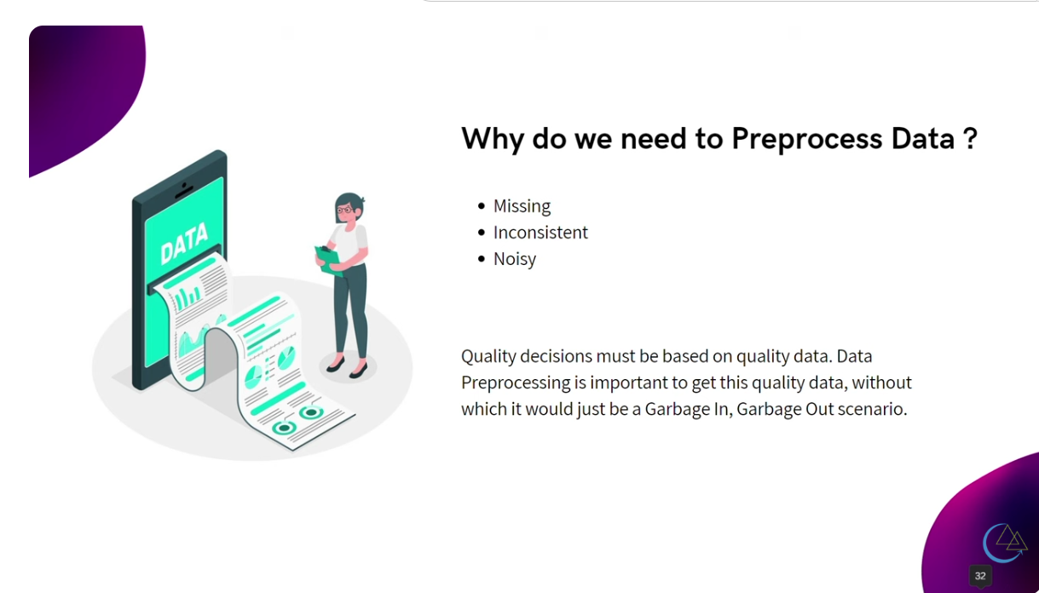

Slide 13
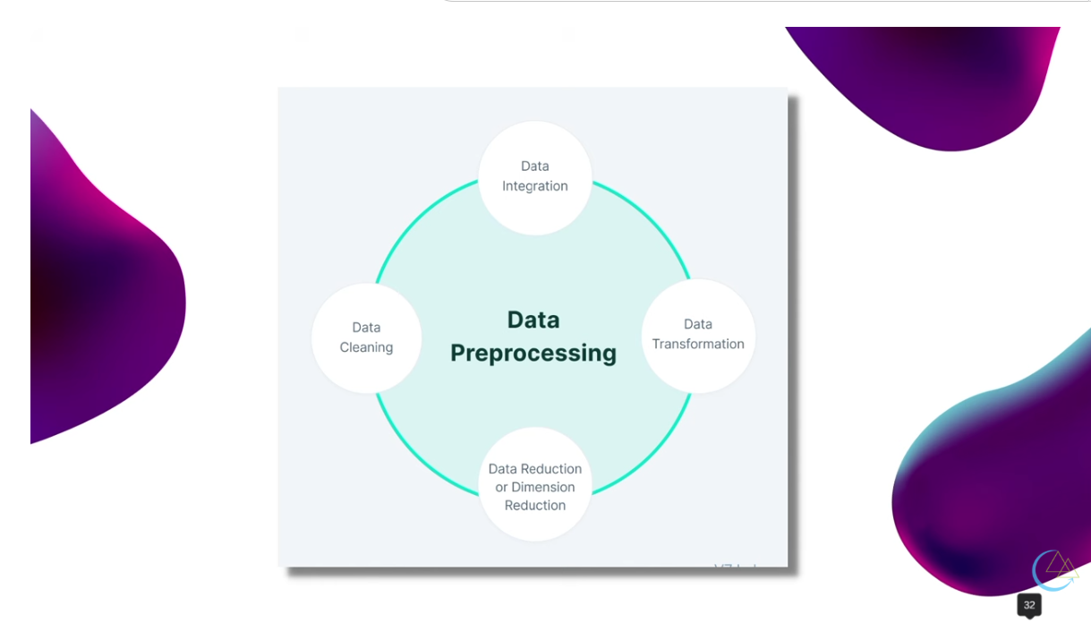

Slide 14
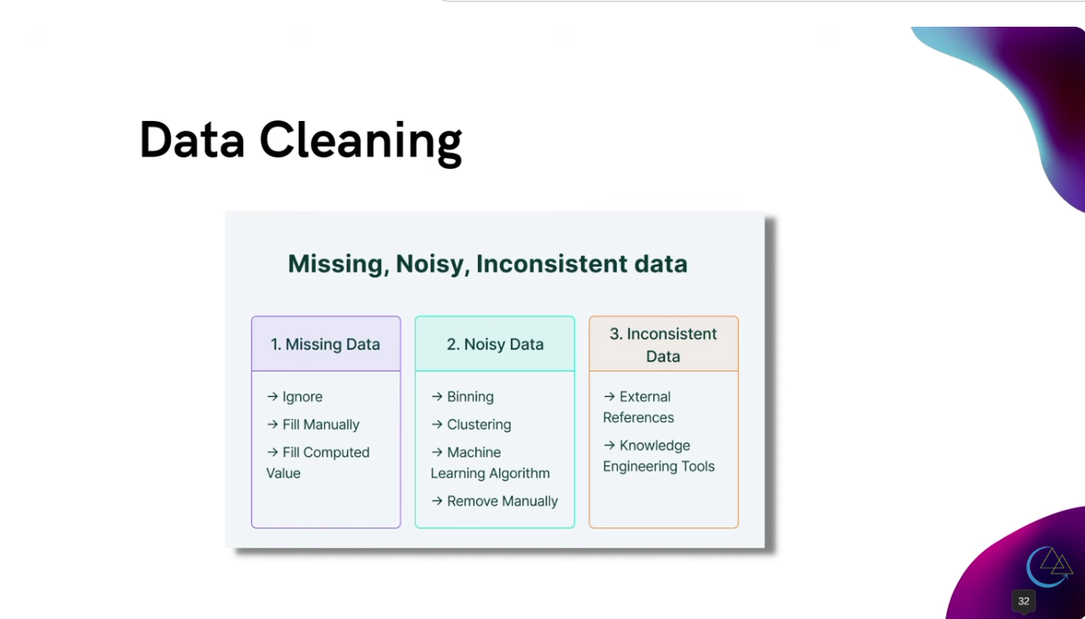

Slide 15
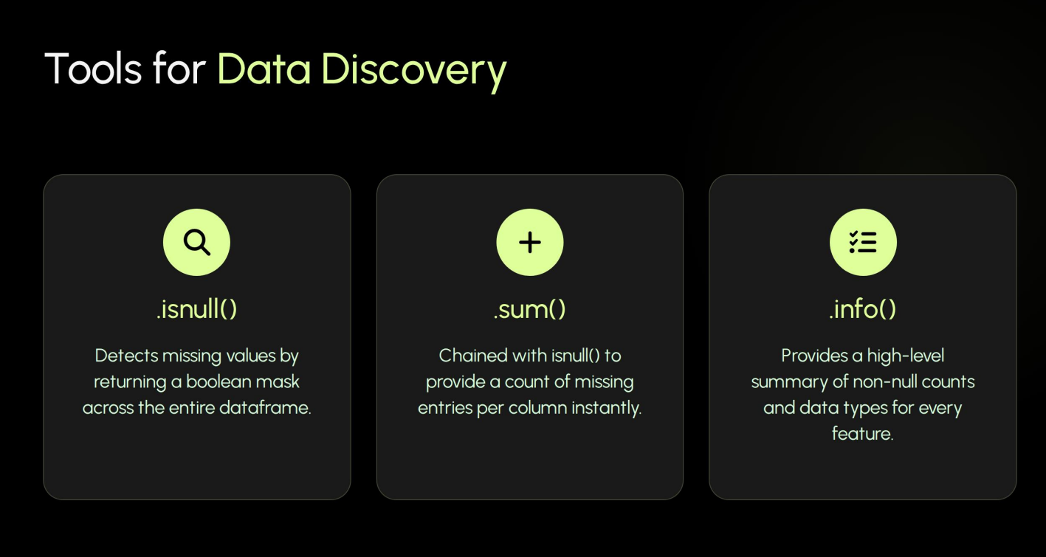
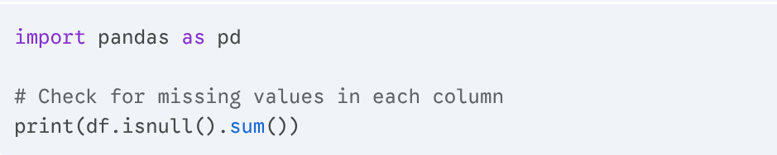

Slide 16
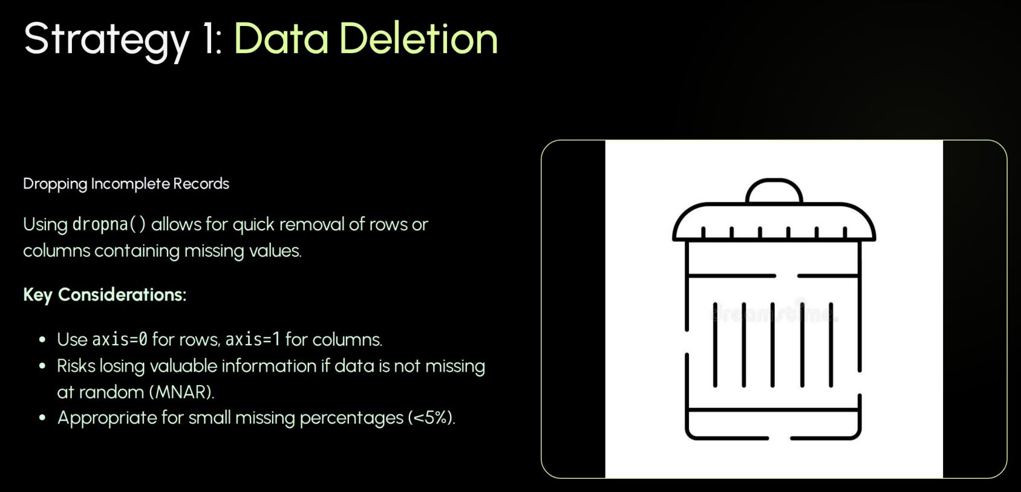
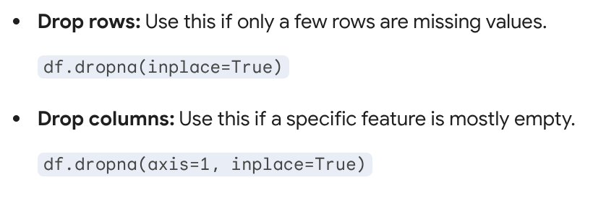

Slide 17
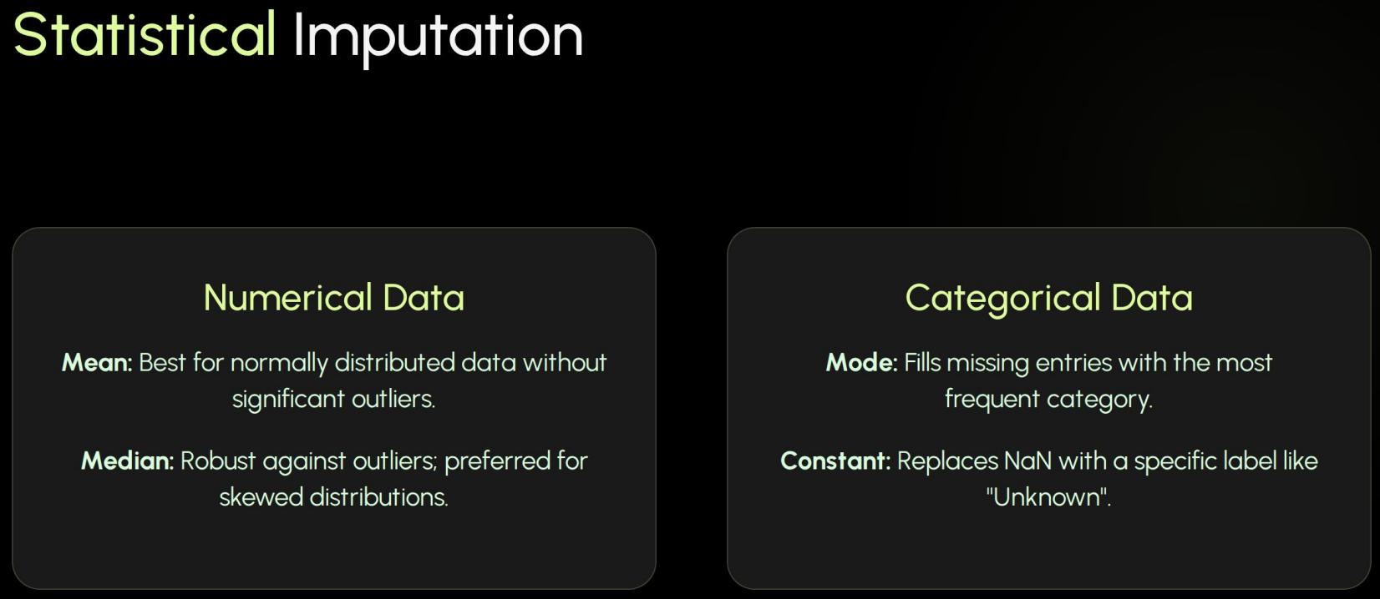
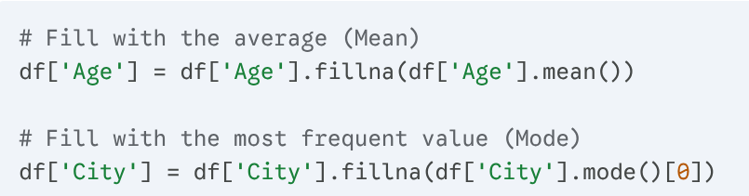


Slide 18

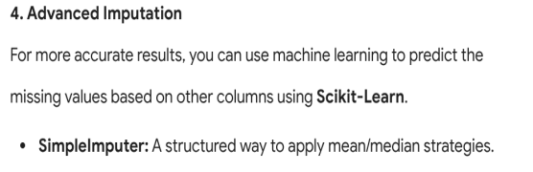
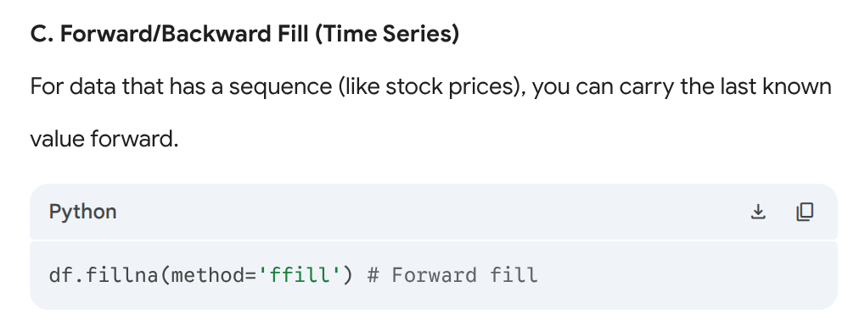
# 1. Initialize the Imputer (using the 'mean/median/most_frequent/constant' strategy)
imputer = SimpleImputer(strategy='constant')
# 2. Fit and Transform the data
# Note: Imputers expect 2D arrays, so we pass the whole DataFrame or specific columns
df_imputed = pd.DataFrame(imputer.fit_transform(df), columns=df.columns)
print(df_imputed)

Slide 19
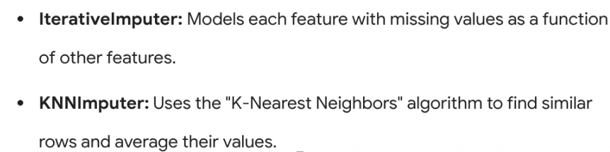
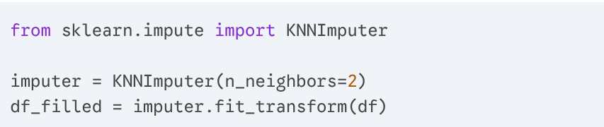
# You must import this line to enable the imputer
from sklearn.experimental import enable_iterative_imputer
from sklearn.impute import IterativeImputer
# 1. Initialize the Imputer
# It defaults to BayesianRidge regression as the "predictor"
it_imputer = IterativeImputer(max_iter=10, random_state=0)
# 2. Fit and Transform
df_imputed = pd.DataFrame(it_imputer.fit_transform(df), columns=df.columns)
print(df_imputed)

Slide 20
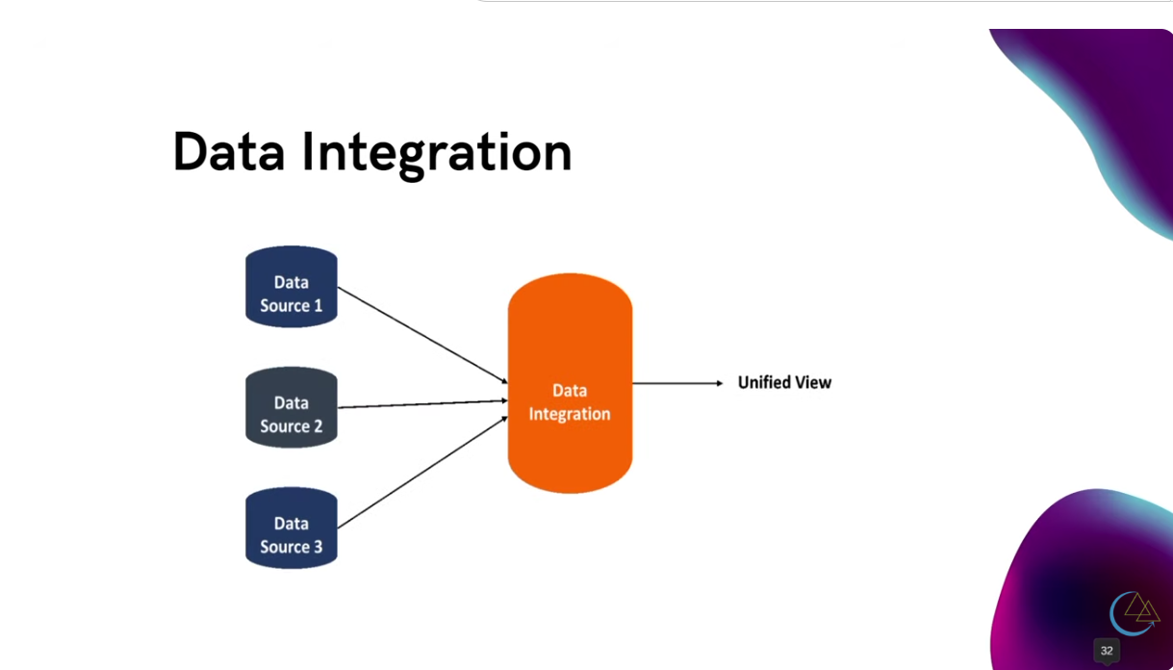

Slide 21

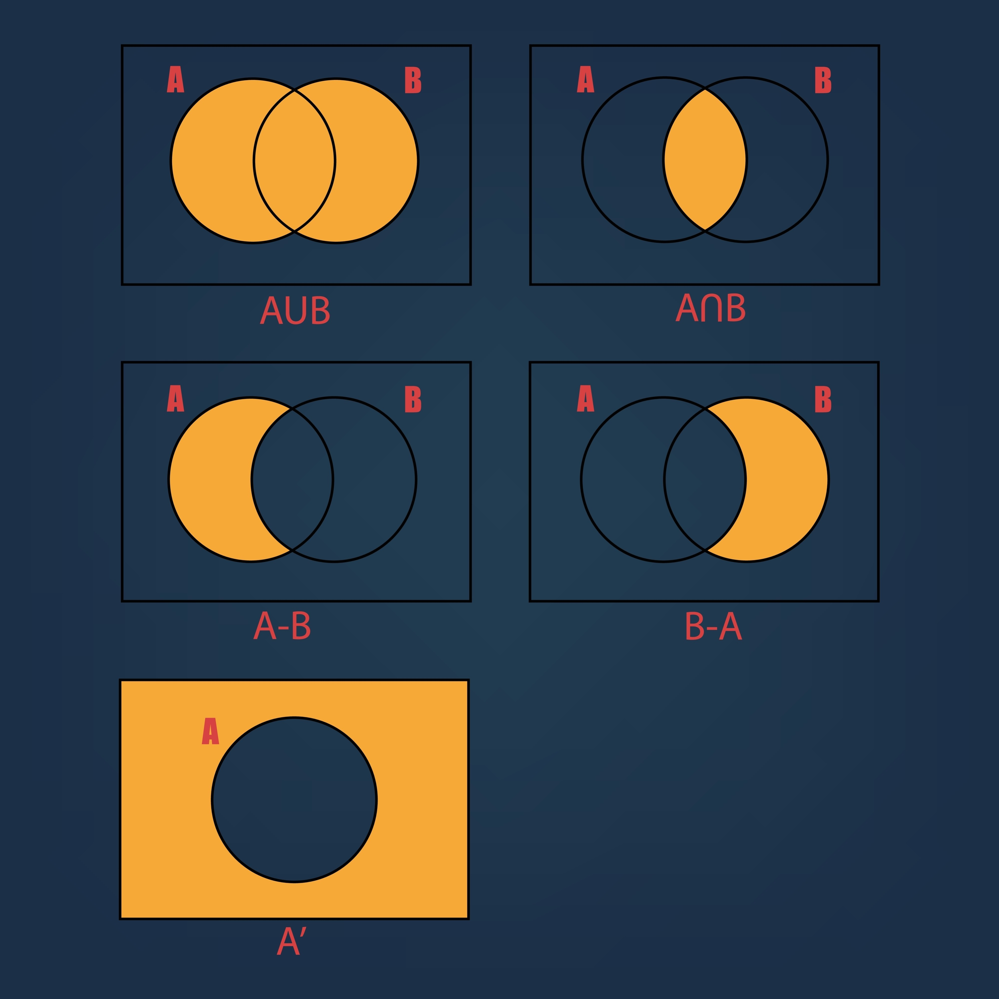
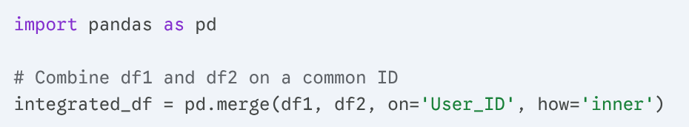
Data integration is the process of combining data from different sources into a unified view. In the context of data cleaning, this is where you handle inconsistencies between datasets, such as different naming conventions, duplicate records, or mismatched scales.
In Python, Pandas is the primary tool for this task, using three main operations: Merging, Joining, and Concatenating.
1. Merging (Database-style Joins)
Merging is used when you want to combine two DataFrames based on a common "key" column (like a User_ID).
Types of Joins:
Inner: Only keeps rows where the key exists in both datasets.
Outer: Keeps all rows from both datasets, filling missing values with NaN.
Left/Right: Keeps all rows from one side and only matches from the other.

Slide 22
2. Concatenation (Stacking Data): Concatenation is used when you have multiple files with the same columns (e.g., "Sales_Jan.csv" and "Sales_Feb.csv") and you want to glue them together.
Vertical (axis=0): Stacks rows on top of each other.
Horizontal (axis=1): Places columns side-by-side.
# Stacking multiple monthly reports into one year
all_sales = pd.concat([jan_df, feb_df, mar_df], axis=0)
3. Cleaning During Integration: Integration often reveals new cleaning issues. Here is how to handle them as you merge:
A. Handling Duplicate Columns
If both datasets have a column named Date, Pandas will create Date_x and Date_y.
Fix: Use the suffixes parameter in merge() to label them clearly, or drop the redundant column after checking that the data matches.
B. Fixing Inconsistent Keys
If one dataset has User_ID and the other has user_id, you must align them before merging.
# Rename for alignment
df2 = df2.rename(columns={'user_id': 'User_ID'})

Slide 23
C. Data Type Alignment
Merging will fail or produce incorrect results if a key is a String in one table and an Integer in another.
# Ensure keys are the same type
df1['User_ID'] = df1['User_ID'].astype(int)
df2['User_ID'] = df2['User_ID'].astype(int)
4. Advanced Integration: Fuzzy Matching
Sometimes keys don't match perfectly (e.g., "Apple Inc." vs "Apple"). For this, you use FuzzyWuzzy or TheFuzz.
from thefuzz import process
# Find the best match for a name from a list of possibilities
best_match = process.extractOne("Apple", ["Apple Inc.", "Microsoft", "Google"])
print(best_match) # Output: ('Apple Inc.', 90)

Slide 24
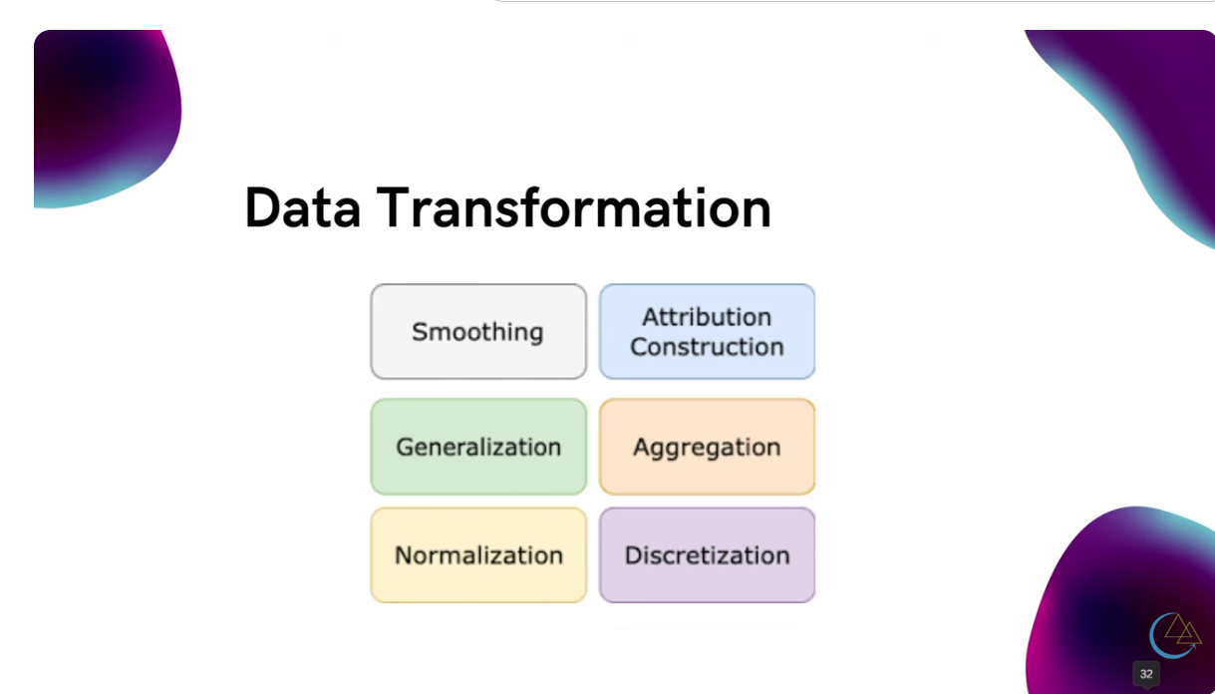

Slide 25

Encoding categorical data is the process of converting text-based information (like "Red", "Blue", or "High", "Low") into numerical values that machine learning algorithms can process.
In scikit-learn, there are two primary tools for this, and choosing the right one depends on whether your data has a natural order.
1. LabelEncoder (Ordinal Data): Use this when your categories have a rank or order (e.g., "Low" < "Medium" < "High"). It converts each label into a unique integer ($0, 1, 2, \dots$). Note: Technically, LabelEncoder is designed for the target variable ($y$). If you are encoding features ($X$), OrdinalEncoder is the preferred tool.
from sklearn.preprocessing import OrdinalEncoder
import pandas as pd
df = pd.DataFrame({'Size': ['Small', 'Medium', 'Large', 'Medium']})
# Define the order manually to ensure 'Large' > 'Small'
encoder = OrdinalEncoder(categories=[['Small', 'Medium', 'Large']])
df['Size_Encoded'] = encoder.fit_transform(df[['Size']])
print(df)

Slide 26
2. OneHotEncoder (Nominal Data): Use this when there is no mathematical order (e.g., "City Names" or "Colors"). If you used integers (1, 2, 3) for "Red, Blue, Green," the model might mistakenly think Green ($3$) is "greater" than Red ($1$).OneHotEncoder creates a new binary column ($0$ or $1$) for each unique category.Pythonfrom sklearn.preprocessing import OneHotEncoder
df = pd.DataFrame({'Color': ['Red', 'Blue', 'Green']})
# sparse_output=False returns a readable array instead of a matrix
encoder = OneHotEncoder(sparse_output=False)
encoded_data = encoder.fit_transform(df[['Color']])
# Convert back to a DataFrame with clear column names
encoded_df = pd.DataFrame(encoded_data, columns=encoder.get_feature_names_out())
print(encoded_df)

Slide 27
Data smoothing is a technique used to remove "noise" or short-term fluctuations from a dataset to reveal the underlying trend. This is essential in time-series analysis, signal processing, and financial modeling.
In Python, the most effective tools for smoothing are Pandas, SciPy, and NumPy.
1. Moving Average (Rolling Window):
The most common technique. It calculates the average of a specific number of previous data points (the "window").
Simple Moving Average (SMA): All points in the window have equal weight.
Exponential Moving Average (EMA): Recent points are given more weight, making it more responsive to recent changes.
import pandas as pd
# Simple Moving Average with a 7-day window
df['SMA_7'] = df['Sales'].rolling(window=7).mean()
# Exponential Moving Average
df['EMA_7'] = df['Sales'].ewm(span=7, adjust=False).mean()

Slide 28
2. Savitzky-Golay Filter
This is a more advanced technique from scipy. It fits a low-degree polynomial to the data points within a window using least squares.
Advantage: It smoothes the data while preserving the shape and height of peaks better than a simple moving average.
from scipy.signal import savgol_filter
# window_length must be odd, polyorder must be less than window_length
df['Savgol'] = savgol_filter(df['Sales'], window_length=11, polyorder=2)
3. Lowess Smoothing (Locally Weighted Regression)
LOWESS (Locally Weighted Scatterplot Smoothing) is a non-parametric method that fits multiple regressions in local neighborhoods. It is highly flexible and excellent for non-linear trends.
import statsmodels.api as sm
# lowess returns a 2D array: [sorted_x, smoothed_y]
lowess = sm.nonparametric.lowess
smoothed_values = lowess(df['Sales'], df.index, frac=0.1)
df['Lowess'] = smoothed_values[:, 1]

Slide 29
2. Savitzky-Golay Filter
This is a more advanced technique from scipy. It fits a low-degree polynomial to the data points within a window using least squares.
Advantage: It smoothes the data while preserving the shape and height of peaks better than a simple moving average.
from scipy.signal import savgol_filter
# window_length must be odd, polyorder must be less than window_length
df['Savgol'] = savgol_filter(df['Sales'], window_length=11, polyorder=2)
3. Lowess Smoothing (Locally Weighted Regression)
LOWESS (Locally Weighted Scatterplot Smoothing) is a non-parametric method that fits multiple regressions in local neighborhoods. It is highly flexible and excellent for non-linear trends.
import statsmodels.api as sm
# lowess returns a 2D array: [sorted_x, smoothed_y]
lowess = sm.nonparametric.lowess
smoothed_values = lowess(df['Sales'], df.index, frac=0.1)
df['Lowess'] = smoothed_values[:, 1]

Slide 30
Data generalization is a technique used in data cleaning and preprocessing to replace specific values with broader, higher-level concepts. This is primarily done to reduce complexity, handle noise, or protect privacy (Data Anonymization).
In Python, this is usually achieved through Binning, Mapping, or Clustering.
1. Binning (Discretization)
This technique converts continuous numerical data into discrete categories or "bins." For example, converting specific ages into age groups.
Fixed-width Binning: Dividing data into equal intervals.
Quantile Binning: Dividing data so each bin has the same number of observations.
import pandas as pd
# Fixed-width binning for ages
bins = [0, 18, 35, 60, 100]
labels = ['Minor', 'Young Adult', 'Adult', 'Senior']
df['Age_Group'] = pd.cut(df['Age'], bins=bins, labels=labels)
# Quantile binning (4 equal groups)
df['Income_Level'] = pd.qcut(df['Salary'], q=4, labels=['Low', 'Medium', 'High', 'Elite'])

Slide 31
2. Conceptual Hierarchy Mapping
This involves replacing specific categorical values with a more general parent category. This is often done using a dictionary map.
Example: Geography Generalization
Instead of analyzing 50 different cities, you generalize them by state or region to see broader patterns.
Python
# Dictionary for mapping
region_map = {
'San Francisco': 'West Coast',
'Los Angeles': 'West Coast',
'New York': 'East Coast',
'Boston': 'East Coast',
'Chicago': 'Midwest'
}
df['Region'] = df['City'].map(region_map)

Slide 32
3. Clustering-based Generalization
When you don't have a clear hierarchy, you can use unsupervised learning (like K-Means) to group similar data points together and replace them with their "Cluster ID."
from sklearn.cluster import KMeans
# Generalizing latitude and longitude into 5 geographic zones
coords = df[['latitude', 'longitude']]
kmeans = KMeans(n_clusters=5)
df['Zone_ID'] = kmeans.fit_transform(coords)
4. Mathematical Aggregation
You can generalize data by rounding or reducing precision. This is common when specific timestamps or decimals add noise without adding value.
Rounding: df['Price'].round(-1) (Generalizes $42 -> 40$, $47 -> 50$).
Resampling: Generalizing seconds/minutes data into hourly or daily averages.
# Generalize time-series data to daily averages
df_daily = df.resample('D', on='Timestamp').mean()

Slide 33

Data normalization is the process of rescaling numerical features so they share a common scale, typically between 0 and 1 or -1 and 1. This is crucial for machine learning algorithms that rely on distance calculations (like KNN, SVM, or K-Means) or gradient descent, as it prevents features with large magnitudes from dominating the model.
In Python, the Scikit-Learn library is the primary tool for these operations.
1. Min-Max Scaling (Normalization)
This technique rescales the data to a fixed range, usually $[0, 1]$. It is very sensitive to outliers because one extreme value can "squish" all other data points into a tiny range.
from sklearn.preprocessing
import MinMaxScaler
import pandas as pd
data = [[-1, 2], [-0.5, 6], [0, 10], [1, 18]]
scaler = MinMaxScaler()
normalized_data = scaler.fit_transform(data)

Slide 34

2. Standard Scaling (Z-score Standardization)
This technique centers the data around a mean of 0 with a standard deviation of 1. It does not have a fixed bounding range, making it more robust to outliers than Min-Max scaling.
from sklearn.preprocessing import StandardScaler
scaler = StandardScaler()
standardized_data = scaler.fit_transform(data)
3. Robust Scaling
If your dataset has significant outliers, the mean and variance used in Standard Scaling will be distorted. RobustScaler uses the Median and the Interquartile Range (IQR) instead, making it much more reliable for "messy" data.
from sklearn.preprocessing import RobustScaler
scaler = RobustScaler()
robust_data = scaler.fit_transform(data)

Slide 35
4. MaxAbsScaler
This scales each feature by its maximum absolute value, ensuring the data is mapped within the range $[-1, 1]$. It is particularly useful for data that is already centered at zero or for sparse data (data with many zeros), as it does not destroy the sparsity.
from sklearn.preprocessing import MaxAbsScaler
scaler = MaxAbsScaler()
maxabs_data = scaler.fit_transform(data)

Slide 36
