Slide 1

Benefits, Challenges, and
Performance Analysis of a Scalable
Web Architecture Based on
Micro-Frontends
Adrian Petcu, Madalin Frunzete, Dan Alexandru Stoichescu
University "Politehnica" of Bucharest, Romania
U.P.B. Sci. Bull., Series C, Vol. 85, Iss. 3, 2023

Slide 2









Table of Contents
1
Introduction
2
Architectural Overview: Monolith vs. Microservices
3
Micro-Frontends: Concept and Motivation
4
Composition Types and Splitting Strategies
5
Benefits of Micro-Frontend Architecture
6
Challenges of Micro-Frontend Architecture
7
Research Methodology and Implementation
8
Results: Performance Comparison
9
Thank You
2

Slide 3

Introduction
Web applications have evolved to support parallel development across multiple layers and teams
The shift from monolithic to microservice-based architectures has transformed backend development
Front-end applications lack a simple, scalable implementation pattern comparable to backend microservices
Micro-frontends extend the microservice philosophy to the UI layer, enabling independent development and scalable codebases
Objective: Explore the benefits, challenges, and performance of a scalable architecture based on micro-frontends
3

Slide 4

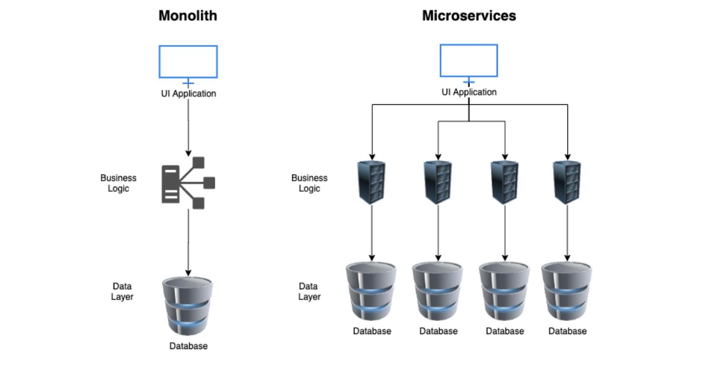

Architectural Overview
Monolithic Architecture
Single-tiered application; all components bundled as one unit
Full redeployment for minor changes
Growing build times, difficult maintenance
Poor fault isolation
Microservices Architecture
Small, autonomous services by sub-domain
Independently developed, deployed, and scaled
Continuous delivery, improved fault isolation
Technology freedom per service
Monoliths scale vertically; microservices scale horizontally
Figure 1. Monolith vs Microservice Architecture
4

Slide 5

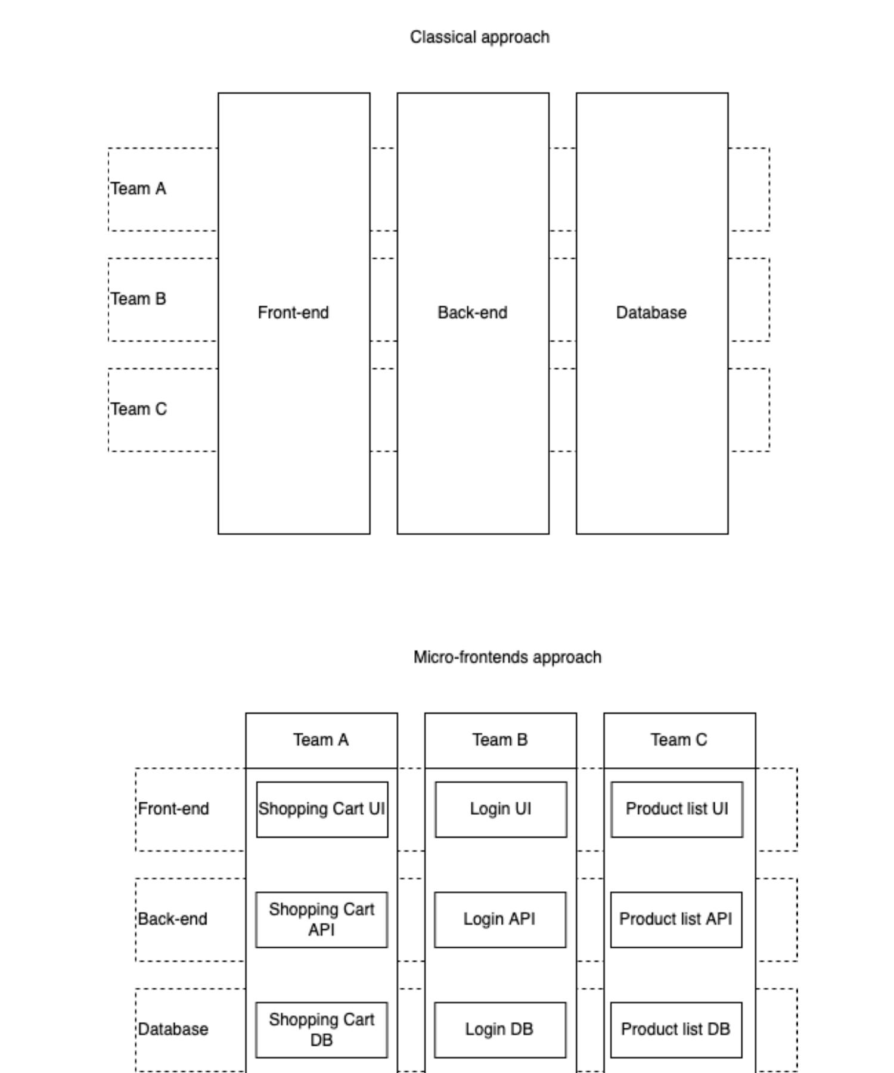
Micro-Frontends: Concept and Motivation
As backend migrates to microservices, front-end monoliths grow larger and harder to maintain
Micro-frontends apply the microservice paradigm to the UI layer
Application split into independent units by functionality or domain
Each unit owned end-to-end by a cross-functional team
Loose coupling via well-defined contracts
Enables technology agnosticism across teams
Figure 2. Cross-functional teams with micro-frontends
5

Slide 6

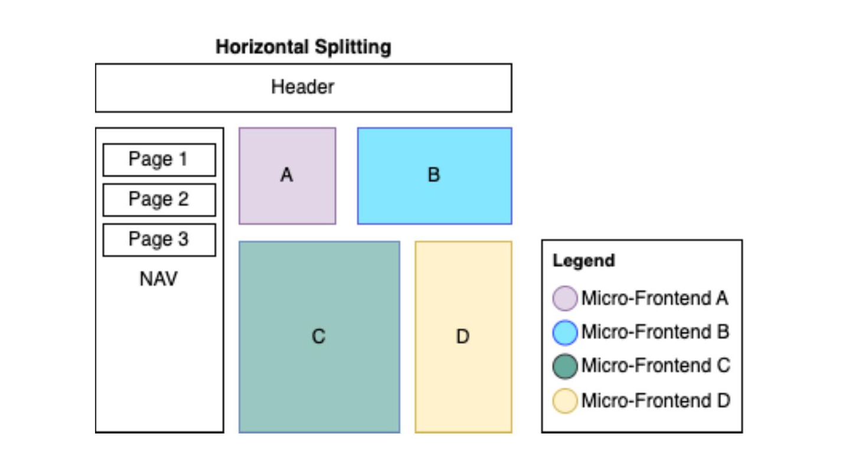
Composition Types and Splitting Strategies
Horizontal Split
Multiple micro-frontends on the same page
Each team responsible for a screen section
Requires inter-team coordination
Vertical Split
Each micro-frontend represents an entire page
Simpler team boundaries and ownership
Solution | Description
Routing | Each route maps to a different micro-frontend
Iframe | Micro-frontends embedded via frames
Web Components | Framework-agnostic browser APIs
Module Federation | Dynamic loading of code and shared resources
Figure 3. Horizontal splitting
6

Slide 7



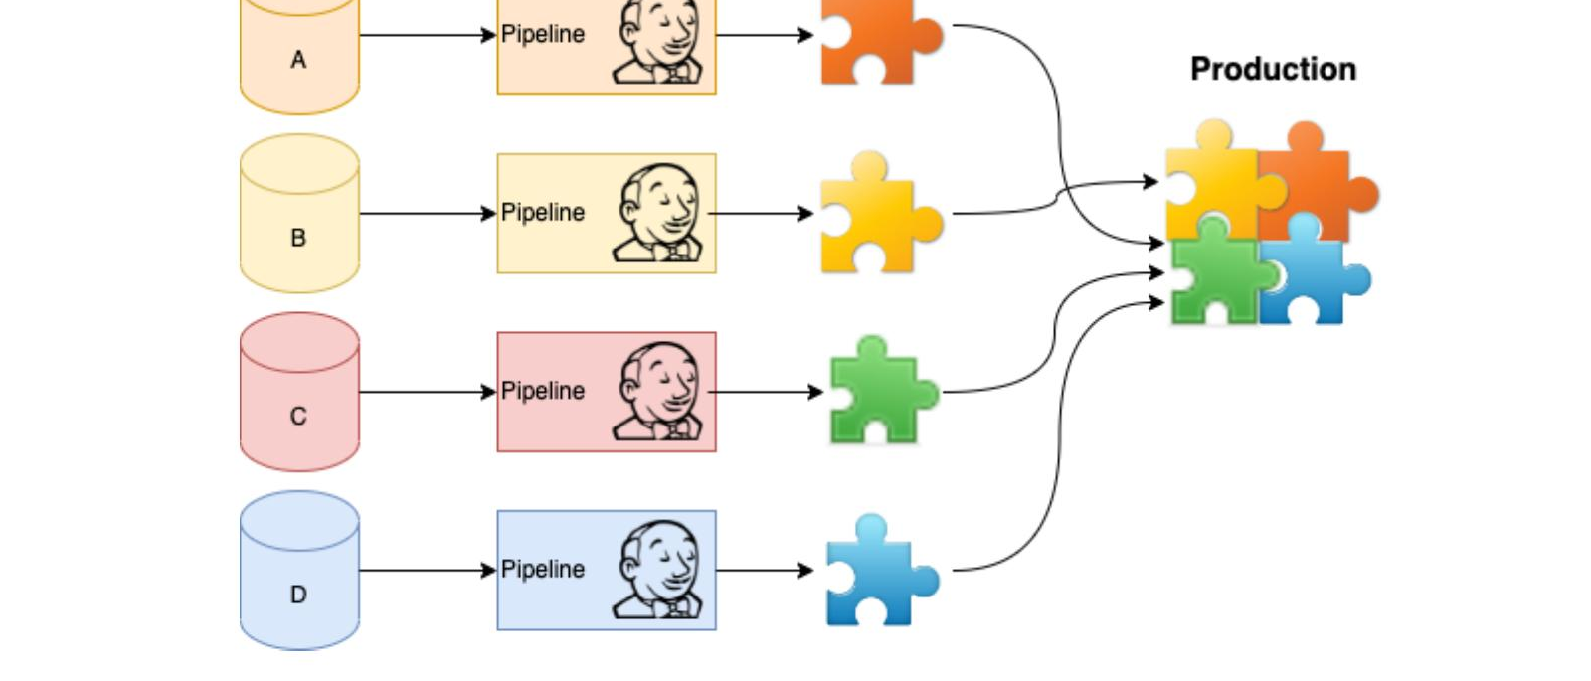
Benefits of Micro-Frontend Architecture
Incremental Updates
Decoupled Codebases
Gradual migration from monolith; isolated experiments on parts of the application
Smaller, focused repositories reduce complexity and code duplication
Independent Deployments
Autonomous Teams
Each micro-frontend released independently; failures impact only one UI area
Cross-functional teams own code quality, business logic, framework, and styling
Figure 5. Independent deployments
7

Slide 8

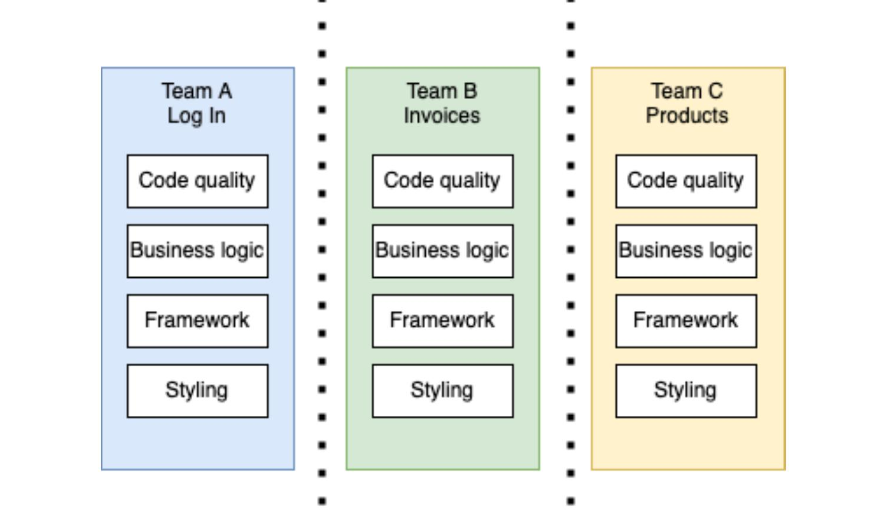
Challenges of Micro-Frontend Architecture
Inter-unit Communication
Robust framework for coordinating events between separate sections
Backward Compatibility
Shell application modifications must not break existing micro-frontends
Standardized Contracts
Well-defined inputs and outputs for inter-unit communication
Centralized Communication
Publisher/Subscriber pattern for multi-component coordination
Bundle Size Control
Framework core instantiated only as needed, not duplicated per unit
Consistent Styling
Shared styling library for visual consistency across all units
Figure 6. Team ownership
8

Slide 9

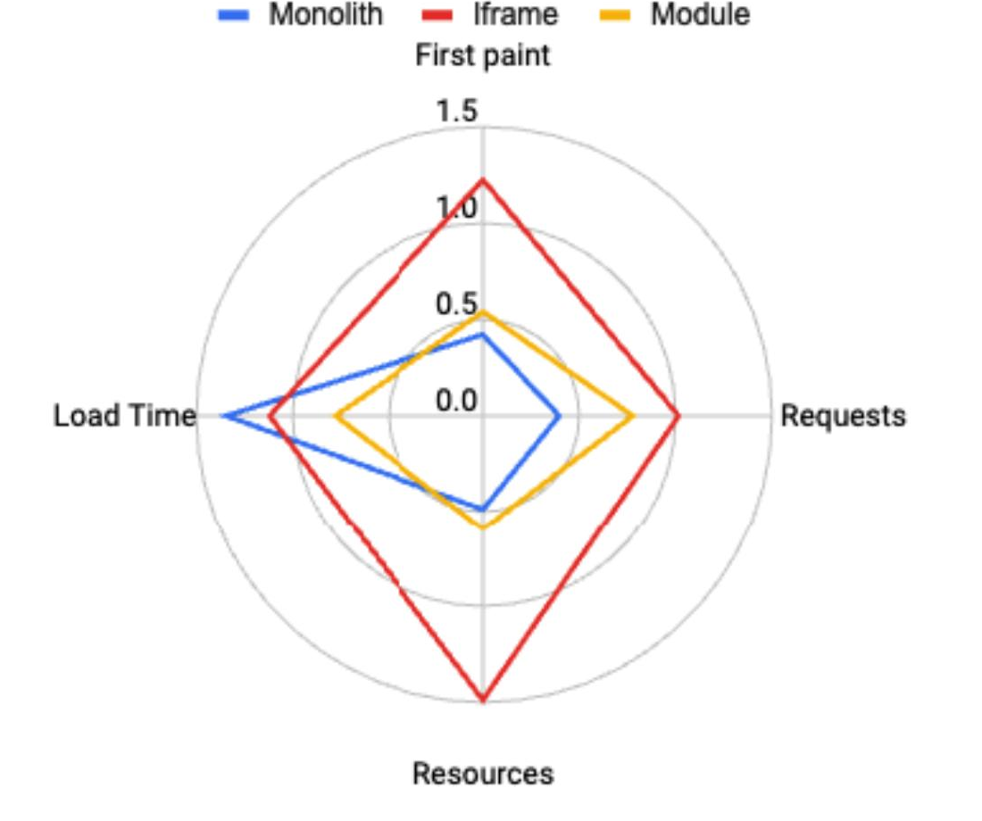
Results: Performance Comparison
Criterion | Monolith | Iframe | Module Fed.
First Paint | 418 ms | 1222 ms | 540 ms
Requests | 13 | 34 | 26
Resources | 5.4 MB | 16.6 MB | 6.6 MB
Load Time | 1.35 s | 1.12 s | 0.774 s
Key Findings
-55%
-60%
-42%
-23%
first paint time vs. Iframe
bundle size vs. Iframe
load time vs. Monolith
requests vs. Iframe
Module Federation expected to outperform monolith for larger applications
Figure 10. Relative comparison between solutions
9

Slide 10


Thank You
Questions?
adrian.petcu@stud.etti.upb.ro
Petcu, A., Frunzete, M., & Stoichescu, D. A. (2023).
U.P.B. Sci. Bull., Series C, 85(3), 319–334.

