Slide 1
MODULEWARDEN
Forecast and gate your software supply chain.
Stop trusting your dependencies. Rank them by trajectory, gate the known-bad, and ship a git-committed evidence memo for every decision.
Team Andrew · Zero-One Hack Vienna 2026 · Sybilion Forecast track · modulewarden.com

Slide 2
THE PROBLEM
Your supply chain is code you did not write.
Every package runs on every machine you ship to. You depend on hundreds — and you can review almost none of them.

Slide 3
THE THREAT
The danger is the delta.
lodash@4.17.20
→
lodash@4.17.21
1
"name": "lodash",
A trusted package ships a new release. The maintainer is compromised, or a contributor goes rogue. A careful attacker leaves nothing a static scanner catches.
2
"main": "lodash.js",
+
"scripts": { "postinstall":
+
"node ./.cache/setup.js" }
4
"version": "4.17.21"
one added line. no new CVE. the diff is the whole story.
What matters is what changed between two versions.

Slide 4
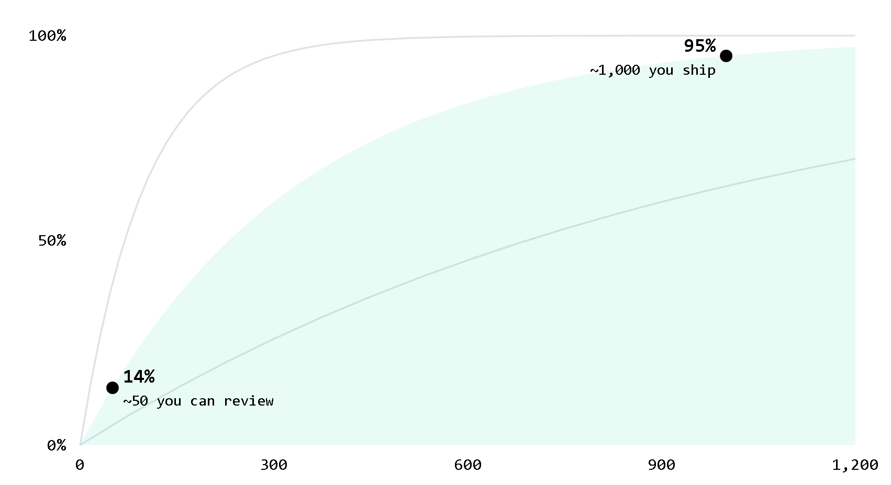
THE MATH YOU CAN'T OUT-REVIEW
Every dependency multiplies the risk.
P = 1 − (1 − p)^{N}
A typical app carries 1,000+ transitive dependencies, pushing the odds toward certain. A team reviews maybe fifty.
p = 0.3% / dep
0.1%
1%

Slide 5
THE DEFENSE
Guard the one interface every package crosses.
MODULEWARDEN
Audited automatically before it reaches your code — one line to turn on
NPM REGISTRY
→
Every new version, the moment it publishes
Allow
Quarantine
Block

Slide 6
EVIDENCE FIRST, VERDICT SECOND
Read exactly what the model saw.
An agentic reviewer reads the code from four angles. Every verdict lands with cited evidence.
01
02
Claimed purpose vs actual behavior
Install-time execution
Does it do what the README says — and nothing else?
What runs before your code ever imports it.
03
04
Known vulnerabilities
Capability deltas
Advisories cross-checked against the changed surface.
New network, filesystem, or process powers vs the last version.

Slide 7
THE MODEL
BASE
27B-parameter Qwen
A 27B auditor, fine-tuned on real CVE diffs.
Real CVE patch diffs
TRAINING DATA
ADAPTERS
2 LoRA adapters
COMPUTE
Leonardo · 4× A100
Trained on real vulnerable-vs-patched version pairs — not synthetic exploits.
PUBLISHED
Hugging Face

Slide 8
TRAINED VS UNTRAINED
Measured, not claimed.
That measures how faithfully it writes up evidence — not whether it spots danger. Detection stays with the gate.
0.21 / 94%
UNTUNED BASE
FINE-TUNED
Drifts the schema — verdicts you can't parse or trust.
Valid evidence schema, every single time.
val loss / token accuracy

Slide 9
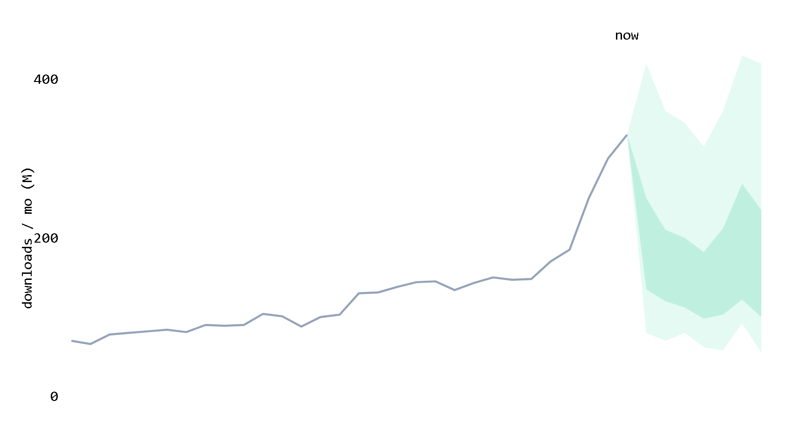
THE FORECAST, TWO SIGNALS
Sybilion sets review order.
Send each package's download history to Sybilion. The slope ranks what we review first; the band width routes it.
Too wide to call → a human. A tight band → the gate auto-audits.
history
median
forecast band

Slide 10
LIVE AT SCALE
The forecast does the triage.
semver
~2.5B downloads / mo
tight band → auto-clear
18 / 28
minimatch
~2.5B downloads / mo
routed to a human / auto-cleared
wide band → a human looks
Ran live across 46 packages. Same size, opposite routing:

Slide 11
THE HONEST FLOOR
We show you what the forecast cannot do.
We tested whether the forecast can detect a dying or compromised package. It cannot. Slope and band do not separate dying from healthy.
0.54
We don't claim 0.90 or "calibrated." False certainty is worse than honest uncertainty.
cold-package classifier auroc — the floor

Slide 12
THE THREAT FROM WITHIN
The gate does not care who runs the install.
The most dangerous attacker isn't always outside. A developer in a hurry. An AI assistant suggesting a package.
74%
ModuleWarden gates the install no matter who runs it.
of breaches involve the human element — verizon dbir

Slide 13
CLOSE
Grow a forecast into a new domain without it lying to you.
KEPT
GATED
CONCEDED
What the forecast earned
What it could not
The rest, with the data
Trajectory ranking — Sybilion sets the order we review in.
The audit pipeline owns the verdict — allow, block, or quarantine.
We published the floor. The forecast doesn't pretend to detect.

Slide 14
MODULEWARDEN
Audit every version. Forecast every trajectory. Show every piece of evidence.
modulewarden.com
github.com/apetersson/ModuleWarden
huggingface.co/ademczuk/modulewarden-auditor-qwen3.6-27b-lora

