Slide 1
MODULEWARDEN
Forecast and gate your software supply chain.
Stop trusting your dependencies. Rank them by trajectory, gate the known-bad, and ship a git-committed evidence memo for every decision.
Team Andrew · Zero-One Hack Vienna 2026 · Sybilion Forecast track
modulewarden.com · github.com/apetersson/ModuleWarden

Slide 2
THE PROBLEM
Your supply chain is code you did not write.
Every package you install runs on every machine you ship to. You depend on hundreds of open-source packages and can review almost none of them.
ModuleWarden · Zero-One Hack Vienna 2026 · Forecast track
2

Slide 3
THE THREAT
The danger is the delta.
A package you trust ships a new release. The maintainer account is compromised, or a contributor goes rogue. A careful attacker leaves nothing a static scanner catches. What matters is what changed between two versions.
ModuleWarden · Zero-One Hack Vienna 2026 · Forecast track
3

Slide 4
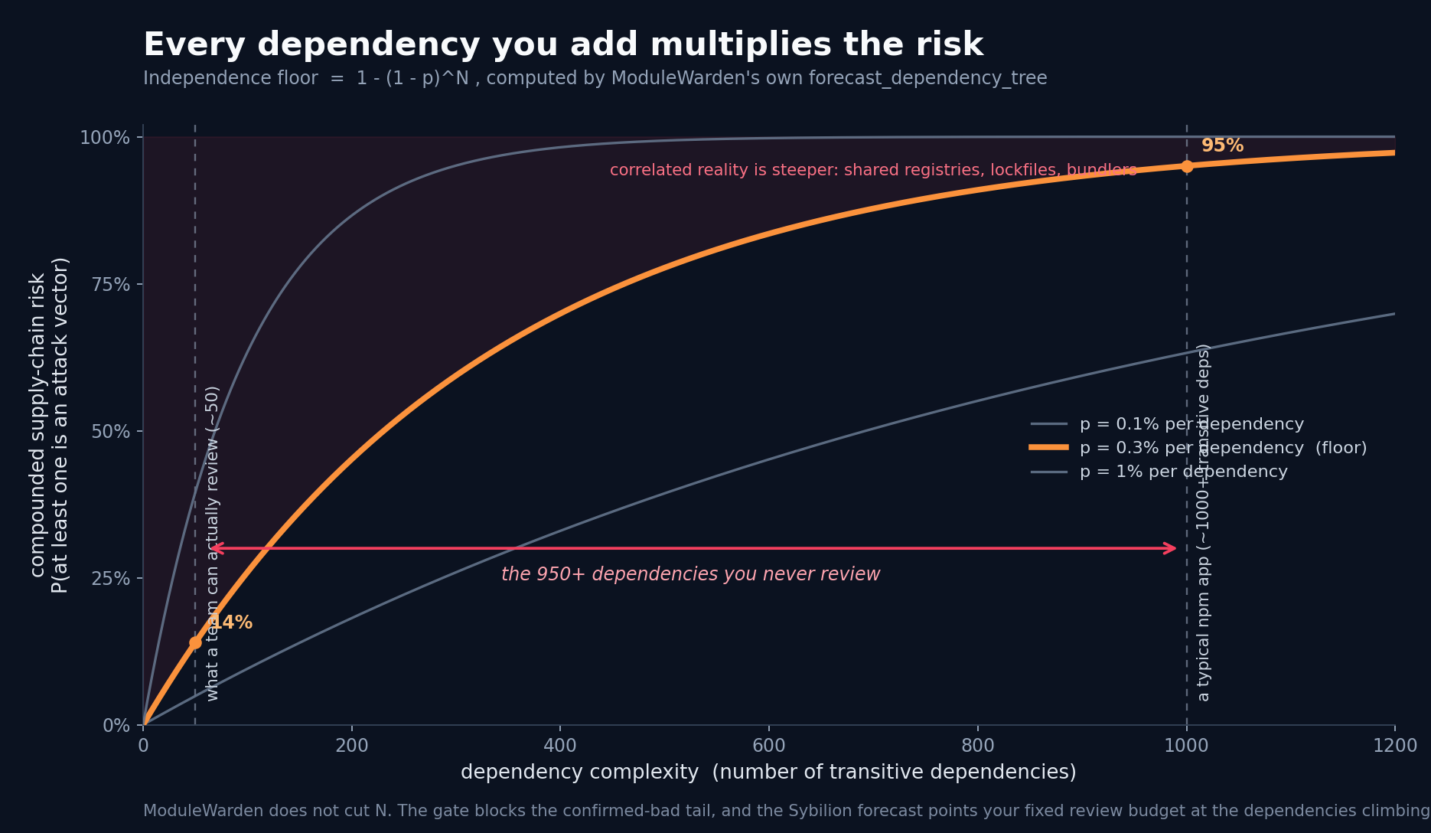
THE MATH YOU CAN'T OUT-REVIEW
Every dependency multiplies the risk.
The chance at least one dependency is an attack vector is 1 - (1 - p)^N. Even at a fraction of a percent per package, a typical app's 1,000-plus transitive dependencies push that toward certain. A team can hand-review maybe fifty.
ModuleWarden · Zero-One Hack Vienna 2026 · Forecast track
4

Slide 5
THE DEFENSE
Guard the one interface every package crosses.
ModuleWarden sits at the registry. Turn it on with a single line, and every new version is audited automatically before it reaches your code. One verdict: allow, block, or quarantine.
ModuleWarden · Zero-One Hack Vienna 2026 · Forecast track
5

Slide 6
EVIDENCE FIRST, VERDICT SECOND
Read exactly what the model saw.
An agentic reviewer reads the code from multiple angles: claimed purpose vs actual behavior, install-time execution, known vulnerabilities, capability deltas. Every verdict lands with cited evidence you can open and read.
ModuleWarden · Zero-One Hack Vienna 2026 · Forecast track
6

Slide 7
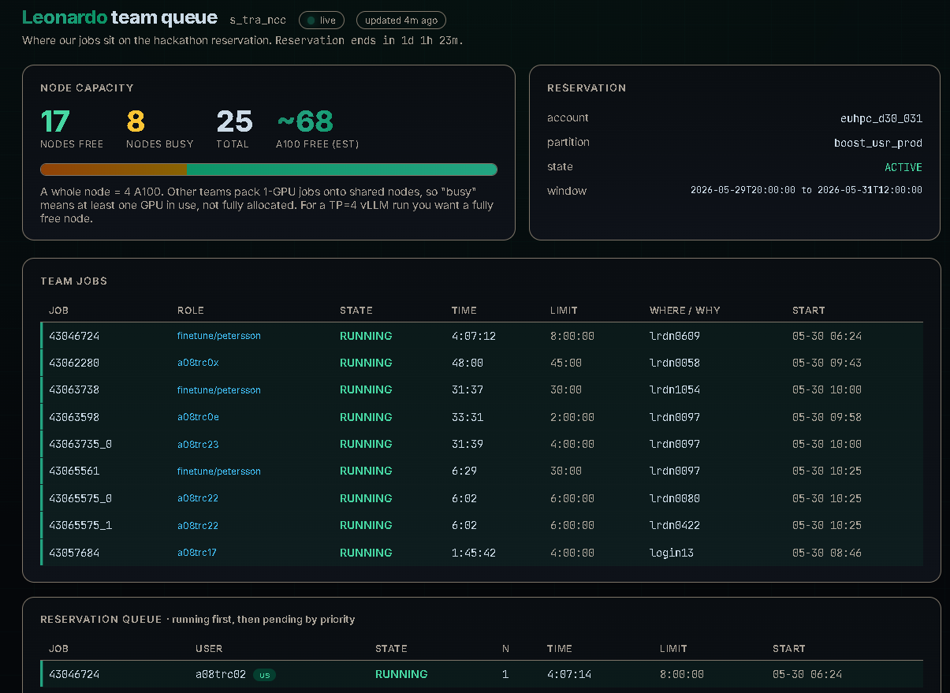
THE MODEL
A 27B auditor, fine-tuned on real CVE diffs.
A 27-billion-parameter Qwen, fine-tuned on real vulnerable-vs-patched version pairs. Two LoRA adapters trained on the Leonardo supercomputer (4x A100). Published on Hugging Face.
ModuleWarden · Zero-One Hack Vienna 2026 · Forecast track
7

Slide 8
TRAINED VS UNTRAINED
Measured, not claimed.
Held-out validation loss 0.21, token accuracy 94 percent. That measures how faithfully the model writes up evidence, not whether it spots danger. Untuned, the base drifts the schema; tuned, it is valid every time. Detection stays with the gate.
0.21 / 94%
val loss / token accuracy
ModuleWarden · Zero-One Hack Vienna 2026 · Forecast track
8

Slide 9
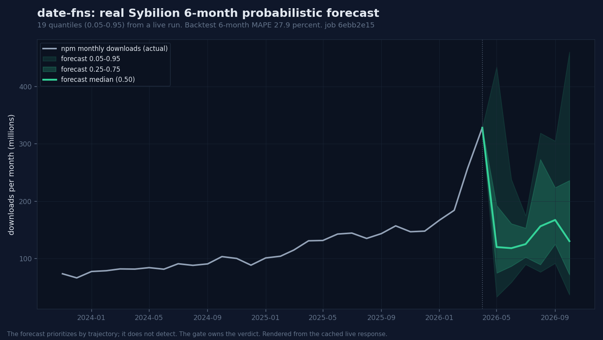
THE FORECAST, TWO SIGNALS
Sybilion sets review order.
We send each package's download history to Sybilion and use two things: the slope, to rank what we review first, and the band width, to route it. Too wide to call goes to a human; a tight band, the gate auto-audits.
ModuleWarden · Zero-One Hack Vienna 2026 · Forecast track
9

Slide 10
LIVE AT SCALE
The forecast does the triage.
We ran it live across 46 packages. semver and minimatch are the same size, about 2.5 billion downloads a month. The forecast separates them: semver's band is tight, it auto-clears; minimatch's is wide, a human looks.
18 / 28
routed to a human / auto-cleared
ModuleWarden · Zero-One Hack Vienna 2026 · Forecast track
10

Slide 11
THE HONEST FLOOR
We show you what the forecast cannot do.
We tested whether the forecast can detect a dying or compromised package. It cannot. The band and the slope do not separate a dying package from a healthy one. We do not claim 0.90, or calibrated. False certainty is worse than honest uncertainty.
0.54
cold-package classifier AUROC (the floor)
ModuleWarden · Zero-One Hack Vienna 2026 · Forecast track
11

Slide 12
THE THREAT FROM WITHIN
The gate does not care who runs the install.
The most dangerous attacker is not always outside. Verizon puts 74 percent of breaches on the human element: a developer in a hurry, an AI assistant suggesting a package. ModuleWarden gates the install no matter who runs it.
74%
of breaches involve the human element (Verizon DBIR)
ModuleWarden · Zero-One Hack Vienna 2026 · Forecast track
12

Slide 13
CLOSE
Grow a forecast into a new domain without it lying to you.
Sybilion says the domain is yours. We kept what the forecast earned (trajectory ranking), gated what it could not (the full audit pipeline owns the verdict), and conceded the rest with the data.
ModuleWarden · Zero-One Hack Vienna 2026 · Forecast track
13

Slide 14
MODULEWARDEN
Audit every version. Forecast every trajectory. Show every piece of evidence.
modulewarden.com
github.com/apetersson/ModuleWarden · huggingface.co/ademczuk/modulewarden-auditor-qwen3.6-27b-lora
ModuleWarden · Zero-One Hack Vienna 2026 · Forecast track
14

