Slide 1
Shading
A modification of Angel powerpoints

Slide 2
WebGL lighting
Need
Normals
Material properties
Lights

Slide 3
Normalization
Cosine terms in lighting calculations can be computed using dot product
Unit length vectors simplify calculation
Usually we want to set the magnitudes to have unit length but
Length can be affected by transformations
Note that scaling does not preserved length
GLSL has a normalization function

Slide 4
Normal for Triangle
n
plane n ·(p - p₀ ) = 0
p₂
n = (p₂ - p₀ ) ×(p₁ - p₀ )
p
p₁
normalize n ← n/ |n|
p₀
Note that right-hand rule determines outward face

Slide 5
Specifying a Point Light Source
For each light source, we can set an RGBA for the diffuse, specular, and ambient components, and for the position
var diffuse0 = vec4(1.0, 0.0, 0.0, 1.0);
var ambient0 = vec4(1.0, 0.0, 0.0, 1.0);
var specular0 = vec4(1.0, 0.0, 0.0, 1.0);
var light0_pos = vec4(1.0, 2.0, 3,0, 1.0);

Slide 6
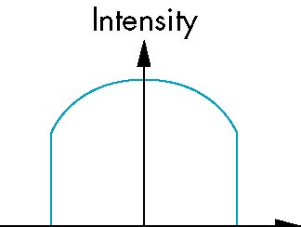
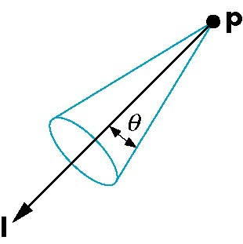
Spotlights
Derive from point source
Direction
Cutoff
Attenuation Proportional to cos^{α}φ
−θ
φ
θ

Slide 7
Global Ambient Light
Ambient light depends on color of light sources
A red light in a white room will cause a red ambient term that disappears when the light is turned off
A global ambient term that is often helpful for testing

Slide 8
Moving Light Sources
Light sources are geometric objects whose positions or directions are affected by the model-view matrix
Depending on where we place the position (direction) setting function, we can
Move the light source(s) with the object(s)
Fix the object(s) and move the light source(s)
Fix the light source(s) and move the object(s)
Move the light source(s) and object(s) independently

Slide 9
Light Properties
var lightPosition = vec4(1.0, 1.0, 1.0, 0.0 );
var lightAmbient = vec4(0.2, 0.2, 0.2, 1.0 );
var lightDiffuse = vec4( 1.0, 1.0, 1.0, 1.0 );
var lightSpecular = vec4( 1.0, 1.0, 1.0, 1.0 );

Slide 10
Material Properties
Material properties should match the terms in the light model
Reflectivities
w component gives opacity
var materialAmbient = vec4( 1.0, 0.0, 1.0, 1.0 );
var materialDiffuse = vec4( 1.0, 0.8, 0.0, 1.0);
var materialSpecular = vec4( 1.0, 0.8, 0.0, 1.0 );
var materialShininess = 100.0;

Slide 11
Using MV.js for Products
var ambientProduct = mult(lightAmbient, materialAmbient);
var diffuseProduct = mult(lightDiffuse, materialDiffuse);
var specularProduct = mult(lightSpecular, materialSpecular);
gl.uniform4fv(gl.getUniformLocation(program,
"ambientProduct"), flatten(ambientProduct));
gl.uniform4fv(gl.getUniformLocation(program,
"diffuseProduct"), flatten(diffuseProduct) );
gl.uniform4fv(gl.getUniformLocation(program,
"specularProduct"), flatten(specularProduct) );
gl.uniform4fv(gl.getUniformLocation(program,
"lightPosition"), flatten(lightPosition) );
gl.uniform1f(gl.getUniformLocation(program,
"shininess"),materialShininess);

Slide 12
Adding Normals for Quads
function quad(a, b, c, d) {
var t1 = subtract(vertices[b], vertices[a]);
var t2 = subtract(vertices[c], vertices[b]);
var normal = cross(t1, t2);
var normal = vec3(normal);
normal = normalize(normal);
pointsArray.push(vertices[a]);
normalsArray.push(normal);
.
.
.

Slide 13
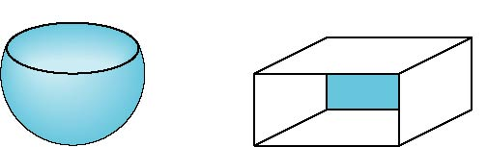
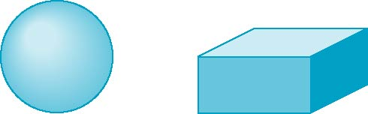
Front and Back Faces
Every face has a front and back
For many objects, we never see the back face so we don’t care how or if it’s rendered
If it matters, we can handle in shader
back faces not visible
back faces visible

Slide 14
Emissive Term
We can simulate a light source in WebGL by giving a material an emissive component
This component is unaffected by any sources or transformations

Slide 15
Transparency
Material properties are specified as RGBA values
The A value can be used to make the surface translucent
The default is that all surfaces are opaque
However with the HTML5 canvas, A<1 will mute colors

Slide 16
Polygonal Shading
In per vertex shading, shading calculations are done for each vertex
Vertex colors become vertex shades and can be sent to the vertex shader as a vertex attribute
Alternately, we can send the parameters to the vertex shader and have it compute the shade
By default, vertex shades are interpolated across an object if passed to the fragment shader as a varying variable (smooth shading)
We can also use uniform variables to shade with a single shade (flat shading)

Slide 17
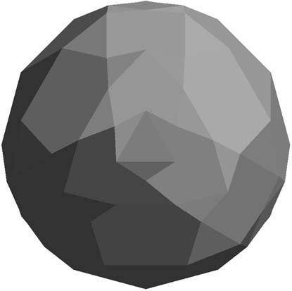
Polygon Normals
Triangles have a single normal
Shades at the vertices as computed by the modified Phong model can be almost same
Consider model of sphere
Want different normals at
each vertex even though
this concept is not quite
correct mathematically

Slide 18
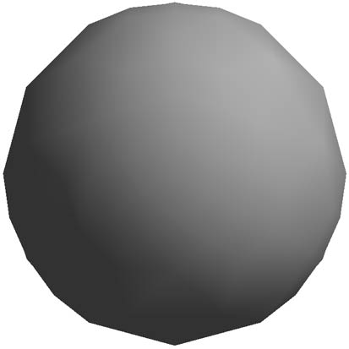
Smooth Shading
We can set a new normal at each vertex
Easy for sphere model
Now smooth shading works
Note silhouette edge

Slide 19
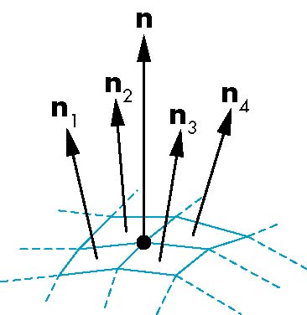
Mesh Shading
The previous example is not general because we knew the normal at each vertex analytically
For polygonal models, Gouraud proposed we use the average of the normals around a mesh vertex
n = (n₁+n₂+n₃+n₄)/ |n₁+n₂+n₃+n₄|

Slide 20
Gouraud and Phong Shading
Gouraud Shading
Find average normal at each vertex (vertex normals)
Apply modified Phong model at each vertex
Interpolate vertex shades across each polygon
Phong shading
Find vertex normals
Interpolate vertex normals across edges
Interpolate edge normals across polygon
Apply modified Phong model at each fragment

Slide 21
Comparison
If the polygon mesh approximates surfaces with a high curvatures, Phong shading may look smooth while Gouraud shading may show edges
Phong shading requires much more work than Gouraud shading
Until recently not available in real time systems
Now can be done using fragment shaders
Both need data structures to represent meshes so we can obtain vertex normals

