Slide 1
Lighting and Shading
A Modification of Angel PowerPoint lecture series

Slide 2
Shading – Which Looks like a Sphere?

Slide 3
Shading
Why does the image of a real sphere look like
Need to consider
Light sources
Material properties
Location of viewer
Surface orientation

Slide 4
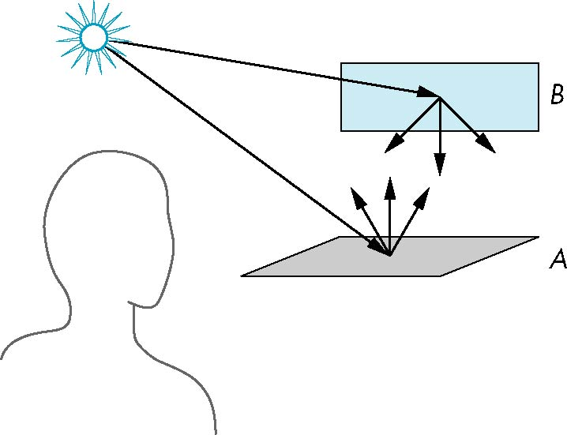
Scattering

Slide 5
Rendering Equation
The infinite scattering and absorption of light can be described by the rendering equation
Rendering equation is global and includes
Shadows
Multiple scattering from object to object

Slide 6
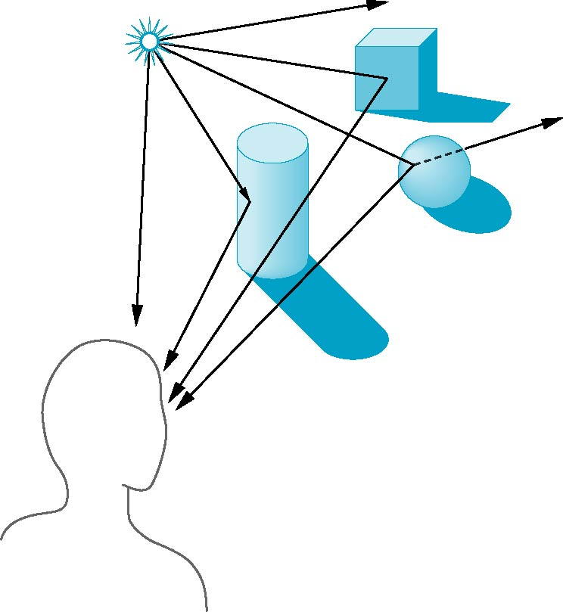
Global Effects
shadow
multiple reflection
translucent surface

Slide 7
Local vs Global Rendering
Correct shading requires a global calculation involving all objects and light sources
Incompatible with pipeline model which shades each polygon independently (local rendering)
In Computer Graphics, we are happy with approximations

Slide 8
Light-Material Interaction
Light that strikes an object is partially absorbed and partially scattered (reflected)
The amount reflected determines the color and brightness of the object
A surface appears red under white light because the red component of the light is reflected and the rest is absorbed
The reflected light is scattered in a manner that depends on the smoothness and orientation of the surface

Slide 9
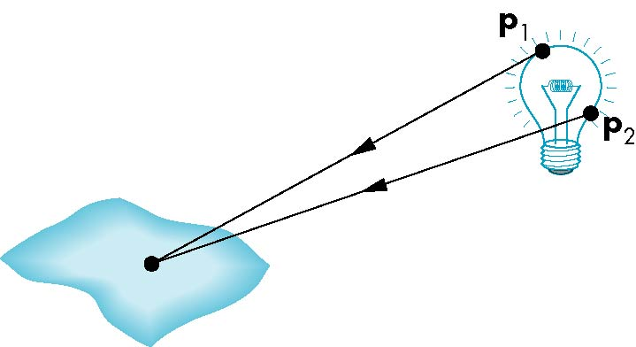
Light Sources
General light sources are difficult to work with because we must integrate light coming from all points on the source

Slide 10
Simple Light Sources
Point source
Spotlight
Ambient light

Slide 11

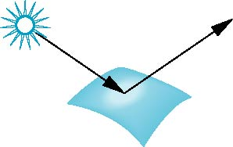
Surface Types
The smoother a surface, the more reflected light is concentrated in the direction a perfect mirror would reflected the light
A very rough surface scatters light in all directions
smooth surface
rough surface

Slide 12
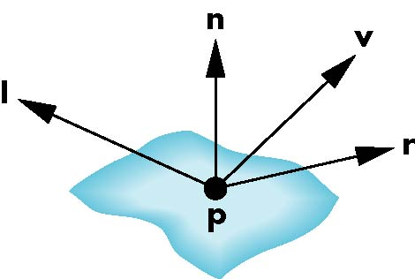
Phong Model
A simple model that can be computed rapidly
Has three components
Diffuse
Specular
Ambient
Uses four vectors
To source
To viewer
Normal
Perfect reflector

Slide 13
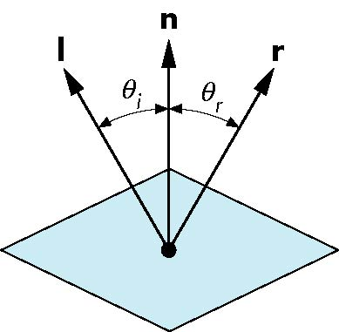
Ideal Reflector
Normal is determined by local orientation
Angle of incidence = angle of relection
The three vectors must be coplanar
r = 2 (l · n ) n - l

Slide 14
Lambertian Surface
Perfectly diffuse reflector
Light scattered equally in all directions
Amount of light reflected is proportional to the vertical component of incoming light
reflected light ~cos θ_{i}
cos θ_{i} = l · n if vectors normalized
There are also three coefficients, k_{r}, k_{b}, k_{g} that show how much of each color component is reflected

Slide 15
Phong Light Model
$$Intensity=ambient+diffuse+specular$$
$Intensity=k_{a}i_{a}+$ $k_{d}\left(l∙n\right)i_{d}+k_{s}{(r∙v)}^{α}i_{s}$

Slide 16

Specular Surfaces
Most surfaces are neither ideal diffusers nor perfectly specular (ideal reflectors)
Smooth surfaces show specular highlights due to incoming light being reflected in directions concentrated close to the direction of a perfect reflection
specular
highlight

Slide 17
Modeling Specular Reflections
Phong proposed using a term that dropped off as the angle between the viewer and the ideal reflection increased
I_{r} ~ k_{s} I cos^{α}φ
φ
reflected
intensity
shininess coef
incoming intensity
absorption coef

Slide 18
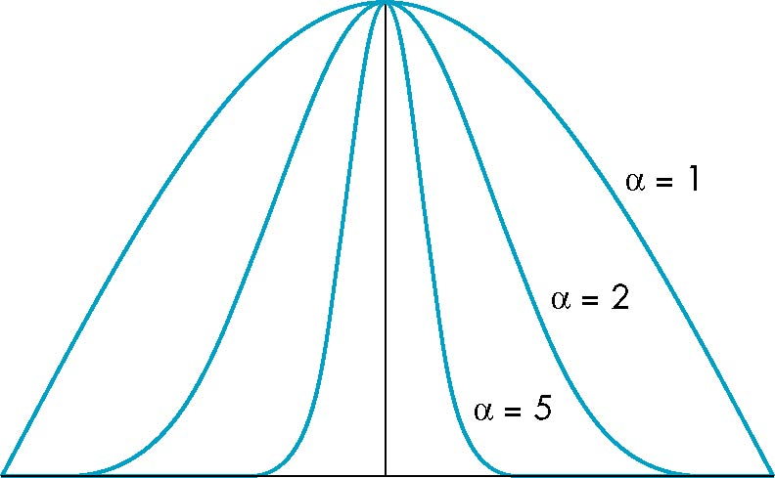
The Shininess Coefficient
Values of α between 100 and 200 correspond to metals
Values between 5 and 10 give surface that look like plastic
cos^{α} φ
-90
φ
90

