Slide 1
Clipping and Projections
slides modified version of resources with the Angel textbook

Slide 2
Lecture Goals
Understand Windows and Viewports
Understand An Implementation of Clipping

Slide 3
Cohen-Sutherland
1010
0010
0110
1000
0000
0100
1001
0001
0101

Slide 4
Cohen-Sutherland (algorithm)
For each line segment:
Assign codes to endpoints
If both codes are 0
Display line
Else
Perform bitwise AND of codes
If result is zero,
Reject line
Else
Perform intersections

Slide 5
Projection Pipeline
modelview
transformation
projection
transformation
perspective
division
4D → 3D
clipping
projection
3D → 2D
against default cube

Slide 6
Render Code -- Projection
Review Code at:
https://www.cs.unm.edu/~angel/BOOK/INTERACTIVE_COMPUTER_GRAPHICS/SEVENTH_EDITION/CODE/05/ortho.js
create eye, at, and up positions (use vec3)
create ModelView Matrix
mvMatrix = lookAt(eye, at, up);
Create ProjectionViewMatrix
pMatrix = ortho(left, right, bottom, top, near, far);

Slide 7
Render Code – Projection
gl.uniformMatrix4fv( modelView, false, flatten(mvMatrix) );
gl.uniformMatrix4fv( projection, false, flatten(pMatrix) );
Set Matrices

Slide 8
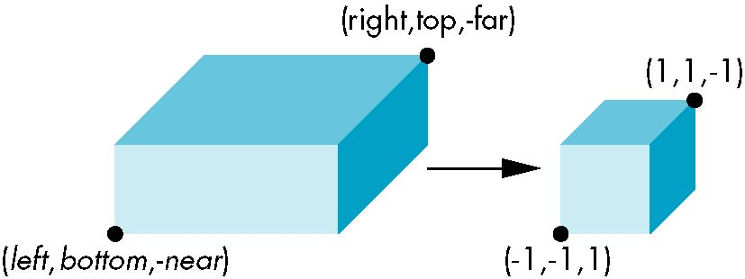
Orthogonal Normalization
ortho(left,right,bottom,top,near,far)
normalization ⇒ find transformation to convert
specified clipping volume to default

Slide 9
Orthogonal Matrix
P =

