Slide 1
WebGL Program

Slide 2
WebGL Program -- Five Steps
Describe page (HTML file)
request WebGL Canvas
read in necessary files
Define shaders (HTML file)
Compute or specify data (JS file)
Send data to GPU (JS file)
Render data (JS file)

Slide 3
Square.html
<script id="vertex-shader" type="x-shader/x-vertex">
attribute vec4 vPosition;
void main(){
gl_Position = vPosition;
}
</script>
<script id="fragment-shader" type="x-shader/x-fragment">
precision mediump float;
void main()
{
gl_FragColor = vec4( 1.0, 1.0, 1.0, 1.0 );
}
</script>

Slide 4
Shaders
Assign names to the shaders to be used in the JS file
These are trivial pass-through shaders that which set the two required built-in variables
gl_Position
gl_FragColor
Note both shaders are full programs
Must set precision in fragment shader

Slide 5
More Square.html
<script type="text/javascript" src="../Common/webgl-utils.js"></script>
<script type="text/javascript" src="../Common/initShaders.js"></script>
<script type="text/javascript" src="../Common/MV.js"></script>
<script type="text/javascript" src="square.js"></script>
</head>
<body>
<canvas id="gl-canvas" width="512" height="512">
Oops ... your browser doesn't support the HTML5 canvas element
</canvas>
</body>
</html>

Slide 6
Files
../Common/webgl-utils.js: Standard utilities for setting up WebGL context in Common directory on website
../Common/initShaders.js: contains JS and WebGL code for reading, compiling and linking the shaders
../Common/MV.js: our matrix-vector package
square.js: the application file

Slide 7
square.js
// Configure WebGL
gl.viewport( 0, 0, canvas.width, canvas.height );
gl.clearColor( 0.0, 0.0, 0.0, 1.0 );
// Load shaders and initialize attribute buffers
var program = initShaders( gl, "vertex-shader", "fragment-shader" );
gl.useProgram( program );
// Load the data into the GPU
var bufferId = gl.createBuffer();
gl.bindBuffer( gl.ARRAY_BUFFER, bufferId );
gl.bufferData( gl.ARRAY_BUFFER, flatten(vertices), gl.STATIC_DRAW );
// Associate out shader variables with our data buffer
var vPosition = gl.getAttribLocation( program, "vPosition" );
gl.vertexAttribPointer( vPosition, 2, gl.FLOAT, false, 0, 0 );
gl.enableVertexAttribArray( vPosition );

Slide 8
Notes
initShaders used to load, compile and link shaders to form a program object
Load data onto GPU by creating a vertex buffer object on the GPU
Note use of flatten() to convert JS array to an array of float32’s
Finally we must connect variable in program with variable in shader
need name, type, location in buffer

Slide 9
Program Execution
WebGL runs within the browser
complex interaction among the operating system, the window system, the browser and your code (HTML and JS)
Simple model
Start with HTML file
start with onload function
event driven input

Slide 10
Coordinate Systems
The units in points are determined by the application and are called object, world, model or problem coordinates
Viewing specifications usually are also in object coordinates
Eventually pixels will be produced in window coordinates
clip coordinates

Slide 11
Coordinate Systems and Shaders
Vertex shader must output in clip coordinates
Input to fragment shader from rasterizer is in window coordinates
Application can provide vertex data in any coordinate system but shader must eventually produce gl_Position in clip coordinates
Simple example uses clip coordinates

Slide 12
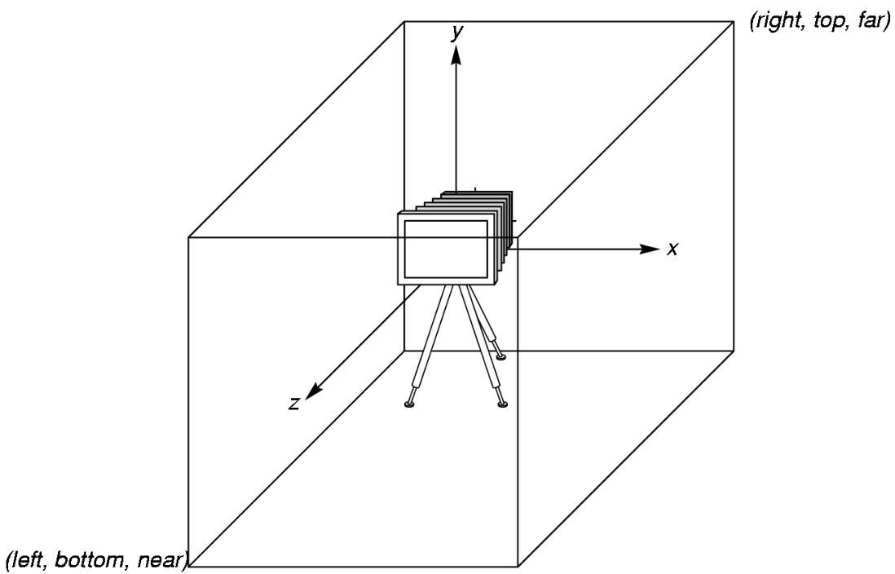
WebGL Camera
WebGL places a camera at the origin in object space pointing in the negative z direction
The default viewing volume
is a box centered at the
origin with sides of
length 2

Slide 13
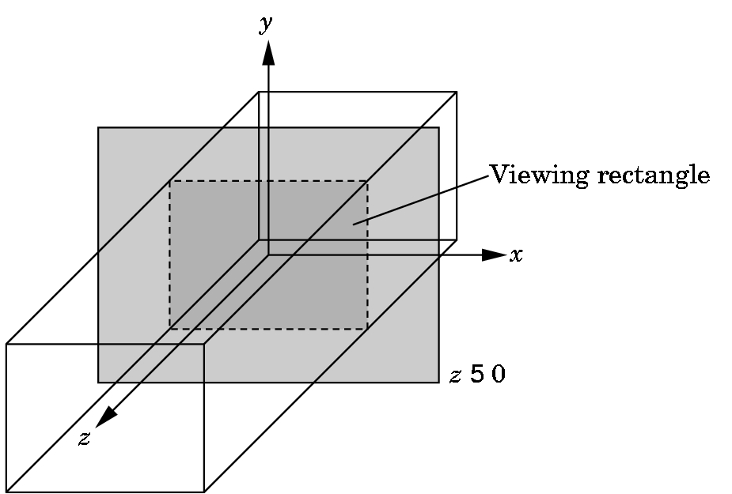
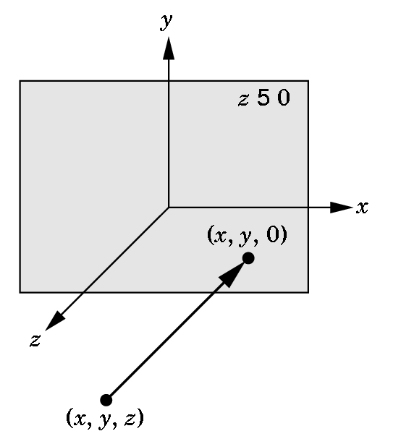
Orthographic Viewing
In the default orthographic view, points are
projected forward along the z axis onto the
plane z=0
z=0
z=0

Slide 14
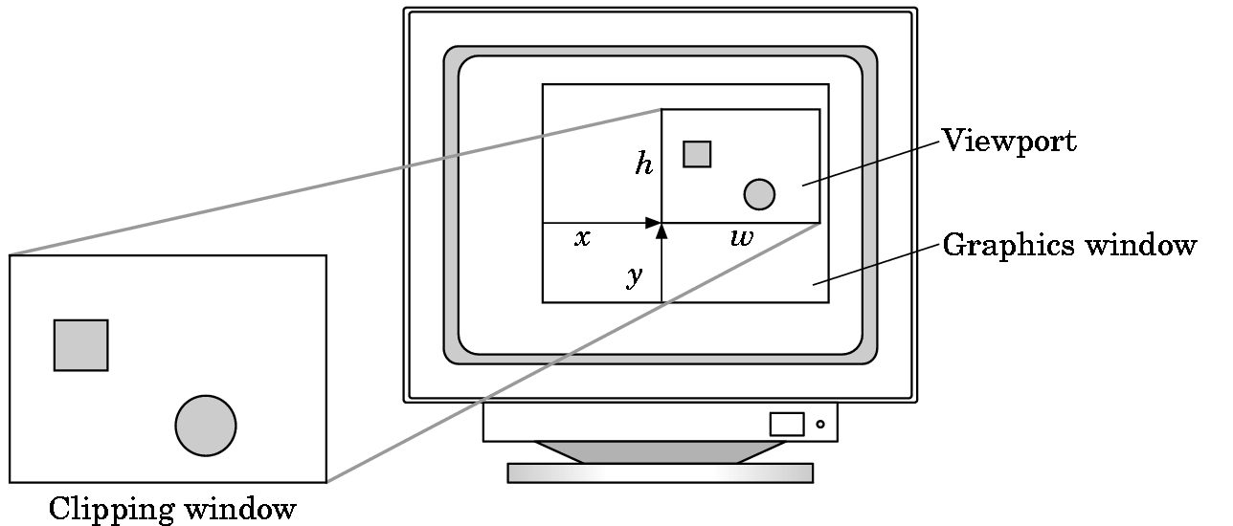
Viewports
Do not have use the entire window for the image: gl.viewport(x,y,w,h)
Values in pixels (window coordinates)

Slide 15
Transformations and Viewing
In WebGL, we usually carry out projection using a projection matrix (transformation) before rasterization
Transformation functions are also used for changes in coordinate systems
Three choices in WebGL
Application code
GLSL functions
MV.js

