Slide 1
Graphics Systems

Slide 2
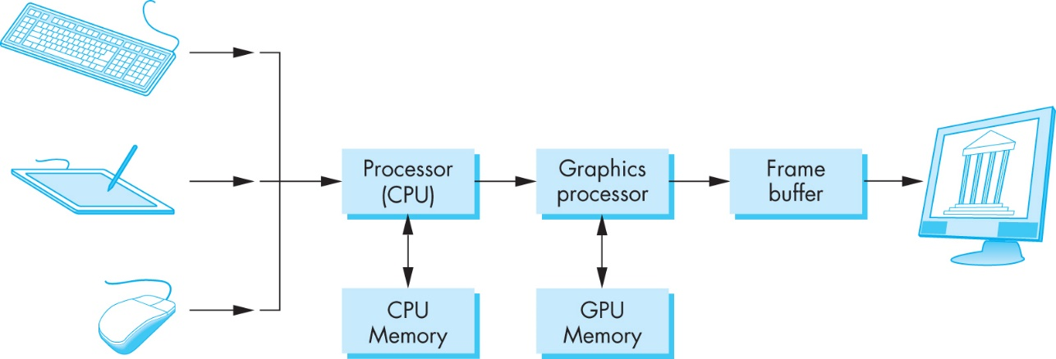
A Basic Graphics System
Output device
Input devices
Image formed in frame buffer

Slide 3
Framebuffer
a collection of buffers that can be used as the destination for rendering. OpenGL has two kinds of framebuffers: the Default Framebuffer, which is provided by the OpenGL Context; and user-created framebuffers called Framebuffer Objects (FBOs). The buffers for default framebuffers are part of the context and usually represent a window or display device.
As defined by OpenGL.org

Slide 4
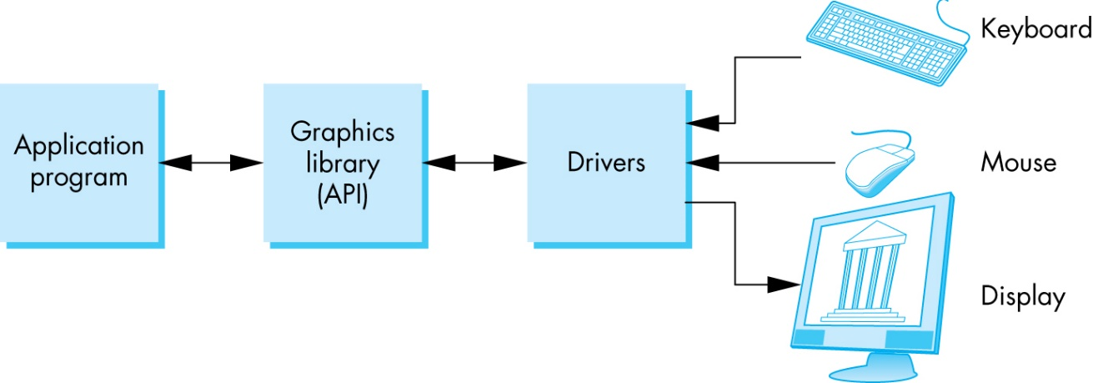
OpenGL System

Slide 5
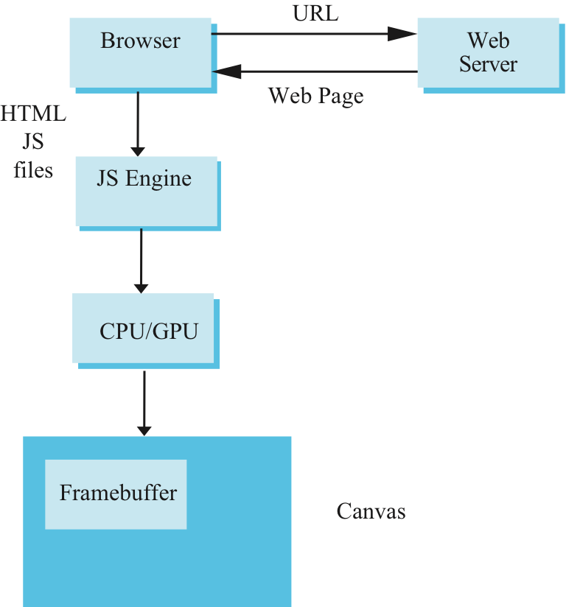
Execution in Browser

Slide 6
Graphics Pipeline
Vertices
Pixels
Vertex Processor
Clipper
Rasterizer
Fragment
Processor

Slide 7
Vector Processor
Vertices
Pixels
Vertex Processor
Clipper
Rasterizer
Fragment
Processor
Converts object representations from one coordinate system to another
Object coordinates
Camera (eye) coordinates
Screen coordinates
Computes vertex colors

Slide 8
Clipper
Vertices
Pixels
Vertex Processor
Clipper
Rasterizer
Fragment
Processor
Projection is the process that combines the 3D viewer with the 3D objects to produce the 2D image
The primitives(lines and polygons) are assembled and determined what is in view.

Slide 9
Clipping Regions

Slide 10
Clipping Regions

Slide 11
Clipping Regions

Slide 12
Rasterizer
Vertices
Pixels
Vertex Processor
Clipper
Rasterizer
Fragment
Processor
Rasterizer produces a set of fragments for each object
Fragments are “potential pixels”
Have a location in framebuffer
Color and depth attributes
Vertex attributes are interpolated over objects by the rasterizer

Slide 13
Fragment Processor
Vertices
Pixels
Vertex Processor
Clipper
Rasterizer
Fragment
Processor
Fragments are processed to determine the color of the corresponding pixel in the frame buffer
Colors can be determined by texture mapping or interpolation of vertex colors
Fragments may be blocked by other fragments closer to the camera
Hidden-surface removal

Slide 14
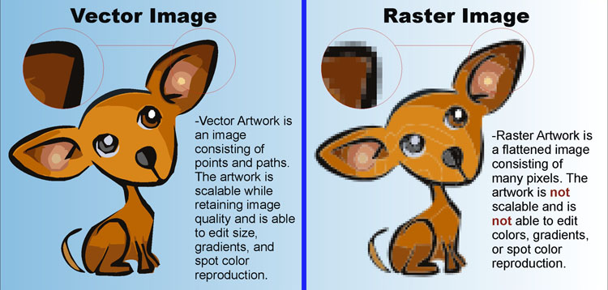
Vector vs Raster Graphics
Image from:

Slide 15
Vector vs Raster Graphics
Vector Graphics: Mathematical representation of lines and shapes (files: .ai, .pdf, .obj)
Pros:
Scalable
Smaller file size
Editable
Cons:
Limited details
Limited Effects
Raster Graphics: Image as an array of pixels (Files: .gif, .jpg, .bmp)
Pros:
Detail on pixel level
Edit on pixel level
Cons:
Not Scalable. Lose detail when enlarged.
Large file size.

Slide 16
Vector Graphics: Equation of Line
The vector equation of a
line containing the points p₀ and p₁:
We get the line segment p₀p₁ when we
limited t to the interval [0,1].
p₁
p₀
What should be stored to represent this line?

Slide 17
Vector Graphics: Scalable
How do you scale lines?
p₀
p₁
p₀
p₁

Slide 18
Vector Graphics: Scalable
How do you scale lines?
p₀
p₁
p₀
p₁
Scalar multiply the points.

Slide 19
Raster Graphics: A Line
How do you scale these lines?

Slide 20
Vector Graphics: Computing the Intersection of two lines
p₀
q₀
q₁
p₁

Slide 21
Vector Graphics: Computing the Intersection of two lines
p₀
I
q₀
q₁
p₁

Slide 22
Raster Graphics: Intersection
We can “see” this intersection…but how do we compute it?

