Slide 1


A Data-Driven Two-Stage Distributionally Robust Planning Tool for Sustainable Microgrids
Paper No: 20PESGM1277
Shahab Dehghan ¹, Agnes Nakiganda ¹, and Petros Aristidou ²
¹ University of Leeds
² Cyprus University of Technology
s.dehghan@leeds.ac.uk

Slide 2

Motivation and Background
Input
Microgrid Planning Tool
Output
Network Topology
Forecast demand
Forecast production
Investment candidates
Minimise Total Costs
Adequacy
Security
Resilience
Uncertain!
Infeasible!
Uncertainty Management
Stochastic
Optimisation
Distributionally Robust Optimisation
Robust
Optimisation

Slide 3
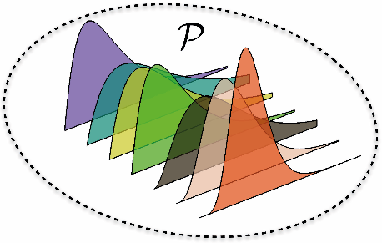
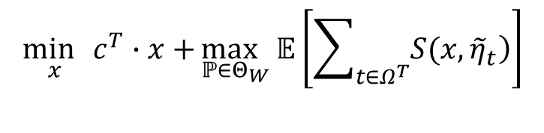

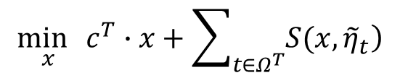
Problem Formulation
Deterministic Model
$$\min_{x}{c^{T}∙x+\sum_{t∈Ω^{T}}{\left.S(x,{\tilde{η}}_{t}\right)}}$$
Investment Cost
Operation Cost
Uncertainty Vector
$$S\left(x,{\tilde{η}}_{t}\right)=\min_{y_{t}}\left\{d^{T}⋅y_{t}|E\left(x\right)+F⋅y_{t}≥G\left(x\right)⋅{\tilde{η}}_{t}\right\}$$
Distributionally Robust Model
Ambiguity Set
$$Θ_{W}=\{ℙ∈Ξ\left(Ω\right) :dist_{W}\left(ℙ,{\hat{ℙ}}_{N_{s}}\right)≤ρ\}$$
Wasserstain Metric
$$\min_{x}{c^{T}∙x+}\max_{ℙ∈Θ_{W}}{𝔼\left[\sum_{t∈Ω^{T}}{\left.S(x,{\tilde{η}}_{t}\right)}\right]}$$
source: https://web.mit.edu/vanparys
A tractable MILP counterpart can be obtained by using the duality theory *.
* G. A. Hanasusanto and D. Kuhn, Oper. Res., vol. 66, no. 3, pp. 849–869, 2018.

Slide 4
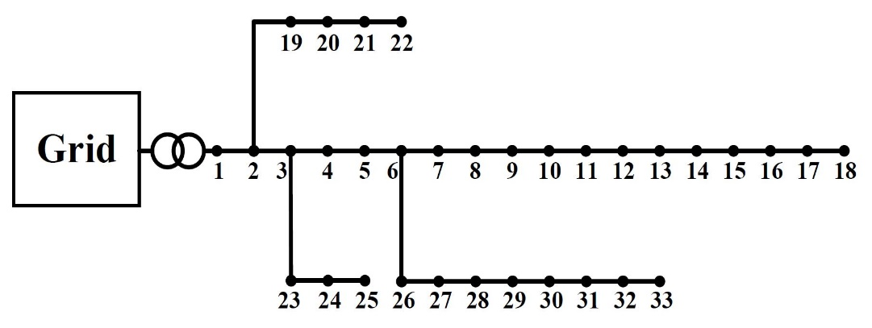
Case Study
Total Costs of Different Planning Models
Daily Patterns of Loads and RES Power Generations
Model | Total Costs ($/Day) | Computation Time (s)
Deterministic | 1667 | 34
Distributionally robust | 2155 | 128
Robust | 2333 | 184
Total Costs in DR-MIRP vs. Number of Training Samples
Training Sample (#) | Total Costs ($/Day) | Computation Time (s)
5 | 2155 | 128
10 | 2141 | 295
Total Costs vs. Values of Confidence Level

Slide 5

Conclusions
Bridge between SO and RO
Present a DRO-based microgrid planning tool
Introduce a tractable MILP counterpart
Control conservatism-level by
Increasing/decreasing the number of training samples
Increasing/decreasing the confidence level
Future works
Implement the proposed model in PyEPLAN
Increase the accuracy of network modeling
Include static/dynamic security constraints under islanding

