Slide 1

The Software Testing Using PowerShell team presents
New object model
in
UIAutomation PowerShell Extensions
part 1

Slide 2
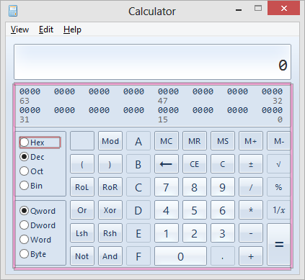
Problem
What actions does a control support?
Invoke-UiaRadioButtonSelectItem?

Slide 3
Problem
we need to exam the control
$radioButton.GetSupportedPatterns()
and search for a cmdlet that invokes an action we need
Get-Command *radio*select*
and after all we need to test whether it works
Get-UiaRadioButton hex | Invoke-UiaRadioButtonSelectItem

Slide 4
Solution
Each control supports some patterns -
why do not use it fluently?
$radioButton = Get-UiaRadioButton hex
$radioButton.Select()
Intellisense should help to write code

Slide 5
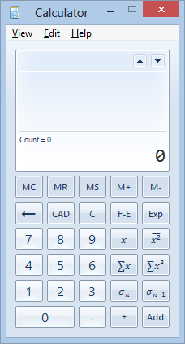
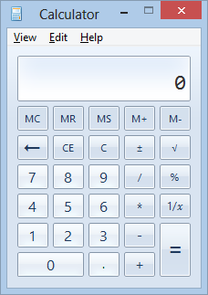

Example task
Turn calculator into the Standard mode:

Slide 6
Example code
$menuView = Start-Process calc -PassThru | Get-UiaWindow | Get-UiaMenuItem view
($menuView.Expand() | Get-UiaMenuItem standard).Click()
# menu item View exposes method Expand()
# menu item Standard accepts Click()

Slide 7
Chaining methods
The majority of methods return the object the method was called on:
$btn1 = Start-Process calc -PassThru | Get-UiaWindow | Get-UiaButton 1
$btn1.Click().NavigateToNextSibling().Click().Click().Highlight()
# this code writes 100 and highlights button 0

Slide 8
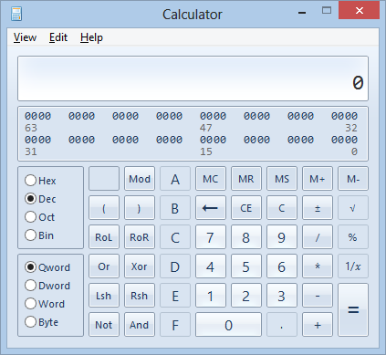
ISupportsSelectionItemPattern
Let's change dec to hex:
$rbtn = Get-UiaRadioButton hex
$rbtn.Select()

Slide 9
ISupportsTransformPattern
Move, Resize, Rotate
$wnd.Move(500, 500)
check whether a control supports a method of pattern:
if ($wnd.CanResize) {
$wnd.Resize(300, 300)
}
# not resizable

Slide 10
ISupportsWindowPattern
$visualState = [System.Windows.Automation.WindowVisualState]
$wnd.SetWindowVisualState(
$visualState::Maximized)
$wnd.WaitForInputIdle(60000)
$wnd.Close()

Slide 11
ISupportsScrollItemPattern
services.msc
# the following may require run as Administrator
$gridItem = Get-UiaWindow -n services | Get-UiaDataGrid | Get-UiaDataItem Workstation
$gridItem.ScrollIntoView()

Slide 12
ISupportsScrollPattern
services.msc
# the following may require run as Administrator
$grid = Get-UiaWindow -n services | Get-UiaDataGrid
$scrollAmount = [System.Windows.Automation.ScrollAmount]
$grid.Scroll(
$scrollAmount::LargeIncrement, $scrollAmount::SmallIncrement)
$grid.ScrollHorizontal($scrollAmount::LargeDecrement)
$grid.ScrollVertical($scrollAmount::NoAmount)

Slide 13
ISupportsValuePattern

Slide 14
ISupportsRangeValuePattern

Slide 15
ISupportsSelectionPattern

Slide 16
ISupportsTogglePattern

