Slide 1

Final task presentation
Alexey Petrunev
alexeypetrunev@gmail.com
https://github.com/apetrunev/ftask

Slide 2
Goals
Build test infrastructure (Web, Router, Database)
Configure each vm according to specified requirements
Demonstrate how this chain works

Slide 3
Tools for virtualization
Vagrant – command line utility for configuring and managing of virtual machines
Virtualbox as virtualization environment provider

Slide 4
How Vms are configured?
The whole infrastructure is configured with Vagrantfile and almost fully automated. Only small part of it is configured manually.
Virtual machines share common configurations : set of packages, timezone, kernel
Bash/shell is used as an instrument of provisioning
After common configuration comes specific one for each node
Vms share directory with a host via NFS mount

Slide 5
Choice of Software
Debian 11
PosgreSQL
Nginx
Unbound ( dns resolver with split-horizon functionality)
Flask
Prometheus/Grafana

Slide 6
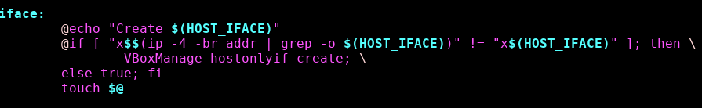
Preparation
Before we run our virtual machines via vagrant up we must complete two prerequisites:
Create network interface for management network we will use to access virtual machines. Just type make iface and VboxManage will create one for you.

Slide 7
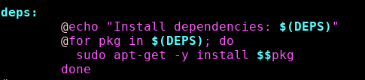
Preparation
Second prerequisite is installing dependencies that are required for enabling NFS access to shared folder that is located on host machine. Type make deps to install it.

Slide 8
Installation of mainline kernel
The process of downloading and installation of the latest linux kernel is time consuming and takes about two hours. We use configuration file from kernel already installed to virtual machines with little modifications:
Preemption model is set to No Forced Preemption
Signature verification is disabled
To download and compile the latest kernel type make kernel command.

Slide 9
Installation of mainline kernel
Provision target inside Vagrantfile that executes kernel installation is never executed automatically and should be executed manually.

Slide 10
Manual configuration
As already mentioned most part of the configuration is automated. The only small parts have been left for manual configuration.

Slide 11
Manual configuration for PostgreSQL
I have put tips for configuration settings to README file in /vagrant/db/ directory. In short we are just putting everything in the right place:
Set the mapping for users in pg_ident.conf
Add authentication directives to pg_hba.conf
Put postgresql to listening on all interfaces
Exec SQL instructions via psql utility
Restart postgresql service

Slide 12
Manual configuration for Grafana
The same tactics as in the former case is applied to grafana settings. The file with settings is called /vagrant/monitoring/README.grafana.settings. The following steps are required:
Choose the data source (prometheus in our case, located on the same host)
Load pre-configured dashboard with metrics

Slide 13

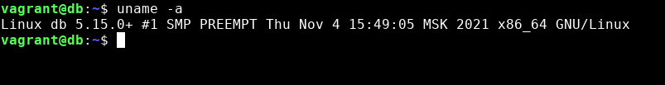

Results: mainline kernel

Slide 14
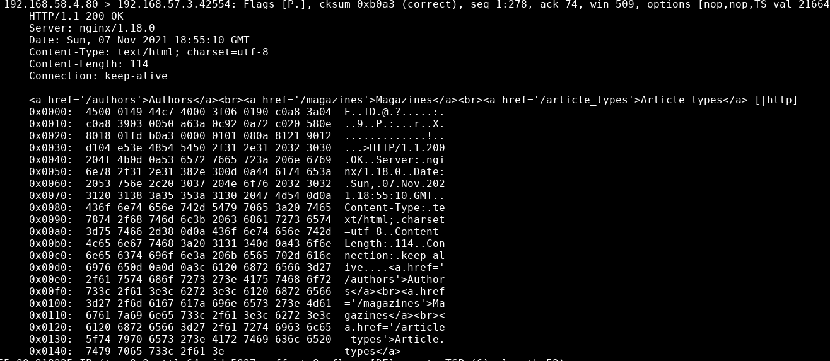
Results: http request from db.local to web.local

Slide 15
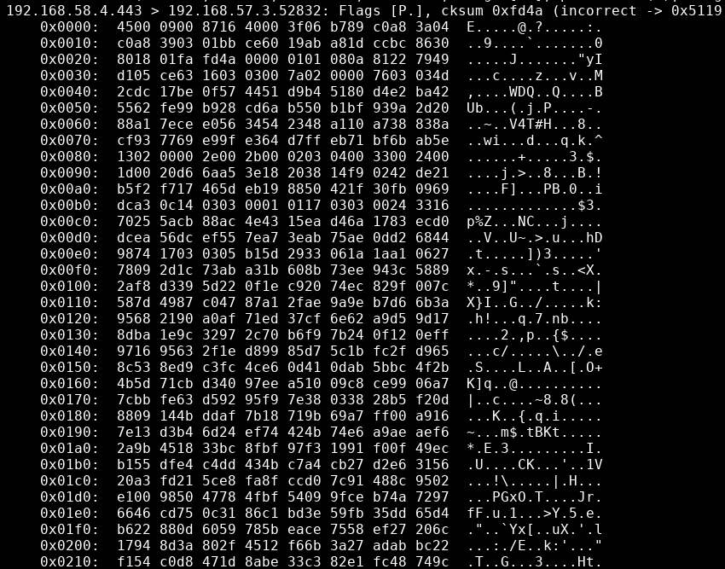
Results: https request from db.local to web.local

Slide 16
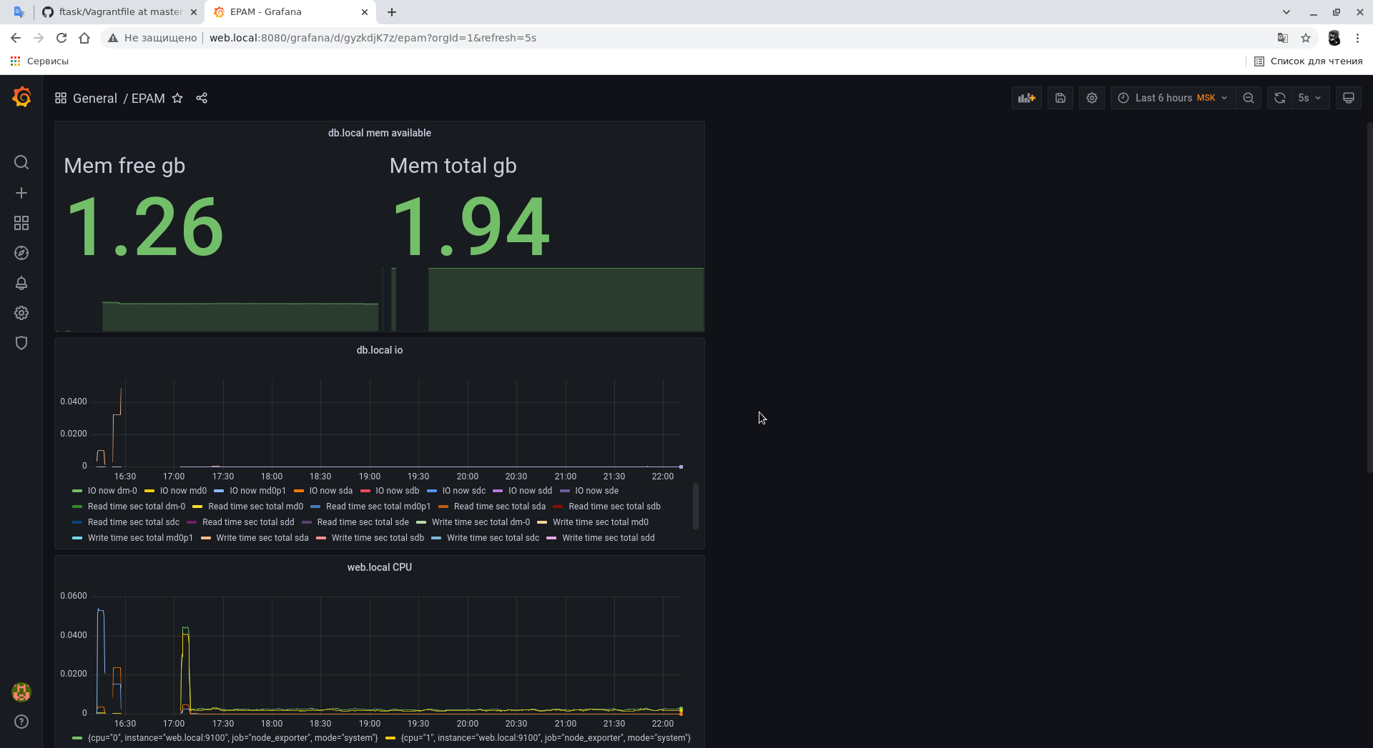
Results: Grafana

Slide 17

Thank you for your attention!
https://github.com/apetrunev/ftask

