Slide 1
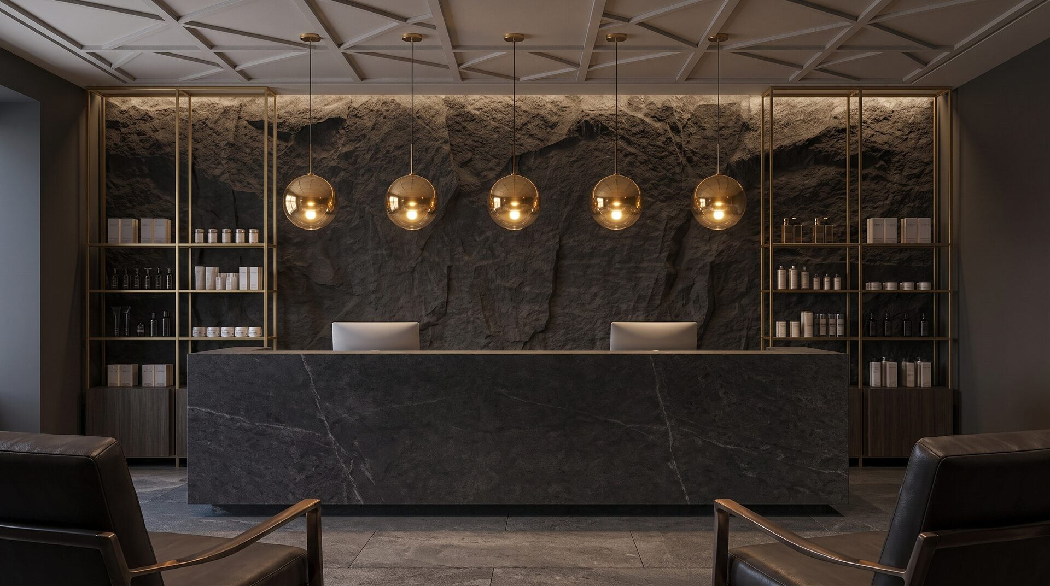

L&K WELLNESS
A recovery club with a licensed clinic inside it.
4655 Admiralty Way, Suite 210 · Marina del Rey, California · 4,925 SF programmed · $4.75M all equity
Laura@culvercitysurgical.com
CONFIDENTIAL · PRIVATE INVESTMENT BRIEF · FOR QUALIFIED RECIPIENTS ONLY

Slide 2
POSITIONING
Self-care is already social. Very few rooms are built to hold it, and fewer still are licensed to treat you in one.
L&K WELLNESS · PRIVATE INVESTMENT BRIEF · CONFIDENTIAL
2

Slide 3
THE PROBLEM
THE WESTSIDE IS FRAGMENTED
A patient optimizing their health today visits a medspa for injectables, a recovery studio for cold plunge, a longevity clinic for labs, and a concierge doctor for hormones. Four intakes, four records, four bills. Not one of them is somewhere you would choose to spend a Saturday morning.
4+
24 of 30
10,488
Separate providers a patient coordinates for care that belongs in one building.
Services on the L&K menu that require a physician, nurse practitioner or nurse. A recovery studio without a physician can offer 6.
US medical spas as of 2023, up from 8,899 the year before. The category is commoditizing on treatment alone.
L&K WELLNESS · PRIVATE INVESTMENT BRIEF · CONFIDENTIAL
3

Slide 4
THE INSIGHT
OTHERS PROVED THE FORMAT
Only a licensed facility can deliver it.
SWEATHOUZ
Soho House
Where a non-medical operator stops. No physician on site means no PRP, no IV therapy, no neuromodulators, no filler, no laser. Not features they skipped: the other side of a licensing threshold.
Where the ladder was proven. Soho Friends is a published annual tier buying discounts and event invitations but no club access. What they lack is medicine.
THE DIFFERENCE
L&K is not a practice built around a doctor. It is the facility a doctor needs.
The rooms, the diagnostics, the infusion suite, the staff and the accreditation, already standing. Physicians practice here, and investors own the building they practice in.
L&K WELLNESS · PRIVATE INVESTMENT BRIEF · CONFIDENTIAL
4

Slide 5
THE MODEL
TWO LAYERS, DIFFERENT DOORS
MEMBERS ONLY · CAPPED
The Club
Contrast suite · Sauna and cold plunge ritual · The Lounge · Member events · Guest passes · Priority booking · Private buyouts
MEMBERSHIP SITS ON TOP. IT NEVER SITS IN FRONT.
OPEN TO EVERYONE · NO MEMBERSHIP REQUIRED
The Clinic
Aescape Robotic Massage · Ammortal Chamber · Red Light Therapy · Hyperbaric Oxygen · Compression Therapy · PRP: Hair & Scalp · PRP: Face & Aesthetic · PRP: Scar & Skin Repair · PRP: Soft Tissue · PRP: Joint & Cartilage · PRP: Post-procedure · Basic Hydration · Myers Cocktail · Recovery / Hangover · Immunity / High-Dose C · Beauty / Glutathione · Athletic Performance · NAD+ 100mg · NAD+ 250mg · NAD+ 500mg · IM Shot: B12 / Lipo · Therapeutic medications · Botox (15-unit minimum) · Filler (0.5 ml) · RF Microneedling · Laser Platform · Advanced Biometrics · DNA Analysis · DUTCH Plus Test · DEXA Scan
L&K WELLNESS · PRIVATE INVESTMENT BRIEF · CONFIDENTIAL
5

Slide 6
THE OFFERING
FIVE VERBS, NOT A BILLING MENU
The information architecture borrows from how a health club organizes itself rather than how a clinic does. Patients do not shop by billing code; they arrive wanting to feel a specific way.
RESTORE
RENEW
RECOVER
RESET
RECONNECT
Regenerative
Aesthetics
Recovery
Diagnostics
The Club
Six PRP protocols, therapeutic medications, a ten-drip infusion menu and NAD+ by dose.
Neuromodulators and filler, RF microneedling, laser resurfacing.
Hyperbaric oxygen, Ammortal chambers, robotic massage, compression, red light.
Advanced biometrics, DEXA, DUTCH, DNA analysis. The baseline everything else is measured against.
The contrast suite, the Lounge, member events, and guest privileges. The reason your membership becomes part of your routine, not just your recovery.
L&K WELLNESS · PRIVATE INVESTMENT BRIEF · CONFIDENTIAL
6

Slide 7
MEMBERSHIP ARCHITECTURE
A LADDER, NOT A GATE
Four tiers, each representing a meaningful step up rather than a repackaging of the last. The accessible annual tier serves as the entry point; the capped monthly tiers drive the core business.
Day Pass
Friends of L&K
Resident
Longevity
$75
$300
$450
$1,250
PER VISIT
PER YEAR
PER MONTH
PER MONTH
Single circuit visit
Procedures at list price
No events or lounge privileges
Member pricing on all procedures
Priority booking window
Invitations to open events
No club or circuit access
Rolling monthly credit bank
Unlimited recovery circuit
Member pricing on all procedures
1 guest pass per month
Member events
Everything in Resident
Quarterly physician consult
Annual biomarker panel, DEXA and DUTCH
Therapeutic medications included
4 guest passes per month
Private buyout privileges
275 visits/mo
900 members
350 members · capped
40 members · capped
A three-month initial commitment followed by month-to-month billing. Credits roll over while membership remains active and expire upon cancellation. Freezes with seven days’ notice. Tier changes available after the initial commitment.
L&K WELLNESS · PRIVATE INVESTMENT BRIEF · CONFIDENTIAL
7

Slide 8
BEFORE DOORS OPEN
FOUNDERS DE-RISK THE RAMP
The single strongest item in this brief for an investor: revenue contracted before the business opens.
150
$3,600
$540,000
Founding memberships, hard capped and sold during construction.
Prepaid for the first year, a 33% discount against list.
Collected before opening, offsetting the construction-period burn.
This converts the opening ramp from a projection into a partially pre-sold book. It is also the cheapest possible market test: if the founding cohort does not sell, that is a signal worth having before the buildout is committed rather than after.
L&K WELLNESS · PRIVATE INVESTMENT BRIEF · CONFIDENTIAL
8

Slide 9
HOW THE LADDER FILLS
THE CLINIC IS THE FUNNEL
Because anyone can book a procedure without joining, every non-member treatment is a paid introduction. The conversion path runs in one direction and each step is cheap to take.
STEP ONE
STEP TWO
STEP THREE
STEP FOUR
Walks in
Becomes a Friend
Becomes a Resident
Becomes Longevity
Books a procedure or buys a day pass. Pays list price. Owes nothing further.
$300 a year pays for itself on roughly two procedures. Low friction, high volume, and it captures the database.
Wants the circuit and the room, not just the treatment. This is where recurring revenue begins.
Physician-delivered programming. Hard capped. The highest retention and the highest lifetime value in the building.
L&K WELLNESS · PRIVATE INVESTMENT BRIEF · CONFIDENTIAL
9

Slide 10
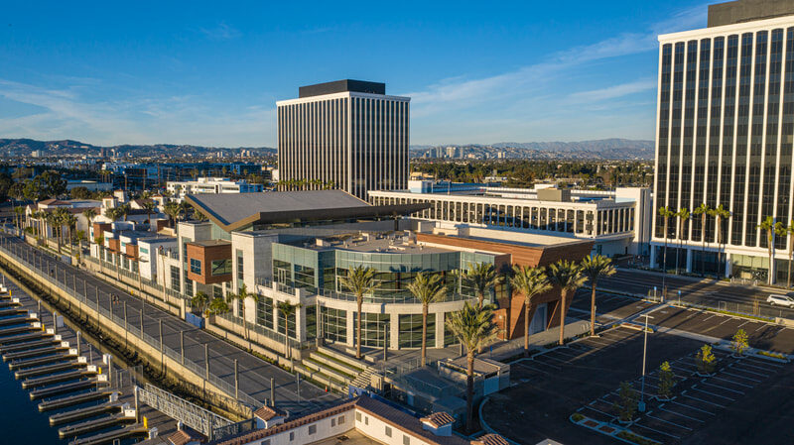
THE LOCATION
4655 ADMIRALTY WAY
The clinic and the club take the second floor of the curved glass building at the head of the basin, with a private terrace over the water.
Suite 210
4655 Admiralty Way, Marina del Rey, California
4,925 SF
Programmed, measured to wall centreline
Private terrace
Wraparound over the main channel, demised to the suite
4655 Admiralty Way, on the main channel
L&K WELLNESS · PRIVATE INVESTMENT BRIEF · CONFIDENTIAL
10

Slide 11
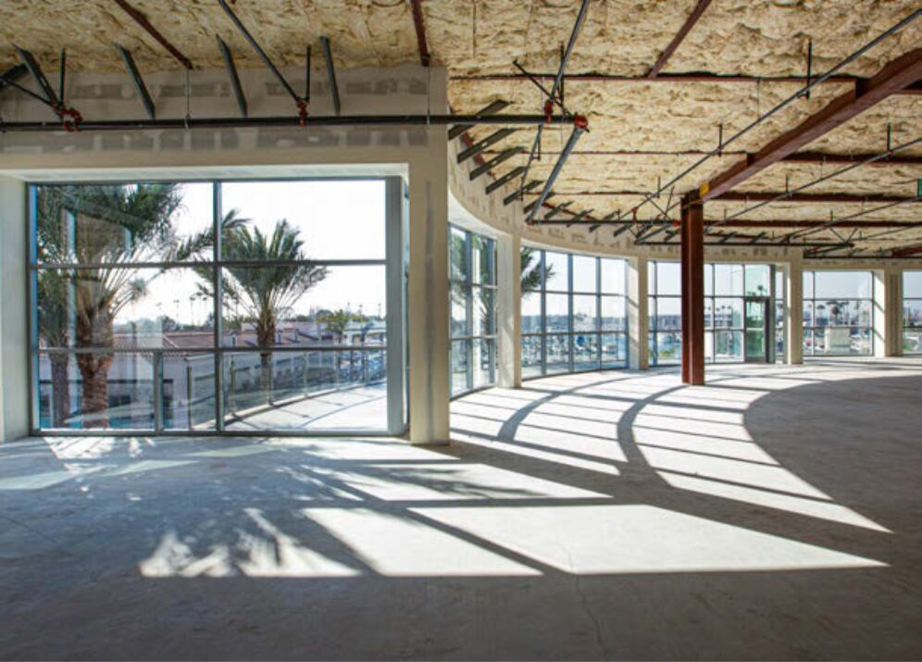
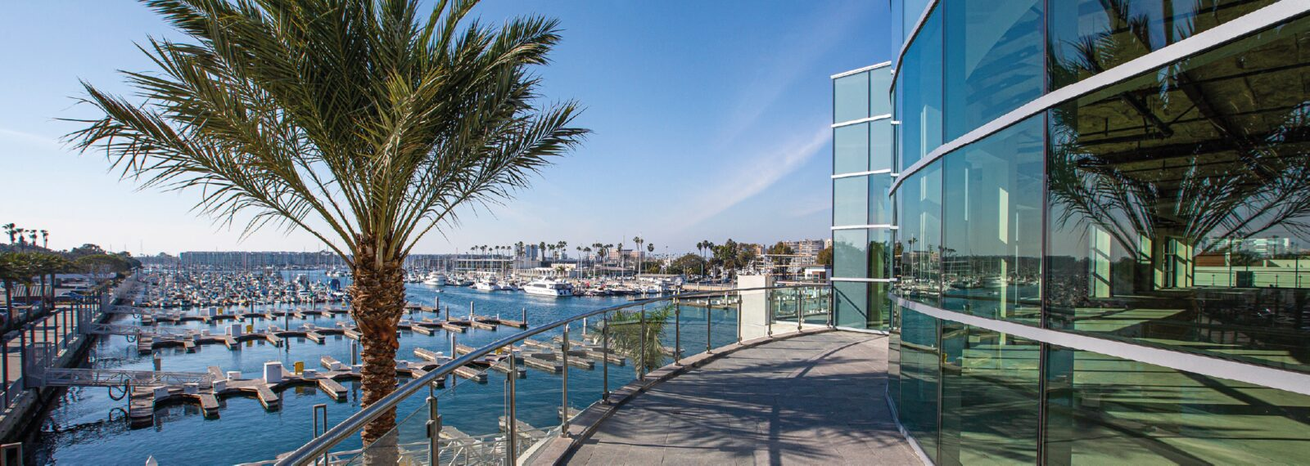
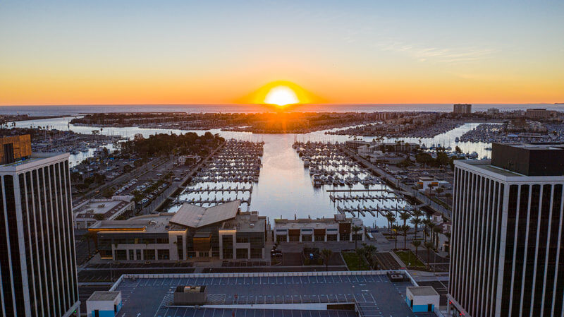
THE LOCATION
THE SPACE TODAY
The suite as it stands: a cold shell behind floor-to-ceiling glass. Everything in the buildout line of the use of funds is what turns this into the facility.
The suite’s terrace, over the marina
Suite 210 today, before buildout
Marina del Rey
L&K WELLNESS · PRIVATE INVESTMENT BRIEF · CONFIDENTIAL
11

Slide 12
THE FACILITY
4,925 SF IN MARINA DEL REY
Full contrast suite, owned equipment, the facility the brand deserves.
4,925 SF
Suite 210
Private terrace
Programmed, measured to wall centreline
4655 Admiralty Way, Marina del Rey, California
Wraparound, over the main channel
SPACE | SF
Arrival, concierge, retail | 350
The Lounge | 700
Contrast suite (2 saunas, 2 plunges) | 250
Aescape | 120
Ammortal chamber | 90
Hyperbaric room (seated) | 120
Red light beds (2) | 150
IV and regenerative lounge (8 chairs) | 375
Treatment rooms (3) | 300
SPACE | SF
Diagnostics and consult (2) | 250
Diagnostic imaging (GE iDXA densitometer) | 125
Locker, shower, changing, bathrooms | 550
Admin offices (2) | 200
Kitchen and breakroom | 200
Storage | 150
MEP | 75
Biohazard and linen closets | 30
Circulation and grossing factor | 890
L&K WELLNESS · PRIVATE INVESTMENT BRIEF · CONFIDENTIAL
12

Slide 13
THE FACILITY
STATIONS AND EQUIPMENT
What sits in the 4,925 square feet, and how it is paid for.
STATION | COUNT
Treatment rooms | 3
IV / regenerative chairs | 8
Saunas | 2
Cold plunges | 2
Aescape robotic massage | 1
Ammortal chambers | 1
STATION | COUNT
Hyperbaric chambers | 1
Redlight rooms | 2
Diagnostic / consult rooms | 2
DEXA scan room | 1
Recovery stations | 4
EQUIPMENT STRATEGY
Purchased where payback justifies it. Wet areas drive cost: plunges, saunas and steam carry a materially higher per-SF buildout than a dry medspa, which is why the lean case trims the contrast suite before it trims treatment rooms.
L&K WELLNESS · PRIVATE INVESTMENT BRIEF · CONFIDENTIAL
13

Slide 14
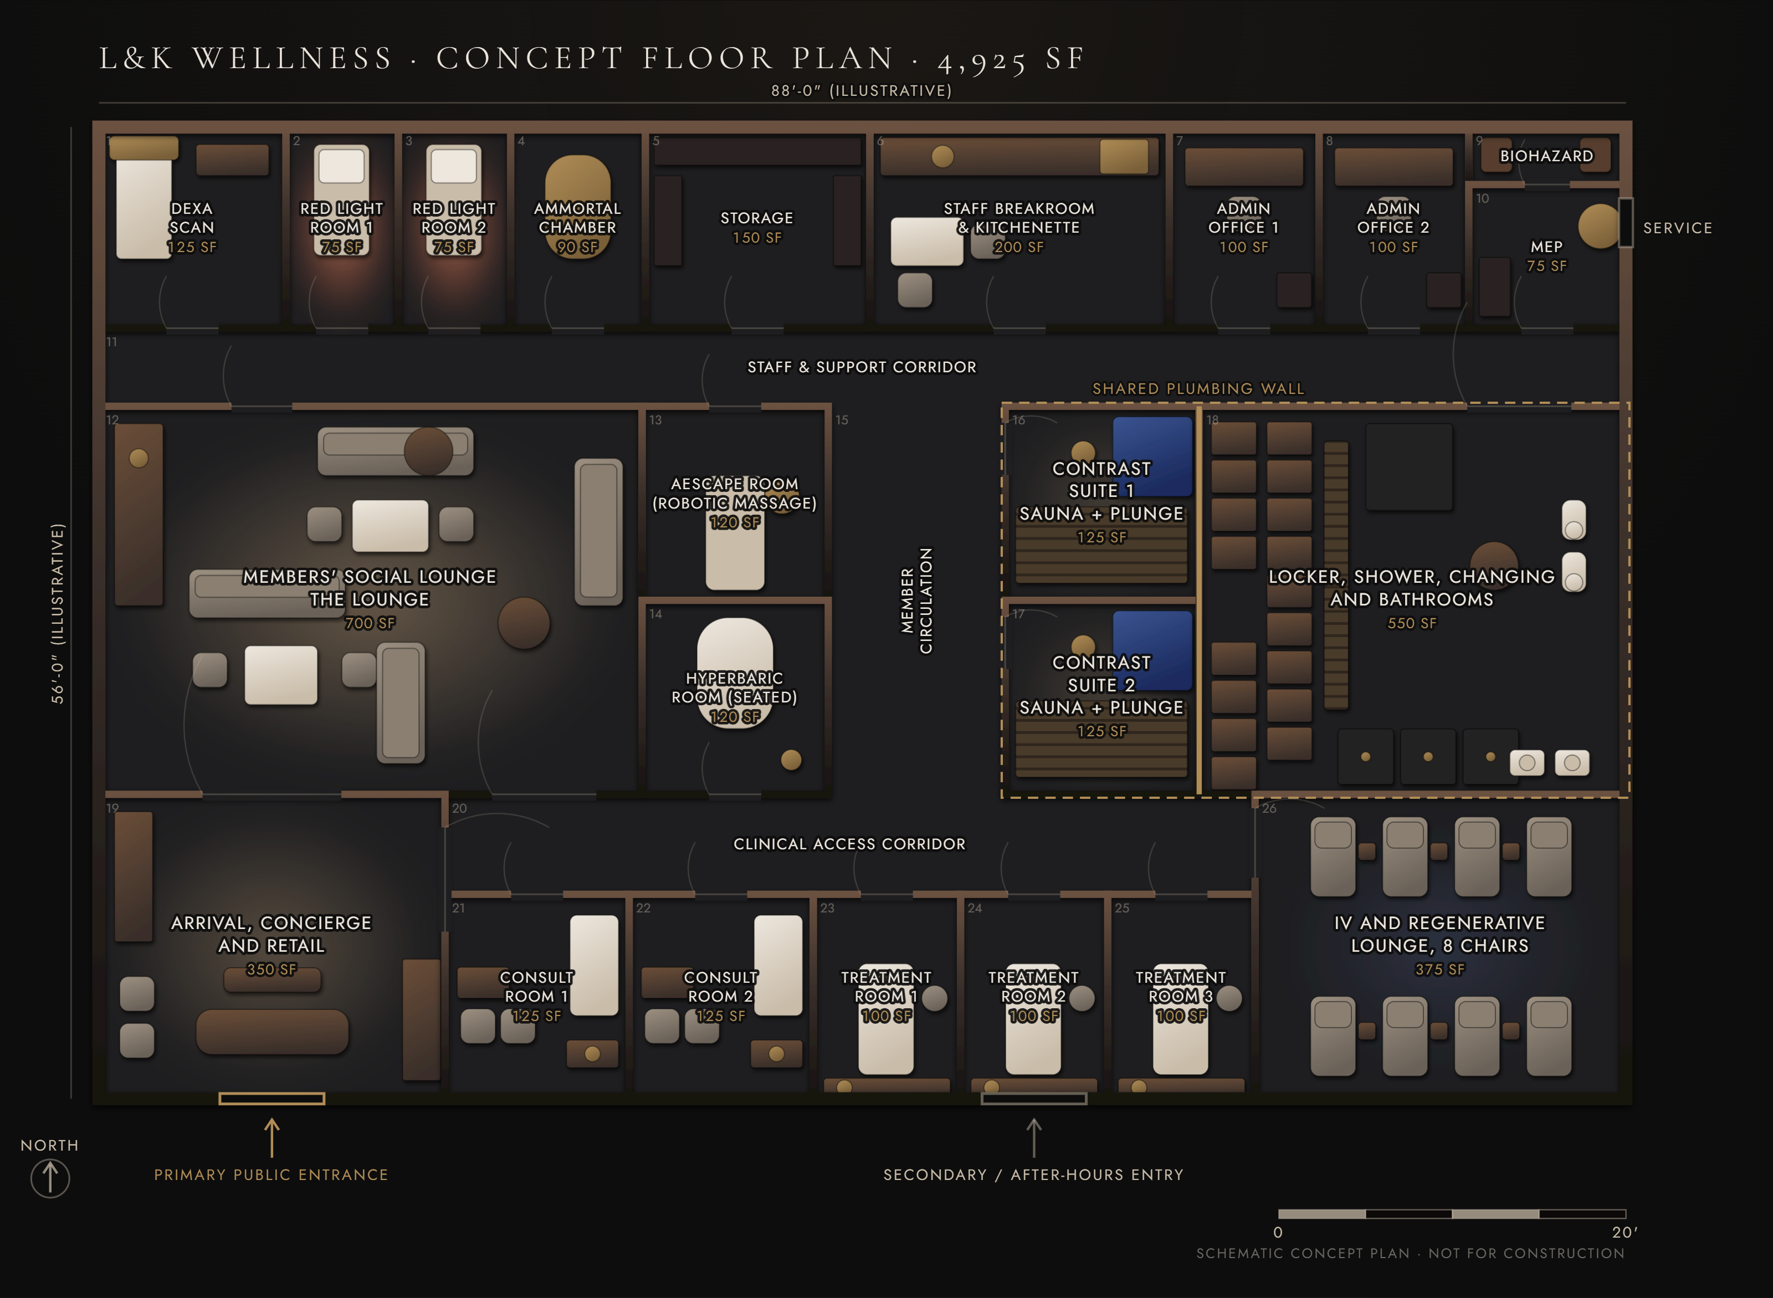
FLOOR PLAN
4,925 SF, DRAWN TO PROGRAM
Drawn to program. The test fit against Suite 210 follows in design.
Every room is drawn to its true programmed area and the adjacencies are the ones the operation actually requires, but the outline is illustrative. The program reflows to an L, a rectangle, a corner unit or a split level. What does not flex is the wet block, the total area, and a clean separation between the public clinic and the members’ club. The architect produces the real test fit against the suite’s as-builts during design.
HARD TO RETROFIT
The wet block, 800 SF: two saunas, two cold plunges and steam on a single plumbing wall, sharing that wall with the locker room. It is the first question we ask about any space.
L&K WELLNESS · PRIVATE INVESTMENT BRIEF · CONFIDENTIAL
14

Slide 15
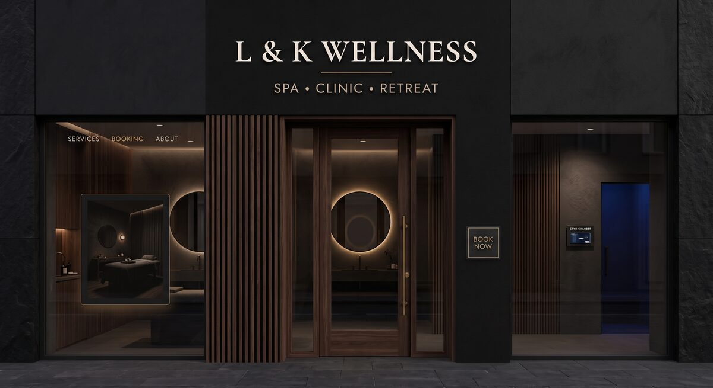

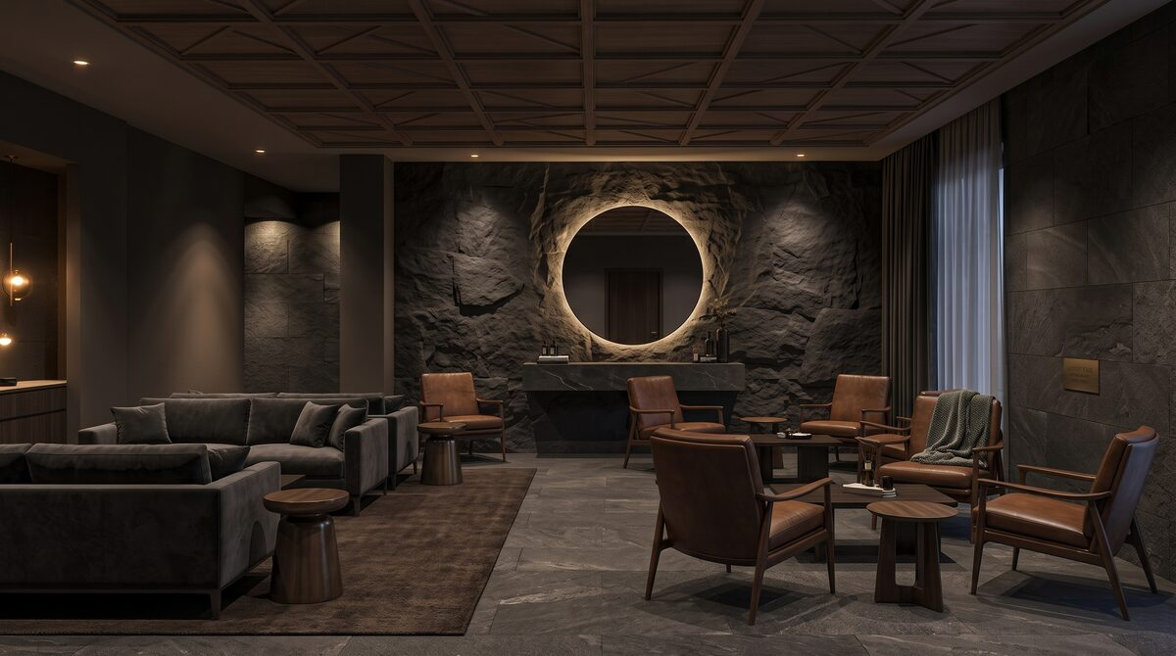
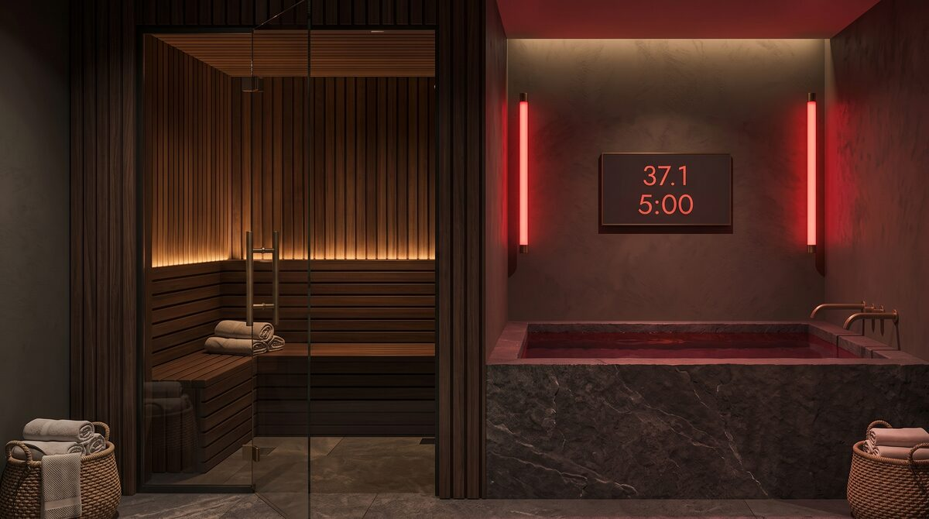
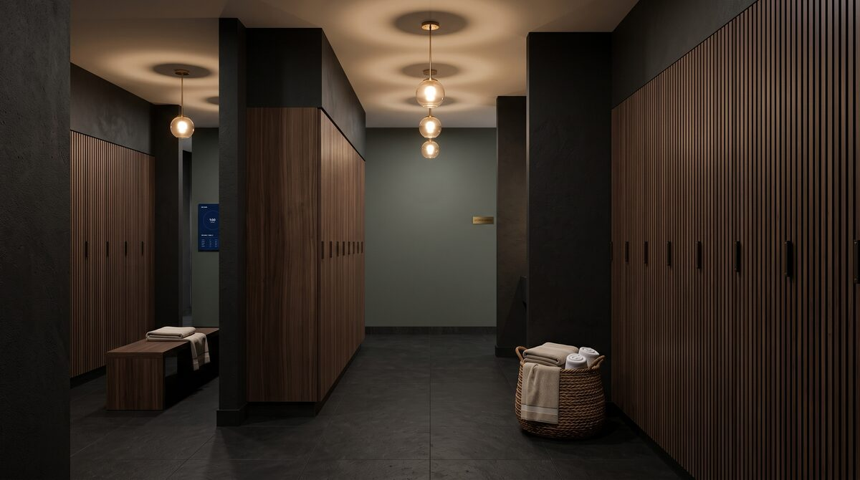
RENDERINGS
DESIGN DIRECTION (1 OF 2)
Storefront
Arrival, concierge and retail
Members' social lounge, The Lounge
Contrast suite, sauna and cold plunge
Locker, shower and changing
L&K WELLNESS · PRIVATE INVESTMENT BRIEF · CONFIDENTIAL
15

Slide 16
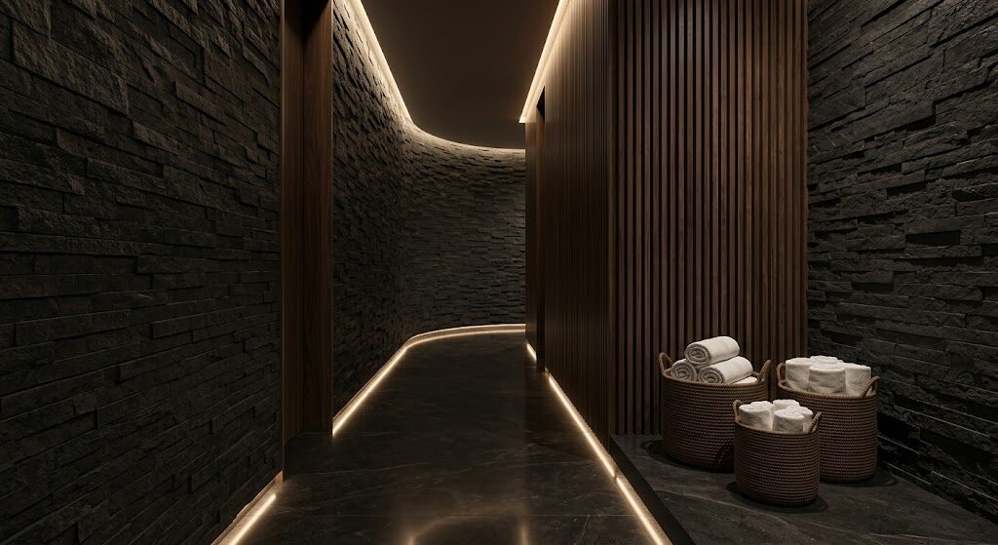
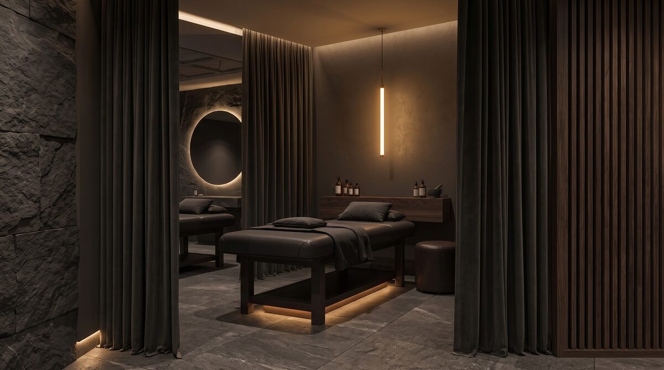
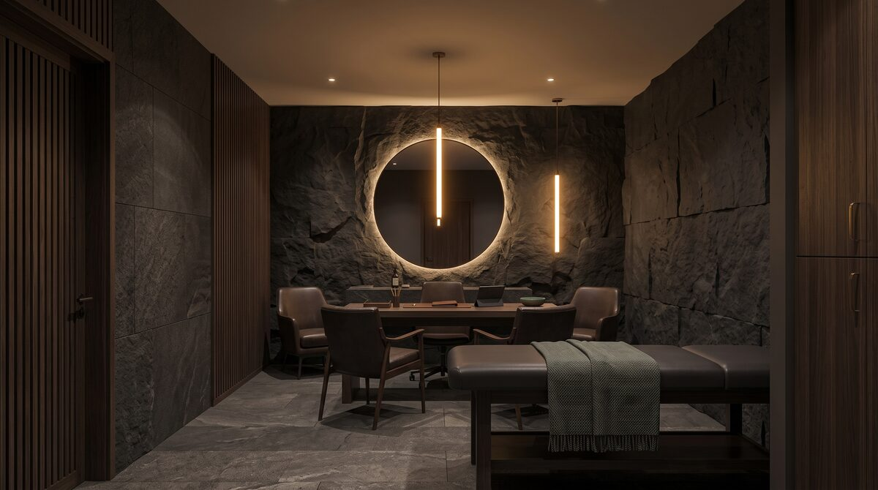
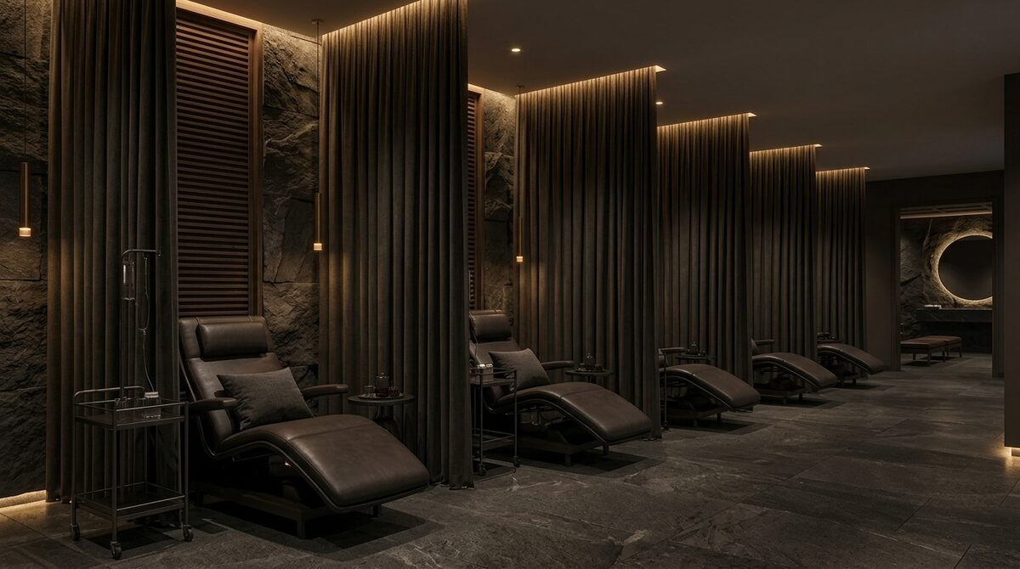
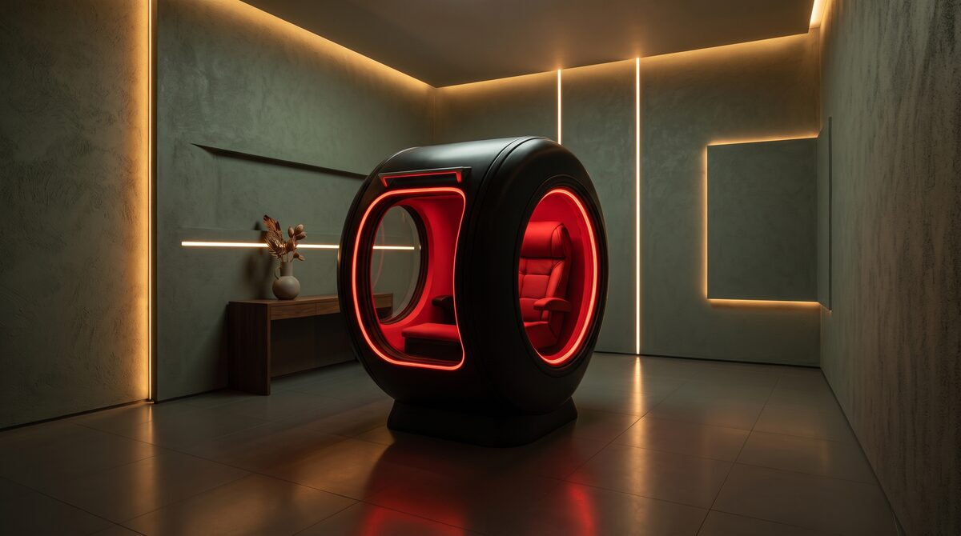
RENDERINGS
DESIGN DIRECTION (2 OF 2)
Member circulation
Treatment room
Consult room
IV and regenerative lounge
Hyperbaric room
L&K WELLNESS · PRIVATE INVESTMENT BRIEF · CONFIDENTIAL
16

Slide 17
CAPACITY
CAPACITY FOR WHAT IS SOLD
Built bottom-up from station hours, not assumed. The circuit bottleneck is the cold plunge, not the sauna; the clinical bottleneck is treatment rooms.
73%
83%
76%
Recovery circuit utilization
Treatment room utilization
Red light utilization
2,345 modeled visits against 3,192 practical capacity, leaving 847 visits of headroom.
419 procedures against 507 practical capacity, leaving 88 slots of headroom.
650 sessions against 851 on 2 beds.
Practical capacity applies a utilization ceiling to theoretical station hours, because demand concentrates at peak times and nothing runs flat out. Headroom is the growth the facility can absorb without further capital.
L&K WELLNESS · PRIVATE INVESTMENT BRIEF · CONFIDENTIAL
17

Slide 18
MARKET
A LARGE, FAST, CASH-PAY CATEGORY
Every figure carries its source. Anything we could not source was cut rather than estimated.
FIGURE | VALUE | SOURCE
Global wellness economy, 2024 | $6.8T | Global Wellness Institute
Global medical spa market, 2026 | $27.8B | Grand View Research
US medical spas, 2023 | 10,488 | Grand View Research
US consumers calling wellness a top or important priority | 82% | McKinsey
US concierge medicine market by 2034 | $19.4B | Cited in Patientfy longevity market map
US adults currently taking a GLP-1 | 1 in 8 | KFF
Longevity retreats market, 2026 | $11.1B | Research and Markets
L&K WELLNESS · PRIVATE INVESTMENT BRIEF · CONFIDENTIAL
18

Slide 19
MARKET
SILICON BEACH, AT ITS DENSEST
The facility sits in Marina del Rey, two miles west of Playa Vista and inside the same Westside corridor. Playa Vista is the master-planned innovation district on the old Hughes Aircraft site that became the centre of gravity for the Westside, with the Google, YouTube and Meta campuses within a walk of one another. LAX is four miles south and the studios fifteen minutes north.
$129,942
500+
~5,100
Playa Vista median household income
Technology companies in Silicon Beach
Employed at The Campus at Playa Vista
Against a Los Angeles County median well below it. This is a cash-pay market. (US Census Bureau, via Point2Homes)
The Westside tech corridor that Playa Vista sits at the center of. (Wikipedia, Silicon Beach)
Up from roughly 2,000 in 2015, a 150% increase. A dense, high-income daytime population inside walking distance. (Los Angeles Business Journal)
INSIDE A REALISTIC DRIVE TIME
Playa Vista · Marina del Rey · Culver City · Venice · Santa Monica · Playa del Rey · El Segundo · Westchester · Mar Vista · Manhattan Beach
L&K WELLNESS · PRIVATE INVESTMENT BRIEF · CONFIDENTIAL
19

Slide 20
UNIT ECONOMICS
30 LINES, ALL CASH-PAY (1 OF 2)
No insurance contracts, no payer mix, no receivables aging. Prices are exact, not banded.
SERVICE | CATEGORY | PRICE | MARGIN | SESSIONS/MO | GROSS/MO | AFTER MARGIN
Aescape Robotic Massage | Recovery | $70 | 82% | 200 | $14,000 | $11,480
Ammortal Chamber | Recovery | $140 | 82% | 120 | $16,800 | $13,776
Red Light Therapy | Recovery | $60 | 82% | 650 | $39,000 | $31,980
Hyperbaric Oxygen | Recovery | $200 | 80% | 50 | $10,000 | $8,000
Compression Therapy | Recovery | $45 | 82% | 225 | $10,125 | $8,303
PRP: Hair & Scalp | PRP | $995 | 72% | 33 | $32,835 | $23,641
PRP: Face & Aesthetic | PRP | $700 | 68% | 35 | $24,500 | $16,660
PRP: Scar & Skin Repair | PRP | $600 | 65% | 10 | $6,000 | $3,900
PRP: Soft Tissue | PRP | $1,000 | 65% | 25 | $25,000 | $16,250
PRP: Joint & Cartilage | PRP | $1,200 | 62% | 25 | $30,000 | $18,600
PRP: Post-procedure | PRP | $650 | 60% | 15 | $9,750 | $5,850
Basic Hydration | Regenerative | $99 | 68% | 71 | $7,029 | $4,780
Myers Cocktail | Regenerative | $199 | 56% | 34 | $6,766 | $3,789
Recovery / Hangover | Regenerative | $249 | 62% | 34 | $8,466 | $5,249
Immunity / High-Dose C | Regenerative | $289 | 61% | 25 | $7,225 | $4,407
Subtotal, continued overleaf |  |  | 71% | 1,552 | $247,496 | $176,665
L&K WELLNESS · PRIVATE INVESTMENT BRIEF · CONFIDENTIAL
20

Slide 21
UNIT ECONOMICS
30 LINES, ALL CASH-PAY (2 OF 2)
SERVICE | CATEGORY | PRICE | MARGIN | SESSIONS/MO | GROSS/MO | AFTER MARGIN
Beauty / Glutathione | Regenerative | $165 | 66% | 57 | $9,405 | $6,207
Athletic Performance | Regenerative | $249 | 65% | 40 | $9,960 | $6,474
NAD+ 100mg | Regenerative | $289 | 74% | 25 | $7,225 | $5,347
NAD+ 250mg | Regenerative | $350 | 76% | 33 | $11,550 | $8,778
NAD+ 500mg | Regenerative | $550 | 78% | 33 | $18,150 | $14,157
IM Shot: B12 / Lipo | Regenerative | $95 | 65% | 58 | $5,510 | $3,582
Therapeutic medications | Regenerative | $300 | 75% | 60 | $18,000 | $13,500
Botox (15-unit minimum) | Aesthetics | $240 | 70% | 80 | $19,200 | $13,440
Filler (0.5 ml) | Aesthetics | $850 | 65% | 56 | $47,600 | $30,940
RF Microneedling | Aesthetics | $1,000 | 75% | 50 | $50,000 | $37,500
Laser Platform | Aesthetics | $850 | 70% | 30 | $25,500 | $17,850
Advanced Biometrics | Diagnostics | $225 | 70% | 20 | $4,500 | $3,150
DNA Analysis | Diagnostics | $600 | 67% | 15 | $9,000 | $6,030
DUTCH Plus Test | Diagnostics | $750 | 65% | 20 | $15,000 | $9,750
DEXA Scan | Diagnostics | $95 | 77% | 95 | $9,025 | $6,949
Wellness delivery at list value |  |  | 71% | 672 | $259,625 | $183,654
L&K WELLNESS · PRIVATE INVESTMENT BRIEF · CONFIDENTIAL
21

Slide 22
REVENUE MODEL
MEMBERSHIP IS NOT ADDITIVE
The easy mistake is to stack membership fees on top of full a la carte revenue. Members draw down a credit bank against services that would otherwise be paid at list price, so redemption is netted out first.
BUILD | MONTHLY
Service delivery at list value | $507,121
less member credit redemption | -$129,500
less member and Friends discount | -$30,210
A la carte revenue | $347,411
plus membership fees | $230,000
plus day pass and access | $20,625
Total revenue per month | $598,036
Residents and Longevity members pay $207,500 a month and redeem $129,500 of service at retail. Redemption ratio 62.4%. If that exceeded 100% the credit bank would be underpriced; the model asserts it cannot.
L&K WELLNESS · PRIVATE INVESTMENT BRIEF · CONFIDENTIAL
22

Slide 23
RAMP
BREAKEVEN AT MONTH 10
Months one through six are construction and founding presales. There is no debt service at any point, so operating income is what the business keeps.
$224,801 / mo
$-80,500 / mo
M6
M12
M18
M24
M30
M36
Cash trough -$42,467 at month 9, against a $1,105,800 working capital reserve funded inside use of funds.
L&K WELLNESS · PRIVATE INVESTMENT BRIEF · CONFIDENTIAL
23

Slide 24
STABILIZED P&L
STABILIZED P&L, PROJECTED
LINE | MONTHLY | % OF REVENUE
Total revenue | $598,036 | 100%
Cost of services delivered | -$146,803 | 25%
Circuit consumables | -$18,760 | 3%
Net after COGS | $432,473 | 72%
Rent (4,925 SF NNN) | -$27,088 | 5%
Clinical and club staff | -$85,920 | 14%
Admin and management | -$18,500 | 3%
Marketing and member acquisition | -$30,000 | 5%
Malpractice and liability | -$12,000 | 2%
Equipment leases | -$16,555 | 3%
Utilities, software, member platform | -$16,000 | 3%
Licensing and compliance | -$1,610 | 0%
Total fixed overhead | -$207,673 | 35%
Operating income | $224,801 | 38%
L&K WELLNESS · PRIVATE INVESTMENT BRIEF · CONFIDENTIAL
24

Slide 25
SENSITIVITY
HOW WRONG CAN WE AFFORD TO BE?
Volume flexed against the base case with fixed overhead held constant, which is the conservative treatment.
LOW
BASE CASE
UPSIDE
$1.24M / yr
$2.70M / yr
$4.15M / yr
Slow member ramp, 72% of base volume
Stated assumptions at stabilization
Waitlist demand, 128% of base volume
Revenue / mo
$430,586
Revenue / mo
$598,036
Revenue / mo
$765,486
Net after COGS
$311,381
Net after COGS
$432,473
Net after COGS
$553,566
Operating / mo
$103,708
Operating / mo
$224,801
Operating / mo
$345,893
Yield on equity
26.2%
Yield on equity
56.8%
Yield on equity
87.4%
L&K WELLNESS · PRIVATE INVESTMENT BRIEF · CONFIDENTIAL
25

Slide 26
THE ASK
$4.75M FOR 30%, RATCHETED
$4,750,000
30%
$11,083,333
$15,833,333
Total raise, all equity
Starting stake
Pre-money valuation
Post-money valuation
The whole project is funded with equity, so no lender sits ahead of the investor. The stake starts at 30% and ratchets toward 40% if trailing operating income at stabilization comes in under $2.2M, set out overleaf. At base case the round prices at 5.87x operating income, inside the published range for a single location under a strong operator. Indicative terms, subject to definitive documents.
USE OF FUNDS
USE OF FUNDS | AMOUNT | % OF PROJECT
Buildout and tenant improvements (4,925 SF @ $250/SF) | $1,231,250 | 26%
Wet areas: 2 saunas, 2 plunges, steam, drainage, ventilation | $465,000 | 10%
Medical and aesthetic equipment (purchased) | $780,000 | 16%
Recovery technology: HBOT purchased, Ammortal deposit | $165,950 | 3%
GE iDXA bone densitometer, purchased | $25,000 | 1%
FF&E, lounge, millwork, retail | $430,000 | 9%
Pre-opening: licensing, legal, insurance, hiring | $310,000 | 7%
Brand, launch, founding member campaign | $237,000 | 5%
Working capital reserve | $1,105,800 | 23%
Total project cost | $4,750,000 | 100%
L&K WELLNESS · PRIVATE INVESTMENT BRIEF · CONFIDENTIAL
26

Slide 27
STRUCTURE
ALIGNED DOWNSIDE PROTECTION
The stake is priced against delivery. If the business underperforms, the investor owns more of it.
Investors start at 30%, priced against base-case stabilized operating income of $2.70M a year.
If trailing twelve-month operating income at stabilization lands below $2,200,000, ownership steps up on a straight line toward a hard cap of 40%, reached at the low case of $1,244,500.
At or above base case the investor stays at 30% and the founder keeps the upside. The ratchet only moves one way.
SCENARIO | OPERATING INCOME /YR | INVESTOR OWNERSHIP | INVESTOR CASH /YR | FOUNDER RETAINED /YR
Low case | $1,244,500 | 40% | $497,800 | $746,700
Base case | $2,697,611 | 30% | $809,283 | $1,888,328
Upside case | $4,150,722 | 30% | $1,245,217 | $2,905,505
In valuation terms the ratchet is exactly a halving of the pre-money, $11,083,333 to $7,125,000. It cushions the downside without making the investor whole: at the low case 40% of $1.24M is $497,800, still below the $809,283 that 30% of base case pays. Indicative terms, subject to definitive documents.
L&K WELLNESS · PRIVATE INVESTMENT BRIEF · CONFIDENTIAL
27

Slide 28
CAPITAL AND RETURNS
FUNDED ENTIRELY WITH EQUITY
CAPITAL STRUCTURE | VALUE
Total project cost | $4,750,000
Senior debt | None
Starting stake | 30%
Pre-money valuation | $11,083,333
Post-money valuation | $15,833,333
Entry multiple, base case | 5.87x operating income
Working capital reserve | $1,105,800
Modeled cash trough | $42,467 at month 9
Equity payback | month 37, extrapolated
CASE | INVESTOR CASH /YR | YIELD | AFTER RESERVE
Low | $497,800 | 10.5% | 7.9%
Base | $809,283 | 17.0% | 12.8%
Upside | $1,245,217 | 26.2% | 19.7%
Founder and operator retains 70% at base case, $1,888,328 a year, and 60% if the ratchet reaches its cap.
Yield is the investor share of operating income against the $4.75M invested, assuming it is distributed in full. After reserve holds back 25% of operating income as retained cash for the second location, which is what the pro-rata page depends on. Both are before tax and before maintenance capital.
Cumulative cash across the modelled 36 months is $4,589,439, including the $540,000 of founding-member prepayments collected during construction. No internal rate of return is projected here: the paths by which an investor realises value, and the published multiples the strategic case rests on, are set out two pages on. Every figure on this page is indicative and subject to definitive documents.
L&K WELLNESS · PRIVATE INVESTMENT BRIEF · CONFIDENTIAL
28

Slide 29
FOLLOW-ON RIGHTS
INVESTING BEYOND LOCATION ONE
Marina del Rey is the first building, and the terms treat it that way.
Location 1 is the proof of concept. It has to open, fill and stabilize before anything else is contemplated, and every figure in this brief describes that one building.
Round 1 investors receive pro-rata rights, not obligations, to invest in future locations at the same or improved terms, in proportion to their original stake. A 30% holder can maintain 30% of the platform without being required to.
Future locations target comparable high-income coastal and Westside markets, and only once Location 1 reaches stabilization.
The 25% expansion reserve on the capital page is what funds that optionality out of operating cash rather than out of a second raise. An investor who would rather take the cash can read the full-distribution column instead; the two are shown side by side because this is the actual trade.
No location beyond Marina del Rey exists today. Pro-rata rights are a mechanism, not a pipeline, and are indicative terms subject to definitive documents.
L&K WELLNESS · PRIVATE INVESTMENT BRIEF · CONFIDENTIAL
29

Slide 30
EXIT
HOW INVESTORS REALIZE VALUE
Three paths, in the order they are most likely to matter.
PATH | HOW IT WORKS
Buyback | The company holds a right, not an obligation, to repurchase investor equity in a defined window in years 3 to 5, priced off a formula tied to trailing twelve-month operating income at a multiple agreed in the definitive documents.
Right of first refusal | If a third-party offer for the business is received, existing investors get the first right to match it before any outside sale proceeds.
Strategic sale | The primary long-term path. Multi-location platforms trade at materially higher multiples than single-location assets, so the value of building a second and third location is realised at exit rather than only in operating cash.
PUBLISHED EBITDA MULTIPLES | RANGE
Single location, owner is primary provider | 3.5x to 5.0x
Single location, strong operator with SOPs | 5.0x to 6.5x
Multi-location, two or more with management | 6.0x to 7.5x
Multi-location, provider bench and recurring revenue | 7.0x to 9.0x
Membership revenue premium | +0.5x to 1.0x
L&K runs 41.9% of revenue from memberships and access, above the 30% to 40% band that source names as a premium driver.
Multiples: Breakwater M&A, 20 February 2026. https://www.breakwaterma.com/blog/medical-spa-valuation-multiples-2026 · Industry M&A comparables, not company projections. The entry price on this round is 5.87x base-case operating income, inside the single-location band above and below every multi-location band.
L&K WELLNESS · PRIVATE INVESTMENT BRIEF · CONFIDENTIAL
30

Slide 31
DISCLOSURES
FLAGGED BEFORE YOU ASK
Year 1 operating income is negative. Six of those months are construction and the rest are the opening ramp. There is no debt service to carry through it, and the $1,105,800 working capital reserve inside use of funds is sized against a modeled cash trough of $42,467 at month 9.
The reserve is deliberately larger than the trough it covers, 26.0 times over. With no lender there is no mandated reserve and no covenant to cure, so the cushion is a choice: it funds a materially slower ramp than the one modeled without a second raise. It is idle cash and we are naming it rather than leaving it to be found.
The ratchet cushions the downside without making the investor whole. At the low case 40% of $1.24M pays $497,800, which is still less than the $809,283 that 30% of base case pays. Every ownership percentage, valuation and buyback term in this brief is indicative and subject to definitive documents.
The multi-location expansion and platform exit thesis represent optionality this structure creates, not a guaranteed roadmap. No location beyond Marina del Rey currently exists, and all forward-looking multiples are sourced from industry M&A comparables, not company-specific projections.
Volume is flexed to 72% of base in the low case and the business still produces $1.24M of annual operating income, with fixed overhead held constant. That is the conservative treatment: in a genuine downside you would cut staff before you cut the lease.
All forward-looking figures are projections on the stated assumptions and are not guarantees. Market and demographic figures carry their sources; anything unsourced was cut rather than estimated.
L&K WELLNESS · PRIVATE INVESTMENT BRIEF · CONFIDENTIAL
31

Slide 32
TIMELINE
FROM SIGNATURE TO STABILIZATION
MONTH 0 TO 3
MONTH 3 TO 6
MONTH 7
MONTH 8 TO 14
MONTH 15 TO 36
Close and design
Build
Open
Fill
Stabilize
Funds close, lease executed, architect and contractor engaged, permits filed. Founding member campaign opens.
Buildout, wet-area rough-in, equipment ordered. Medical director and injector recruited and credentialed.
Doors open to founding members first, public booking the same week. Clinic and club launch together.
Membership ramp, events programming, referral engine from the open clinic. Operating breakeven lands here.
Caps approached on Resident and Longevity. Waitlist opens.
L&K WELLNESS · PRIVATE INVESTMENT BRIEF · CONFIDENTIAL
32

Slide 33
MEET THE TEAM
MEET THE FOUNDERS
L&K Wellness is led by two co-founders.
HEALTHCARE ADMINISTRATION AND DEVELOPMENT
BRAND, CAPITAL AND MEMBERSHIP GROWTH
Co-founder
Co-founder
One has spent over 14 years in executive leadership of a Joint Commission-accredited, multispecialty outpatient surgery center and medical clinic in Los Angeles. Roles included overseeing operations, finance, and practice management and development, as well as administration for a team of board-certified surgeons across orthopedics, spine, pain management, plastic surgery, and general surgery. That healthcare administration and development background brings licensed-facility discipline to the longevity club model.
The other founder is a former professional athlete turned film producer, with deep experience in capital raising and marketing, along with strong connections within LA’s entertainment and fitness community. This background will be essential in driving the club’s brand and membership growth.
Ownership operates an existing surgical practice in Culver City, so this is not a first venture.
L&K WELLNESS · PRIVATE INVESTMENT BRIEF · CONFIDENTIAL
33

Slide 34
MEET THE TEAM
THE OPERATING TEAM IS IN PLACE
Clinical, aesthetic, longevity and hospitality leadership are all seated. No key role is open at opening.
SEAT | RESPONSIBILITY | STATUS
Founder & Operator | Operations, brand, capital, compliance | In place
Medical Director (MD/DO) | Clinical oversight, protocols, standing orders | In place
Aesthetics Injector (NP or PA) | Neuromodulators, filler, energy devices | In place
Longevity Clinical Lead | Therapeutic medications, GLP-1 and biomarker programs | In place
Club General Manager | Membership, events, hospitality, retention | In place
Registered Nurses (2) | IV therapy, regenerative, recovery floor | In place
MEDICAL LEADERSHIP
All care is physician-directed, led hands-on by board-certified specialists in pain management, sports medicine, orthopedics, and plastic surgery, supported by NPs and RNs. This clinical structure sets L&K apart from the medical spas and wellness centers already in overabundance across this healthcare sector.
L&K WELLNESS · PRIVATE INVESTMENT BRIEF · CONFIDENTIAL
34

Slide 35
RISKS
WHAT COULD GO WRONG
RISK | MITIGATION
Membership fills slower than modeled. | The clinic is open to non-members from day one, so revenue does not depend on the club filling. The low case flexes volume to 72% of base and still produces positive operating income.
Members redeem more than their fees cover. | Credit banks are sized against measured redemption and the model asserts the ratio stays below 100%. The three-month minimum with 30-day change notice makes repricing operationally possible.
A key clinical seat turns over during the ramp. | The asset is the facility, not any one clinician. The club layer, recovery floor and infusion suite run on materially less scarce staffing than the injectable and prescribing lines, so a temporary gap narrows the offering without closing the building. A licensed, equipped facility can credential a replacement. Clinical compensation carries retention terms through the ramp.
The ramp runs slower than modeled and the cash runs out. | This is the risk that replaces financing risk when there is no lender. There is no payment to miss and no covenant to breach, so the only hard constraint is cash. The reserve is sized against the modeled trough, the low case still produces positive operating income at stabilization, and founding presales land during construction rather than after opening.
A national brand opens nearby. | The defensible asset is the licensed facility, not the sauna. Adding injectables, infusions and physician oversight is not a product decision for a recovery studio: it means becoming a licensed medical facility, with the staffing, supervision, malpractice and accreditation that implies.
Wet-area construction overruns. | The highest-variance line in the buildout. The lean case exists precisely as the fallback scope, and the reserve is sized against the modeled cash trough rather than to a round number.
L&K WELLNESS · PRIVATE INVESTMENT BRIEF · CONFIDENTIAL
35

Slide 36
THANK YOU
Doors open to founding members first, public booking the same week. Clinic and club launch together.
$4.75M all equity · 30% starting stake · 4,925 SF · $224,801 a month at stabilization
Full model, capacity workbook and buildout detail available under NDA.
Laura@culvercitysurgical.com
This document is not an offer to sell or a solicitation of an offer to buy any security. Forward-looking figures are projections and not guarantees of future performance.
L&K WELLNESS · PRIVATE INVESTMENT BRIEF · CONFIDENTIAL
36

Slide 37
APPENDIX
HOW THESE NUMBERS WERE BUILT
Everything in this brief resolves to a stabilized P&L and a use-of-funds table. These pages itemise both, every overhead line into its components and every capital line into what it buys, and each build-up is checked at build time to sum to the total it explains. Fixed overhead totals $207,673 a month; rent is 4,925 SF at $5.50/SF/month NNN. The written methodology ships as ASSUMPTIONS.md and methodology.html.
CLINICAL AND CLUB STAFF, $85,920 A MONTH
ROLE | FTE | MONTHLY, LOADED
Officers (2 @ $150,000/yr) | 2.0 | $25,000
Medical Director (MD/DO) | 0.4 | $3,000
Aesthetics Injector (NP or PA): $85/hr | 1.0 | $13,600
Longevity Clinical Lead (NP or PA): $100/hr | 1.0 | $16,000
Registered Nurse (IV, regenerative, recovery): $55/hr | 1.0 | $8,800
LVN: $30/hr | 1.0 | $4,800
Medical assistant / technician: $25/hr | 1.0 | $4,000
Administrator: $45/hr | 1.0 | $7,200
Front desk / concierge: $22/hr | 1.0 | $3,520
Total |  | $85,920
L&K WELLNESS · PRIVATE INVESTMENT BRIEF · CONFIDENTIAL
37

Slide 38
APPENDIX · FIXED OVERHEAD
THE OTHER OVERHEAD LINES
EQUIPMENT LEASES
ADMIN AND MANAGEMENT
MARKETING AND MEMBER ACQUISITION
COMPONENT | MONTHLY
Ammortal chamber (1 unit) financed | 3000
Aescape robotic massage (1 unit) subscription | 5000
Second red light bed financed | 1375
Other leased equipment | 3000
Balance of clinical equipment financed (~$190,000 @ 2.2%/mo) | 4180
Total | $16,555
COMPONENT | MONTHLY
Bookkeeping and accounting | 4000
Legal and compliance retainer | 1500
IT and managed services | 2500
Business insurance (GL, property, cyber) | 1000
Merchant processing and banking | 9500
Total | $18,500
COMPONENT | MONTHLY
Paid digital and social | 12000
Content, photography, video | 4000
Events and community programming | 5000
Agency / fractional marketing lead | 6000
Referral and partnership incentives | 3000
Total | $30,000
MALPRACTICE AND LIABILITY
UTILITIES, SOFTWARE, MEMBER PLATFORM
LICENSING AND COMPLIANCE
COMPONENT | MONTHLY
Medical Director policy | 3500
Aesthetics injector policy | 3000
Longevity clinical lead policy | 2500
Nursing coverage | 1500
Entity policy and umbrella | 1500
Total | $12,000
COMPONENT | MONTHLY
Utilities (electric, gas, water) | 7000
Member platform and booking | 2500
EMR / charting | 2000
Phone, internet, security monitoring | 1500
Laundry and linen service | 2000
Music, AV, miscellaneous systems | 1000
Total | $16,000
COMPONENT | MONTHLY
Business licenses and permits | 1600
CLIA waiver / lab (bi-annual, amortised) | 10
Total | $1,610
L&K WELLNESS · PRIVATE INVESTMENT BRIEF · CONFIDENTIAL
38

Slide 39
APPENDIX · COST OF GOODS
WHAT THE MARGINS PAY FOR
Cost of goods runs $165,563 a month against $598,036 of revenue, a blended 72.3% margin. Circuit consumables are carried separately at $8 a visit across 2,345 monthly visits, or $18,760.
CATEGORY | MARGIN | WHAT THE COST SIDE IS
Recovery | 80–82% | Consumables, filters and water treatment, linens, device servicing contracts. Almost no per-session variable cost, which is why these margins are the highest in the building.
PRP | 60–72% | Draw kits, separation tubes and centrifuge consumables, needles and sharps, topical anaesthetic. Cost per case is close to fixed, so the margin spread across the six lines is a pricing decision rather than a cost one.
Regenerative | 56–78% | IV bags and tubing, vitamins, glutathione and NAD+ compound, pharmacy cost on prescribed therapeutics. The widest band in the book: NAD+ carries the compound cost and the hydration drips carry almost none.
Aesthetics | 65–75% | Neuromodulator and filler units at acquisition cost, RF microneedling tips, laser consumables, topicals. Filler is the thinnest because product cost dominates a single syringe.
Diagnostics | 65–77% | Reference lab send-out fees, DEXA consumables, DNA and DUTCH collection kits, interpretation time. DEXA sits at the top because the scanner is owned and the marginal cost of a scan is small.
Surgery: facility fee | 78–80% | Disposables, implants, drugs and linens, instrument reprocessing. Clinical staff sits in fixed overhead and the surgeon takes no share of the facility fee, which is why these exceed the treatment-room lines.
Surgery: full fee | 73–76% | As above, plus graft handling and technician time on hair restoration and laser consumables on ablative resurfacing.
L&K WELLNESS · PRIVATE INVESTMENT BRIEF · CONFIDENTIAL
39

Slide 40
APPENDIX · SENSITIVITY
IF RENT IS WRONG, WHAT HAPPENS
Rent is the largest single assumption in the model and the easiest to check. Everything else is held constant.
RENT $/SF/MONTH NNN | MONTHLY RENT | OPERATING /MO | ANNUAL | YIELD ON EQUITY
$5.50 (modelled) | $27,088 | $224,801 | $2,697,611 | 56.8%
$6.00 | $29,550 | $222,338 | $2,668,061 | 56.2%
$6.50 | $32,013 | $219,876 | $2,638,511 | 55.5%
$7.00 | $34,475 | $217,413 | $2,608,961 | 54.9%
Yield is stabilized operating income against the equity raised, before tax and before any distribution. The modelled rate is the more aggressive of the figures shown; a broker letter or signed lease would replace this assumption with a fact.
L&K WELLNESS · PRIVATE INVESTMENT BRIEF · CONFIDENTIAL
40

Slide 41
APPENDIX · USE OF FUNDS
THE ITEMISED CAPITAL LINES
WET AREAS
RECOVERY TECHNOLOGY
COMPONENT | AMOUNT
Saunas (2), cedar, heaters, controls | 95000
Cold plunges (2), chillers, filtration | 70000
Steam room and generator | 45000
Waterproofing, drainage, floor slopes | 110000
Dedicated ventilation and dehumidification | 85000
Tile, benching, finishes | 60000
Total | $465,000
COMPONENT | AMOUNT
Hyperbaric oxygen chamber, purchased | 150000
Ammortal chamber ($159,500 list), 10% finance deposit | 15950
Aescape robotic massage (1 unit), subscription only | 0
Total | $165,950
L&K WELLNESS · PRIVATE INVESTMENT BRIEF · CONFIDENTIAL
41

Slide 42
APPENDIX · USE OF FUNDS
WHAT EACH CAPITAL LINE COVERS
LINE | AMOUNT | BASIS
Buildout and tenant improvements (4,925 SF @ $250/SF) | $1,231,250 | Square footage × $250/SF for clinic and club space.
Wet areas: 2 saunas, 2 plunges, steam, drainage… | $465,000 | Itemised below. Wet construction is the highest-variance line in the whole buildout: waterproofing failures and ventilation rework are the classic overrun.
Medical and aesthetic equipment (purchased) | $780,000 | Purchased portion of the medical and aesthetic package. Excludes bone densitometry, which is itemised on its own line below.
Recovery technology: HBOT purchased, Ammortal deposit | $165,950 | Only the hyperbaric chamber is bought outright. The Ammortal chamber is financed, so the capital cost is the deposit alone.
GE iDXA bone densitometer, purchased | $25,000 | A GE Lunar iDXA bone densitometer, bought outright rather than leased, plus the 125 SF room it occupies.
FF&E, lounge, millwork, retail | $430,000 | Furniture, lounge fit-out, millwork and retail fixtures.
Pre-opening: licensing, legal, insurance, hiring | $310,000 | Licensing, legal, insurance binders, recruiting and pre-opening payroll.
Brand, launch, founding member campaign | $237,000 | Identity, site, photography, launch campaign and the founding member drive.
Working capital reserve | $1,105,800 | Sized against the modelled cash trough, not set to a round number.
Total project cost | $4,750,000
L&K WELLNESS · PRIVATE INVESTMENT BRIEF · CONFIDENTIAL
42

Slide 43
APPENDIX · PROVENANCE
WHAT RESTS ON JUDGMENT (1 OF 3)
Each figure below is an estimate, an inherited assumption or a single vendor quote.
RENT (4,925 SF NNN)
This is the most exposed number in the model. There is no broker letter, no comparable set and no listing behind it anywhere in the lineage. The prior Playa Vista model implied $6.77/SF, so $5.50 is the more aggressive figure. Sensitivity is shown at the end of this document.
EQUIPMENT LEASES
One Ammortal chamber, not two: $159,500 list including delivery, install and onboarding, a 10% deposit, and roughly $3,000 a month on vendor financing. Aescape cannot be purchased at all, and the single unit runs $5,000 a month on enterprise terms plus $10 for every completed massage, which is a variable cost already sitting inside that service line’s margin rather than here. The second red light bed is vendor-financed at $1,375 a month: red light runs 650 sessions a month on the current menu, which one bed cannot physically deliver.
ADMIN AND MANAGEMENT
Merchant processing is the largest component and scales with card revenue at roughly 2.6%. Everything else is a fixed vendor cost.
MARKETING AND MEMBER ACQUISITION
Weighted toward paid digital during the ramp and toward events and referral once the membership base exists. No blended CAC target is claimed, because none has been measured.
MALPRACTICE AND LIABILITY
Priced per credentialed provider plus an entity policy and umbrella. The surgical case adds facility coverage for an accredited operating room, which is the single largest driver of the difference.
L&K WELLNESS · PRIVATE INVESTMENT BRIEF · CONFIDENTIAL
43

Slide 44
APPENDIX · PROVENANCE
WHAT RESTS ON JUDGMENT (2 OF 3)
UTILITIES, SOFTWARE, MEMBER PLATFORM
Wet areas dominate the utility line: saunas, plunges and their dehumidification run continuously and are materially more energy intensive than a dry medspa of the same footprint.
LICENSING AND COMPLIANCE
Routine regulatory carrying cost. The surgical case adds accreditation maintenance and a standing quality and performance improvement programme, both of which the accrediting body requires between surveys.
BUILDOUT AND TENANT IMPROVEMENTS (4,925 SF @ $250/SF)
The prior Playa Vista model used $200–$300/SF for comparable clinic buildout, so $250 sits mid-range. It is not a contractor bid; a general contractor bid remains the most valuable document to obtain before closing.
MEDICAL AND AESTHETIC EQUIPMENT (PURCHASED)
Category ranges come from the prior Playa Vista line-item budget: IV and exam $80K–$150K, PRP processing $40K–$125K, aesthetic laser $150K–$400K, RF microneedling $80K–$180K, body contouring $100K–$275K, diagnostics $80K–$180K. That budget is an internal planning document, not vendor quotes. The diagnostics range above covers biometrics, phlebotomy and the lab interface only: the GE iDXA is named and priced separately so the two cannot be counted twice.
RECOVERY TECHNOLOGY: HBOT PURCHASED, AMMORTAL DEPOSIT
The single Ammortal chamber lists at $159,500 including delivery, install and onboarding, with $15,950 down and roughly $3,000 a month thereafter. Both the Ammortal payment and the Aescape subscription appear in the monthly equipment lease line rather than here, along with the red light beds.
L&K WELLNESS · PRIVATE INVESTMENT BRIEF · CONFIDENTIAL
44

Slide 45
APPENDIX · PROVENANCE
WHAT RESTS ON JUDGMENT (3 OF 3)
GE IDXA BONE DENSITOMETER, PURCHASED
Price supplied by the operator. It is well below new-unit list, so it assumes a refurbished or off-lease scanner: confirm the condition, the remaining tube life and whether a service contract is included before closing. The room it needs added 125 SF to the footprint, which carries $31,250 of buildout at $250/SF; both that and the scanner itself are funded from the working capital reserve, so the project cost is unchanged. Owning the scanner rather than referring out is what puts the DEXA service line at a 77% margin and lets it be priced as a $95 screening entry point.
FF&E, LOUNGE, MILLWORK, RETAIL
Hospitality-grade rather than clinical-grade, because the lounge is the product. Per square foot this is the line most exposed to taste and specification drift.
PRE-OPENING: LICENSING, LEGAL, INSURANCE, HIRING
The surgical case additionally carries the written transfer agreement with a nearby acute-care facility, which the accrediting body expects. It is priced inside this line rather than broken out.
BRAND, LAUNCH, FOUNDING MEMBER CAMPAIGN
Sized against the founding member target: the campaign has to convert enough pre-opening memberships to matter, and those proceeds are modelled as offsetting construction-period burn.
WORKING CAPITAL RESERVE
This is the one capital line that is computed rather than estimated. The model runs a 36-month cash curve and this reserve must exceed the deepest cumulative shortfall; a build assert fails if it does not. That is why the figure is not round.
L&K WELLNESS · PRIVATE INVESTMENT BRIEF · CONFIDENTIAL
45

