Slide 1
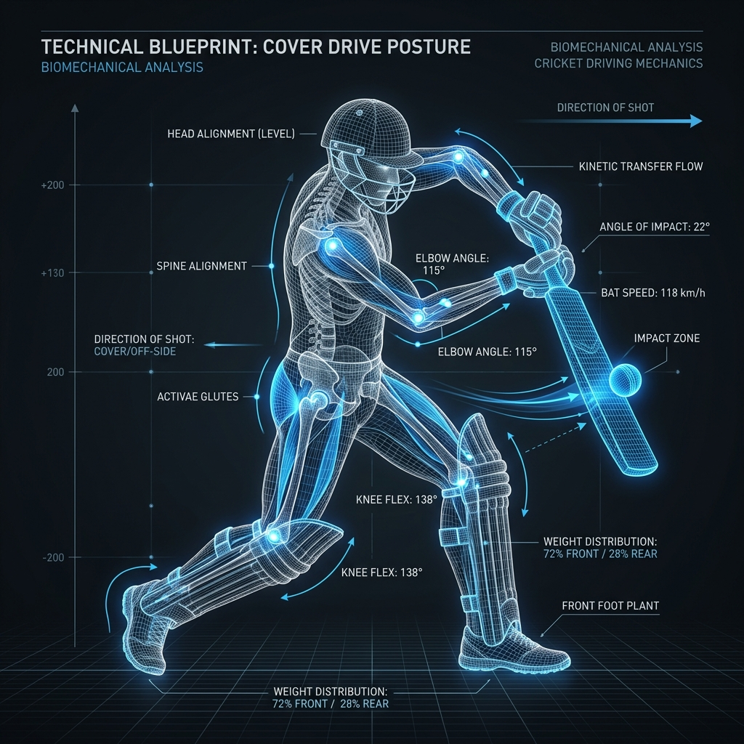
APEXFORMZ
AI form coaching that works wherever an athlete trains
A startup pitch for browser-based technique intelligence, real-time feedback, and habit-forming practice.
Pitch deck | July 2026
Notes:
[Sources]
Project README describes SmartCoach as an AI-powered sports training platform with real-time pose estimation.
Visual asset: apps/frontend/public/postures/cricket_cover_drive.png.

Slide 2
Technique coaching still happens too late for most athletes
Athletes practice far more often than they are observed by a trained coach. The result is delayed correction, uneven quality, and weak follow-through between formal sessions.
01
Access gap
02
Feedback gap
03
Adherence gap
Quality coaching is scarce, scheduled, and expensive for everyday athletes.
Most form errors are noticed after the rep, not at the moment they happen.
Progress is hard to sustain when practice does not feel measurable.
APEXFORMZ
02
Notes:
[Sources]
Problem framing inferred from implemented product capabilities: real-time analysis, feedback, saved sessions, XP, streaks, and social circles.
Primary repo references: README.md; apps/frontend/src/app/page.tsx; apps/backend/prisma/schema.prisma.

Slide 3
Apexformz turns a phone camera into a live form coach
The product converts ordinary video into coachable posture data, then returns concise corrections while the athlete is still moving.
01
Capture
02
Analyze
03
Coach
04
Retain
Browser AI reads pose, hand, and face landmarks on the athlete device.
A rules engine compares joint angles, phase timing, and kinetic sequence.
The app shows score, priority issues, and voice guidance without waiting for a trainer.
Sessions become progress, XP, streaks, achievements, and circle motivation.
APEXFORMZ
03
Notes:
[Sources]
Frontend training loop: apps/frontend/src/app/train/[sport]/page.tsx.
Pose capture: apps/frontend/src/hooks/useHolisticDetection.ts.
Voice coaching: apps/frontend/src/hooks/useVoiceCoaching.ts.
Backend session persistence: apps/backend/src/routes/sessions.ts.

Slide 4
The MVP already covers a multi-sport coaching surface
Apexformz is not a single-pose demo. The repository contains a multi-service product, sport-specific posture libraries, and dynamic movement definitions.
6
60
12
sports supported: cricket, tennis, yoga, running, boxing, and football
static pose blueprints for frame-by-frame form comparison
dynamic movement blueprints for multi-phase skill analysis
APEXFORMZ
04
Notes:
[Sources]
Counts computed from apps/ai-service/app/data/reference_poses.json and apps/ai-service/app/data/reference_movements.json.
Sport selection UI: apps/frontend/src/app/dashboard/page.tsx and apps/frontend/src/app/train/[sport]/setup/page.tsx.

Slide 5
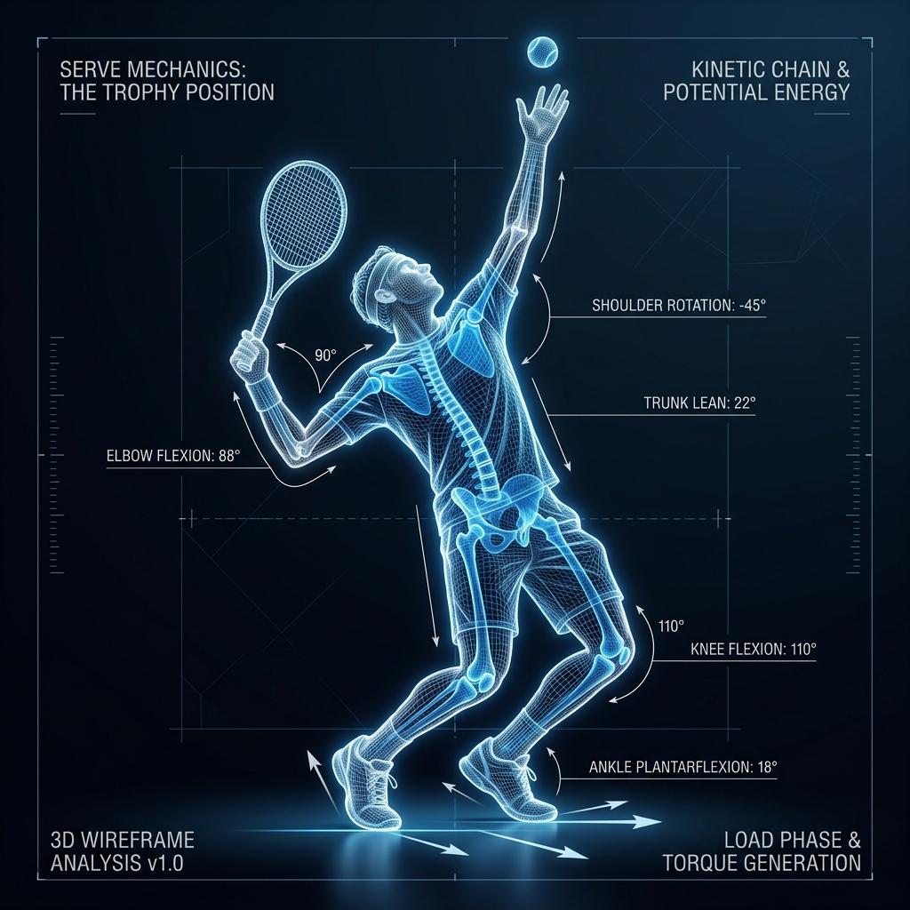
The athlete sees scored correction during the rep
The live training page combines camera view, skeleton overlay, score ring, high-priority corrections, target posture, and voice prompts into one coaching loop.
01
Prioritized issues
02
Voice cueing
Only medium and high severity corrections are surfaced to avoid overwhelming the athlete.
Speech guidance is throttled and sequential so the user hears one actionable fix at a time.
APEXFORMZ
05
Notes:
[Sources]
Live session UI: apps/frontend/src/app/train/[sport]/page.tsx.
Feedback UI: apps/frontend/src/components/ActionableFeedback.tsx.
Voice logic: apps/frontend/src/hooks/useVoiceCoaching.ts.
Visual asset: apps/frontend/public/postures/tennis_serve_trophy.png.

Slide 6
The architecture separates fast perception from coaching logic
Video frames stay local. The system streams abstract keypoints through a WebSocket relay to a dedicated AI service, then persists sessions and frame evidence for progress tracking.
Browser
Relay
AI service
Database
MediaPipe Holistic detects pose, hands, and face; frames are downscaled for speed.
>
Socket.IO authenticates sessions and forwards keypoints to the AI service.
>
FastAPI analyzers return score, severity, joint angles, and coaching issues.
>
PostgreSQL stores sessions, frames, XP, streaks, circles, and leaderboards.
APEXFORMZ
06
Notes:
[Sources]
Architecture summary: README.md and docker-compose.yml.
Browser perception: apps/frontend/src/hooks/useHolisticDetection.ts.
WebSocket relay: apps/backend/src/websocket/sessionRelay.ts.
AI service: apps/ai-service/main.py and apps/ai-service/app/routes/analysis.py.
Persistence model: apps/backend/prisma/schema.prisma.

Slide 7
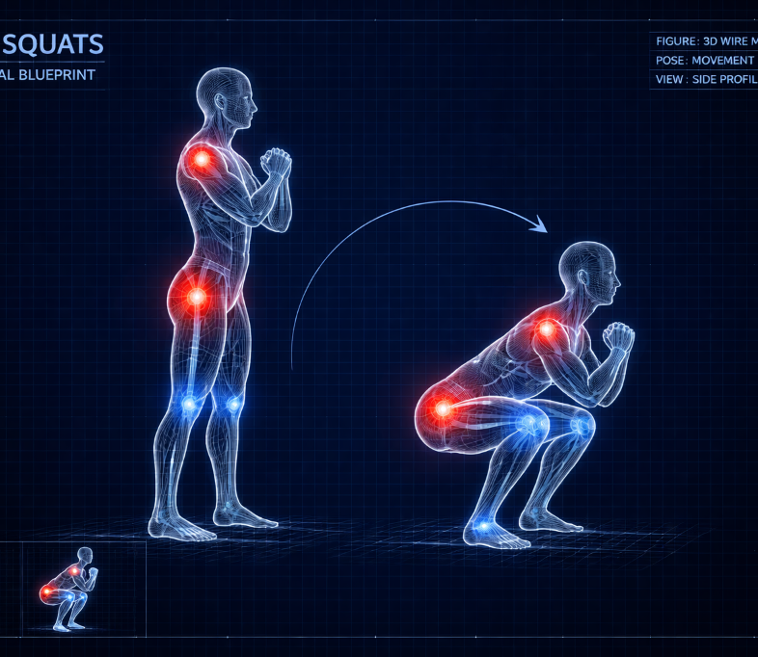
Dynamic analysis is the start of the moat
Static angle checks tell athletes what a position looks like. Dynamic analysis evaluates whether the movement sequence is actually being performed well.
01
Phase detection
02
Kinetic chain
03
Fluidity score
A finite-state machine tracks stance, load, impact, follow-through, or cycle stages.
The engine checks whether hips, shoulders, and arms fire in the expected order.
Motion smoothness is estimated from changing angular velocities over time.
This shifts Apexformz from pose matching toward sport-specific movement intelligence.
APEXFORMZ
07
Notes:
[Sources]
Dynamic analyzer: apps/ai-service/app/services/dynamic/dynamic_analyzer.py.
Phase detector: apps/ai-service/app/services/dynamic/phase_detector.py.
Kinetic chain validator: apps/ai-service/app/services/dynamic/kinetic_chain.py.
Visual asset: apps/frontend/public/postures/yoga_squats.png.

Slide 8
Apexformz turns practice into retained behavior
The product does not stop at correction. It uses progress mechanics and small-group accountability to make training measurable, repeatable, and social.
XP and levels
Achievements
Session duration and score convert into XP, levels, and visible progression.
Milestones reward first sessions, streaks, perfect scores, and volume.
Validated streaks
Training circles
Streaks count only when duration and sport-specific quality thresholds are met.
Shared streaks, health scores, roles, and nudges create peer accountability.
APEXFORMZ
08
Notes:
[Sources]
Gamification engine: apps/backend/src/utils/gamification.ts.
Enhanced streak logic: apps/backend/src/services/streak.service.ts.
Circle logic: apps/backend/src/services/circle.service.ts; apps/backend/src/routes/circles.ts.
Dashboard UI: apps/frontend/src/app/dashboard/page.tsx.

Slide 9
The wedge is coaching between formal sessions
Apexformz can enter where athletes already practice alone, then expand into coach-led programs once the data trail proves improvement.
Individual athletes
Academies and clubs
Wellness and fitness
Home practice for cricket, tennis, yoga, running, boxing, and football learners who need immediate form feedback.
Coach dashboards can convert session histories into between-practice assignments and measurable development plans.
Static poses, squats, planks, gait, and posture routines create an entry point outside competitive sport.
APEXFORMZ
09
Notes:
[Sources]
Customer wedge inferred from repository-supported sport coverage, posture library, saved sessions, and circle/social mechanics.
Repo references: apps/frontend/src/app/train/[sport]/setup/page.tsx; apps/backend/prisma/schema.prisma.

Slide 10
Revenue can scale from users to teams to infrastructure
The same coaching engine can support direct subscriptions, coach-managed deployments, and eventually biomechanics APIs or white-label integrations.
Athlete app
Academy toolkit
Motion intelligence API
Freemium onboarding, paid unlimited analysis, sport packs, and advanced training history.
Coach seats, team rosters, assigned drills, progress review, and circle-based accountability.
Scoring, pose blueprint, dynamic phase, and kinetic-chain services for partners.
B2C
B2B
Platform
APEXFORMZ
10
Notes:
[Sources]
Business model is a recommended pitch framing inferred from the implemented user app, session data model, circle model, and AI service architecture.
No external pricing or revenue claims are used.

Slide 11
APEXFORMZ
Product validation
Funding now turns the MVP into a defensible coaching platform
Run structured pilots with academies and committed individual athletes.
Technical depth
Hire computer-vision, biomechanics, and product engineering capacity.
Near-term capital should harden reliability, validate paid demand with pilots, and expand the movement intelligence library.
Data advantage
Build consented movement datasets and coach-reviewed scoring standards.
Commercial launch
Package athlete, academy, and partner offerings with clear retention metrics.
Seeking seed capital and pilot partners
Apexformz | AI technique coaching
Notes:
[Sources]
Roadmap and ask are pitch recommendations based on current MVP capabilities observed in the repository.
No funding amount, revenue, or user traction is asserted because the repository does not contain those metrics.

