Slide 1

Helping out @ Home

Slide 2
Motivation :
This is an Informative app for looking data and help connect people.

Slide 3
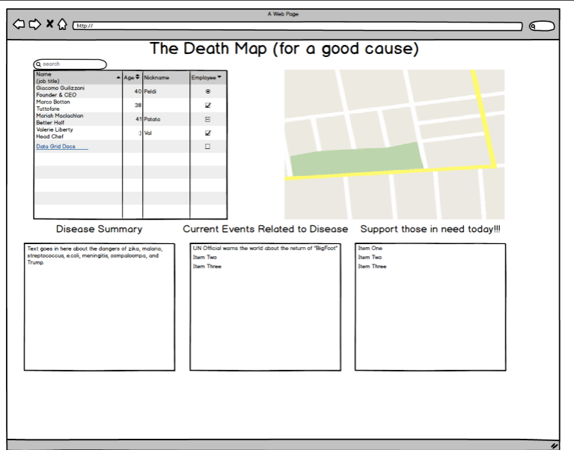
Mock Up Screen :

Slide 4
Technologies We Used :
APIs:
US Census
New York Times
Google Maps
FireBase
Bootstrap,
jQuery

Slide 5

Demo of Application :
Final screenshot of the application

Slide 6


Direction For Future Development:
We are here right now!

Slide 7
THANKS
ANY QUESTIONS?

