Slide 1
Company Manager
Location Manager
Location Manger
Fleet Manager
Driver
CarChip Connect Heirarchy
Prepared by: Jun Rebayno

Slide 2
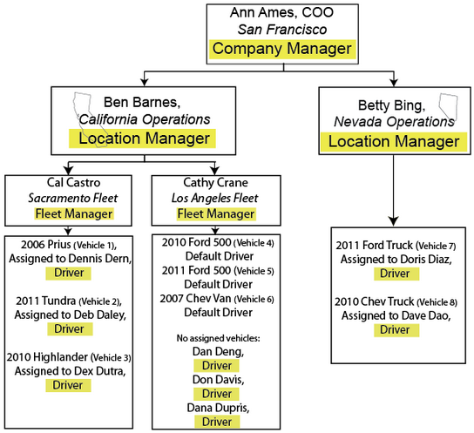
Company Manager
Location Manager
Location Manger
Fleet Manager
Driver
CarChip Connect Heirarchy

Slide 3
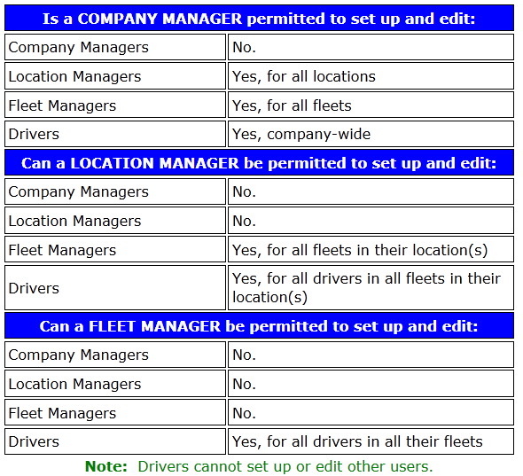
Company Manager
Location Manager
Location Manger
Fleet Manager
Driver
Roles and Permissions
The table below shows which users each type of manager can be permitted to set up and edit:

Slide 4


CarChip Connect Hierarchy
Contact Person
Mr. Jun Rebayno
General Manager

