Slide 1
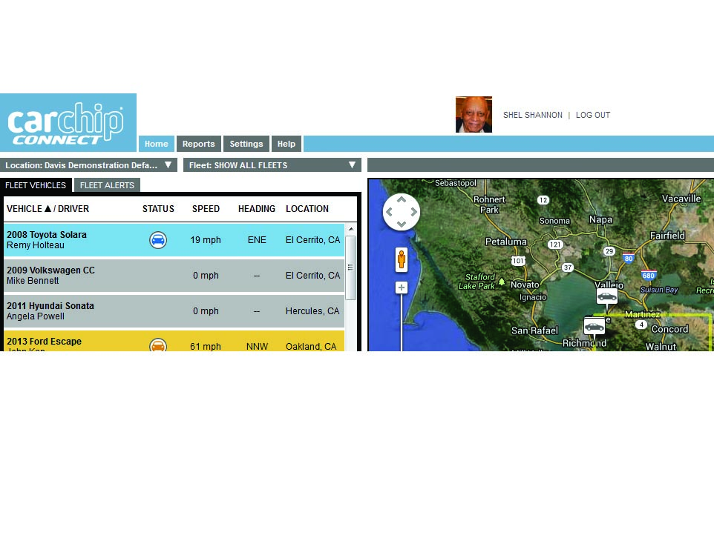
CarChip Connect Training Presentation
Homepage overview
Prepared by: Jun Rebayno

Slide 2
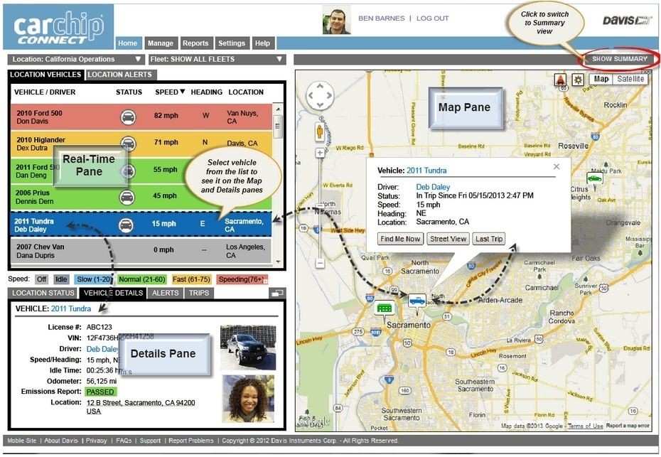
Your home page

Slide 3
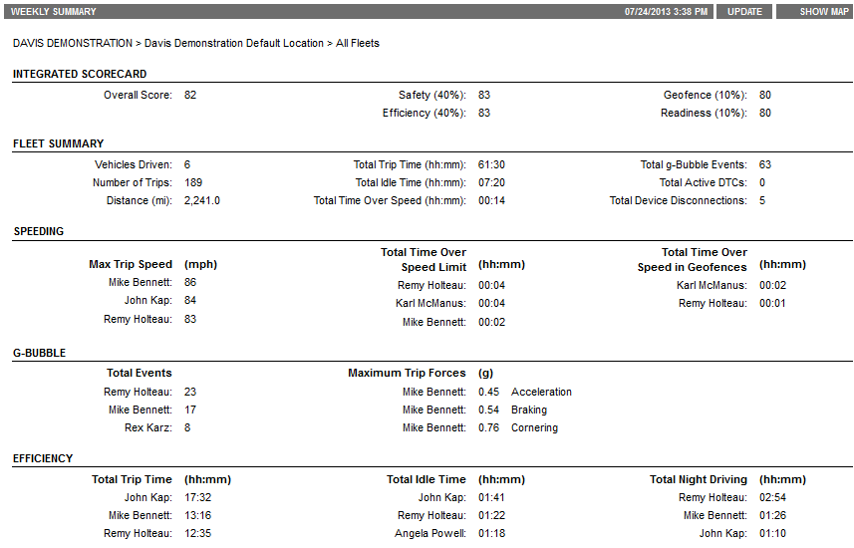
Summary Pane

Slide 4
Map or Summary Pane
Map or Summary pane is the largest pane on the Home Page.
Only the Summary will be available to those users with plans that do not include GPS.
Summary
A quick overview of how your location or fleet (depending on your role and permission).
Integrated Scorecard: Overall score for your fleet or location, as well as the scores for each area: Safety, Efficiency, Geofence, and Readiness that go into the Integrated Scorecard
Location/Fleet Summary: Information about your vehicles and trips
Speeding, g-Bubble, and Efficiency: Gives managers what they need to know about their drivers at a glance: the top three ""worst offender" drivers. The three drivers with the highest maximum trip speeds, g-Bubble (hard acceleration, deceleration and cornering) events, and poorest efficiency (such as idling, night driving).

Slide 5
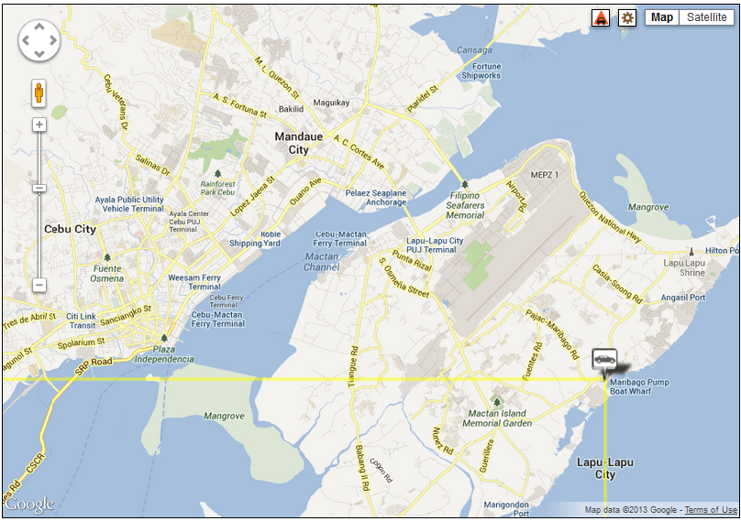
Map Pane
Map
The map shows the current location and activity of your vehicles.
Vehicles are shown depends upon the role and permissions set for the user by a manager at a higher level. For example, a Location Manager's home page map will show all the vehicles in all the fleets in his preferred location and fleet (as set in Site Preferences), while a Driver's home page map will show only his own vehicle.
You can control the view of the map:
zooming in, out, moved over the map it turns into a "hand." Clicking and holding the mouse button closes the hand to "grab" the map and allows you to move the map.

Slide 6
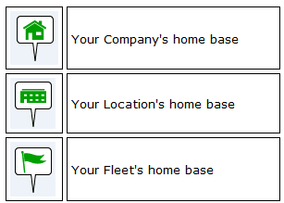
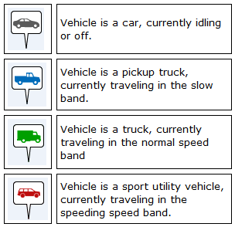
Map Pane
Map Icons and Bubbles
Home base locations
Vehicles
The current location of each vehicle in your location or fleet is shown on the map by a color-coded vehicle icon.
The icon indicates the vehicle type, (such as car, pickup truck, or van) as chosen when the vehicle was set up.
The icon's color indicates its current speed. For example:

Slide 7
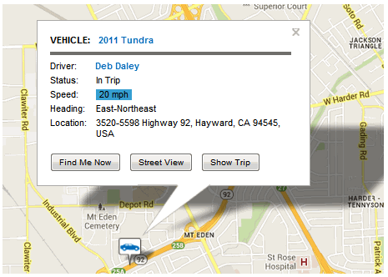
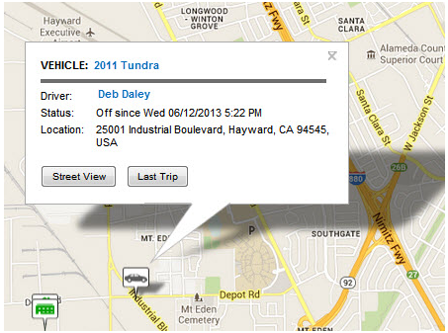
Map Pane
If the vehicle is currently in a trip, the detail bubble will indicate speed and heading:
If the vehicle is off, the detail bubble will show when the vehicle was turned off, and the location where it was turned off.

Slide 8
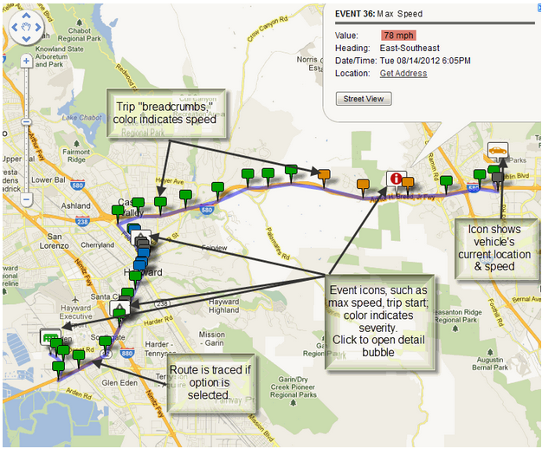
Map Pane
Trips on the Map: Trips are shown on the map by a trail of events (GPS breadcrumbs and alerts).
When a trip is in progress, its route will be shown as a trail of GPS breadcrumbs and alert icons, which will appear as colored icon flags.
The color of the GPS breadcrumb flag indicates the vehicle's speed at the time the data was received. The color of the alert icon will indicate the severity of the alert.

Slide 9
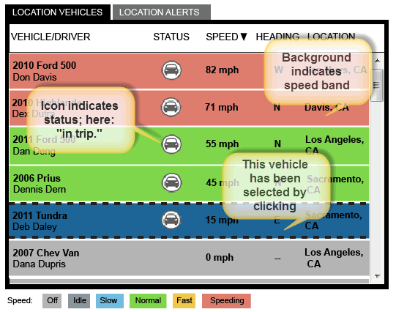
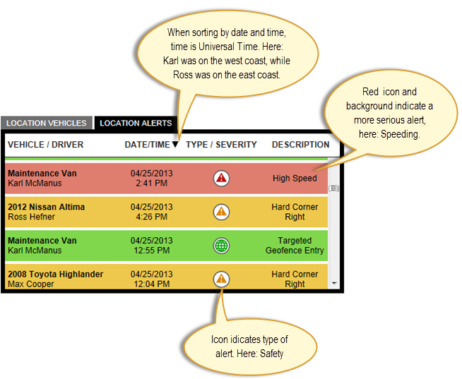
Real-Time Pane
Drivers will see only their own vehicle(s) and alerts.
Shows a sortable list of the most recent 100 alerts triggered by vehicles in your location or fleet, or, if you are a driver, by your vehicle.
Shown with a color-coded background that indicates the severity of the issue (not the speed).
High hazard alerts are shown with a red background.
Less hazardous alerts appear with an amber background.
Informational alerts appear with a blue background.

Slide 10
Real-Time Pane
Alerts
CarChip Connect reports a very large range of data, in the form of "events." An event can be a GPS breadcrumb, a trip start or end, a device disconnect, a geofence entry or exit, a high speed, a hard braking - or many others. Every event, with the exception of a GPS breadcrumb, is also defined as an Alert.
Alerts are categorized into four groups:
· Safety (for example, high speed, extreme brake)
· Efficiency (for example, excessive idle time)
· Geofence (for example, entry into a restricted geofence)
· Readiness (for example, CarChip Connect disconnected)

Slide 11
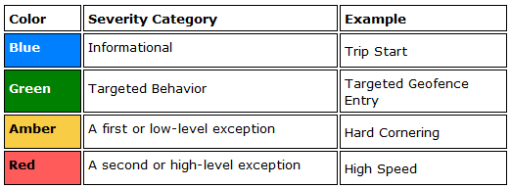
Real-Time Pane
Alerts
Alerts are further categorized by severity, and appear color-coded for easy visual review.

Slide 12
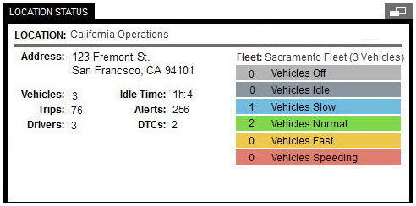
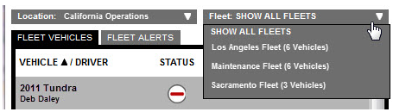
Details Pane
The pane on the lower left-hand side of the Home Page is the Details Pane. Content and tabs will change according to the user's role and permissions.
For Managers, a color-coded list shows the number of location/fleet vehicles by their current status: off, idle or traveling the normal, fast, and speeding speed bands.

Slide 13
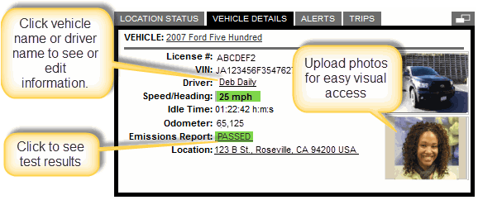
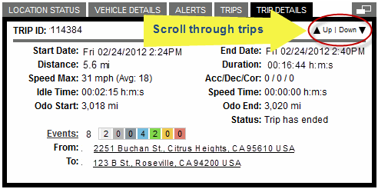
Details Pane
Vehicle Details Tab
Clicking on any vehicle in the vehicle list in the Real-Time Pane adds tabs to this window and opens the Vehicle Details tab for the selected vehicle.
Vehicle Details Tab
Clicking on any vehicle in the vehicle list in the Real-Time Pane adds tabs to this window and opens the Vehicle Details tab for the selected vehicle.

Slide 14
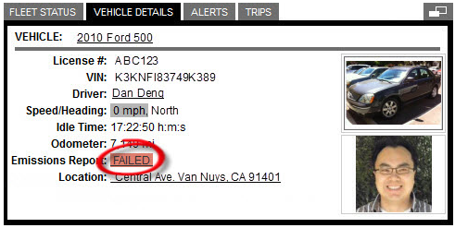
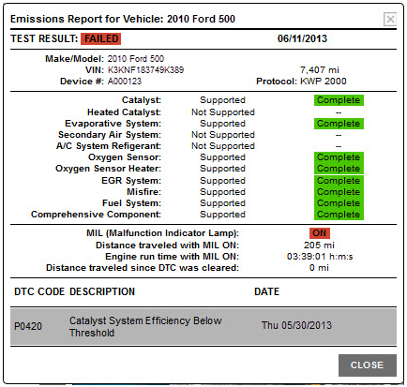
Details Pane
Emissions Report
The Emissions Report presents information about the vehicle's engine diagnostics and emissions. It reports the results of the last self-tests performed by the vehicle, and indicates a vehicle's readiness to pass emissions testing.
Click Emissions Report result (PASSED or FAILED) to bring up the detail report.

Slide 15


Homepage overview
Contact Person
Mr. Jun Rebayno
General Manager

