Slide 1
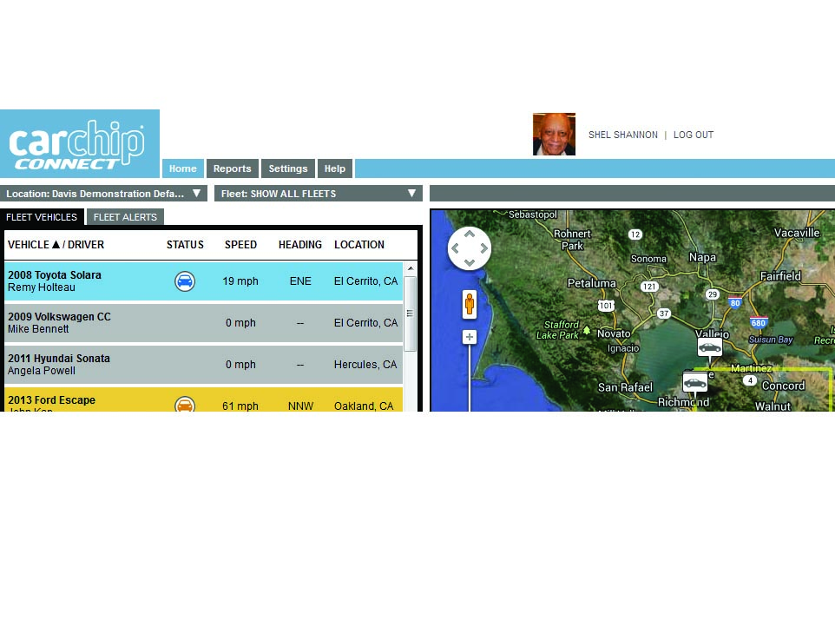
CarChip Connect Training Presentation
Menu Tabs
Prepared by: Jun Rebayno

Slide 2
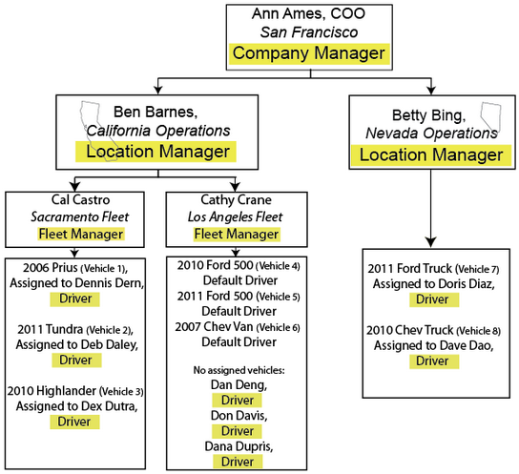
CarChip Connect Hierarchy

Slide 3
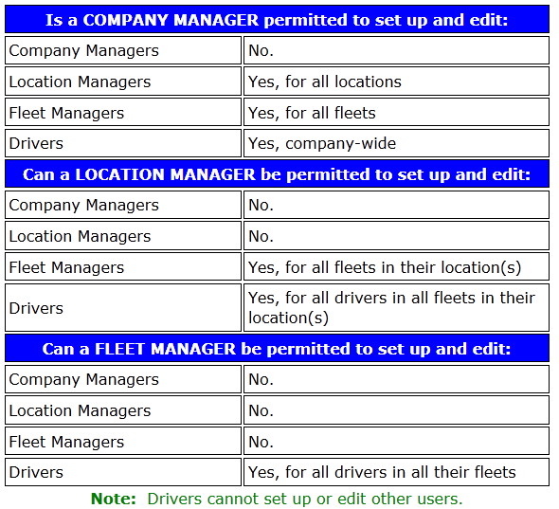
CarChip Connect Hierarchy
Roles and Permissions.
The table below shows which users each type of manager can be permitted to set up and edit:

Slide 4
Manage Tab
Manage Locations:
Company Managers can use this tab to add or edit locations. Set Up Locations and the Setting Up page for your role for details about setting up locations.
Manage Fleets:
Managers who have been given permission will use these menu items to set up and edit their locations and/or fleets. Set Up Fleets, and the Setting Up page for your role for details about setting up fleets.
Manage Geofences:
Managers who have been given permission will use this menu item to create and edit geofences.
Manage Vehicles and Manage Drivers:
Managers who have been given permission will use these menu items to set up and edit their vehicles and drivers. Set Up Drivers, and the Set Up Vehicles.
Manage Devices:
Allows managers to assign and unassign devices to vehicles and to upload data from CarChip Fleet Pro devices to their CarChip Connect page.

Slide 5
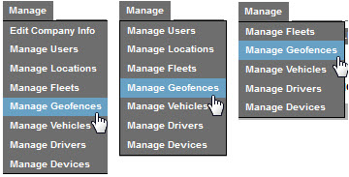
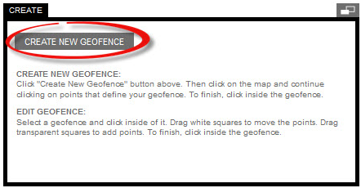
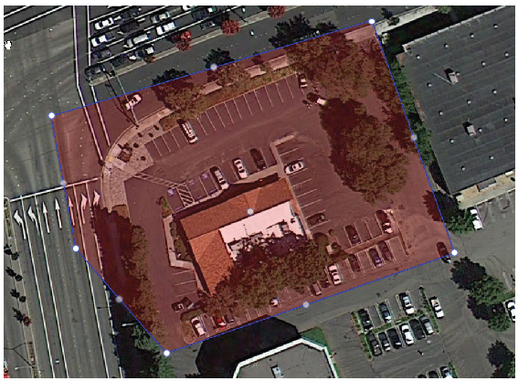
Manage Tab
Manage Geofences
To create a new geofence:
Create New Geofence

Slide 6
Manage Geofences
Understanding Geofences
Geofences allow managers to precisely monitor drivers' activities within specific geographic areas. A geofence alert will be triggered when a driver enters/exits a geofence area to which his vehicle has been assigned.
Geofences allow the manager to assign territories into which drivers are restricted (red), targeted (green), confined (amber), or informational or Waypoint (blue).
Types of geofences:
Restricted:
As a manager, you do NOT want your drivers to drive into a park, or past a city limit, or on a freeway: you can create a restricted geofence that will lower the driver's score and alert you when the driver does so, and/or when he exits the area.
Targeted:
As a manager, you DO want drivers to enter the area where customers are, or where the work is being done; you can create a targeted geofence that will improve the scores of drivers and alert you when they enter or exit it.

Slide 7
Manage Geofences
Understanding Geofences
Confined:
As a manager, you want your drivers to STAY within 50 miles of the fleet's home base, or on the facility's campus, or on the work site: you can create a confined geofence that will lower the scores of drivers and alert you when they leave it or return to it.
Waypoint:
As a manager, you want to know when a driver goes over a toll bridge, arrives or leaves a construction site, or arrives or leaves work or home. These events are not necessarily good or bad and they do not affect the driver's score; they are simply of interest to you.

Slide 8
Manage Geofences
Understanding Geofences
Geofence Speed Limits
Managers can set up geofence-specific speed limits; for example, a lower speed limit in a construction zone. When there is a speed limit set within a geofence, regardless of the type, it effectively replaces the general speed limit as set in vehicle settings.
This means that if a driver is traveling in a non-geofenced area at 55 mph (and therefore well below the 75 mph set as the max speed limit), then enters a geofence with a maximum speed limit set at 35, he will immediately be over max speed. He will hear an onboard alarm for both the geofence entry and the max speed. His score for "time over max speed" will be affected.
This offers another use for waypoint geofences -- giving the manager a way to set special speed limits for specific drivers. For example, Western Fleet Co. has set up a maximum speed limit for all vehicles of 65 mph. However, one driver, Deb, routinely travels on a freeway with a speed limit of 75. She has complained that staying under 65 is impractical while on that freeway, and adversely affects her scores when she is driving safely. The manager can set up a waypoint geofence around that freeway, set the geofence speed limit to 75, and assign only Deb's vehicle to that geofence. Now when Deb drives at 74 on that freeway, she will not be alerted or scored lower.

Slide 9
Manage Geofences
Understanding Geofences
Nested Geofences
Managers can create geofences within other geofences. While this can be useful, it should be done carefully. When nested, the effect is like a "layer cake" -- all speed limits and restrictions are layered upon each other, so that a driver can be penalized several times by exceeding several geofences restrictions at the same time.

Slide 10
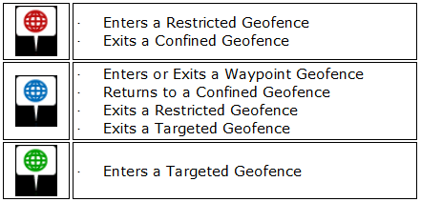
Manage Geofences
Understanding Geofences
Geofence Alerts
When a driver enters or exits a geofence, an alert will appear in the alert list, and as an icon on any trip route in which it is triggered.
The severity of the alert will be indicated by the color of the alert icon.
The driver will also hear three audible beeps, informing the driver that she has entered or exited a geofence. This allows the driver, for example, to correct entering a restricted geofence by quickly exiting, or to lower her speed within a speed-limited geofence.

Slide 11
Manage Geofences
Geofence Scenarios
To understand how you can take advantage of the powerful and endlessly customizable tool of geofences.
Targeted
Restricted
Waypoint
Confined
Speed limits
Nested

Slide 12
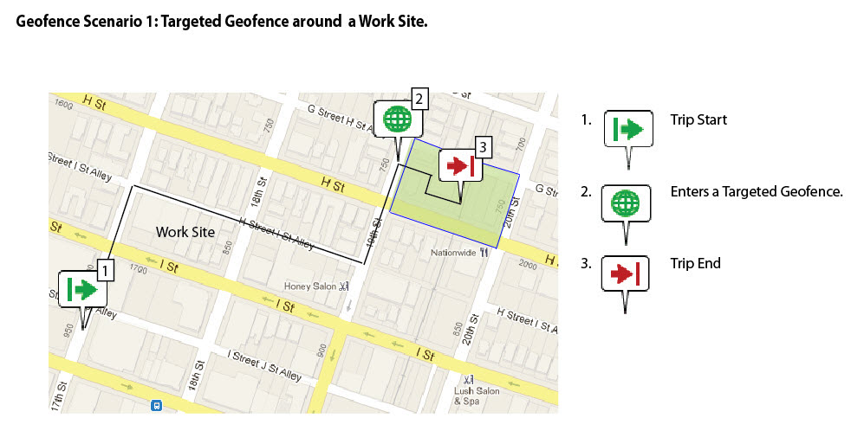
Manage Geofences
Geofence Scenario 1

Slide 13
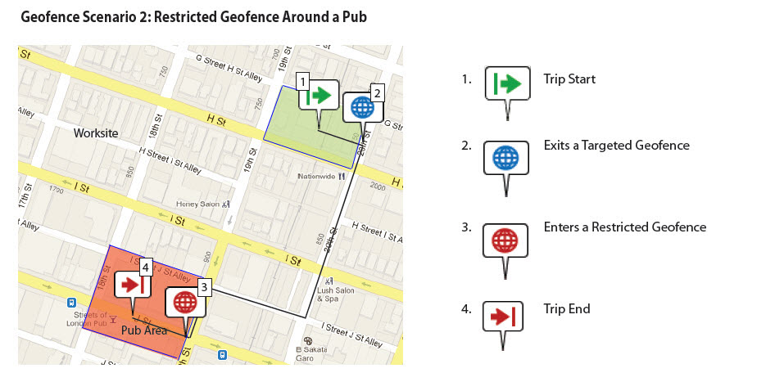
Manage Geofences
Geofence Scenario 2

Slide 14
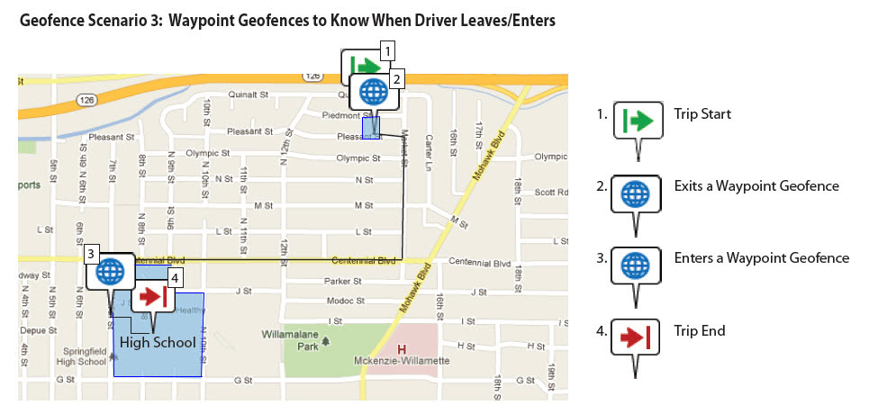
Manage Geofences
Geofence Scenario 3

Slide 15
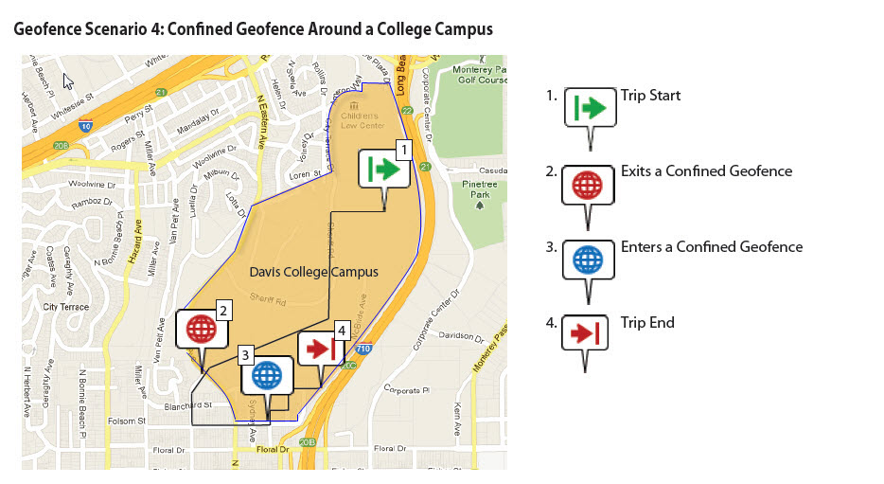
Manage Geofences
Geofence Scenario 4

Slide 16
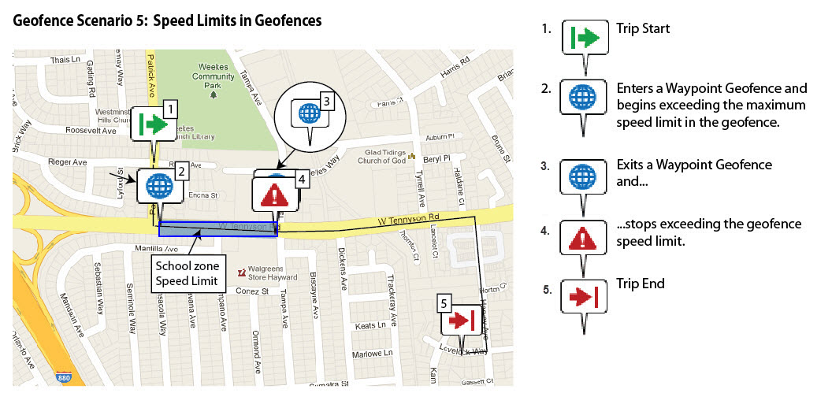
Manage Geofences
Geofence Scenario 5

Slide 17
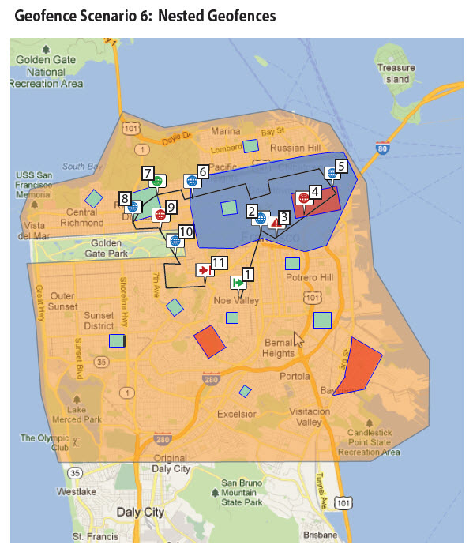
Manage Geofences
Geofence Scenario 6

Slide 18
Reports and Charts

Slide 19
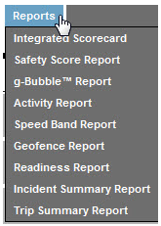
Reports and Charts
Users can use the Reports tab to run or customize reports, if they have permission to do so. (If the user has no report permissions, this tab will not appear.) Drivers who have permission to run reports see only their own data, along with company/location averages.
CarChip Connect gives managers customizable reporting options that can be set based on your company's specific parameters. Please note that all reports have been set up with default settings to allow you to start running reports immediately. To change the default settings, see Individual Report Settings.
However, they are also designed to be easily customized for your specific needs. See the description of each report to see what scores or data are included in each report, what the default settings and weights are, and how they can be changed.
Most of the reports are scored reports that use a set of weighted inputs to create a final score. Inputs and their weights can be customized to make the scores reflect exactly what you as a manager want to see. See Understanding Scored Reports

Slide 20
Reports and Charts
CarChip Connect provides managers with a set of reports that gives a score or grade, to drivers/vehicles (or fleets, locations -- even companies), presented with color-coding for fast visual assessment.
Each report draws from data for specific parameters, such as Top Speed or Time Over (Top) Speed.
For reports with multiple parameters, the final score is a compilation of those individual parameter scores, with each one weighted in comparison to the others.
The Integrated Scorecard is a compilation of the scores of all the sub-reports, each weighted in comparison to the others.
CarChip Connect's report parameter thresholds and weights of each parameter within the report are set to default values that are based on industrial research and many years of experience in creating reports. Managers can accept the defaults and begin running reports immediately.
Or, the defaults can be changed to reflect specific needs. You will need to understand how the default scores, weights and factors are set if you wish to change them.

Slide 21
Scoring Parameters
We can think of scores as academic grades, such as what
might be seen on a school test. A student who gets all the
answers right, or 100%, will get an A. A student who gets only half the questions correct will get an F. But other students might get an A with 95% and an F, with 30%.
In the CarChip Connect reports, scores for any parameter are reported on a scale of 0 to 100. The scale of scores on this continuum is set by two points, 100 or "perfect" and 50 or "failing." From those two points, the zero and all other points on the scale can be interpolated. The conditions that define "perfect" or "failing" are set for each report by default (or by custom settings). Drivers and vehicles can receive any score from 0 to 100, but not below 0 or over 100.
As an example, let's consider Time Over (Maximum) Speed, which is a parameter included the Safety Score Report.

Slide 22
Scoring Parameters
The goal, in this case, is to minimize speeding. Therefore, a perfect score of 100 would be awarded, by default, if a driver never exceeds the maximum speed, or 0% of time is over the maximum speed limit. A failing score of 50 would be awarded if a driver spends 3% of his or her driving time over the maximum speed limit. (Anything more than 3% is unacceptable, although a driver could certainly achieve a higher percentage.)
From this, the software assigns parameter scores on the scale of 0 = 100 and 3 = 50, and, by extrapolation, 6 = 0. So a driver who spends 1.5% of the time over the maximum speed limit would be awarded a score of 75. A driver who spends 6% of the time over top speed would get a zero. A driver who spends 10% of the time over the top speed limit would also get a zero.

Slide 23
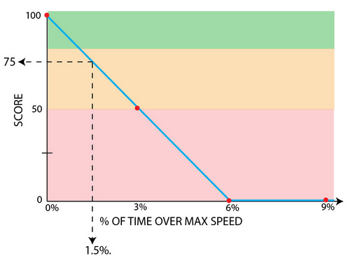
Scoring Parameters
In some cases, the "perfect" score for a parameter might not be "never" or "always." For example, a driver will be awarded a perfect score of 100 even though he has had several hard braking occurrences over many miles of driving, because some hard braking occurrences are bound to occur even when the driver has made no driving errors. Therefore, the hard braking threshold for a "perfect" score is defaulted to be 2 per 100 miles. In this case, a driver could do better than "perfect." For example, a driver may have no hard braking events even over many miles. But the awarded score will still be 100.

Slide 24
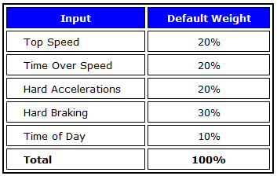
Applying Parameter Score Weights
When a parameter score is used in a report, it must be weighed against the other parameter scores. For example, Time Over Speed is used in the Safety Score Report, along with Top Speed, Hard Acceleration, Hard Braking, and Time of Day. By default, the Time Over Speed score is weighted at 20% of the Safety Score.
The weight of parameters used in any report score can be changed from the default. For example, in the Safety Score the default weights are:

Slide 25
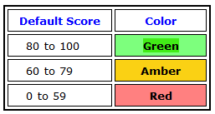
Color Coding
To make reports easily understandable, the scores are shown in color-coded cells. Like a stoplight: green, amber, and red are applied globally to all reports. A driver whose scores are mostly green knows quickly that he is doing a good job, amber means some work needs to be done, and red indicates more serious problems. The defaults are:
Who Can Change Defaults?
Company and Location Managers can control who can change default settings in reports by assigning permissions to managers below them. Full report permission includes the ability to change settings and push them to the locations or fleets the manager has access to.

Slide 26
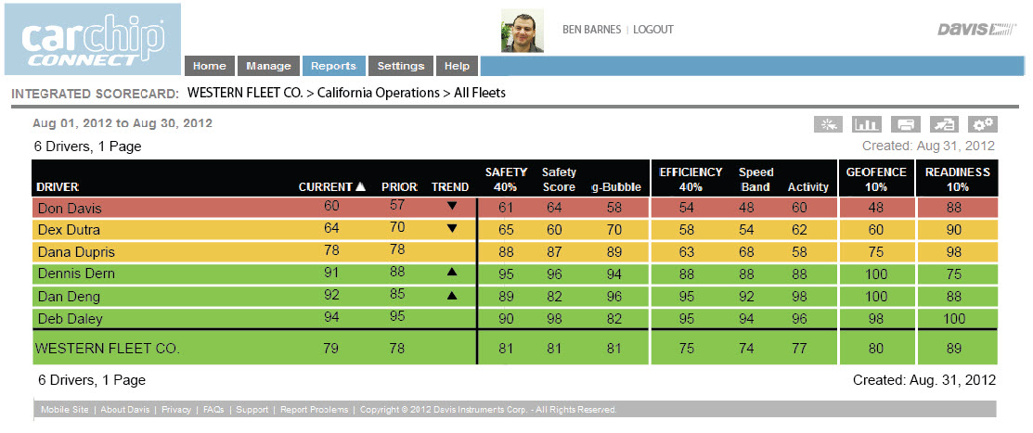
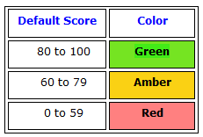
Scoring Parameters
When a report is generated, it will use the most current data and display the results with color-coding for easy visual assessment.

Slide 27
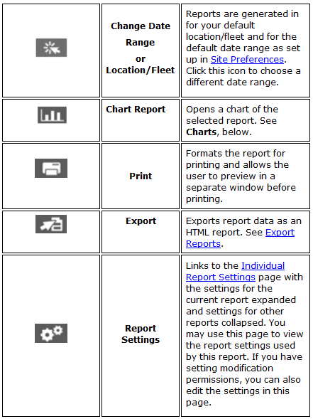
Reports & Charts
You may change the sorting of the rows in the report by clicking the column heading. An arrow in the column heading indicates how the rows are sorted. Click the arrow to change from an ascending list to a descending list.
Several icons will appear above the report:

Slide 28
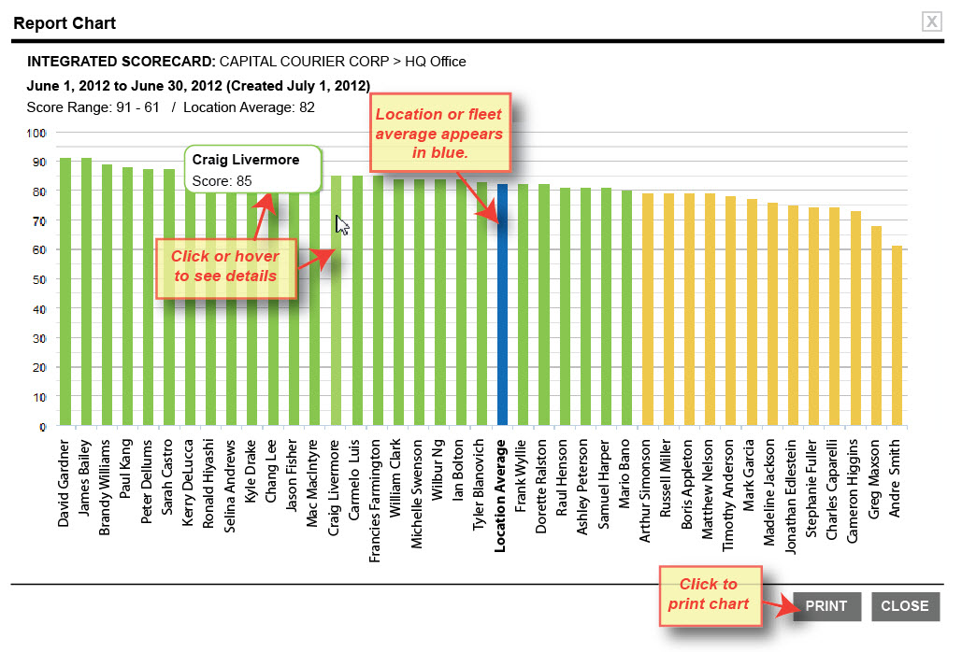
Reports & Charts
Each scored report's data can also be viewed in a graphical form.
Click the to open a chart in a new window. The color of the bars is based on the grading system.

Slide 29


Menu Tabs
Contact Person
Mr. Jun Rebayno
General Manager

