Slide 1
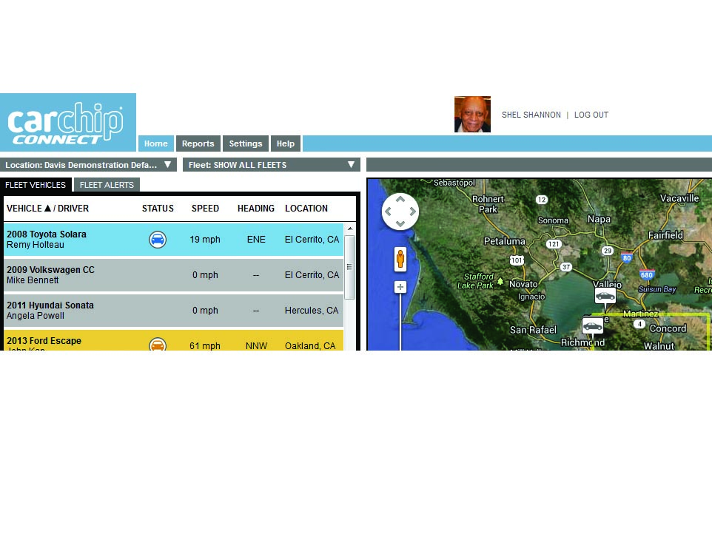
CarChip Connect Product Overview
Prepared by: Jun Rebayno

Slide 2
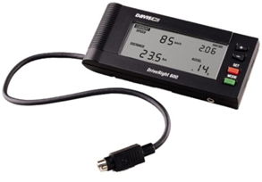
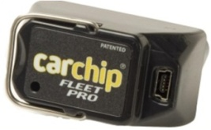
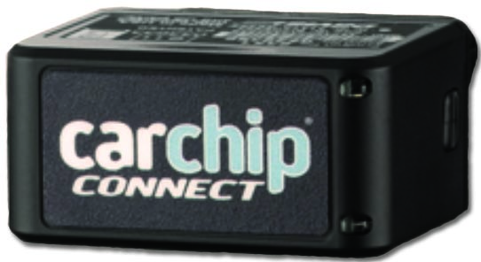
Product Introduction
CarChip Connect:
The compact Real-time Telematics with Web-based Analytics.
Provide fleet managers broad, comprehensive driver and vehicle performance data to better manage their fleets.
+
+
=
GPRS
Service
Plans
DriveRight 600e
Trip start and End times,
Trip distance and duration,
High speeds alert,
hard acceleration,
braking, and accidents.
CarChip Fleet Pro
Engine diagnostics- vehicle readiness and maintenance issues.
Service Plans
Bronze: No GPS data.
Silver: 30 real-time GPS location requests per month and geofencing.
Gold: GPS location updates every 5 minutes, 30 real-time GPS location requests and geofencing.
Platinum: GPS location updates every 1 minute, unlimited real-time GPS location requests and geofencing.

Slide 3
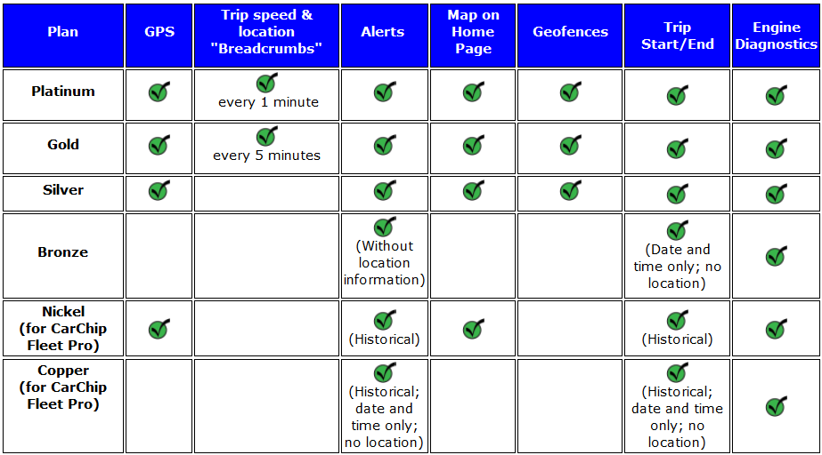
Service Plans
The CarChip Connect device and the service plans are country specific.

Slide 4
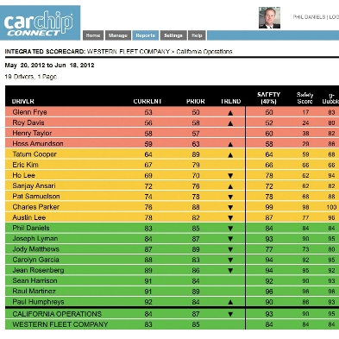
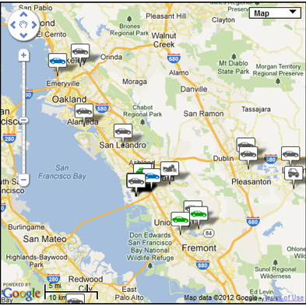
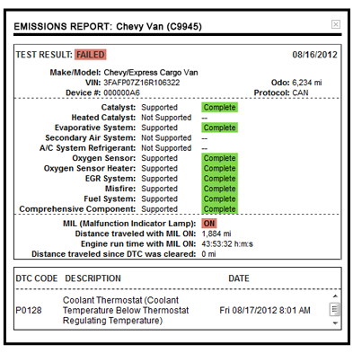
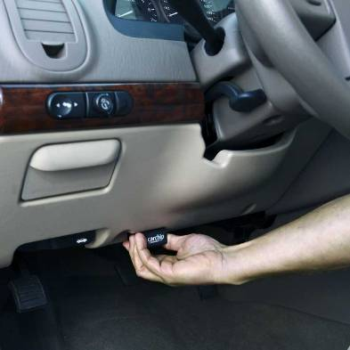
Product Benefits
Your Answer to Fleet Management
An integral part of any fleet manager's safety, efficiency and readiness programs.
Safety
Efficiency
Readiness
Compact and Easy to Install

Slide 5
Product Benefits
Safety
Determine and set the driving parameters - speed, acceleration,
deceleration.
Buzzer sounds in the vehicle, giving your drivers immediate
feedback when they exceed a safety limit and geofence area.
Alert notifications by email and text.
Davis' exclusive g-Bubble™ reporting helps you to identify and address aggressive driving.
Aggressive driving is measured using a built-in 3-axis accelerometer.

Slide 6
Product Benefits
Efficiency
Knowing when and how vehicles are being used.
Tracking engine idle time, stop time and total driving time.
Decrease idle time and side trips.
Improving your fleet's overall efficiency by even 30 minutes a day can increase productivity by 7 to 10 percent.

Slide 7
Product Benefits
Readiness
Maintenance scheduling and costs on every problem?
CarChip Connect monitors emission status and engine diagnostic trouble codes (DTCs) and will alert you in real time when the engine light or other diagnostic indicator goes off.
Use the DTCs to schedule service and have the needed parts on hand before the vehicle gets to the garage.
No need to depend on your drivers to report engine trouble.

Slide 8
Product Benefits
Compact and Easy to Install
Just plug CarChip Connect into the OBD II port and you're ready to go.
The unit automatically connects to the vehicle's computer and begins sending data.
Packed into this 2" x 1" X 1.875" (5 cm x 2.54 cm x 2.22 cm) device are powerful telematics:
GPS tracking;
geofence boundaries;
three-axis accelerometer motion detection;
driver safety limits; and
engine and driver diagnostics.

Slide 9
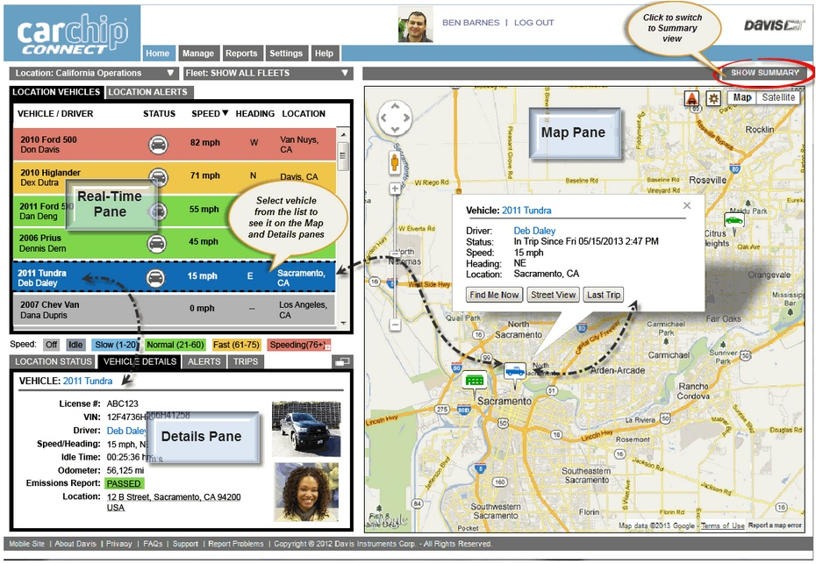
Sample Home Page

Slide 10
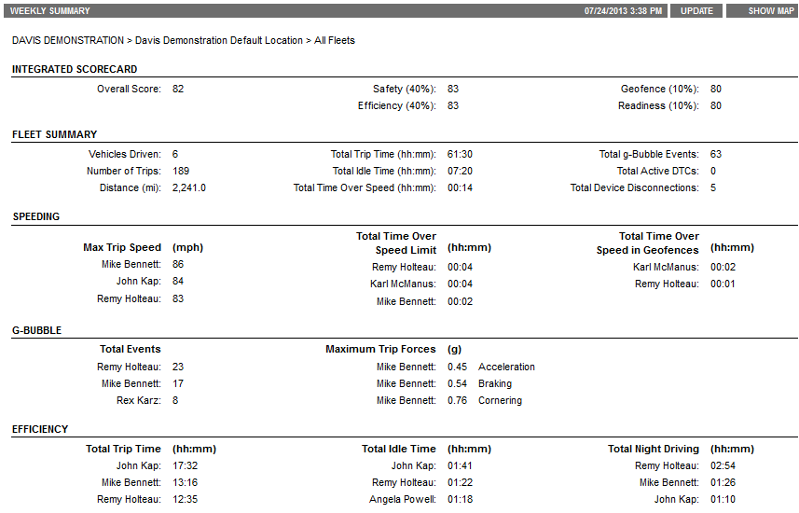
Sample Home Page

Slide 11
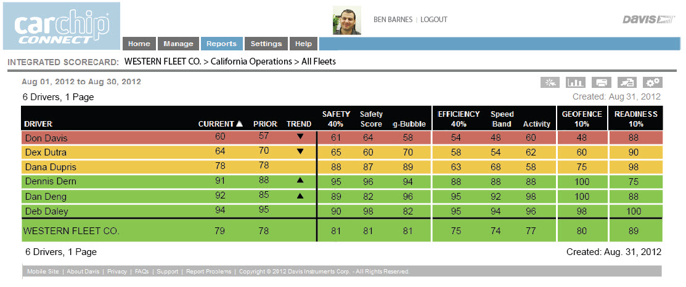
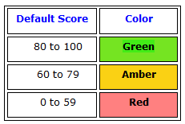
Reports and Charts
When a report is generated, it will use the most current data and display the results with color-coding for easy visual assessment.

Slide 12
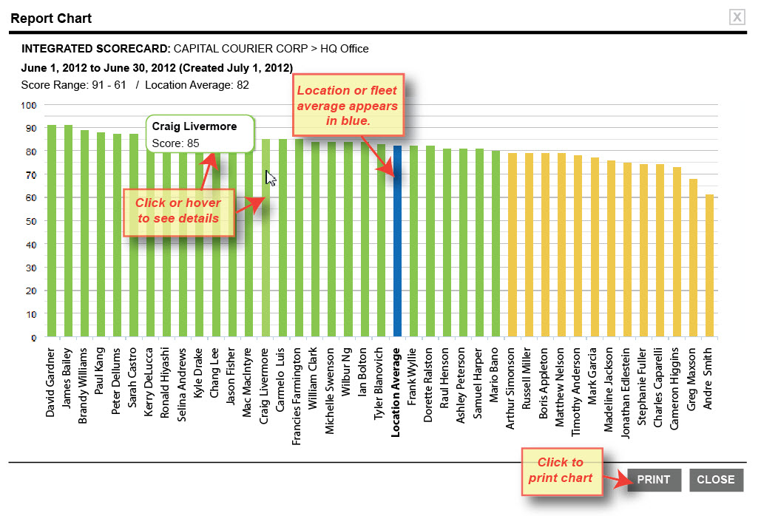
Reports and Charts

Slide 13


Contact Us
CarChip Connect Product Overview
Contact Person
Mr. Jun Rebayno
General Manager

