Slide 1

Setup Users Accounts
Prepared by: Jun Rebayno

Slide 2
Setup Users Accounts Flow
Upon first use, Your Home Page will open. Your Company will be already set up by Davis Instruments/APEXS.
At least one default Location and one default Fleet will have already been created. The "Location" is defaulted to be at the Company address.
As Company Manager
1. Edit the default Location and set up an additional Locations.
2. Set up Location Managers.
3. You and/or your Managers will set up Fleets within those Locations and set up Fleet Managers.
4. You and/or your Managers will then set up vehicles within those Fleets.
At this point, you can install the devices in vehicles, keeping track of which device by serial number is installed in which vehicle.
5. Finally, you and/or your Managers will set up Drivers, and assign devices and Drivers to the vehicles.

Slide 3
Setup Users Accounts
You and/or your Managers can then set up and assign geofences, alerts and notifications, and report settings now, or operate without geofences and with the default settings until a later time.
Set Yourself Up as a Driver: If you are going to also be a Driver with a device installed in your vehicle, you will need to set yourself up as a Driver. This will require a second username and password. When you log in as Company Manager, you will be able to see your Driver data along with all the other Drivers' data. When you log in as Driver, you will see only your own data.

Slide 4
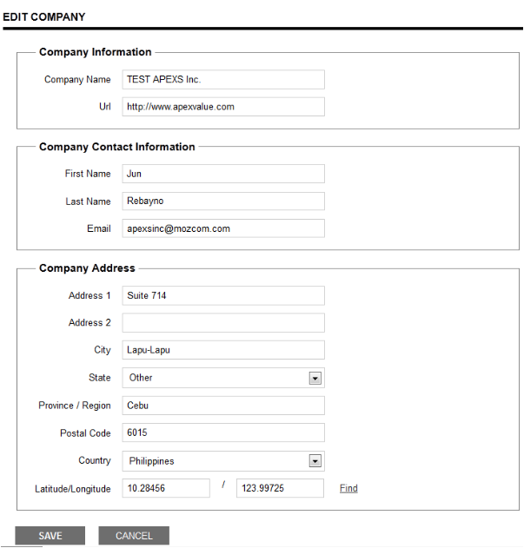
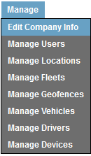
Edit the default Location and set up an additional Locations.

Slide 5
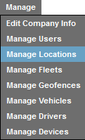
Edit the default Location and set up an additional Locations.
3. Enter the new Location's name, and website (if applicable).
4. Enter the name of the contact person at the Location, and their email address. (This will probably be the person you choose for Location Manager, but not necessarily.)
5. Enter the address of the Location.
6. You may enter the longitude and latitude of the Location address. Click Find on Map to see that address on a map. Click the x in the upper right corner to close the map.
7. Make sure the Active box is checked. In the future, should this Location become inactive, uncheck the box. This preserves the data for archive purposes, but the Location will no longer appear in the Locations list.
8. Click Save to save your new Location.

Slide 6


Setup Users Accounts
Contact Person
Mr. Jun Rebayno
General Manager

