Slide 1


CarChip Connect Training Presentation
Prepared by: Jun Rebayno

Slide 2


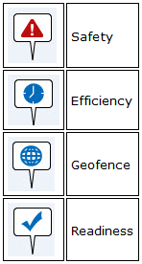
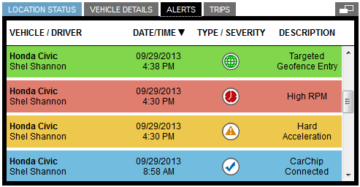
Alarm: The device will sound an audible alarm (as a beep or series of beeps) to warn the Driver when certain thresholds have been exceeded (g-Bubble, speed, geofence, incident). You can adjust the volume or turn the audible alarms off in Vehicle Settings.
Alert: Any "event" reported by CarChip Connect, with the exception of a GPS location breadcrumbs. Alerts can be viewed in the Real Time Pane by clicking the (Location/Fleet) Alerts tab. Managers can choose which alerts to show or hide. Alerts can be set to notify you (or whoever you set up) via email or text when they occur.

Slide 3
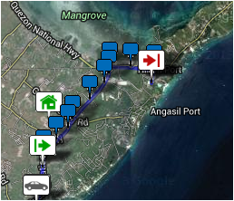
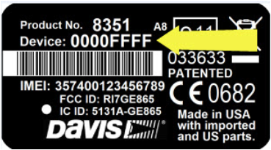
Breadcrumb: A trip marker. A breadcrumb is a type of GPS "event," appearing every time a GPS location is sent (at a frequency defined by the service plan). Breadcrumbs appear as a trail of marker flags on the map. The color of each flag indicates the vehicle's general speed at the time the breadcrumb was sent for easy visual review of a trip.
Device #: The unique number on each CarChip Connect device that is used to associate the device with the vehicle. It can be found on the label:

Slide 4
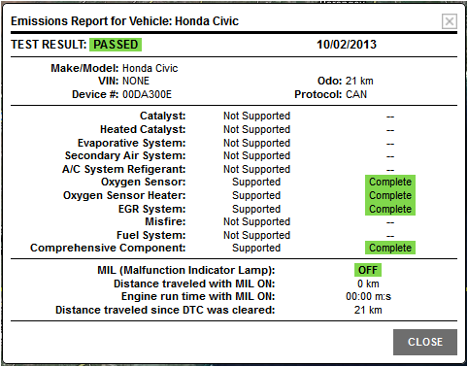
DTC: Engine diagnostic code. These standardized codes are generated by the vehicle's self-diagnostic capabilities and are retrieved and reported by the CarChip Connect device. The DTC will be reported with a short description of the problem from the standard OBD II Parameter ID. Further comparing the code to a list provided by the vehicle manufacturer can pinpoint an engine malfunction or emissions problem.
Emissions Report: Current vehicle emissions status; "Passed" indicates that check engine light is not on and all monitors show ready for inspection.

Slide 5
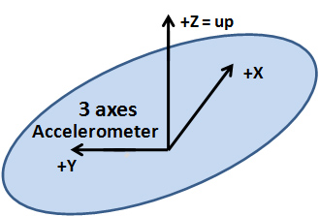
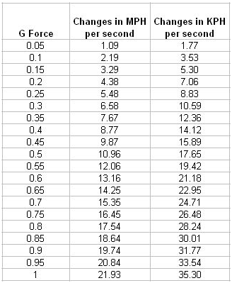
Event: Any information sent from your company's vehicles is an "event." Events include things like GPS breadcrumbs, trip start and end, geofence entry and exit, and any safety, efficiency, readiness thresholds exceeded. All events except breadcrumbs are also "alerts." A Manager can choose what alerts to show in the Real-Time Pane Alerts tab, and which alerts warrant immediate notification via email or text.
g-Bubble: An imaginary bubble created by the thresholds set for the 3-axis accelerometer. When a vehicle exceeds any threshold for side-to-side, up and down, or back and forth motion (in g's), a g-Bubble event is reported.
g or g-Force: The g-Force associated with an object's acceleration relative to free-fall. Negative values show deceleration.

Slide 6
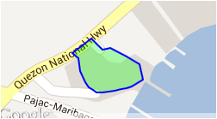

Geofence: A geographic area defined by your Managers. The area can be one Managers would like to discourage Drivers from entering, discourage Drivers from leaving, or encourage Drivers to maximize their time there. It can also be one about which they simply want information, or want to set up with specialized speed limits. Entering or exiting a geofence creates a geofence event.
GPS: The Global Positioning System is a satellite-based navigation system made up a network of over 30 satellites, each carrying atomic clocks, provided by the United States Air Force. Satellites circle the earth twice a day and broadcast radio signals to earth. GPS receivers take this information and use triangulation to calculate the user's exact location.

Slide 7
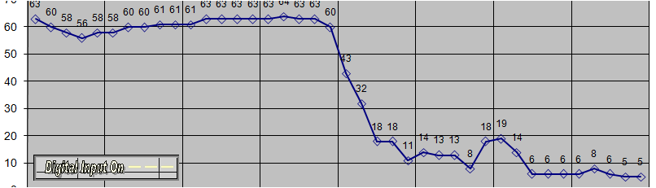
Location: A Location can be defined by the Company and allows Managers to separate their vehicles geographically or by utilization. It can be a large geographical area such as a county or state, or smaller, like a garage. Fleets are within a Location, which is within the Company. Managers should set up Locations from a reporting point of view, as reports are based on Locations.
Incident: A event that meets specific conditions of g-Bubble and speed that may or may not be an accident.
MIL: Malfunction Indicator Lamp -- the"Check Engine" light that lights when the vehicle self-diagnoses has a DTC. You can use CarChip Connect to turn the light off by choosing Clear DTCs in the vehicle's Vehicle Settings. This will not solve the problem that originally turned on the MIL. If the problem persists, it will come back on.

Slide 8

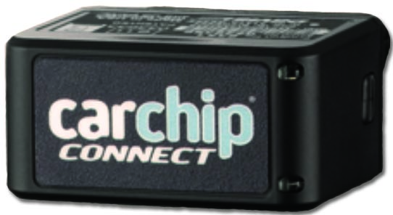
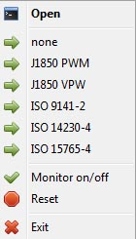
MTM or Mobile Terminated Message: A short message sent TO the device.
For example, MTMs tell the device what the speeding threshold is for that vehicle,
MOM or Mobile Originated Message:
A short message sent FROM the device, such as a GPS breadcrumb.
Protocol: The networking rules that govern the data transfer between sensors, micro-controllers, and actuators in a vehicle. The list includes CAN, SAE J1850, ISO and others.

Slide 9
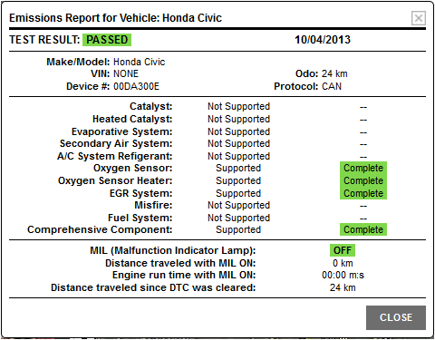
Readiness Monitor: The vehicle's OBD II system self-tests up to 11 emissions-related systems, called Readiness Monitors.
"Supported" means the monitor is incorporated in the manufacturer's emission control design.
"Not supported" means the vehicle is not equipped with the component monitor.
"Completed" indicates that the component is functioning within the manufacturers specifications. Clearing the DTCs also clears any "completed" tests.

Slide 10
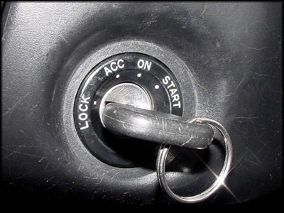
Trip: A trip begins when the vehicle is started and ends when it is turned off. Trip duration is the length of time between these two events. Duration is determined on UTC time, so crossing into another time zone during a trip will not affect accuracy of the reported duration. Trip distance is the distance between the locations of these two events.
A
B
Engine Start
Engine Off
Trip distance
Trip duration

Slide 11
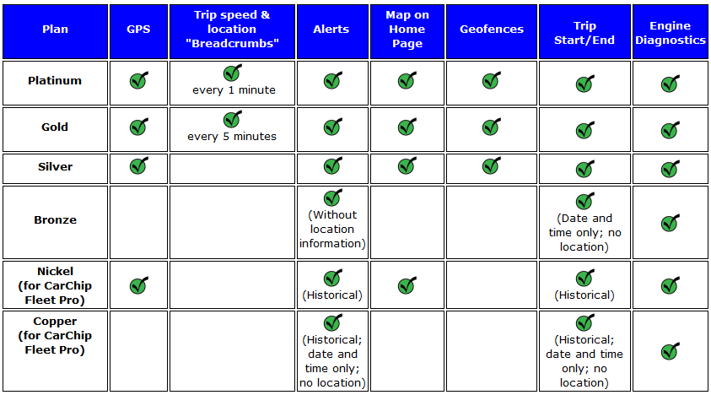
Service Plan: The service plan selected for your company will affect the data and reports available to you. For example, GPS, which is not included in the Bronze plan, is required for any GPS-stamped information, such as trip location "breadcrumbs" and geofences.

